Slide 1
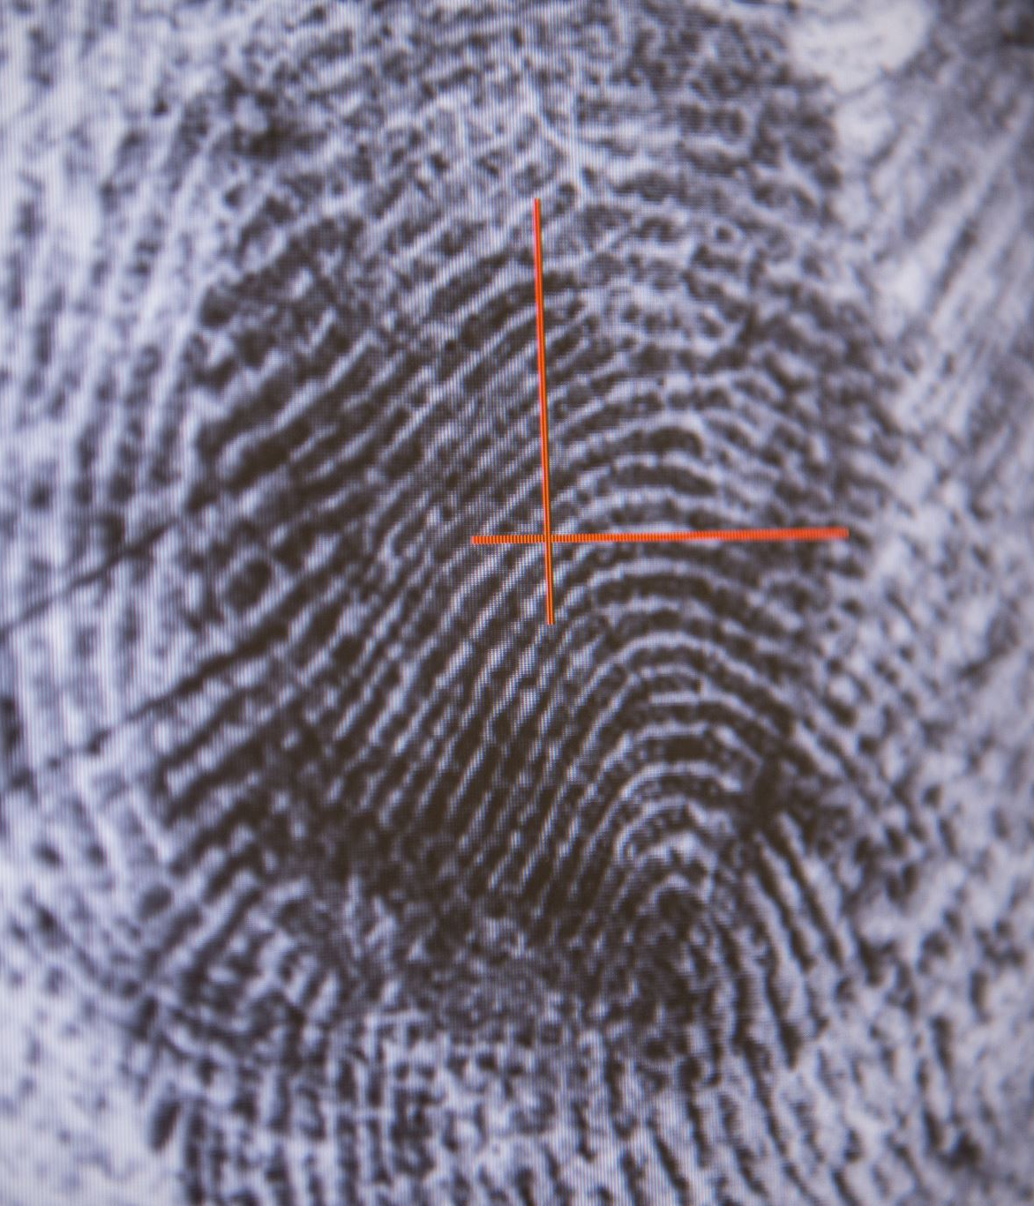
Detecting Structural Breaks
with Time Series Embeddings

Slide 2
Structural Breaks
Test for structural breaks with known break dates
Test for a structural break with an unknown break date
Wald and likelihood-ratio tests Robust to heteroskedasticity
Cumulative sum (CUSUM) test for multiple breaks

Slide 3
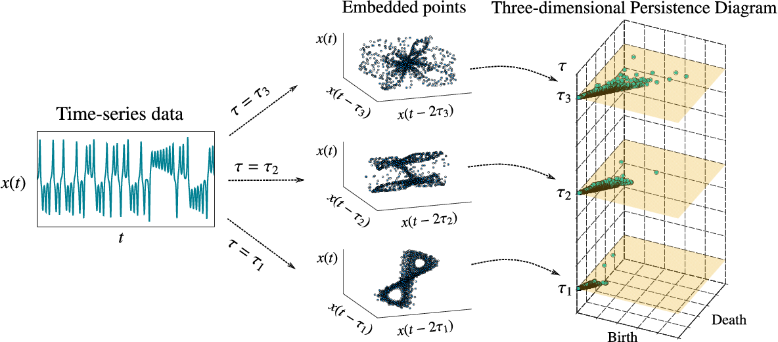
Time Series Embeddings

Slide 4
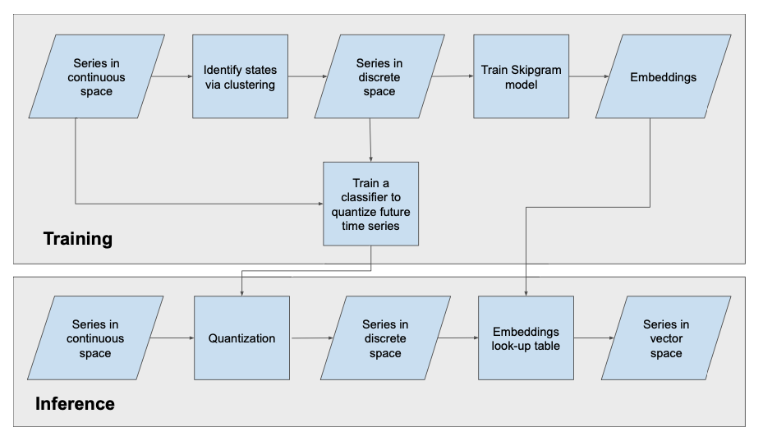
Signal2Vec

Slide 5
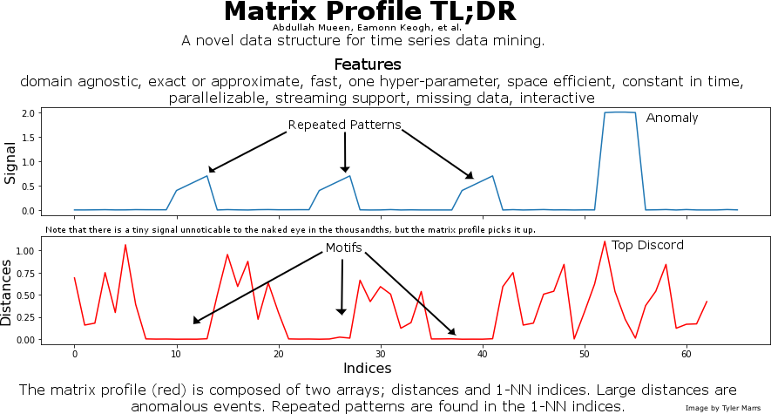
Matrix Profiles

Slide 6
Matrix Profiles

Slide 7
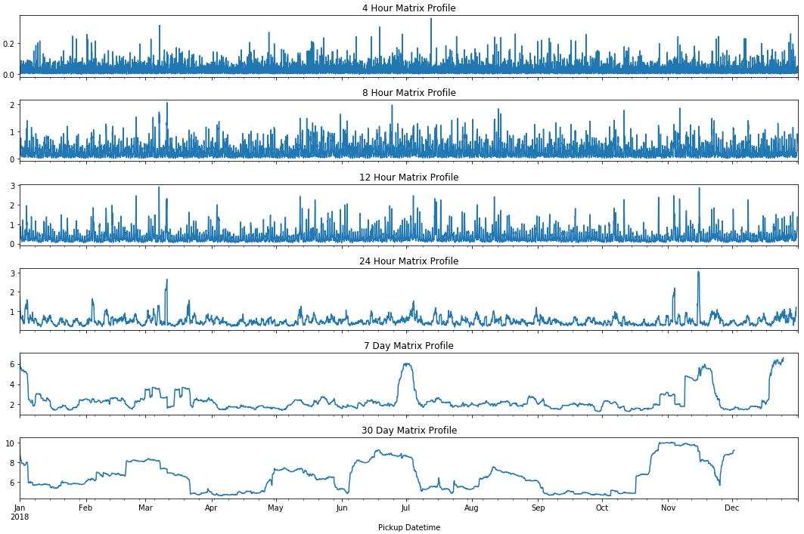
Matrix Profiles

Slide 8
Matrix Profiles
The advantages of using the Matrix Profile (over hashing, indexing, brute forcing a dimensionality reduced representation etc.) for most time series data mining tasks include: It is exact: For motif discovery, discord discovery, time series joins etc., the Matrix Profile based methods provide no false positives or false dismissals.
It is simple and parameter-free
It is space efficient
It does not require the user to set similarity/distance thresholds: For time series joins, the Matrix Profile provides full joins, eliminating the need to specify a similarity threshold, which is an unintuitive task for time series.
It can leverage hardware: Matrix Profile construction is embarrassingly parallelizable, both on multicore processors and in distributed systems.
It has time complexity that is constant in subsequence length
It can handle missing data: Even in the presence of missing data, we can provide answers which are guaranteed to have no false negatives.

