Slide 1
Risk valuation using ProActive workflows

Slide 2


Basics
Value At Risk (VaR)
One-day 95% VaR of $1 million ⇔ 5% probability that the portfolio worst-case loss will exceed $1 million over a one-day period
Monte Carlo (MC) simulations
The Law of Large Numbers states for large n, the empirical average is very close to the expected value
Estimating the VaR using MC simulations
x the portfolio VaR
L_{t} the porfolio loss at t
α the VaR probability
nb_VaR the number of MC simulations

Slide 3
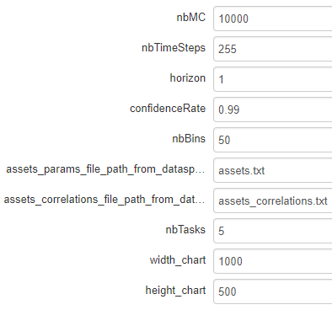
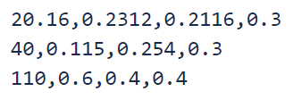

Monte_Carlo_VaR_portfolio.xml
Estimates the Monte Carlo Value at Risk (MC VaR) of a portfolio. We use the geometric Brownian motion (GBM) method to simulate stock price paths, but more advanced assets can be integrated thanks to the Quantlib C++ lib.
number of portfolio simulations. The number of tasks does not necessary divide the total number of simulations
number of time steps of the portfolio simulations paths, up to the horizon
horizon. Here time steps are set to 1/255
VaR confidence rate. Here 99%
number of bins to plot the frequencies bar chart
file to describe assets params, a line per asset: start price, drift rate (yearly return), volatility rate (yearly return), weight
correlations matrix of the assets
number of replicated tasks to parallelize the MC simulations
width of the generated chart
height of the generated chart

Slide 4
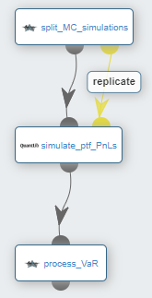
Monte_Carlo_VaR_portfolio.xml
Estimate the number of MC simulations per replicated task. The tasks number does not necessary divide the total number of simulations
Using Quanlib, each replicated task proceses a subset of the MC simulations and deduces the PnL (profit and loss) of each simulated path (value at horizon of a simulation - value at start). On the task side, PnLs are saved into a dedicated file
This task gathers all the PnLs into a single array, sorts them, and retrieves the VaR at the VaR_index corresponding to (1 - confidenceRate) * nbMC. Finally, it generates the corresponding frequencies bar chart and exposes it (view/download)

Slide 5
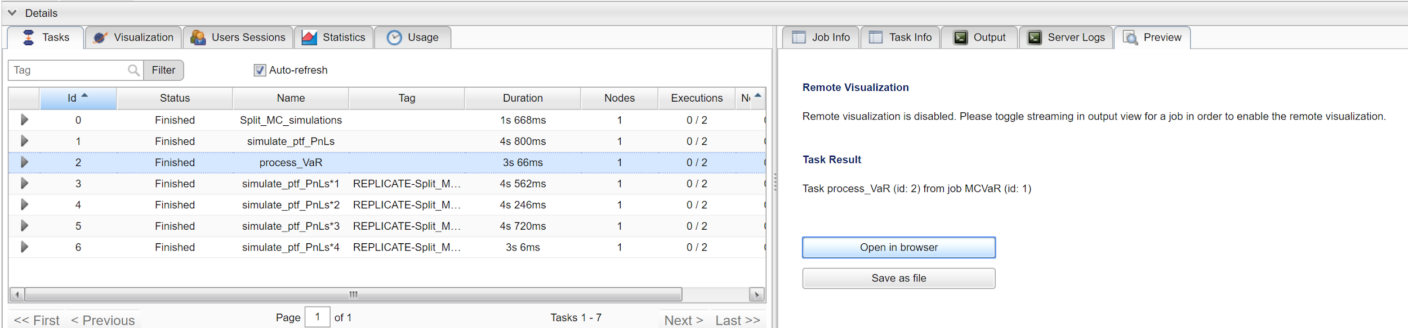
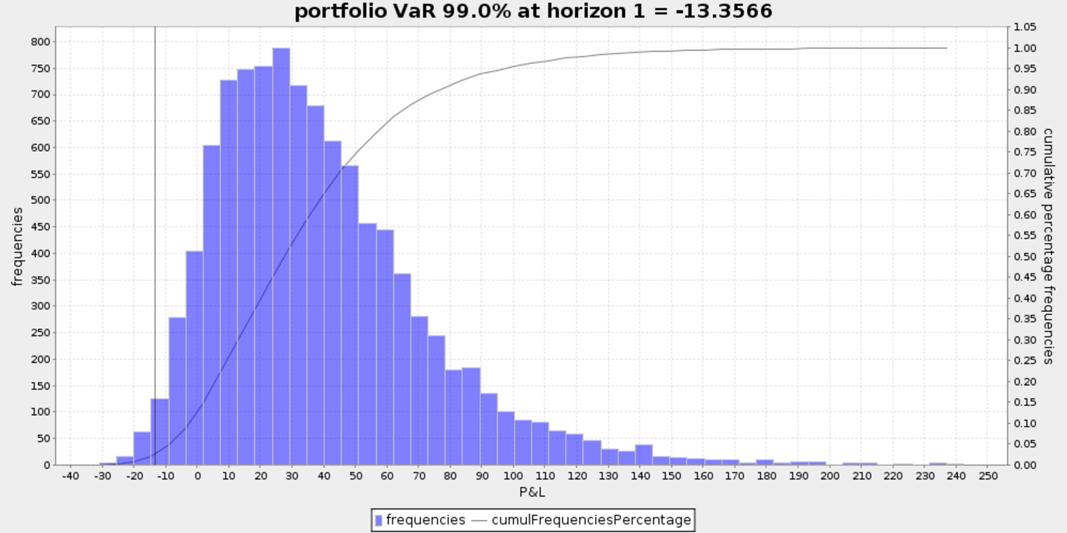
Monte_Carlo_VaR_portfolio.xml

Slide 6
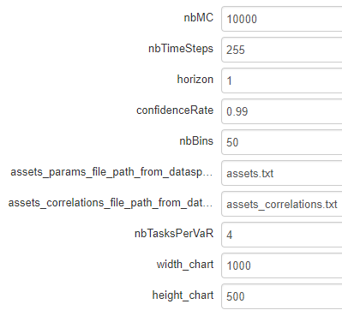
incremental_Monte_Carlo_VaR_each_portfolio_asset.xml
Estimates the incremental VaR (iVaR) for each asset of the portfolio. iVaR quantifies the risk a position (or sub-portfolio) is adding to a portfolio. For instance, the iVaR related to an asset Y, is the difference between the portfolio VaR with and without Y.
number of portfolio simulations. The number of tasks does not necessary divide the total number of simulations
number of time steps of the portfolio simulations paths, up to the horizon
horizon. Here time steps are set to 1/255
VaR confidence rate. Here 99%
number of bins to plot the frequencies bar chart
file to describe assets params, a line per asset: start price, drift rate (yearly return), volatility rate (yearly return), weight
correlations matrix of the assets
number of replicated tasks per VaR to parallelize the MC simulations
width of the generated chart
height of the generated chart

Slide 7
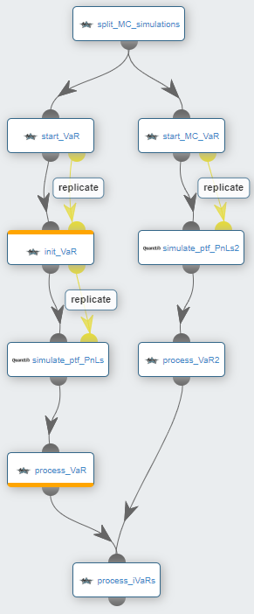
incremental_Monte_Carlo_VaR_each_portfolio_asset.xml
Estimate the number of MC simulations per replicated task for each VaR (right branch and left branch). The tasks number must divide the total number of simulations
1st level of replicated tasks: a replicated task per asset (Y)
Each replicated task instanciates an assets params files, by setting to 0 its corresponding asset. By this way, the estimated VaR will not consider the asset
2nd level of replicated tasks: a replicated task per subset of MC simulations. Each replicated task processes a subset of the MC simulations according to its instanciated assets params file (i.e. instanciated by its father replicated task)
1st level of replicated tasks: a replicated task to merge the MC simulations processed by its sons task. Each task estimates the VaR related to Y, stores it, and generates the corresponding frequencies bar chart
Compute and println the iVaR related to each asset (portfolio VaR estimated by the right branch - portfolio VaR without the asset Y estimated by the left branch), merge all the frequencies bar charts into a single png file and exposes it
Perform the MC VaR like Monte_Carlo_VaR_portfolio.xml

Slide 8
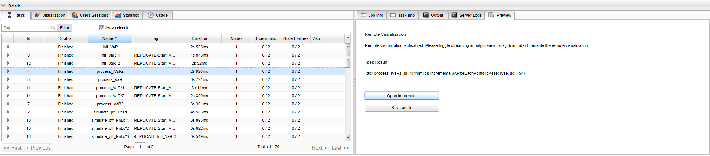
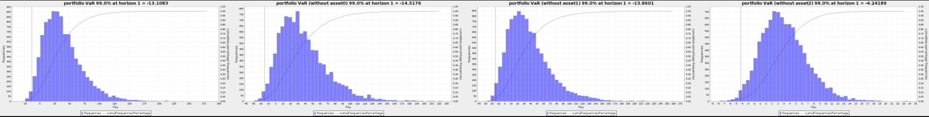
incremental_Monte_Carlo_VaR_each_portfolio_asset.xml

Slide 9
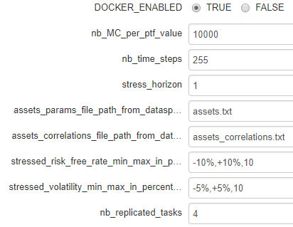
stress_testing_Monte_Carlo_value_portfolio.xml
Estimates the portfolio PnL (Profit and Loss) over stressed volatilities and risk free rates.
run the plotting task into a docker container for matplotlib support
number of portfolio simulations per PnL estimation
number of time steps of the portfolio simulations paths, up to the horizon
horizon until which portfolio is stressed (here time steps are set to 1/255)
file to describe assets params, a line per asset: start price, drift rate (yearly return), volatility rate (yearly return), weight
correlations matrix of the assets
range of the percentages of variation to apply to the risk free rate and number of steps to consider in this range
range of the percentages of variation to apply to the portolio asset volatilities and number of steps to consider in this range
number of replicated tasks which have in charge the stressed PnL simulations

Slide 10
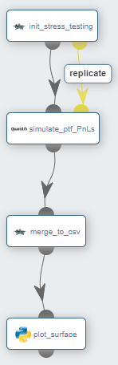
stress_testing_Monte_Carlo_value_portfolio.xml
Estimate the number of MC simulations per replicated task. The tasks number must divide the total number of simulations
Using Quanlib, each replicated task processes a subset of the MC simulations and deduces the PnL (profit and loss) of each simulated path. An expected PnL is estimated per risk free rate and volatility stressed percentage. On the task side, PnLs are saved into a dedicated file
Merge all stressed PnLs into a single csv file
Plot a 3D representation of the stressed PnLs

Slide 11
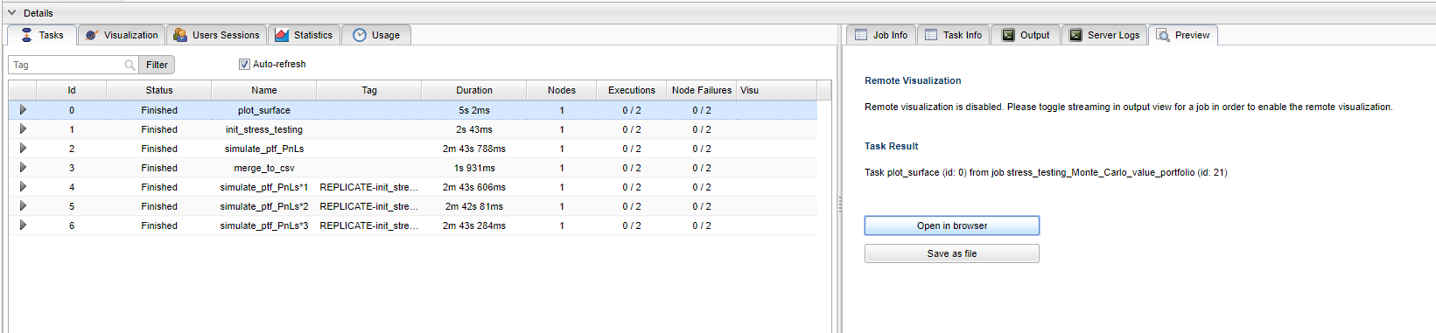
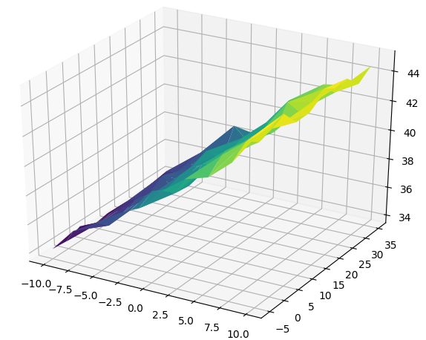
stress_testing_Monte_Carlo_value_portfolio.xml
PnL
volatility rate stressed %
risk free rate stressed %

Slide 12


Mark_to_Future_cube_stats.xml
Estimates a Mark-to-Future (MtF) cube of a bond portfolio. Each cell of the cube integrates the valuation of a bond at a specific time given a specific scenario. This can be easily extended thanks to the high maintenability of the implementation (C++ Quantlib for the pricing engine, inputs split in Java/Groovy, R for the cube/cubelet stats,..).
MtF tables
1 MtF table per instrument
REDUCTION BY INSTRUMENTS
evaluation dates
scenarios
shocked risk-free rates
FULL PARALLELIZATION OF CUBELETS ESTIMATIONS
REDUCTION BY SCENARIOS

Slide 13
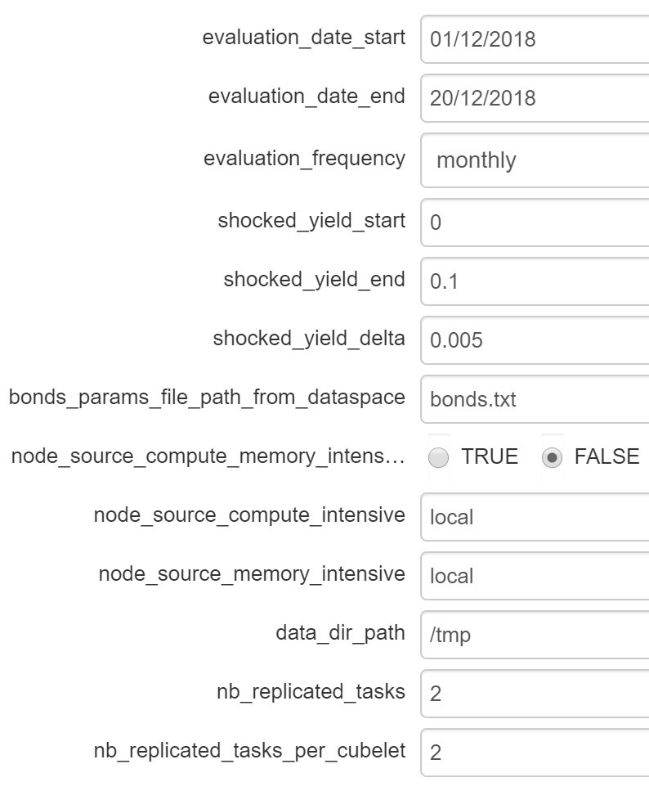
Mark_to_Future_cube_stats.xml
start date of the evaluations
end date of the evaluations
evaluation frequency (monthly, biweekly)
shocked yield start
shocked yield end
shocked yield delta
file to describe bonds params, a line per bond: bond id, settlement days, face amount, coupon rate, redemption, issue date, maturity date, payment frequency boolean to either reserve compute and memory intensive nodes sources for compute and memory intensive tasks or not
compute intensive node source name
memory intensive node source name
data dir path to store generated data before reductions (for large data)
number of replicated tasks to split scenarios
number of replicated tasks to split bonds

Slide 14
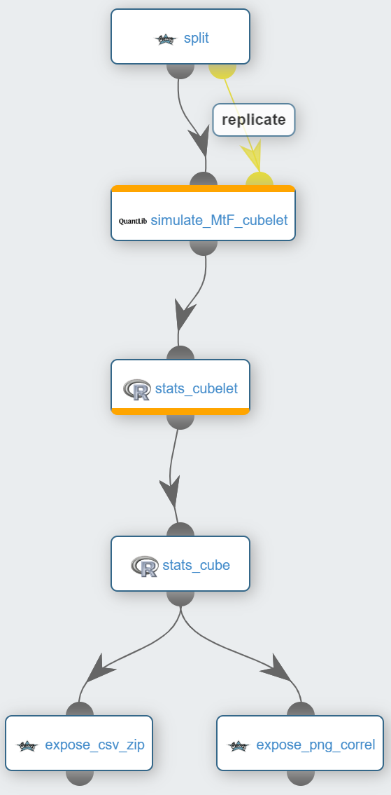
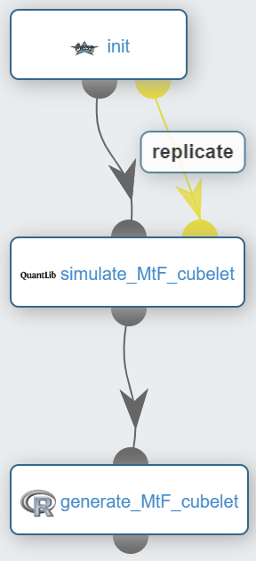
Mark_to_Future_cube_stats.xml
Split the scenarios and bonds over the replicated tasks
1st level of replicated tasks: a replicated task per subset of scenarios
Each replicated task pull from the catalog and submit the cubelet simulation workflow
Compute the portfolio clean prices per scenario and evaluation date (cubelets)
Merge the portfolio clean prices into a single csv file (cube). Compute portfolio prices time series for each scenario and create a csv file. Compute correlations over scenarios and create a csv file + heat map png file
Allow user to visualize/download the png/csv zip files
Init parameters
2nd level of replicated tasks: a replicated task per subset of bonds
Using Quanlib, each replicated task estimates a subset of the portfolio clean prices (cubelet)
Merge cubelets (bonds -> portfolio) and create a csv file

Slide 15
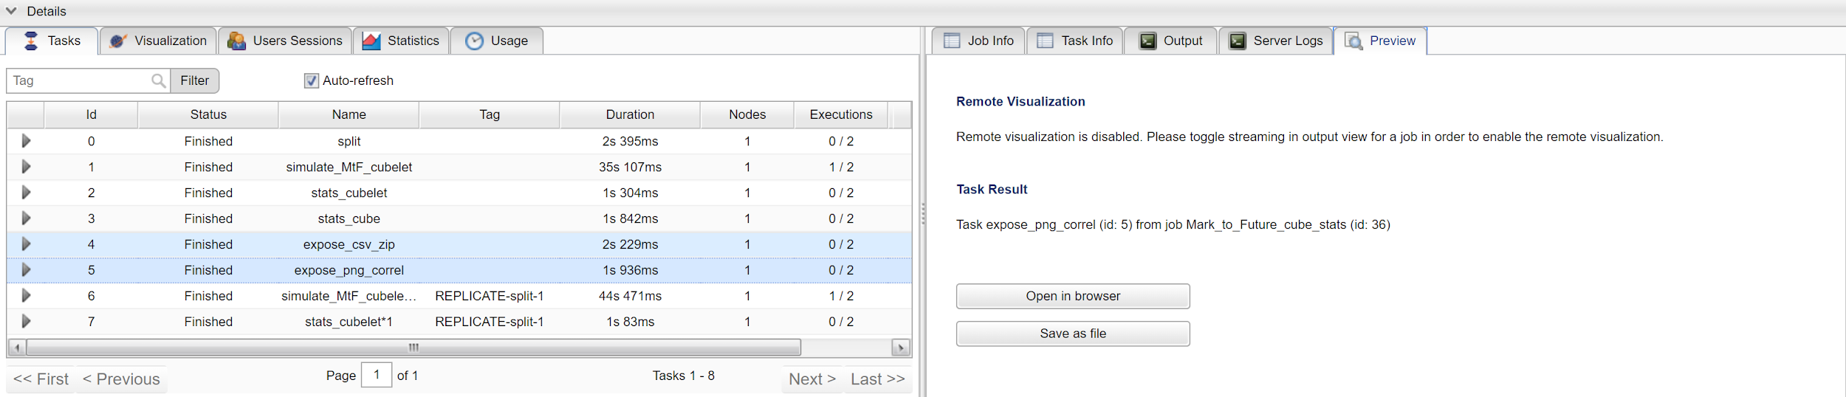
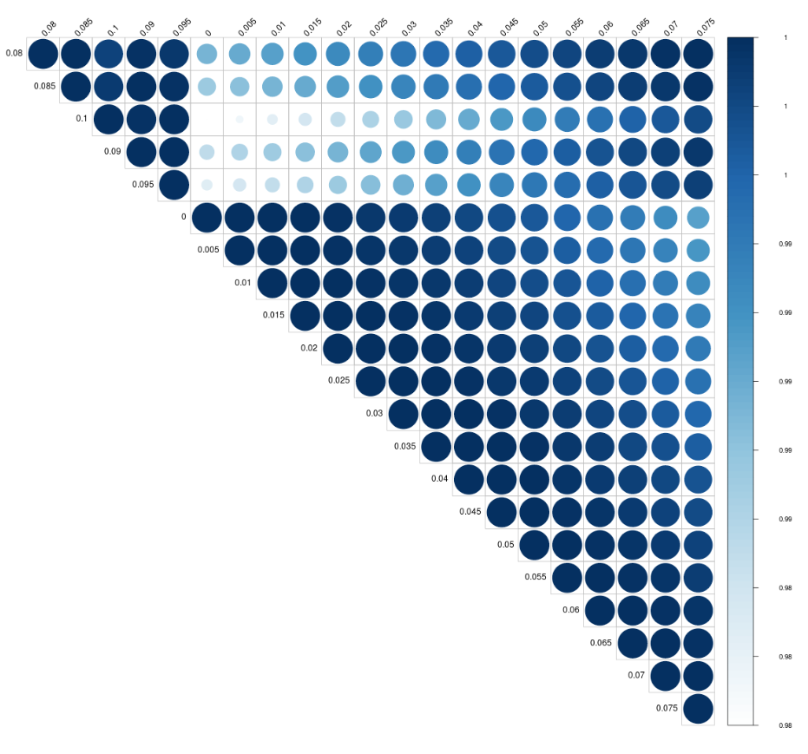
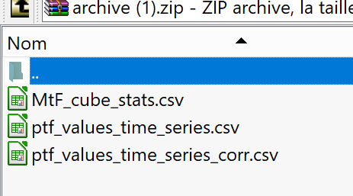
Mark_to_Future_cube_stats.xml

