Slide 1
Deploying HPC platforms using ProActive

Slide 2
The main steps
Swarm.xml to allow container-to-container network using overlay network, natively supported by docker engine swarm mode (a swarm is a cluster of Docker engines/nodes offering services: add/remove nodes,..). An overlay network requires a key-value store (here consul supported by docker) to holds information about the network state.
Deploy your HPC platform via docker containers, for a portable deployment. To start/control docker containers on (remote) hosts, we use the docker-machine command relying on ssh.
HDFS.xml if you just need a dedicated file system adapted to big data
Spark.xml for a big data processing platform
HDFS.xml and Spark.xml if you need both
Test your platform
Spark_Pi.xml to only test your Spark platform (compute PI)
Spark_Write_Read_HDFS.xml to test both your HDFS and Spark platforms (write and read objects in Spark from/to the HDFS)

Slide 3
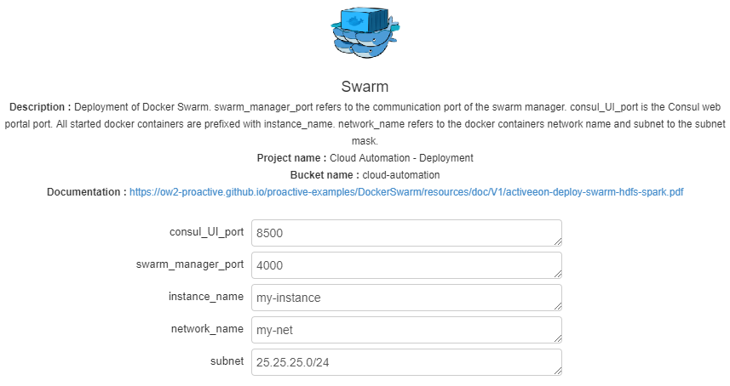
Swarm wkw params
port of the consul web portal
port of the swarm manager process
base name of the docker containers (consul, swarm)
name of the docker network to connect
subnet of the docker network

Slide 4
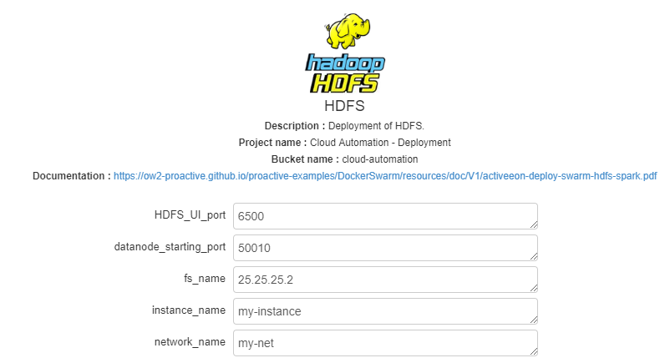
HDFS wkw params
port of the HDFS web portal
Port range start of the datanodes
name of the default file system
base name of the HDFS docker containers
name of the docker network to connect

Slide 5
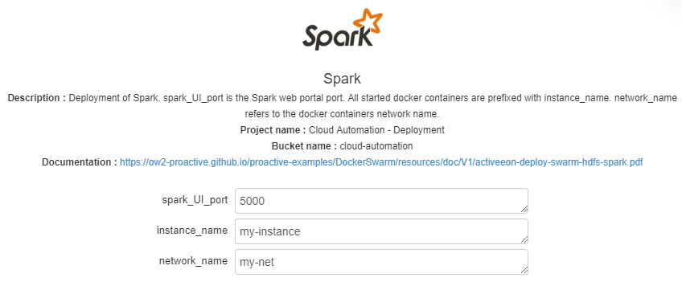
Spark wkw params
port of the Spark web portal
base name of the HDFS docker containers
name of the docker network to connect

Slide 6
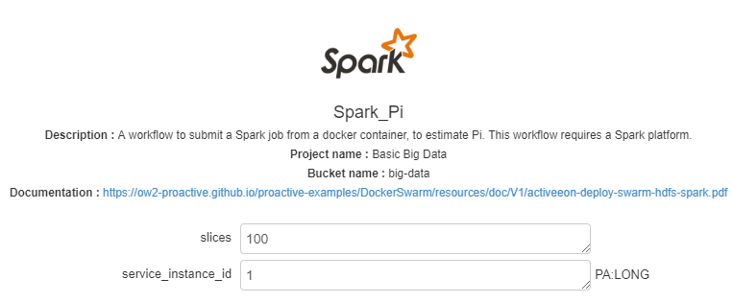
Spark_Pi wkw params
number of slices to cut the random number dataset into. Spark will run one task for each slice of the clusterport of the Spark web portal
instance id of your cloud automation service

Slide 7
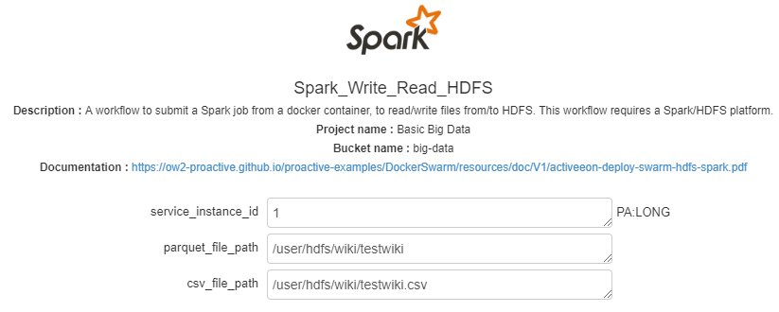
Spark_Write_Read_HDFS wkw params
instance id of your cloud automation service
parquet file path on the hdfs
csv file path on the hdfs

