Slide 1
Risk valuation using ProActive workflows

Slide 2


Basics
Value At Risk (VaR)
One-day 95% VaR of $1 million ⇔ 5% probability that the portfolio worst-case loss will exceed $1 million over a one-day period
Monte Carlo (MC) simulations
The Law of Large Numbers states for large n, the empirical average is very close to the expected value
Estimating the VaR using MC simulations
x the portfolio VaR
L_{t} the porfolio loss at t
α the VaR probability
nb_VaR the number of MC simulations

Slide 3
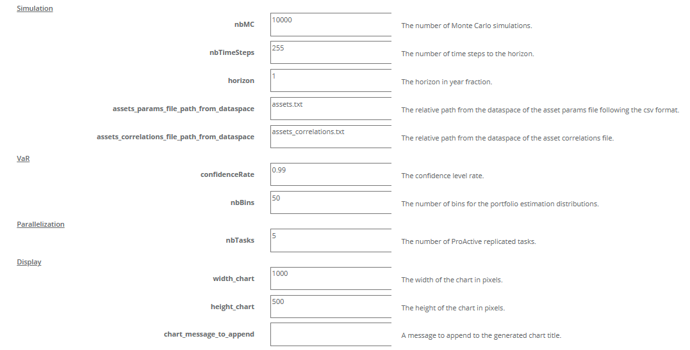
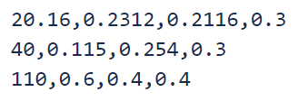

Monte_Carlo_VaR_portfolio.xml
Estimates the Monte Carlo Value at Risk (MC VaR) of a portfolio. We use the geometric Brownian motion (GBM) method to simulate stock price paths, but more exotic assets can be integrated thanks to the Quantlib C++ lib.
<start price>, <riskless rate>, <volatility rate>,<weight>

Slide 4
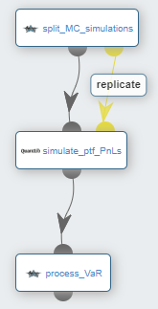
Monte_Carlo_VaR_portfolio.xml
Estimates the number of MC simulations per replicated task. The tasks number does not necessary divide the total number of simulations
Using Quanlib, each replicated task proceses a subset of the MC simulations and deduces the PnL (profit and loss) of each simulated path (value at horizon of a simulation - value at start). On the task side, PnLs are saved into a dedicated file
This task gathers all the PnLs into a single array, sorts them, and retrieves the VaR at the VaR_index corresponding to (1 - confidenceRate) * nbMC. Finally, it generates the corresponding frequencies bar chart and exposes it (view/download)

Slide 5
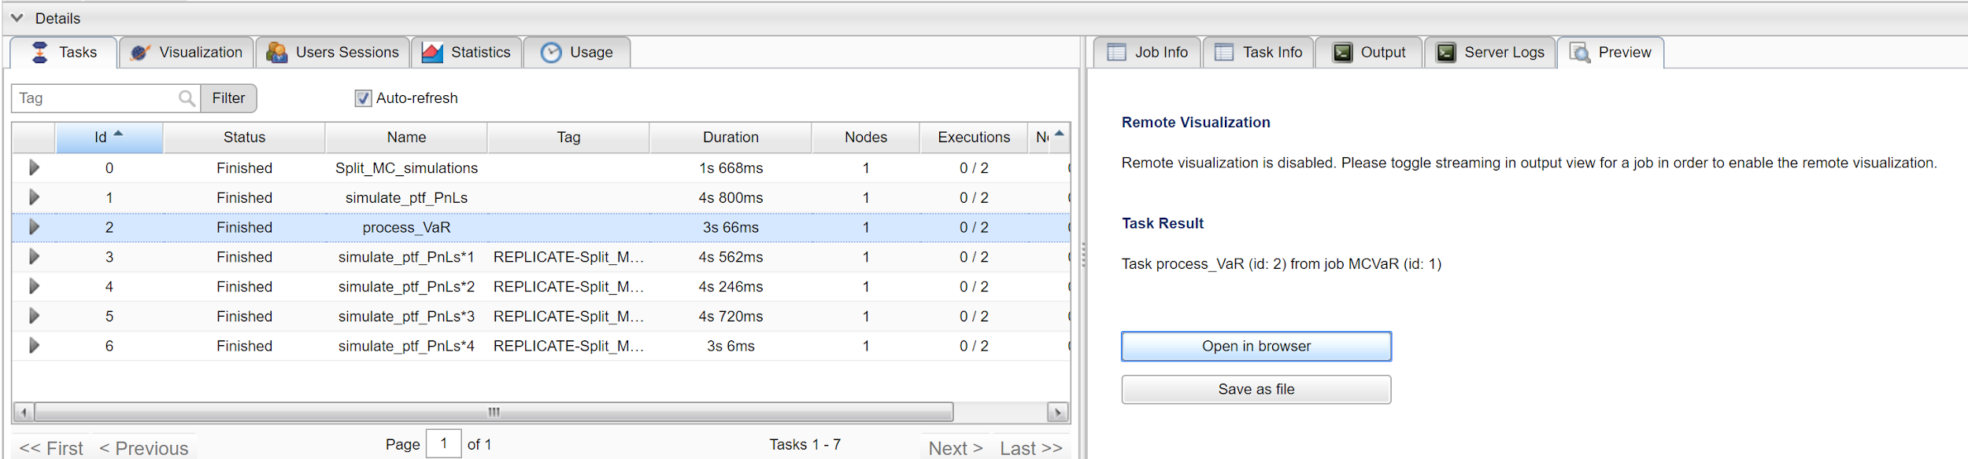
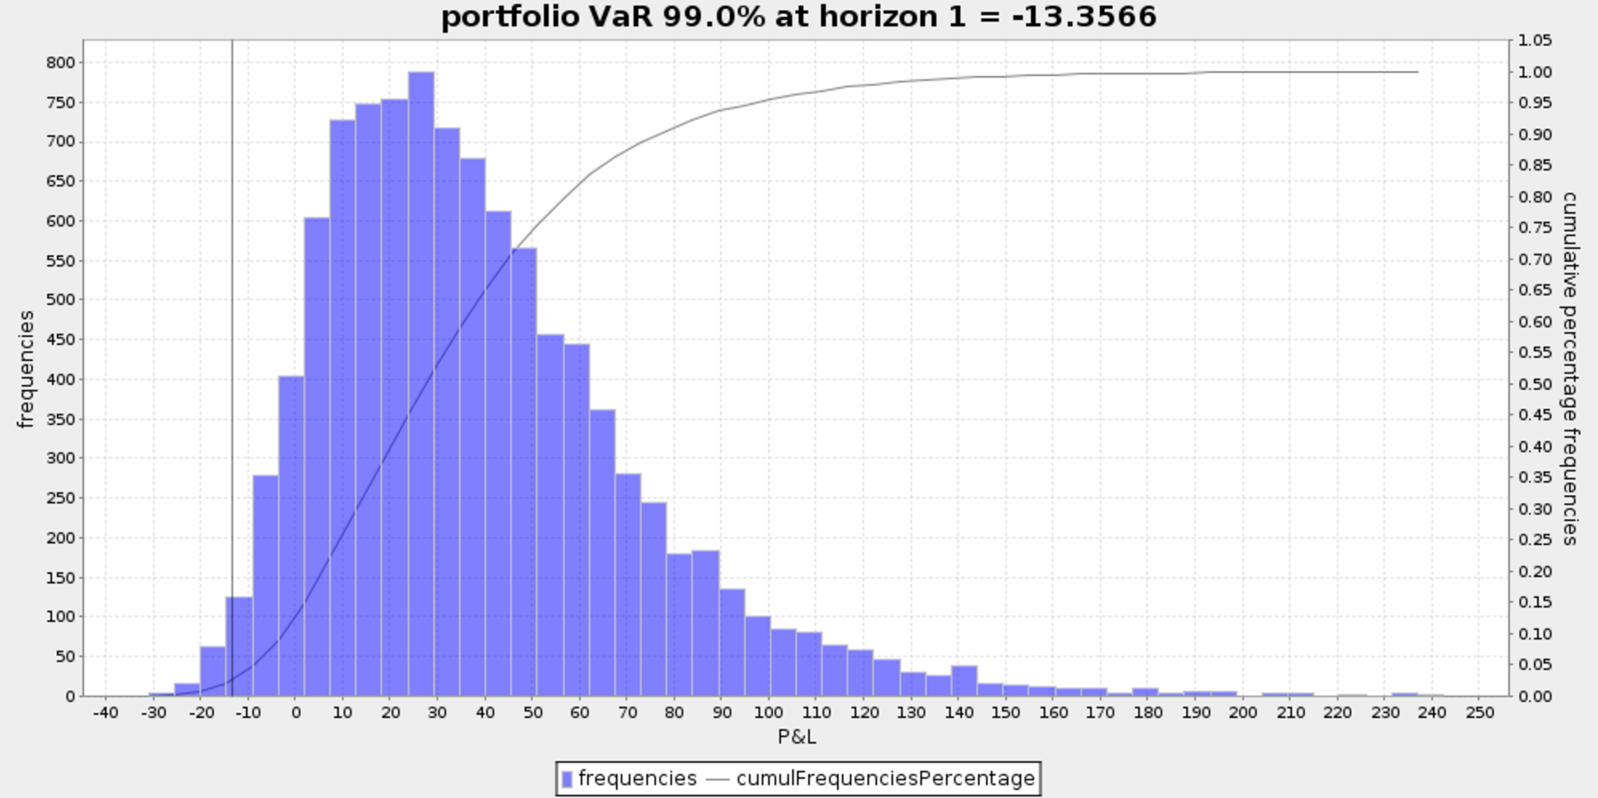
Monte_Carlo_VaR_portfolio.xml

Slide 6
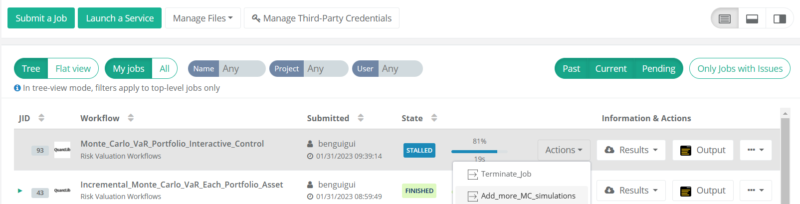
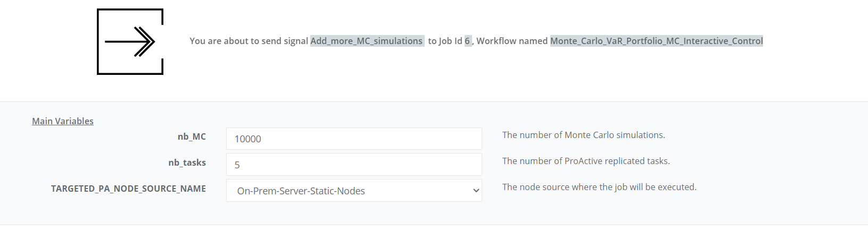
Monte_Carlo_VaR_portfolio_Interactive_Control.xml
The interactive version of the Monte_Carlo_VaR_portfolio workflow allows the user to add more MC simulations to the current results, for a more accurate VaR. “The estimated VaR can be refined incrementally.”
The user will be asked to specify the new MC simulation number to be aggregated to the VaR estimation.

Slide 7
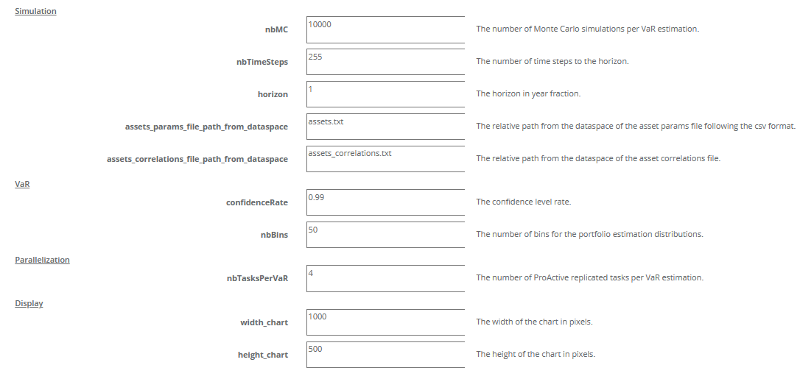
Incremental_Monte_Carlo_VaR_Each_Portfolio_Asset.xml
Estimates the incremental VaR (iVaR) for each asset of the portfolio. iVaR quantifies the risk a position (or sub-portfolio) is adding to a portfolio. The iVaR related to an asset Y, is the difference between the portfolio VaR with and without Y.

Slide 8
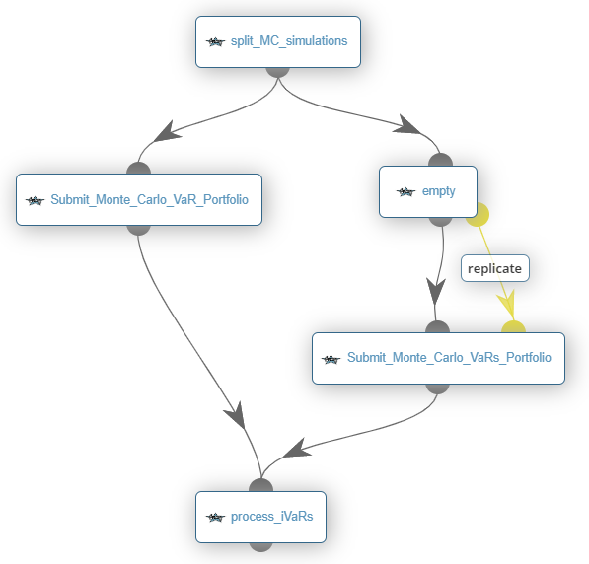
Incremental_Monte_Carlo_VaR_Each_Portfolio_Asset.xml
Estimates the number of MC simulations per replicated task for each VaR (right branch and left branch). The tasks number must divide the total number of simulations
(left branch) This task submits the Monte_Carlo_VaR_portfolio wkw by considering all assets specified by the user
(right branch) 1st level of replicated tasks: a replicated task per asset (Y)
(right branch) Each replicated task instanciates an asset params files, by excluding an asset from the portfolio, ie setting to 0 the asset weight. Then each task submits the Monte_Carlo_VaR_portfolio wkw (2nd inner level of replicated tasks) with an instanciated asset params file as input.
Gather the portfolio VaR over all assets (left branch) and all partial VaRs (right branch). Compute and print the iVaR related to each asset (portfolio VaR estimated by the left branch - portfolio VaR without the asset Y estimated by the right branch)

Slide 9
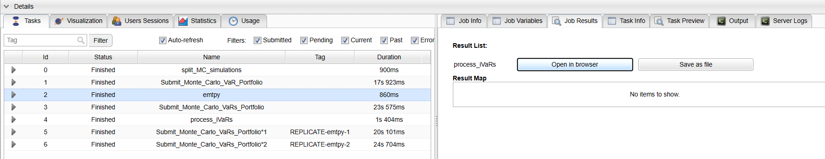
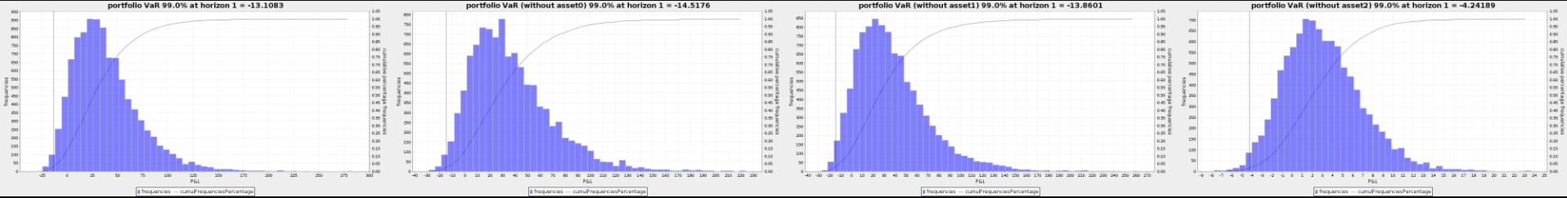
Incremental_Monte_Carlo_VaR_Each_Portfolio_Asset.xml

Slide 10
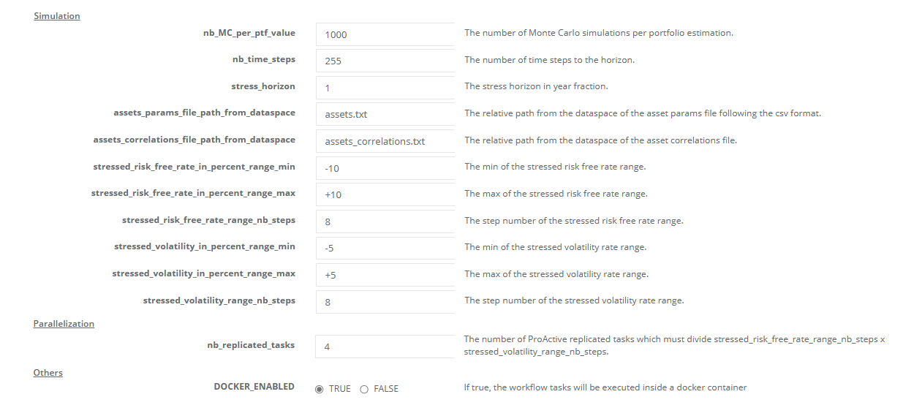
Stress_Testing_Monte_Carlo_Value_Portfolio.xml
Estimates the portfolio PnLs (Profits and Losses) over stressed risk free rates and volatilities.

Slide 11
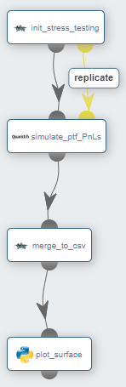
Stress_Testing_Monte_Carlo_Value_Portfolio.xml
Generates all the combinations <stressed risk free rate, stressed volatility> according to their min,max,step user parameters. The number of replicated tasks must divide the number of combinations, i.e. the number of scenarios
Each replicated task processes a subset of the scenarios and estimates per scenario, the mean/expected portfolio Profit and Loss (P&L) over the given number of MC simulations. These simulations are processed in C++/Quantlib. Each task writes into a dedicated file all its estimated P&Ls (a P&L per senario)
Merge all stressed PnLs into a single csv file
Plot a 3D representation of the stressed PnLs

Slide 12
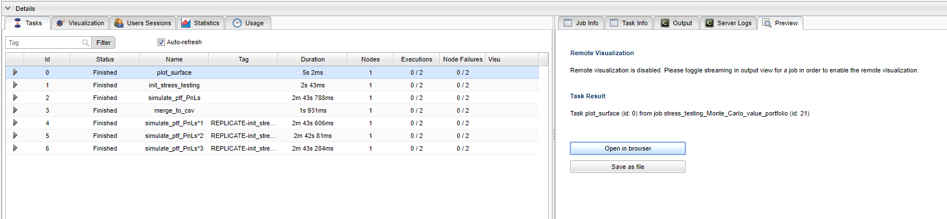
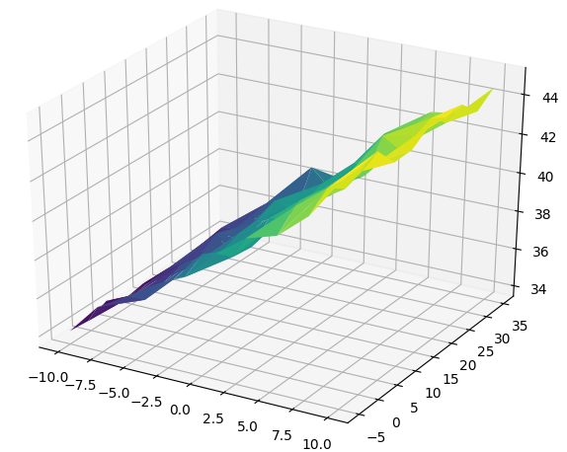
Stress_Testing_Monte_Carlo_Value_Portfolio.xml
PnL
volatility rate stressed %
risk free rate stressed %

Slide 13
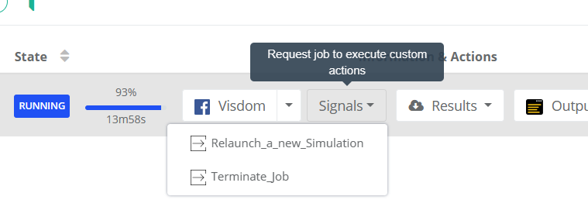
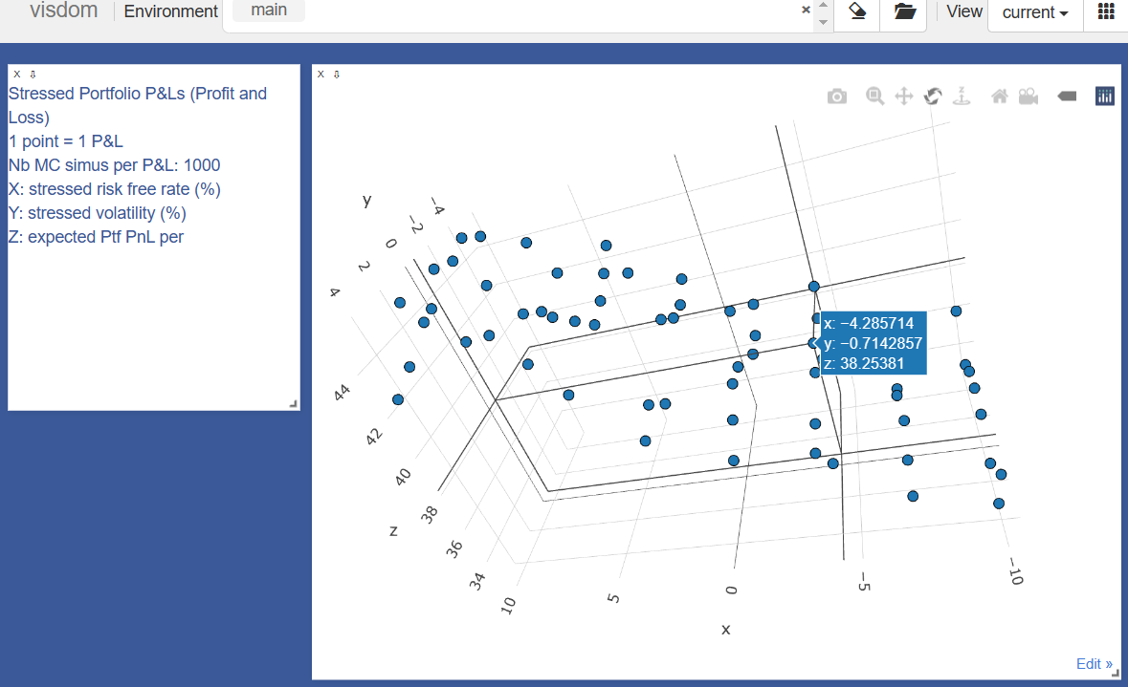
Stress_Testing_Monte_Carlo_Value_Portfolio_MC_Interactive_Control.xml
The interactive version of the Stress_Testing_Monte_Carlo_Value_Portfolio workflow allows the user to stress test the portfolio by considering a new set of parameters.

Slide 14


Mark_to_Future_cube_stats.xml
Estimates a Mark-to-Future (MtF) cube of a bond portfolio. Each cell of the cube estimates the valuation of a bond at a specific time given a specific scenario. This can be easily extended to more exotic instruments thanks to the high maintenability of the implementation (C++ Quantlib for the pricing engine, inputs split in Java/Groovy, R for the cube/cubelet stats,..).
MtF tables
1 MtF table per instrument
REDUCTION BY INSTRUMENTS
evaluation dates
scenarios
shocked risk-free rates
FULL PARALLELIZATION OF CUBELETS ESTIMATIONS
REDUCTION BY SCENARIOS

Slide 15
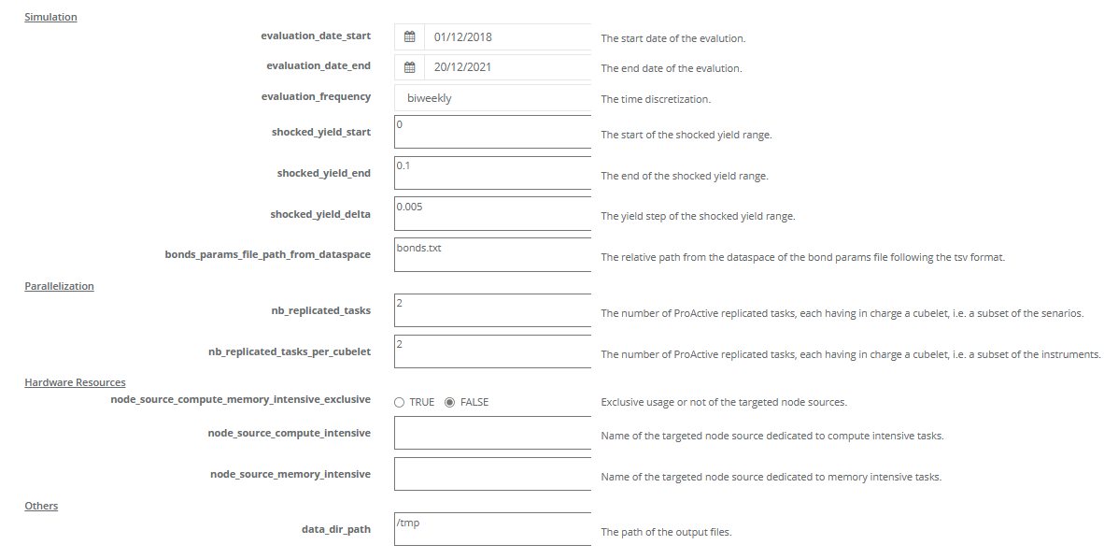
Mark_to_Future_cube_stats.xml

Slide 16
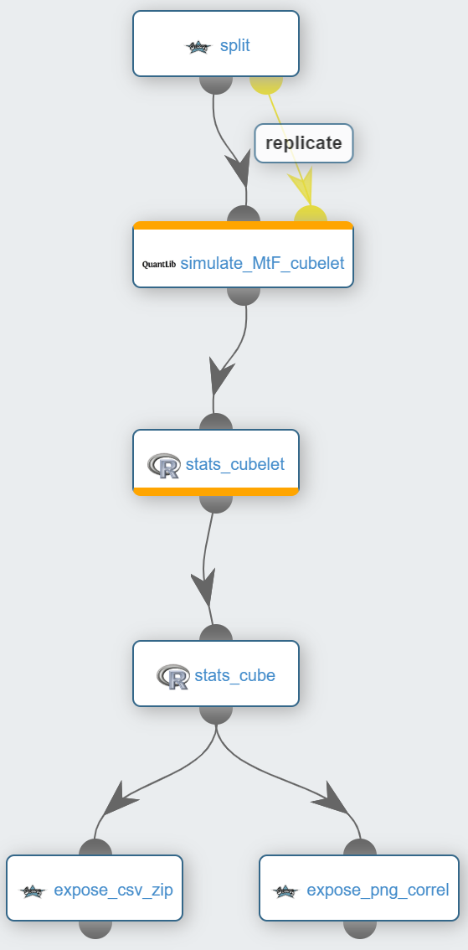
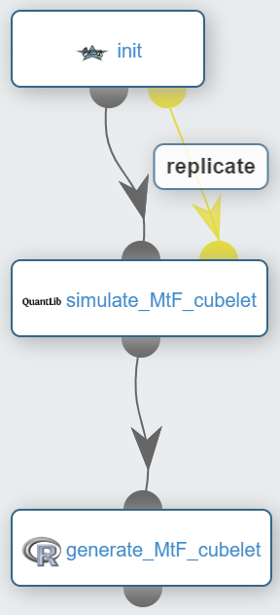
Mark_to_Future_cube_stats.xml
Splits the scenarios and bonds over the replicated tasks
1st level of replicated tasks: a replicated task per subset of scenarios
Each replicated task pulls from the catalog and submits the cubelet simulation workflow
Computes the portfolio clean prices per scenario and per evaluation date (cubelets)
Merges the portfolio clean prices into a single csv file (cube). Computes portfolio prices time series for each scenario and creates a csv file. Computes correlations over scenarios and creates a csv file + heat map png file
Allows user to visualize/download the png/csv zip files
Init parameters
2nd level of replicated tasks: a replicated task per subset of bonds
Using Quanlib, each replicated task estimates a subset of the portfolio clean prices (cubelet)
Merges cubelets (bonds -> portfolio) and creates a csv file

Slide 17
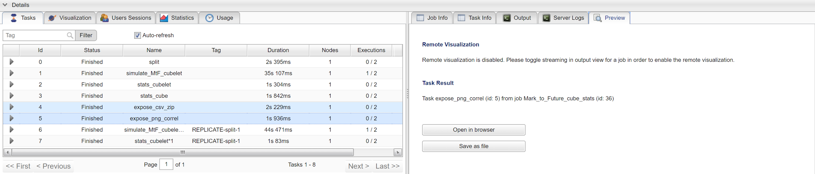
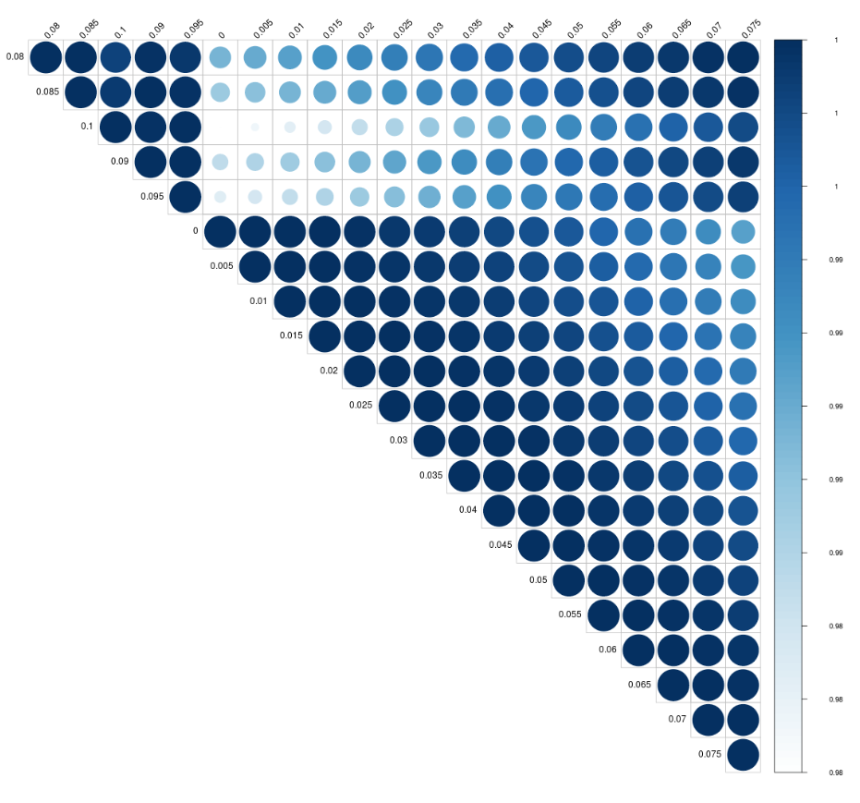
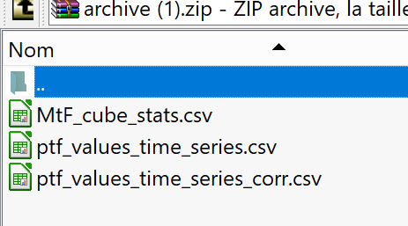
Mark_to_Future_cube_stats.xml

