Slide 1
Deploying HPC platforms using ProActive

Slide 2
The main steps
Swarm.xml to allow container-to-container network using overlay network, natively supported by docker engine swarm mode (a swarm is a cluster of Docker engines/nodes offering services: add/remove nodes,..). An overlay network requires a key-value store (here consul supported by docker) to holds information about the network state.
Deploy your HPC platform via docker containers, for a portable deployment. To start/control docker containers on (remote) hosts, we use the docker-machine command relying on ssh.
HDFS.xml if you just need a dedicated file system adapted to big data
Spark.xml for a big data processing platform
HDFS.xml and Spark.xml if you need both
Test your platform
submit_spark_PI.xml to only test your Spark platform (compute PI)
submit_write_read_persons_HDFS.xml to test both your HDFS and Spark platforms (write and read objects in Spark from/to the HDFS)

Slide 3
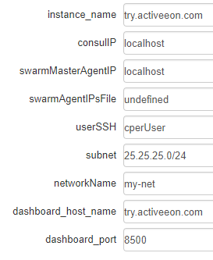
Swarm wkw params
base name of the docker containers (consul, swarm)
IP of the targeted consul machine
IP of the targeted swarm master machine
file name of the targeted swarm agent machines IPs
username used by docker-machine to ssh
subnet for container networking
network name
hostname of the consul web portal
port of the consul web portal

Slide 4
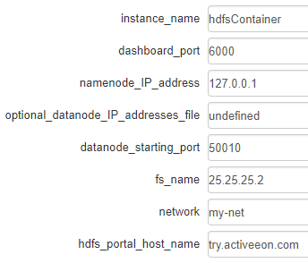
HDFS wkw params
base name of the HDFS docker containers
port of the HDFS web portal
IP of the targeted namenode machine
file name of the targeted datanode machines IPs (if required)
Port range start of the datanodes
name of the default file system
network name
hostname of the HDFS web portal

Slide 5
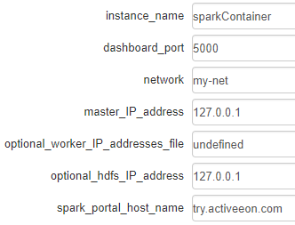
Spark wkw params
base name of the Spark docker containers
port of the Spark web portal
network name
IP of the targeted master machine
file name of the targeted worker machines IPs (if required)
IP of the HDFS namenode machine (if required for a HDFS/Spark install)
hostname of the Spark web portal

Slide 6

submit_spark_pi wkw params
spark master url (displayed on the spark web portal)
network name

Slide 7
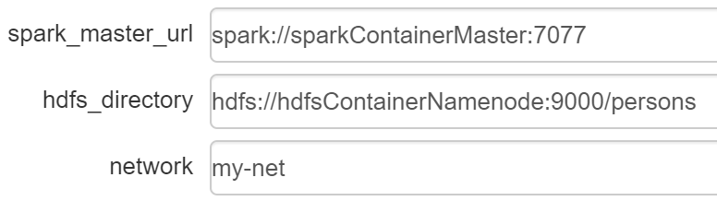
submit_write_read_persons_HDFS wkw params
spark master url (displayed on the spark web portal)
hdfs directory for IO operations
network name

