Slide 1
Put the SAR 40 million into the four regions furthest below 65%.
We are asking you to approve:
Najran
Northern Borders
Al-Baha
Jazan
SAR 15.6M
SAR 8.7M
SAR 8.3M
SAR 7.4M
Nationally we are already past 65%. These four are still 2 to 4 points short. The other four regions below target are less than a point away.
Split by the size of each region's gap. Checked on the dashboard in June 2026.
1
Notes:
Presenter 1 · 0:00–0:30
We're asking you to approve the 40 million for four regions: Najran 15.6, Northern Borders 8.7, Al-Baha 8.3, Jazan 7.4 million. Nationally Tayseer is already past 65%. These four are the ones still well short.

Slide 2
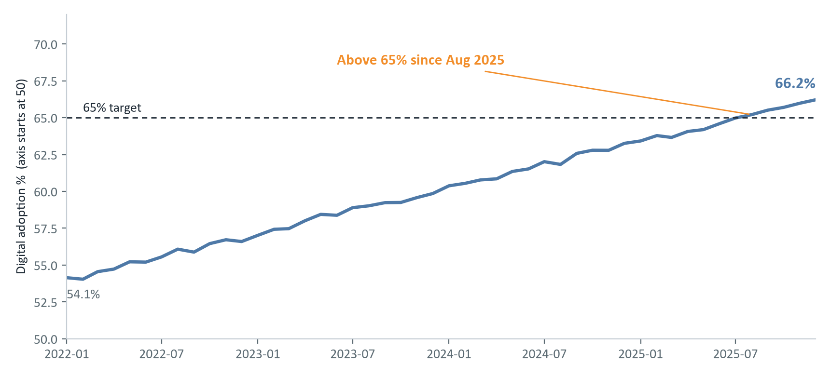
Nationally, Tayseer passed the 65% target in 2025.
From 54.1% in January 2022 to 66.2% in December 2025.
So the national number is fine. The question is where it isn't.
2
Notes:
Presenter 1 · 0:30–1:15
Top is the KPI from our Tableau dashboard: 66.2% in December 2025. Below is the monthly trend, weighted by users. The dashed line is 65%. We crossed it in August 2025 and stayed above it. Hand over to the regions.

Slide 3
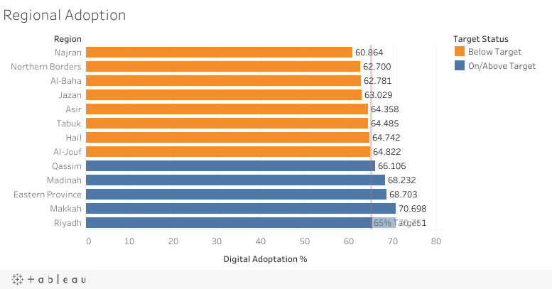
But 8 of 13 regions are still below 65%.
December 2025, from the dashboard.
Orange is below target, blue is on or above.
Riyadh and Makkah are near 71%. Najran is lowest at 60.9%.
3
Notes:
Presenter 2 · 1:15–2:00
This is the regional chart from the dashboard. Bars start at zero, sorted lowest first, the red line is 65%. Five regions are over it. Eight are under, in orange. Najran is the lowest at 60.9%.

Slide 4
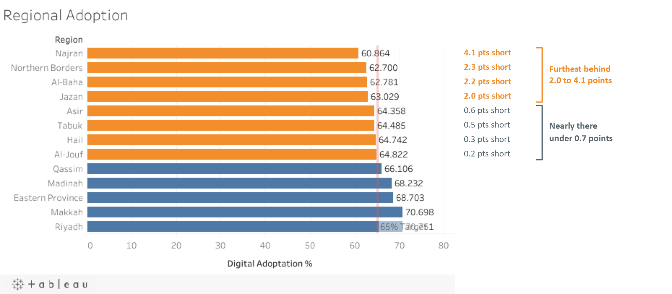
Four regions are 2 to 4 points short. The other four are under a point away.
Gap = 65 minus the region's December rate. If the four furthest behind reach 65%, national adoption goes from 66.2% to 66.8% and no region is more than 0.7 points short.
4
Notes:
Presenter 2 · 2:00–4:00
Same Tableau chart, with the gap to 65% written next to each orange bar. Look at the top four: Najran 4.1 points short, Northern Borders 2.3, Al-Baha 2.2, Jazan 2.0. Then Asir, Tabuk, Hail and Al-Jouf, all under 0.7 points. So there are really two groups. Four regions with a real gap, and four that are almost there. If the first four reach 65%, the national rate goes up to about 66.8%. Next, three ways to split the money.

Slide 5
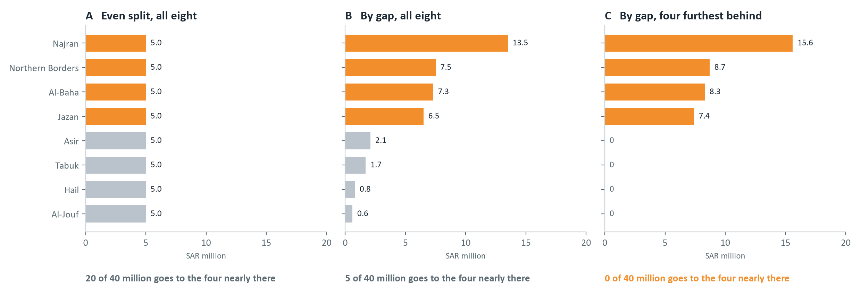
An even split sends half the money to regions that are almost at 65%.
The eight regions below target, lowest at the top. Orange: the four furthest behind. Grey: under a point away.
5
Notes:
Presenter 3 · 4:00–5:15
Three ways to split the same 40 million. Same scale on all three. A gives each of the eight 5 million, so 20 million goes to regions that are almost there. B splits by gap across all eight. Better, but 5 million still goes to those four. C splits by gap across only the four furthest behind. Najran gets the most because its gap is the biggest.

Slide 6
We recommend option C: split by gap across the four furthest behind.
Option C
Najran SAR 15.6M
Northern Borders SAR 8.7M
Al-Baha SAR 8.3M
Jazan SAR 7.4M
Expected effect: if the four reach 65%, national adoption rises to about 66.8% and every region is within 0.7 points of target.
Why not A or B: they spend 20M and 5M on regions that are already within a point. The data doesn't tell us how many points a million riyals buys, so the June check matters.
6
Notes:
Presenter 3 · 5:15–6:15
We recommend C. Najran 15.6, Northern Borders 8.7, Al-Baha 8.3, Jazan 7.4 million. Each region gets money in line with how far it has to go. A and B spend part of the budget on regions that are already within a point. If the four reach 65%, national adoption goes to about 66.8%. We don't know how many points each million buys, which is why we check in June.

Slide 7
Approve the SAR 40 million split today. We check progress in June 2026.
Najran 15.6M, Northern Borders 8.7M, Al-Baha 8.3M, Jazan 7.4M
June 2026 checkpoint, on the Tableau dashboard
Each region should have closed at least half its gap:
Najran 62.9% Northern Borders 63.9% Al-Baha 63.9% Jazan 64.0%
If a region is behind, we bring it back here before more is spent there. Target: all four at 65% by December 2026.
7
Notes:
Presenter 3 · 6:15–7:00
So we're asking you to approve Najran 15.6, Northern Borders 8.7, Al-Baha 8.3, Jazan 7.4 million today. In June we check the dashboard. Each region should have closed at least half of its gap. If one hasn't, we come back to you before more is spent there. Thank you, happy to take questions.

Slide 8
Appendix: how the numbers were calculated
Adoption
SUM(digital % × unique users) ÷ SUM(unique users). Weighted by users, not an average of percentages. Same calculated field as the dashboard.
Month
December 2025, the latest month in the Tayseer dataset (2022–2025, 13 regions).
Gap
65 minus the region's December rate, in percentage points.
Option C
40M × region's gap ÷ total gap of the four regions 2+ points short (10.6 points).
Effect
Adds the digital users each of the four needs to reach 65%, then recomputes the national rate (66.8%).
Dashboard
https://public.tableau.com/app/profile/abdulaziz.alabdulkareem/viz/digitaladoption/Tayseer-DigitalAdoption
A1
Notes:
Only if asked.

