Slide 1
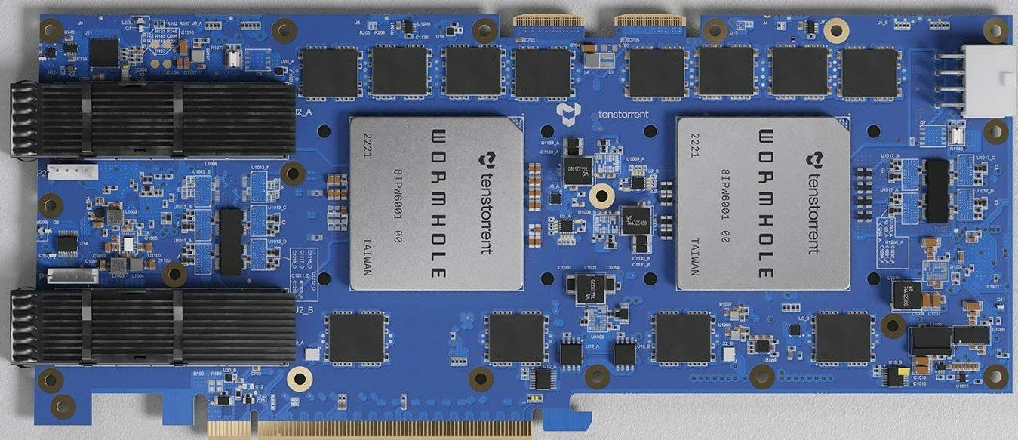


Wrap up

Slide 2
Thanks for coming!
Sample solutions are available for all practicals
Located in the tt-tutorial directory on the machine you are using, under sample_solutions for each practical
https://github.com/RISCVtestbed/tt-tutorial
Access to the machine will continue for the rest of this week
Your visitor account will work until Saturday
Feel free to not only work on the practicals we used today, but to also explore more complex codes on the architecture
Beyond this, for long term access you can sign up for an account on our RISC-V testbed to continue using the Wormhole
And also the Blackhole, and other RISC-V technologies too!
https://riscv.epcc.ed.ac.uk

Slide 3
Materials and the Tenstorrent community
All materials for this tutorial are open source and can be found at
https://github.com/RISCVtestbed/tt-tutorial
More generally if you wish to continue exploring this after the tutorial finishes
https://docs.tenstorrent.com/
https://docs.tenstorrent.com/tt-metal/latest/tt-metalium/tt_metal/examples/matmul_multi_core.html is a good example of running multi-core across Tenix units
There is a Tenstorrent developer community
https://tenstorrent.com/developers
Discord at https://discord.com/invite/tenstorrent

