Slide 1
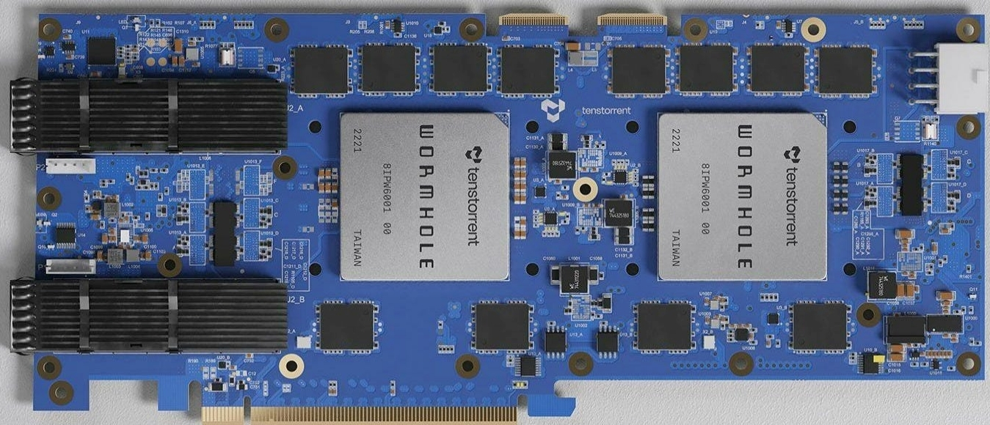


Overview of TT-Metalium SDK: Part one

Slide 2

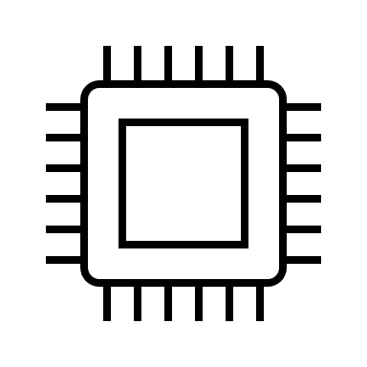
Host and device overview
Host
PCIe accelerator
Configure DDR data
Create CBs and L1 buffers
Set up kernels
Copy input data to DDR
Wormhole
Results from DDR

Slide 3
The structure of the host code
There is quite a bit of boilerplate code in the host C++ file (we will see this in the practical) but in-fact it’s actually quite simple
These are the major activities that the host is doing
We will look at these in more detail now….
Initialise the device
Allocate DDR-DRAM memory
Allocate L1 buffers
Allocate circular buffers (CBs)
Create kernels and set their runtime arguments
Copy input data onto device
Queue up kernels to run
Wait for kernels to complete
Copy results back to host

Slide 4
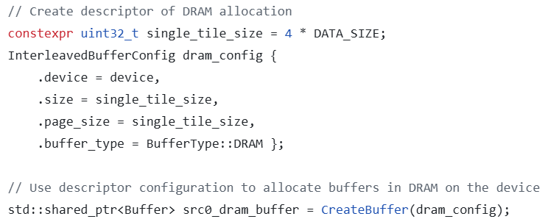
Host: Allocating memory in DDR-DRAM
There is 12GB of DDR-DRAM available on the Wormhole board
This is visible to the host and typically Tensix cores will load from, and write to, this
Create a memory configuration that defines the overall size, page size and location
All memory is allocated in pages, here we have a single page which equals the overall size
Performs the memory allocation based upon the configuration. We can then use this handle on the host when referring to the buffer

Slide 5
Host: Transferring data between host and DDR-DRAM
Writes data from the host to the device’s DDR-DRAM
Both these calls operate in a blocking (true) or non-blocking form. Blocking will wait for the data transfer to complete, non-blocking will add this to the command queue and that is then waited on later
The command queue
The buffer handle
Host memory
Whether to block
Reads data from the DDR-DRAM to host memory

Slide 6
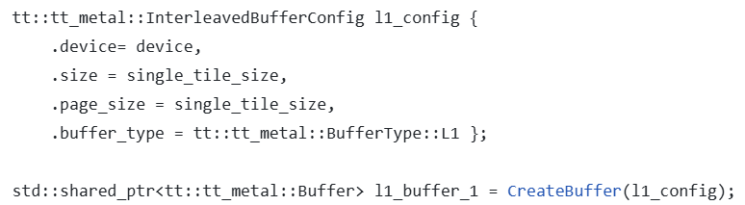
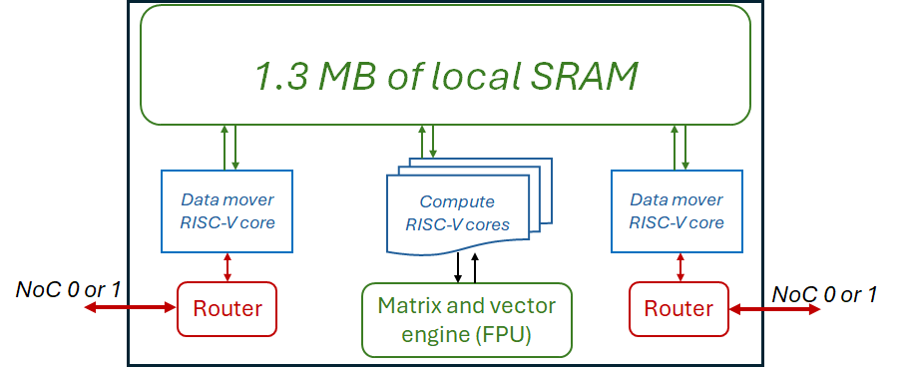
Host: Allocating memory in L1 SRAM
Each Tensix unit has 1.3MB of local SRAM
Can allocate memory into here and then use this on the device, for instance as a temporary scratch pad.
Approach is similar to DDR allocation, but with a buffer type of L1

Slide 7
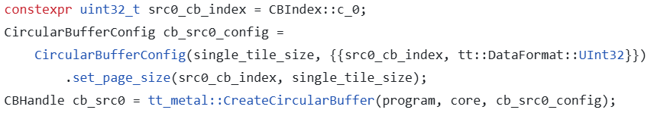
Host: Circular Buffers
1.3 MB of SRAM
CB
In a way are similar to L1 buffers
In addition to memory, provide a producer-consumer model to share data between RISC-V cores in a structured manner
Are created on the host for each Tensix unit
Pushes to make available
Waits on CB being available
Producer RISC-V core
Consumer RISC-V core
Configuration of CB (size, data type and index)
Create CB based on configuration on a specific core

Slide 8
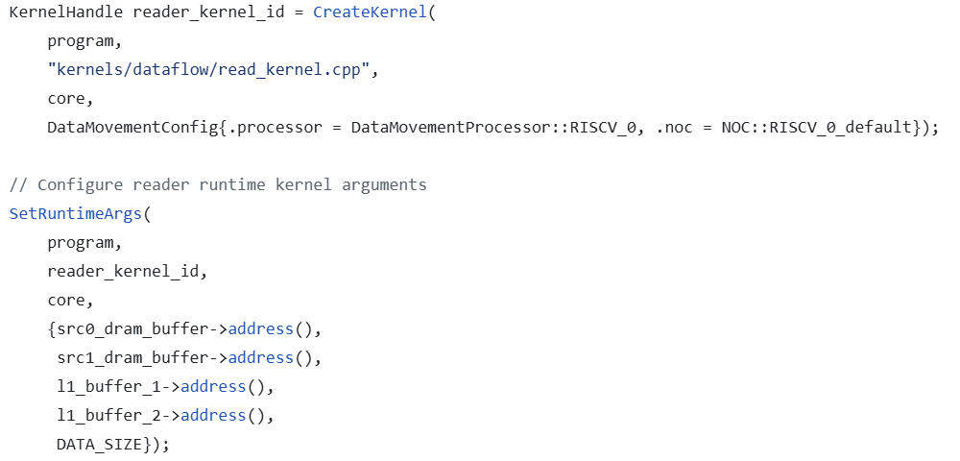

Host: Configuring and launching kernels
Create a kernel based upon the source filename, specify it will be placed on a specific RISC-V baby core of a Tensix core
Set runtime arguments for the kernel (we will look at the device side unpacking those in a moment….)
Add the program to the command queue, running the kernels. The Boolean determines whether this is blocking (true) or non-blocking (false)
Wait for command queue to finish all it’s tasks

Slide 9
Device side
kernels
Typically three kernels are provided by the programmer
Reader kernel is launched on data movement baby RISC-V core 0
Writer kernel is launched on data movement baby RISC-V core 1
Compute kernel is launched on the three compute RISC-V cores
This structure is typical, but not fixed
dataflow
compute
reader kernel
writer kernel
compute kernel
Importantly, the kernel is only compiled when the host code is executed (and not when the host code is compiled)
Here we concentrate on the dataflow kernels, the compute kernel is in the next lecture

Slide 10
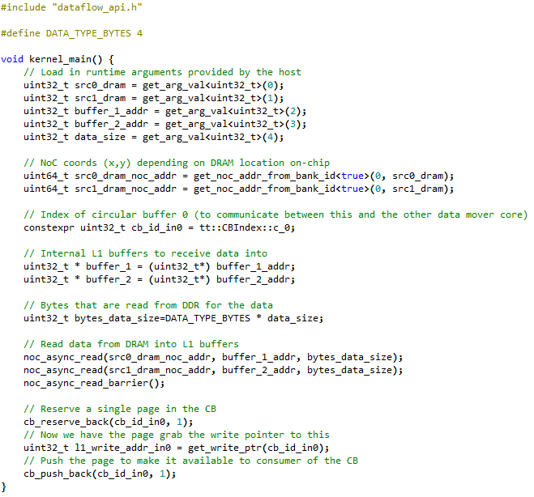
Device side
Read runtime arguments set from the host
Read data from DRAM
Push data into circular buffer

Slide 11
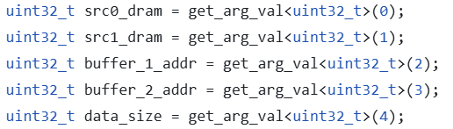
Device: Runtime arguments and reading DDR-DRAM
We are showing quite a few things here
Reading the five runtime arguments (set by the host)
Obtaining the “global” Network on Chip (NoC) address of the DDR memory to read from
Reading data from DDR into the L1 SRAM buffer and then blocking for this to complete
Each runtime argument is read based upon its index
Obtain the global, NoC, address of the memory that we will read from
Read from DDR using the NoC address into the L1 SRAM buffer
Block until this data reading has completed

Slide 12

Device: Circular buffers
1.3 MB of SRAM
CB
One RISC-V core will produce data to add into the CB, the other will consumer data from the CB.
The API marshals access to the CB as well as making available the underlying memory
Pushes to make available
Waits on CB being available
Producer RISC-V core
Consumer RISC-V core
On the producer, will reserve a page in the CB, get the write pointer to this (and then can use that to write to the memory), before pushing it to the CB and making it available.
On the consumer, will wait until a page has been pushed into the CB, then will retrieve the read pointer from this and work with the data. Once the consumer has completed it will pop the data so the producer can add some more if required.

Slide 13
Writing results to DDR
Writing data from L1 to DDR via the NoC is very similar to reading data
Is also non-blocking and we need to then wait for completion
Typically:
Reader kernel will reserve page(s) in CB(s), read data from DDR memory into these CB(s) and then push the CB(s) to make them available
Compute kernel waits for CBs, then uses these to drive compute on the FPU and reserves page(s) in output CB(s), writing results to these CB(s) and making them available
Writer kernel will wait for the output CB(s), then writes the data here to DDR
All these run concurrently in a pipelined fashion, working on separate chunks (or tiles)

Slide 14
Printing for debugging
An extremely helpful feature is the ability to print from kernels on the device to the terminal. This is super helpful during debugging
Need to explore the environment variable via export TT_METAL_DPRINT_CORES=0,0
DPRINT << “Hello “ << ENDL();
DPRINT_MATH(DPRINT << “Hello “ << ENDL());
DPRINT in the kernel will print, furthermore there are function calls such as DPRINT_MATH that select which specific core will do the printing. Also calls to print contents of CBs too.
As it’s a debugging thing, I tend to find DPRINT sufficient for most things
Lots more details at https://docs.tenstorrent.com/tt-metal/latest/tt-metalium/tools/kernel_print.html

Slide 15
Building and running
Device kernels are JIT compiled by Metalium when the host code is launched
The make command here builds the ex_one host executable but nothing else
When this host executable is launched, the device kernels are then built
Hence we need to provide the source file when calling CreateKernel on the host
[user-id@tenstorrent1 ~/tt-tutorial/practical/one/sample_solutions]$ make
………
[user-id@tenstorrent1 ~/tt-tutorial/practical/one/sample_solutions]$ ./ex_one
2025-09-01 18:38:54.566 | info | SiliconDriver | Opened PCI device 0; KMD version: 1.29.0; API: 1; IOMMU: disabled (pci_device.cpp:197)
2025-09-01 18:38:54.579 | info | Device | Opening user mode device driver (tt_cluster.cpp:192)
2025-09-01 18:38:54.579 | info | SiliconDriver | Opened PCI device 0; KMD version: 1.29.0; API: 1; IOMMU: disabled (pci_device.cpp:197)
2025-09-01 18:38:54.590 | info | SiliconDriver | Opened PCI device 0; KMD version: 1.29.0; API: 1; IOMMU: disabled (pci_device.cpp:197)
2025-09-01 18:38:54.601 | info | SiliconDriver | Harvesting mask for chip 0 is 0x300 (NOC0: 0x300, simulated harvesting mask: 0x0). (cluster.cpp:295)
2025-09-01 18:38:54.603 | info | SiliconDriver | Opened PCI device 0; KMD version: 1.29.0; API: 1; IOMMU: disabled (pci_device.cpp:197)
2025-09-01 18:38:54.699 | info | SiliconDriver | Harvesting mask for chip 1 is 0x204 (NOC0: 0x204, simulated harvesting mask: 0x0). (cluster.cpp:295)
2025-09-01 18:38:54.702 | info | SiliconDriver | Opening local chip ids/pci ids: {0}/[0] and remote chip ids {1} (cluster.cpp:157)
2025-09-01 18:38:54.705 | info | SiliconDriver | All devices in cluster running firmware version: 255.255.0 (cluster.cpp:138)
2025-09-01 18:38:54.705 | info | SiliconDriver | Software version 6.0.0, Ethernet FW version 6.9.0 (Device 0) (cluster.cpp:935)
2025-09-01 18:38:54.705 | info | SiliconDriver | Software version 6.0.0, Ethernet FW version 6.9.0 (Device 1) (cluster.cpp:935)
Completed successfully on the device, with 100 elements
2025-09-01 18:38:58.053 | info | Device | Closing user mode device drivers (tt_cluster.cpp:383)

Slide 16
Next steps: Getting hands on
We will get you logged into the Tenstorrent host that is in the RISC-V testbed
Practicals one and two at this point:
Practical one explores adding pairs of numbers on one of the data mover RISC-V cores
Getting data between the host and the device
Allocating L1 buffers on the device
Passing runtime arguments to the device
Reading and writing data between DDR-DRAM and the L1 buffer on the device
Working with L1 buffer on the device
Practical two explores using the second RISC-V data mover core to write results to DDR
Circular buffers between RISC-V baby cores to enable communication of data between them
All practicals have the exercise itself with the readme walking you through the steps required. There is also a sample solution in-case you get stuck.

