Slide 1
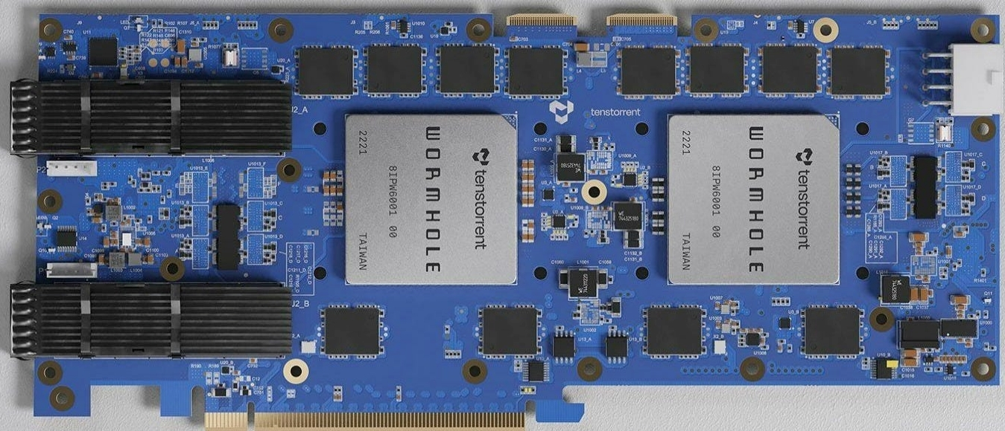


Overview of TT-Metalium SDK: Compute

Slide 2
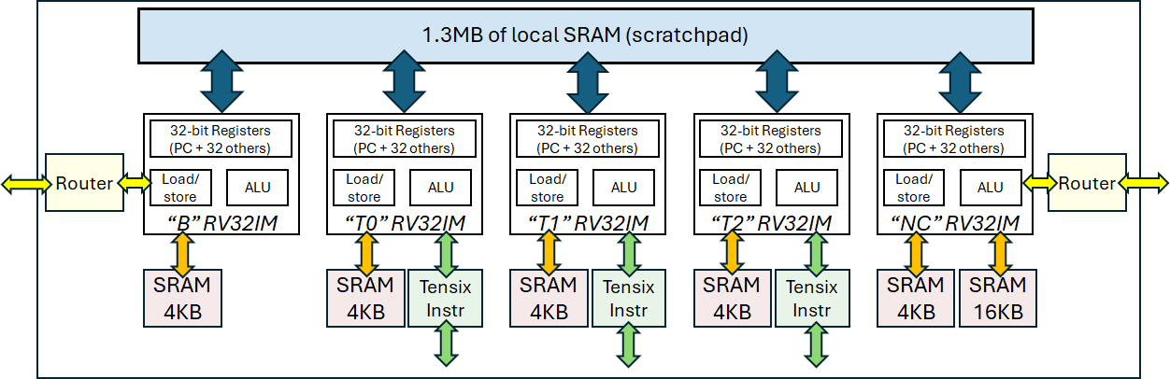
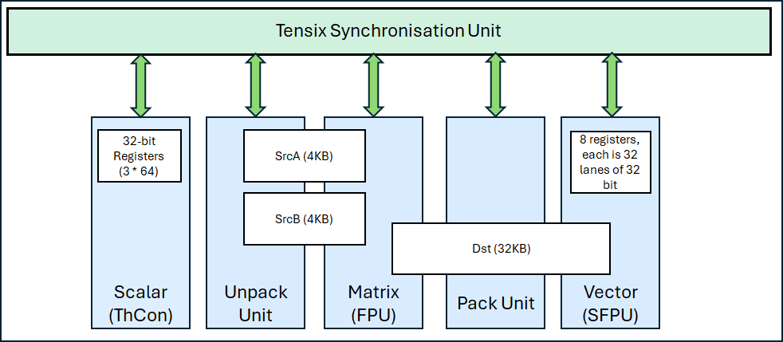
The compute engine has a scalar, matrix and vector unit
SrcA and SrcB are input registers
Dst is an output register (and input register for Vector unit too)

Slide 3
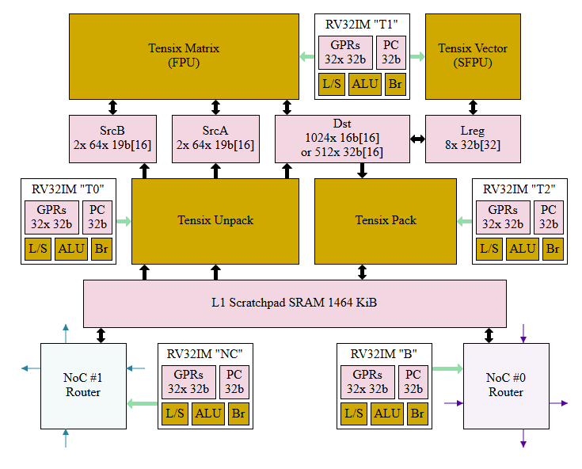
A more accurate diagram….
The matrix unit can perform up to 4.096 TFLOP/s
The vector unit can perform 32 FP32 maths operations per cycle
This is FP32(ish)
The matrix unit makes several sacrifices to IEEE compliance to achieve this performance
Maximum of 19 bits for each element, so supports a maximum of TF32
The vector unit provides full FP32 support, so for HPC workloads this is probably the one we would use
However, performance is slower
From Pete Cawley’s blog at https://www.corsix.org/content/tt-wh-part7

Slide 4
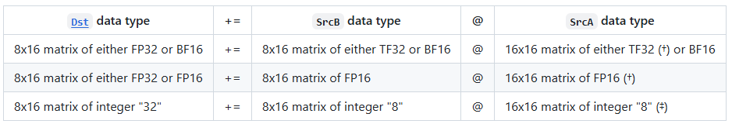
Data supported by the matrix unit (FPU)
srcA
FPU
dst
Inputs to the matrix unit (srcA and srcB) are two banks of 64 rows by 16 columns of 19-bit data
srcB
1024 elements computed with by the FPU, the majority of compute FPU operations have a latency of five cycles but are pipelined and can be issued each cycle
Matrix multiplication can deliver up to 4.096 TFLOP/s and element wide operations 0.256 TFLOP/s
Whilst the FPU provides the potential for performance, the data types that are supported are rather limited
From https://github.com/tenstorrent/tt-isa-documentation/blob/main/WormholeB0/TensixTile/TensixCoprocessor/SrcASrcB.md

Slide 5
Issuing compute operations to matrix unit
tile lock
CB
unpacker
srcA
FPU
dst
packer
CB
CB
unpacker
srcB
To get input data in
To compute
To get results out
Acquire exclusive compute lock on DST (target) registers using tile_regs_aqcuire API call
Issue corresponding matrix API call such as add_tiles, sub_tiles, mul_tiles with CB index as input
Release exclusive compute lock on DST (target) registers using tile_regs_commit API call
Acquire exclusive pack lock on DST (target) registers using tile_regs_wait API call
Copy results from dst register to target CB via pack_tile API call
Release exclusive pack lock on DST (target) registers using tile_regs_release API call
Wait for two CBs (LHS and RHS) to be available via cb_wait_front API call

Slide 6
Data supported by the vector unit (SFPU)
Inputs to the vector unit are from the dst register
1024 rows of 16 columns of 16-bit data, or 512 rows of 16 columns of 32-bit data
BF16, FP16, FP32, int8, int16 and int32 are supported
The vector unit has 32 lanes, each of 32 bit
dst
SFPU
dst
LReg
dst
LReg
The vector unit is fed from LReg, which contains 17 times, 32 lanes of 32 bit (8 of which can be used for inputs)
LReg is loaded from chunks of dst , from a maximum of 1024 elements
Binary operations will load different lanes of LReg from different chunks in dst
Most operations have a latency of 2 cycles and can be issued each cycle – but only work on 32 elements

Slide 7
Issuing compute operations to vector unit
SFPU
CB
Explicit unpacker call
tile lock
dst
Explicit packer call
CB
CB
Explicit unpacker call
To get input data in
To compute
To get results out
Wait for two CBs (LHS and RHS) to be available via cb_wait_front API call
Acquire exclusive pack lock on DST (target) registers using tile_regs_wait API call
Copy both input tiles into dst register using segment index
Release exclusive pack lock on DST (target) registers using tile_regs_release API call
Acquire exclusive compute lock on DST (target) registers using tile_regs_aqcuire API call
Issue corresponding vector API call such as add_binary_tile, sub_binary_tile with segment index determining inputs (first input overwritten with results)
Release exclusive compute lock on DST (target) registers using tile_regs_commit API call
Acquire exclusive pack lock on DST (target) registers using tile_regs_wait API call
Copy results from dst register to target CB via pack_tile API call
Release exclusive pack lock on DST (target) registers using tile_regs_release API call

Slide 8
The key points
Inputs are CBs and the output is a CB
dst register is split into 16 segments
Matters more when using the vector unit
Interaction with dst is always explicit and you need to acquire locks on the dst register as this coordinates instructions from the pack, compute and unpack RISC-V cores

Slide 9
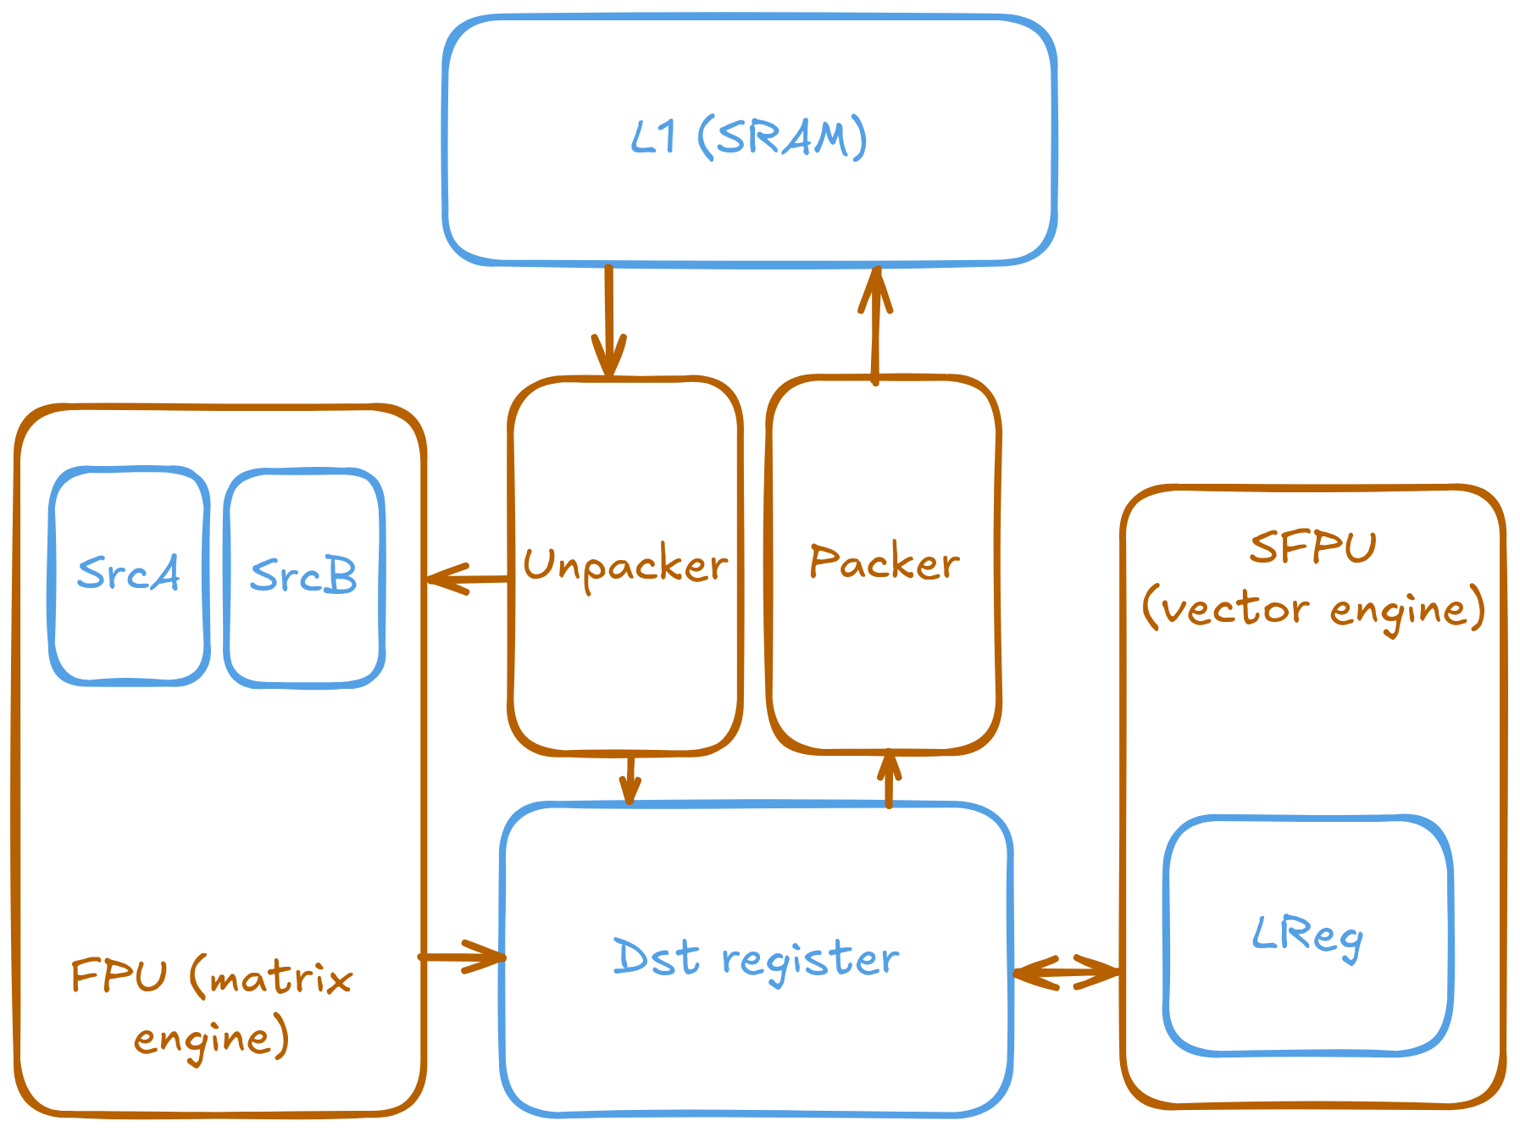
Initialisation
The compute engine must be initialised, taking the input and output circular buffers as arguments
This configures the unpacker, packer, and FPU for the specific operation being performed.
Re-initialization is not required for repeated operations with the same source, destination, and data type parameters.
Image from https://docs.tenstorrent.com/tt-metal/latest/tt-metalium/tt_metal/advanced_topics
In practical four (FPU) you will see we use binary_op_init_common (with input and output CBs) and add_tiles_init (with input CBs)
In practical five (SFPU) we use init_sfpu (with an input and output CB) and add_int_tile_init (with no arguments)
init_sfpu sets up the packer and unpackers, but there are limits (assumes all CBs the same type and doesn’t support FP32) and copy_tile_init can be used instead to get round these

Slide 10
Most common maths calls
Vector unit
add_binary_tile
sub_binary_tile
mul_binary_tile
abs_tile
exp_tile
Isinf_tile
Isfinite_tile
Isnan_tile
sqrt_tile
square_time
tan_tile
sin_tile
cos_tile
atan_tile
acos_tile
asin_tile
ltz_tile
eqz_tile
lez_tile
gtz_tile
neq_tile
gez_tile
unary_ne_tile
unary_gt_tile
unary_lt_tile
unary_max_tile
unary_min_tile
Matrix unit
And integer variants
add_tiles
sub_tiles
mul_tiles
matmul_tiles
reduce_tile
transpose_wh_tile
This also explains why the vector unit consumes from dst, as a common ML use-case is to execute with the matrix unit and then run another operation on results via the vector unit
This column operations are for comparison

Slide 11
Three compute cores…
Each Tensix unit has three RISC-V baby cores for compute
Unpacker drives the unpack unit
Maths drives FPU, SFPU, ThCon
Packer drives the pack unit
Programmer’s compute kernel is launched on all three cores which execute it concurrently
In the Metalium API there are explicit sections for different cores, where one (or more) cores will execute some code and additional synchronisation
But we don’t really need to worry about this, however, it explains why there are locks on the dst register to avoid conflict between the math and pack cores

Slide 12
Tiling data to drive compute
Tile 1
Tile 2
We have talked about bringing the FPU into play but the registers are only of a certain size
srcA and srcB contain a maximum of 1024 elements and similar if you use the SFPU
Therefore need to tile data across chunks
Tenstorrent use the terminology tile due to the architecture being designed for matrix multiplications, and chunk would be better as a tile can be 1D
Practical three will explore how to do this, before using the matrix multiplication engine in practical four and vector unit in practical five to perform the compute
Tile 3
Tile 4
Tile 1
Tile 2
Tile 3
Tile 4

Slide 13
What now: Practicals 3,4 & 5 and more information
We are now going to move onto looking at practicals 3, 4, and 5
Practical three chunks up data (into tiles) and operates on each chunk in tern. This is in preparation to use the FPU/SFPU as they have a maximum of 1024 elements at a time
Practical four explores using the FPU (matrix unit) to undertake element wise addition. We sacrifice accuracy (can only use int8) but get performance.
Practical five explores using the SFPU (vector unit) to undertake element wise addition. We sacrifice performance but get accuracy (can use int32).
There is API based documentation at https://docs.tenstorrent.com/tt-metal/latest/tt-metalium/tt_metal/apis/index.html
But this is somewhat incomplete, the API header files at https://github.com/tenstorrent/tt-metal/tree/main/tt_metal/include/compute_kernel_api tend to be more useful
Detailed architecture documentation can be found at https://github.com/tenstorrent/tt-isa-documentation/tree/main/WormholeB0

