Slide 1
AI & MACHINE LEARNING
Summer Internship Project Portfolio Recreated 11 Streamlit Web Applications
Presented by Owais Khan â€¢ Developed in Streamlit & Python

Slide 2
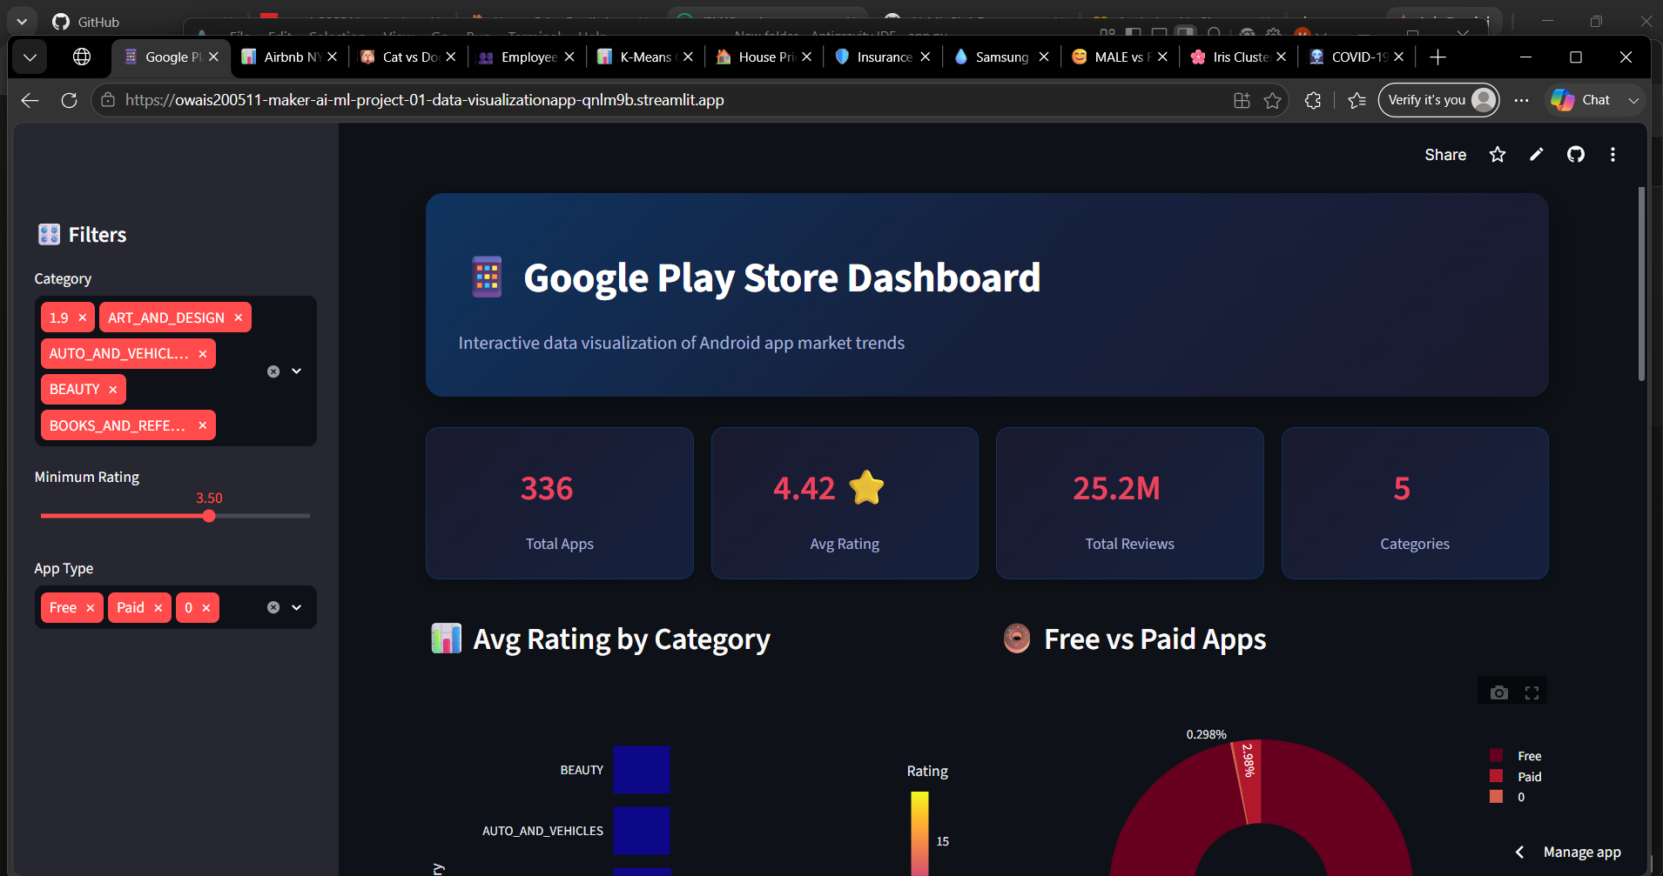
DATA VISUALIZATION
PROJECT 01 OF 11
Google Play Store Data Visualization
Interactive dashboard to explore Android app market trends, user ratings, and installations
KEY FEATURES
- Analyzes app sizes, ratings, pricing, and category distribution. - Interactive sidebar filters for categories, app type, and ratings. - Polished visualizations using dynamic Plotly charts.
TECH STACK Streamlit, Plotly, Pandas, NumPy

Slide 3
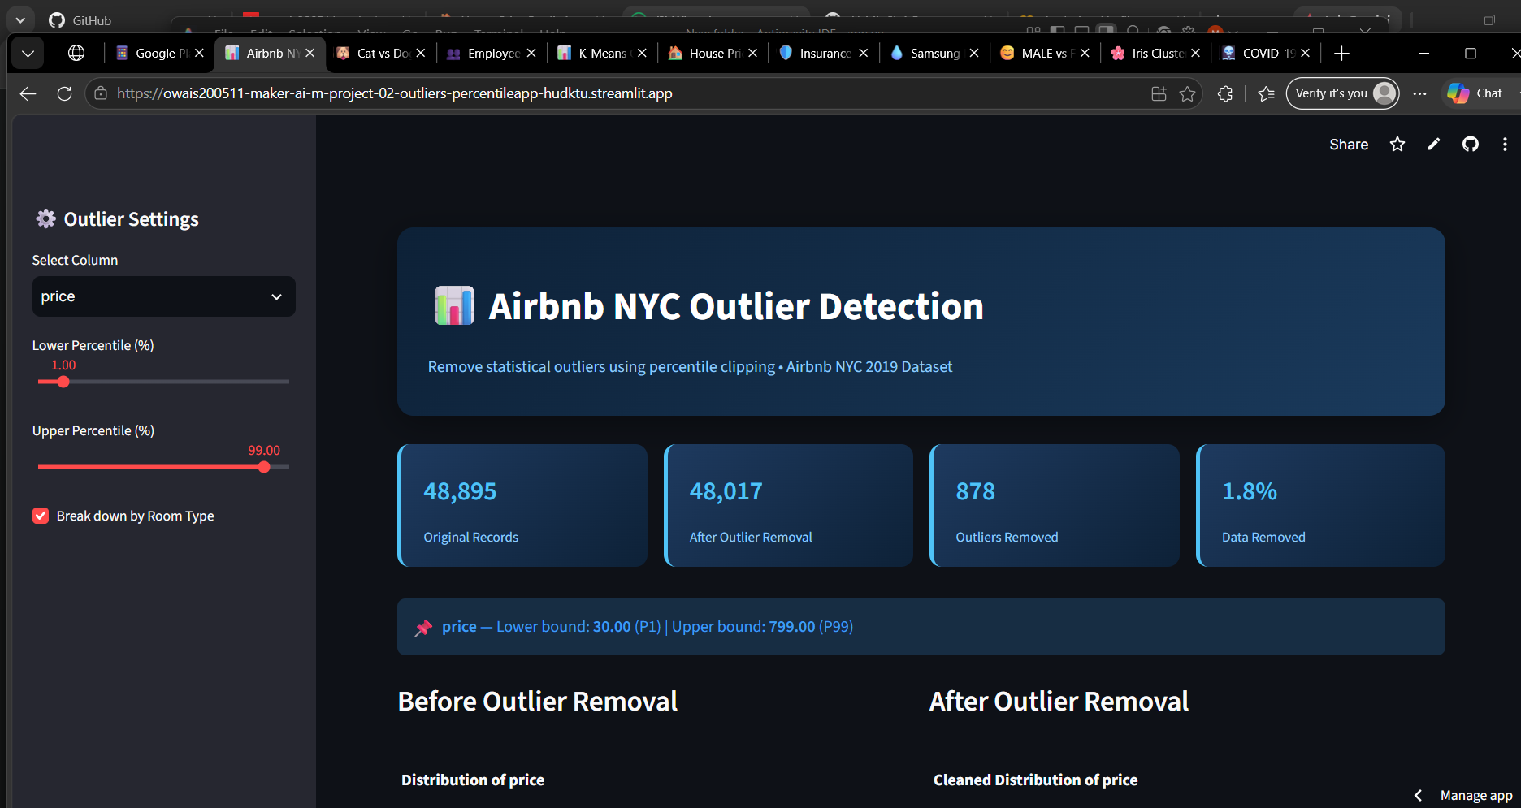
DATA CLEANING
PROJECT 02 OF 11
Airbnb NYC Outliers Percentile Clipping
Statistical data cleaning dashboard that detects and filters outliers in NYC housing listing prices
KEY FEATURES
- Interactive percentile sliders (e.g., P1 to P99 clipping). - Compares data distributions before and after outlier removal. - Geographical map visualizations of listing locations.
TECH STACK Streamlit, Plotly, Pandas, NumPy

Slide 4
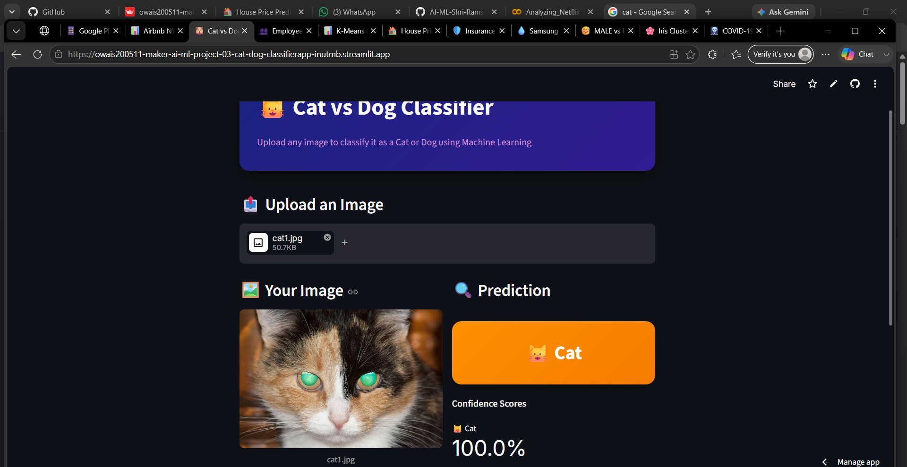
COMPUTER VISION
PROJECT 03 OF 11
Cat vs Dog Image Classifier
Computer Vision app classifying uploaded images of cats and dogs using machine learning
KEY FEATURES
- Drag-and-drop file uploader for JPG/PNG images. - SVM classifier trained on image features with standard scaling. - Displays real-time confidence scores and probability break-downs.
TECH STACK Streamlit, Scikit-learn, PIL, NumPy

Slide 5
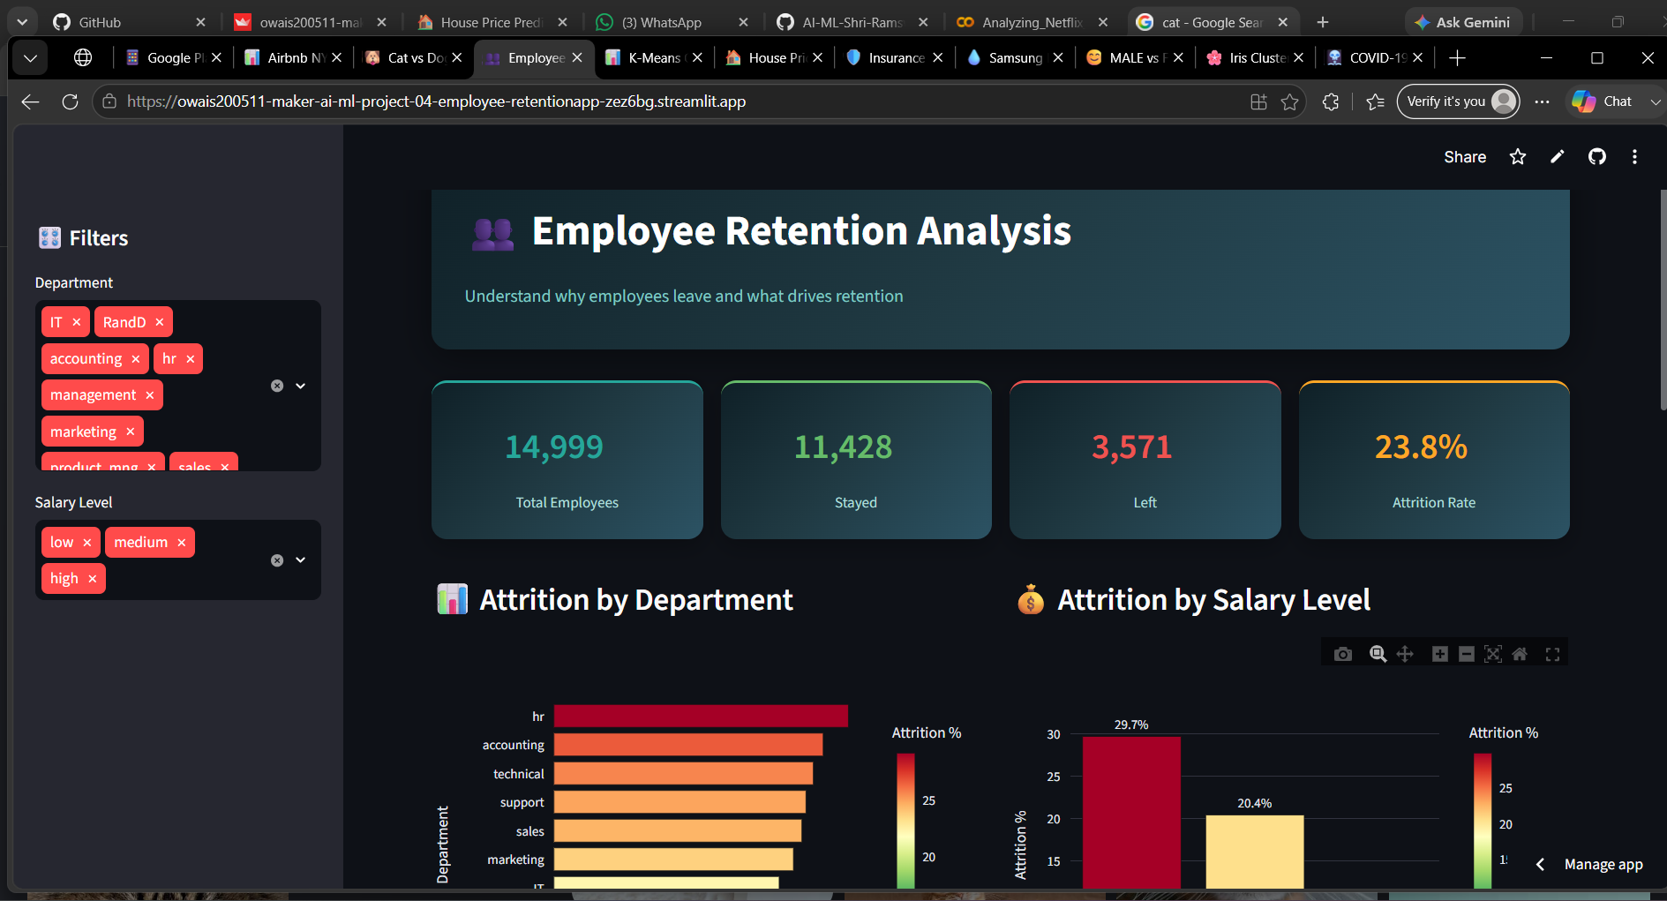
HR ANALYTICS
PROJECT 04 OF 11
Employee Retention Analysis
Human Resources analytics platform investigating factors driving employee resignation rates
KEY FEATURES
- Departmental attrition analysis showing which roles have highest turnover. - Salary level comparisons highlighting the impact of compensation. - Interactive filtering widgets for tailored exploration of data.
TECH STACK Streamlit, Plotly, Pandas, NumPy

Slide 6
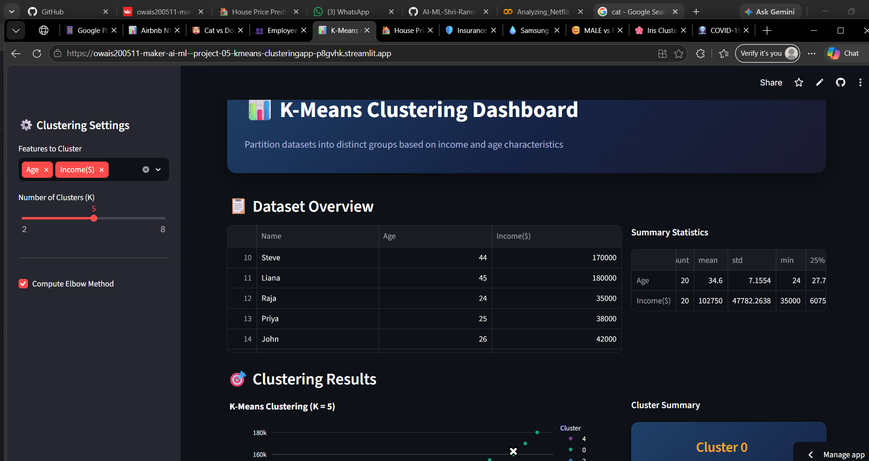
UNSUPERVISED ML
PROJECT 05 OF 11
K-Means Income Clustering
Unsupervised learning app grouping customers into distinct demographic segments based on age and income
KEY FEATURES
- Dynamic cluster count selector (K slider) for rapid iteration. - Elbow method chart built-in for finding optimal cluster count. - Interactive scatter plots visualizing cluster centroids.
TECH STACK Streamlit, Scikit-learn, Plotly, Pandas

Slide 7
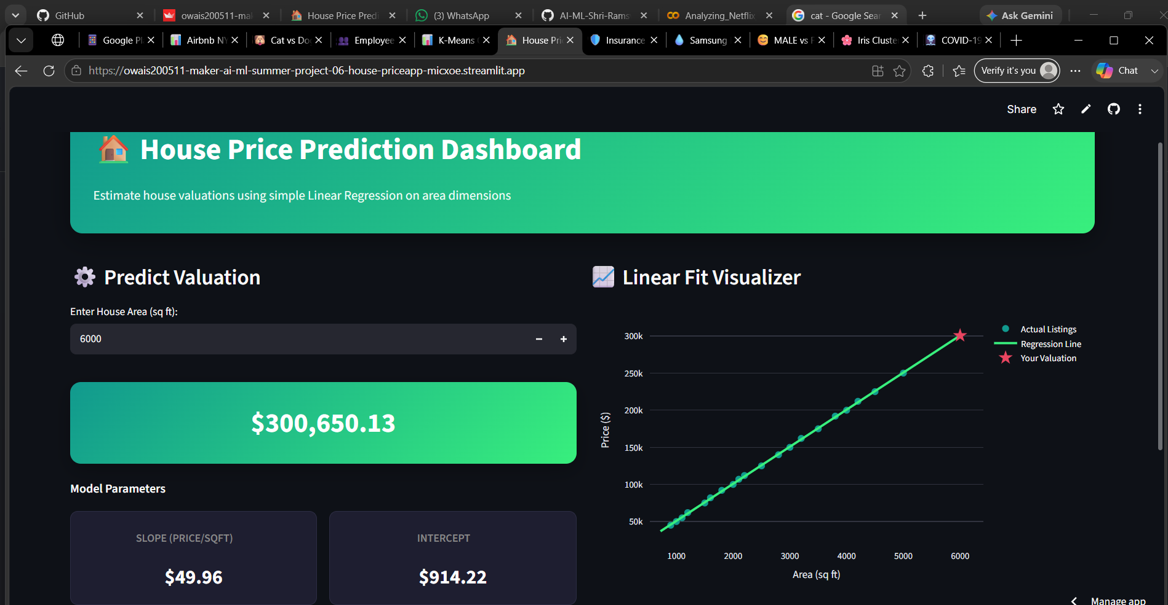
SUPERVISED ML
PROJECT 06 OF 11
House Price Prediction
Predictive modeling application estimating real estate valuations based on square footage
KEY FEATURES
- Interactive area input box with instantaneous prediction response. - Real-time linear regression line fitting to visualize trends. - Displays slope and intercept parameters for mathematical transparency.
TECH STACK Streamlit, Scikit-learn, Plotly, Pandas

Slide 8
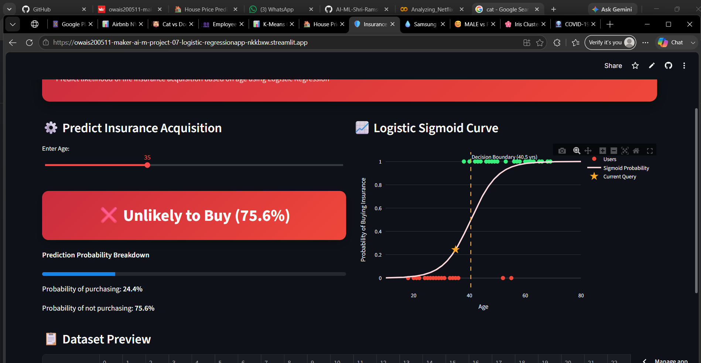
SUPERVISED ML
PROJECT 07 OF 11
Insurance Logistic Regression
Classification model predicting whether a customer will purchase insurance based on age
KEY FEATURES
- Probability sigmoid curve visualization mapping predictions. - Decision boundary locator at 40.5 years shown on the graph. - Interactive age input slider with probability estimation.
TECH STACK Streamlit, Scikit-learn, Plotly, Pandas

Slide 9
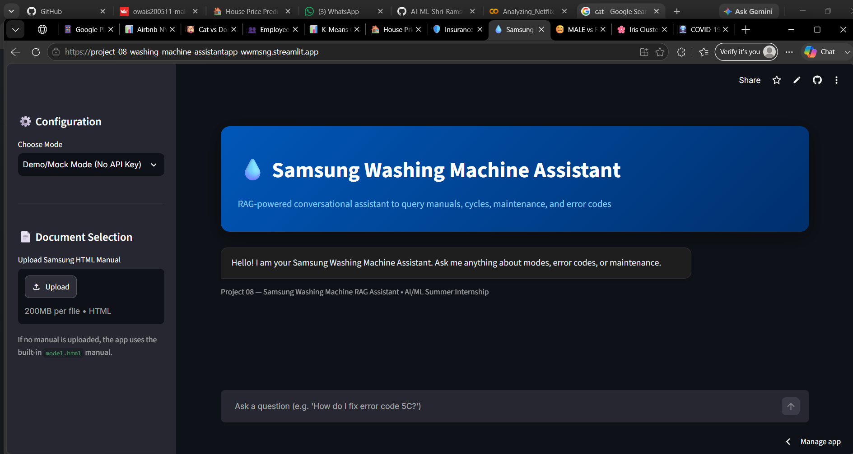
NLP & LLM
PROJECT 08 OF 11
Samsung Washing Machine Assistant
AI-powered conversational assistant answering questions about user manuals
KEY FEATURES
- PDF/HTML manual ingestion for custom context retrieval. - Contextual conversational Q&A system powered by LLMs. - Built-in demo/mock mode fallback for offline testing without API keys.
TECH STACK Streamlit, LangChain, OpenAI, Chromadb

Slide 10
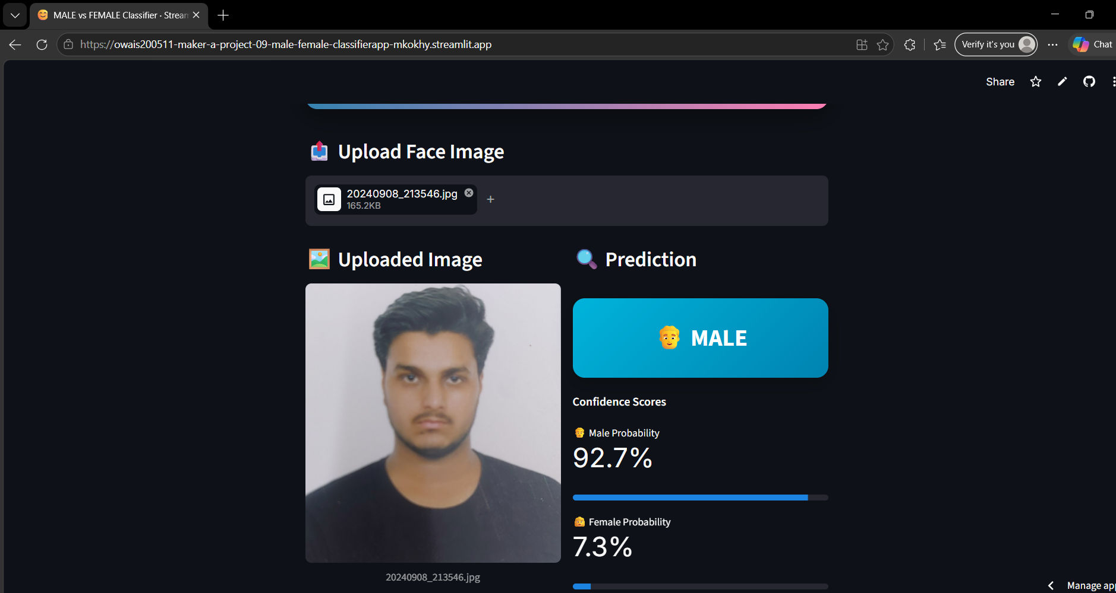
DEEP LEARNING
PROJECT 09 OF 11
Male vs Female Classifier
High-accuracy face classification app identifying gender from uploaded photos
KEY FEATURES
- DeepFace CNN architecture utilizing pre-trained deep learning. - Bypasses external cascades via skip-detection mode for robust hosting. - Real-time confidence scores for Male/Female classification.
TECH STACK Streamlit, DeepFace, TensorFlow, OpenCV

Slide 11
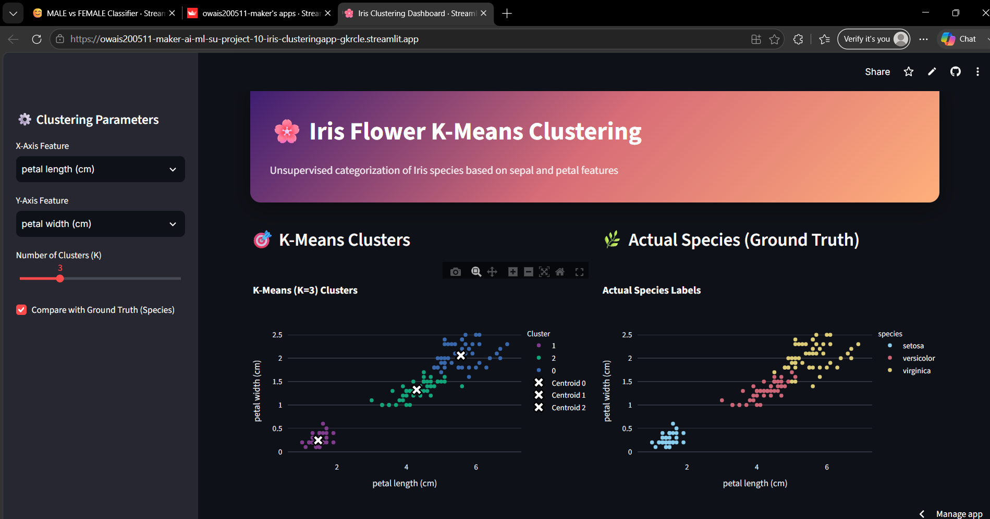
UNSUPERVISED ML
PROJECT 10 OF 11
Iris Flower K-Means Clustering
Classic ML clustering visualization analyzing the biological features of Iris flowers
KEY FEATURES
- Pair-wise feature selection dropdowns for sepal/petal dimensions. - Side-by-side comparison of K-Means clusters and actual species. - Dynamic centroids mapped to scatter plot in real-time.
TECH STACK Streamlit, Scikit-learn, Plotly, NumPy

Slide 12
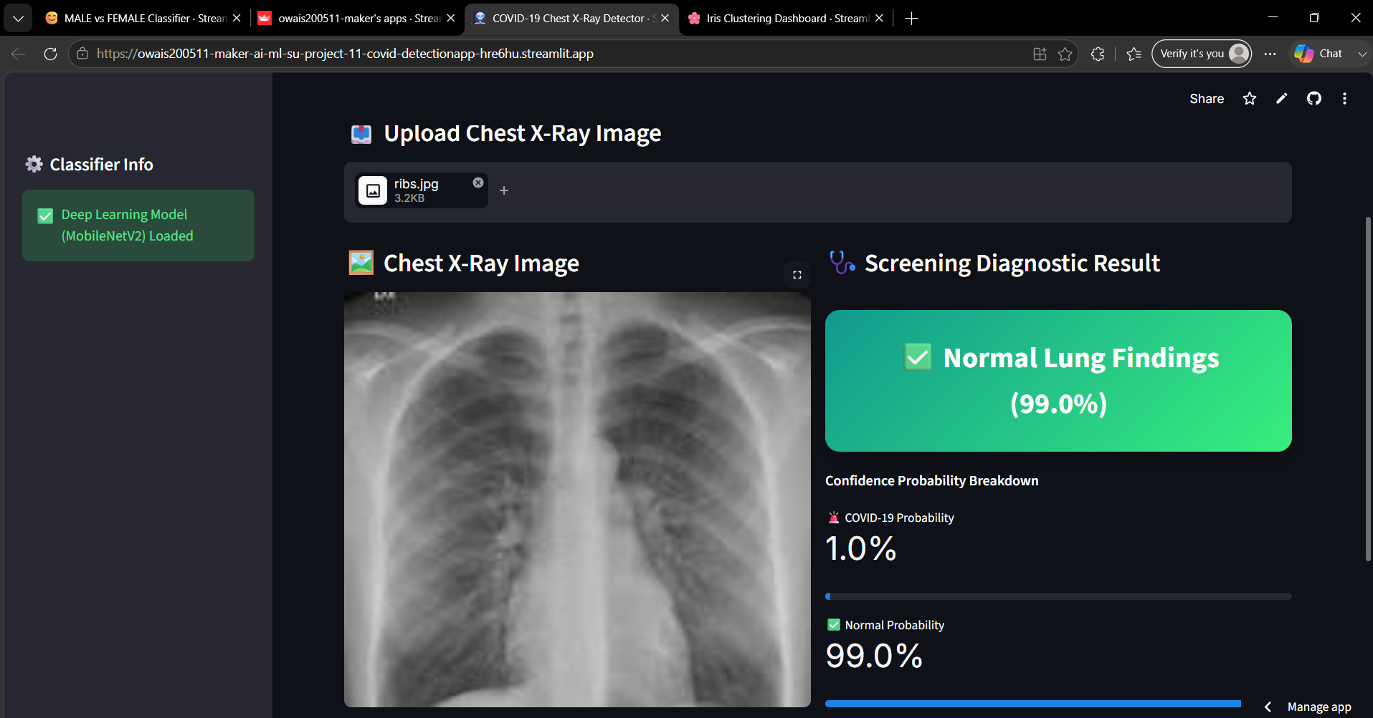
DEEP LEARNING
PROJECT 11 OF 11
COVID-19 Chest X-Ray Detector
Medical imaging diagnostic app scanning chest X-rays to detect potential COVID-19 infection
KEY FEATURES
- ResNet/MobileNet deep feature extraction architecture. - Medical scan viewer showing probability breakdown. - Visual progress bar showing clinical probability of COVID-19 vs Normal.
TECH STACK Streamlit, TensorFlow, Keras, PIL

Slide 13
Thank You!
All 11 Streamlit apps are successfully deployed and functional. Ready for final presentation and grading.

