Slide 1
FULL PROJECT WALKTHROUGH
Campus Coin
NextGen BudgetBee — Student Budget Tracker
TEAM BOMBERS
Muhammad Bilawal · Muhammad Owais · Muhammad Esam · Muhammad Muneeb · Syed Haider
A complete MERN-style full-stack app: Next.js 14 client + Express MVC API + MongoDB Atlas + Socket.IO live alerts + AI (Groq / rule-based fallback).
Every controller, model, service, page and feature — described in one deck.
Next.js 14
React 18
Tailwind CSS
Express 4
Mongoose 8
MongoDB Atlas
JWT + OTP
Client :3000 · API :5000 · github.com/owais2507d-alt/MAlik_Owais_Campus_Coim
Campus Coin · NextGen BudgetBee — Full Project Walkthrough
1 / 26

Slide 2
CAMPUS COIN · TEAM BOMBERS
Meet the Team
B
O
E
M
H
MUHAMMAD BILAWAL
MUHAMMAD OWAIS
MUHAMMAD ESAM
MUHAMMAD MUNEEB
SYED HAIDER
Project Lead
Full-Stack Dev
Tester
Frontend Dev
QA & Docs
Backend & database
API architecture, models,
seeds & Atlas setup
Categorize, insights,
BudgetBee chat,
tips engine
Auth, OTP, admin panel
ngrok tunnel + deployment
GitHub / integration
Testing and Presentation
Dashboard, reports
charts, budgets UI,
dark theme
Playwright E2E suite,
requirement coverage,
project docs
Campus Coin · NextGen BudgetBee — built end-to-end by Team Bombers
Campus Coin · NextGen BudgetBee — Full Project Walkthrough
2 / 26

Slide 3
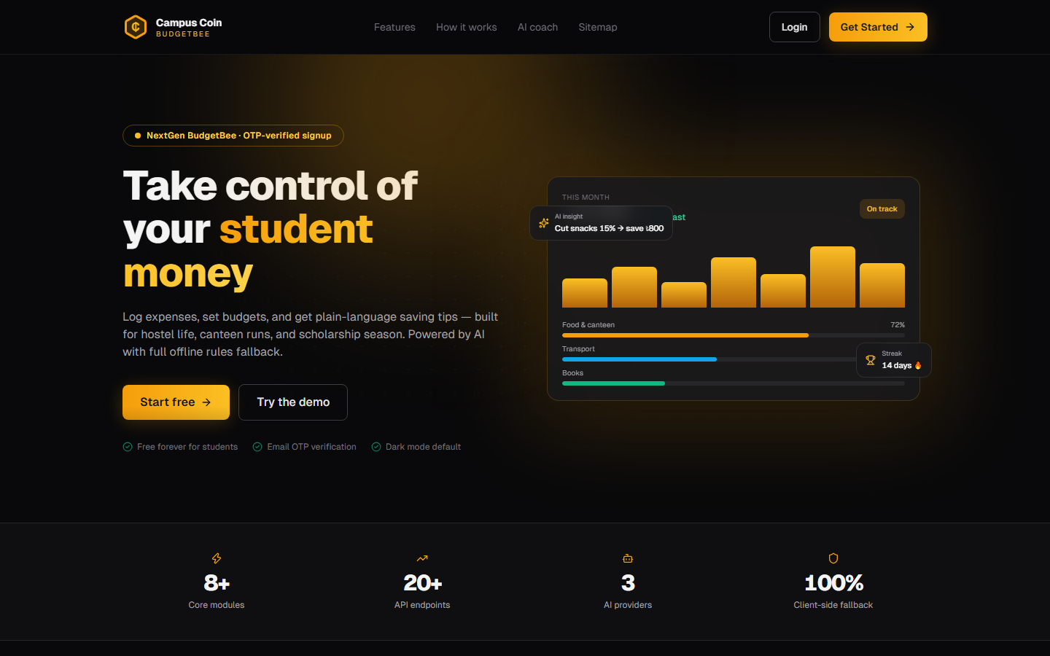
CAMPUS COIN
What is Campus Coin?
🎯 Purpose
Budget / expense tracker built for college & university students — fast income/expense logging, student-relevant categories, per-category monthly budgets with alerts, saving tips, monthly reports with PDF export, and an AI layer.
👥 Two roles
Student — dashboard, transactions, budgets, reports, tips, AI chat
Admin — stats, manage users / system categories / announcements
⚡ Highlights
• OTP email registration (dev shows code)
• JWT httpOnly cookies, auto refresh on 401
• Live budget alerts over WebSocket
• AI categorize + monthly insights + chatbot
• CSV import, PDF export, dark mode, streaks
Campus Coin · NextGen BudgetBee — Full Project Walkthrough
3 / 26

Slide 4
CAMPUS COIN
System Architecture — How It All Connects
BROWSER (Next.js :3000)
EXPRESS API (:5000)
MONGODB ATLAS
• App Router pages + route guards
• Zustand stores (auth/ui/notifs)
• lib/api.js fetch wrapper (cookies)
• socket.io-client live events
• Tailwind + Framer Motion UI
app.js → CORS → helmet → rate-limit
→ /api/v1 router
routes/ (14 files) → validate(Zod)
→ protect / adminOnly
→ controllers/ (11 files)
→ models (Mongoose) + services/
socket.io on same HTTP server
rooms: user:{id}
events: notification:new,
budget:updated, tx:created,
announcement:new
• 10 models: User, Transaction,
Category, Budget, Tip, Insight,
Notification, Bookmark,
Announcement, PendingReg
• Fallback: local → memory server
AI PROVIDERS (optional)
SEEDS ON BOOT
• Groq (llama-3.3-70b) primary
• OpenRouter fallback
• Local keyword rules always work
• Categorize / Insights / Chat
• 12 system categories
• admin@campuscoin.app
• demo@campuscoin.app
• idempotent (skip if exists)
Campus Coin · NextGen BudgetBee — Full Project Walkthrough
4 / 26

Slide 5
CAMPUS COIN
Project Structure
server/ — Express ESM API
client/ — Next.js 14 App Router
server/src/
├─ app.js · server.js boot + middleware stack
├─ config/ env · db · socket
├─ routes/ 14 files → /api/v1/*
├─ controllers/ 11 *.controller.js
├─ models/ 10 Mongoose schemas
├─ services/ tipsEngine · budgetAlerts
│ notify · ai/{categorize,
│ insight, chat, provider,
│ financeContext}
├─ middlewares/ protect · validate
│ rateLimit · error
├─ validators/ auth.validators (Zod)
├─ seeds/ categories · users · seed
└─ utils/ apiError · token · response
client/src/
├─ app/
│ ├─ page.js landing
│ ├─ (auth)/ login · register
│ │ forgot/reset-password
│ └─ (dashboard)/ dashboard,
│ transactions{,new,import,edit},
│ budgets · categories · reports,
│ tips · insights · bookmarks,
│ profile · admin{,users,
│ categories,announcements}
├─ components/ layout · ui · auth · ai
├─ store/ auth · ui · notifications
├─ hooks/ useSocket (WS singleton)
└─ lib/ api.js · utils · confetti
Campus Coin · NextGen BudgetBee — Full Project Walkthrough
5 / 26

Slide 6
CAMPUS COIN
Authentication Flow — OTP Register → JWT Session
1
REQUEST OTP
2
VERIFY + CREATE
3
LOGIN
4
REFRESH (auto)
POST /auth/request-otp
name, email, password,
academicYear, savingsGoal
→ bcrypt hash (cost 12)
→ 6-digit OTP (sha256)
→ PendingRegistration
TTL 10 min, 5 attempts
→ devOtp returned in dev
POST /auth/register
email + otp
→ check expiry/attempts
→ User.create()
→ seed 12 categories
→ set cookies
→ 201 + user + tokens
POST /auth/login
→ isActive check
→ bcrypt compare
→ loginStreak (days)
→ cookies:
accessToken 15m /
refreshToken 7d
Any 401 in lib/api.js
→ POST /auth/refresh
(refresh cookie only
scoped /auth path)
→ re-issue both JWTs
→ retry original request
SECURITY DETAILS
Cookies: httpOnly + sameSite=lax; access token path=/ (15 min), refresh path=/api/v1/auth (7 d) so it never leaks to other routes.
Roles: JWT claim {sub, role, email} → protect middleware → adminOnly = requireRole('admin') guards ALL /admin routes. Client layout also redirects non-admins away from /admin*.
Rate limits: authLimiter 30 req/15 min on auth endpoints · apiLimiter 500 req/15 min on /api · Zod validate() on every body · password reset = sha256 token, 30-min expiry.
Campus Coin · NextGen BudgetBee — Full Project Walkthrough
6 / 26

Slide 7
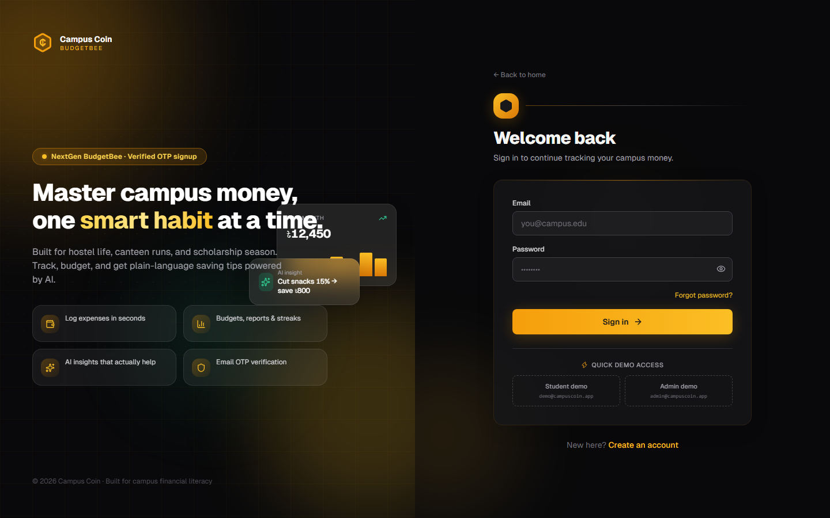
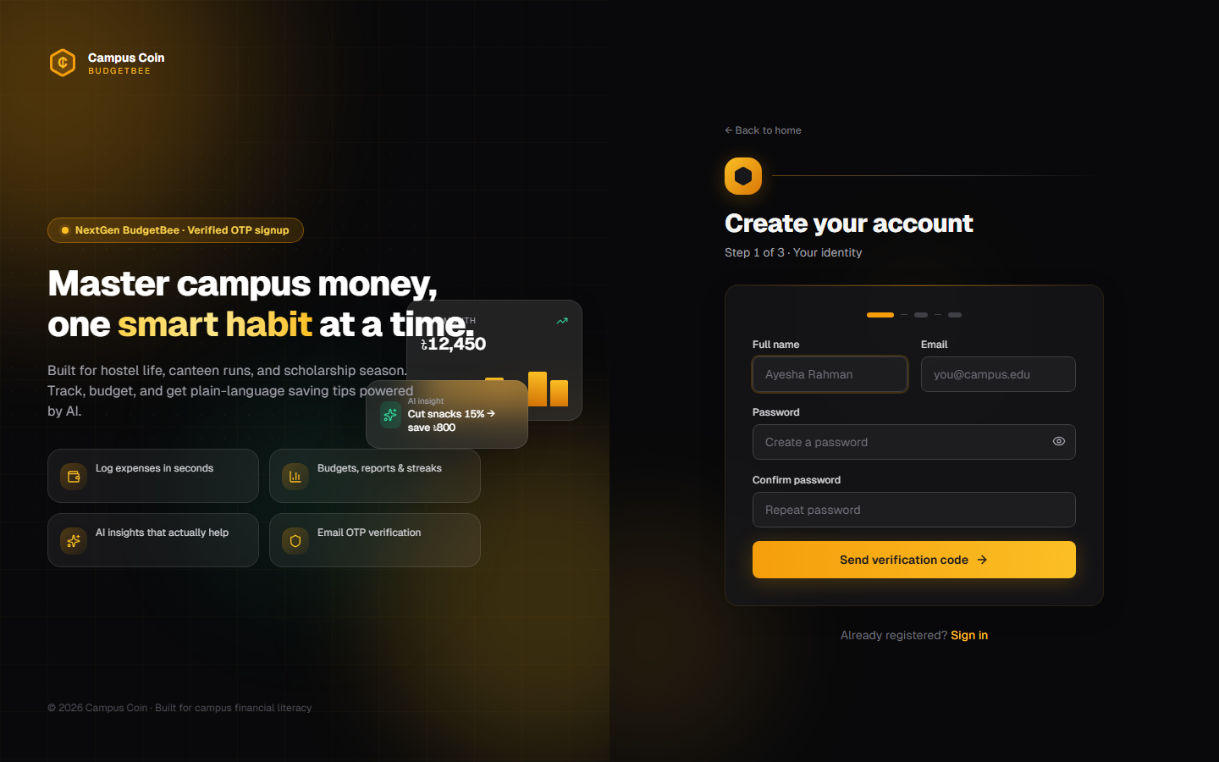
CAMPUS COIN
Auth Screens — Login & 3-Step OTP Registration
Login — demo fill buttons, role-based redirect
Register — wizard with 6-box OTP
• Student → /dashboard · Admin → /admin
• Show/hide password, ?next= deep link
• Demo: admin@campuscoin.app / Admin@123
• demo@campuscoin.app / Demo@123
• Step 1 identity → Step 2 OTP → Step 3 money profile
• Password strength meter + confetti
• OTP shown as devOtp (no SMTP yet)
• Optional: allowance, savings goal, currency
Campus Coin · NextGen BudgetBee — Full Project Walkthrough
7 / 26

Slide 8
CAMPUS COIN
API Request Lifecycle
HTTP Request
CORS
helmet + JSON
apiLimiter
/api/v1 router
validate(Zod)
protect / adminOnly
controller
fetch with
credentials:
'include'
origin allowlist
localhost:3000/3001
credentials:true
security headers
1 MB body limit
cookie-parser
500 req / 15 min
429 when exceeded
route file picks
method + path
schema check →
400 errors[] or
req.body replaced
JWT from cookie
or Bearer header
req.user set
business logic →
Mongoose + services
→ sendSuccess()
RESPONSE ENVELOPE (utils/response.js)
ERROR HANDLER (middlewares/error.js)
success: true | false
message: "Logged in" | "Invalid email..."
data: { user, accessToken, ... }
errors: ["email: Required"] (Zod)
stack: shown only in development
// controller pattern
return sendSuccess(res, {…}, "OK");
throw ApiError.unauthorized("…");
Mongoose ValidationError → 400
CastError (bad ObjectId) → 400
duplicate key 11000 → 409
ApiError.* → its status
everything else → 500
// notFound → 404 for unmatched
// logs stack unless NODE_ENV=test
Campus Coin · NextGen BudgetBee — Full Project Walkthrough
8 / 26

Slide 9
CAMPUS COIN
Route Map — All Endpoints (/api/v1)
Router | Endpoints (method path) | Guard
auth | POST request-otp · register · login · logout · refresh · forgot-password · reset-password · GET me | public / protect
users | GET users · PATCH users · PATCH users/password | protect
categories | GET · POST · PATCH :id · DELETE :id (support ?type=income|expense) | protect
transactions | GET list (filters+page) · POST · GET/:id · PATCH/:id · DELETE/:id · POST import | protect
budgets | GET (?month) · POST upsert · DELETE :id | protect
dashboard | GET dashboard → one aggregated payload | protect
reports | GET category · trend · daily-weekly · filtered | protect
tips | GET list · POST refresh · PATCH :id/status | protect
bookmarks | GET · POST toggle · DELETE :id | protect
notifications | GET · PATCH read-all · PATCH :id/read | protect
admin | GET stats/users/categories/announcements · CRUD users, system categories, announcements | adminOnly
ai | GET status · insights · insight-stats/:month · POST categorize · categorize-batch · insight/:month · chat | protect
announcements | GET / (active, latest 10) | public
Campus Coin · NextGen BudgetBee — Full Project Walkthrough
9 / 26

Slide 10
CAMPUS COIN
Controllers (1/2) — What Each One Does
Controller | Exported handlers | Responsibility
auth.controller | requestOtp, register, login, logout, refresh, me, forgotPassword, resetPassword | OTP pending store, bcrypt verify, loginStreak, setAuthCookies (access 15m + refresh 7d), sha256 reset tokens
user.controller | getProfile, updateProfile, updatePassword | Whitelisted profile fields (name, year, allowance, goal, currency, theme, fontSize), password change
category.controller | list, create, update, delete | User + system defaults merge, duplicate-name 409, blocks deleting category used by txs
transaction.controller | list, get, create, update, delete, importTransactions | Filters + pagination, AI auto- categorize when no categoryId, checkBudgetAlerts on expense, tx:created socket, bulk CSV
Pattern: every handler is asyncHandler-wrapped — thrown ApiError bubbles to errorHandler; responses always use sendSuccess/sendError envelope.
Campus Coin · NextGen BudgetBee — Full Project Walkthrough
10 / 26

Slide 11
CAMPUS COIN
Controllers (2/2) — Dashboard, Reports, Admin
Controller | Exported handlers | Responsibility
budget.controller | listBudgets, upsertBudget, deleteBudget | Per (user, category, month) upsert, spent% aggregation, budget:updated socket, notifications
dashboard.controller | getDashboard | Single Promise.all aggregation: income/expense/balance, topCategory, recent tx, pinned tips, unread notifs, budgets w/ %, 180-day trend
report.controller | categoryReport, sixMonthTrend, dailyWeeklySummary, filteredReport | Donut data, 6-month line, daily + ISO-week bars, arbitrary filter → byCategory + totals + transactions
tip.controller / bookmark / notification | list, refresh, status; toggle; list, markRead, markAllRead | tipsEngine.generateTips() recompute, pin/dismiss, bookmark toggle (Tip|Insight), unread count
admin.controller | getStats, listUsers, toggle, resetPwd, deleteUser, CRUD default categories + announcements | Platform stats + top categories, user search/disable/delete, system category CRUD, announcement broadcast
Campus Coin · NextGen BudgetBee — Full Project Walkthrough
11 / 26

Slide 12
CAMPUS COIN
Data Model — 10 Mongoose Schemas
Model | Key fields | Indexes / notes
User | name, email(uniq), password(bcrypt 12), role student|admin, academicYear, allowanceBaseline, savingsGoal, currency, theme, fontSize, isActive, loginStreak, lastLoginAt | email unique; toSafeJSON() hides password
PendingRegistration | profile copy + otpHash(sha256), otpExpires, attempts | TTL index on otpExpires (auto-purge 10 min)
Category | userId(null=system), name, type income|expense, icon, color, isDefault | (userId,type), (userId,name,type)
Transaction | userId, type, amount≥0.01, categoryId, note, date, isRecurring, recurringDay 1–31, aiSuggested, userCorrectedCategory, flags[] | (userId,date), (userId,categoryId,date)
Budget | userId, categoryId, month YYYY-MM, limit≥0 | UNIQUE (userId,categoryId,month)
Tip / Insight / Bookmark | Tip: title, body, impactScore, status Insight: month, narrative, flags, meta (AI cache) Bookmark: refModel Tip|Insight, refId, title, snippet | Insight UNIQUE (user, month) Bookmark UNIQUE (user, ref)
Notification / Announcement | Notification: userId, type enum, title, message, read Announcement: title, body, active (global) | (userId, read, createdAt)
Campus Coin · NextGen BudgetBee — Full Project Walkthrough
12 / 26

Slide 13
CAMPUS COIN
Server Services — Tips Engine, Budget Alerts, Notify
💡 tipsEngine.js
🔔 budgetAlerts.js
📡 notify.js + socket
generateTips(userId) compares
this month vs last month:
• Category spend up >20%
→ "Food spending up 40%"
impact = rise % (cap 100)
• Top spend category
→ impact = min(90, total/100)
• Budget >70% used
→ impact 85
• Savings rate <20% (3 mo)
→ impact 95
Ranked by impactScore, top 6
upserted by (userId, title);
pinned/dismissed never overwritten
→ GET /tips · POST /tips/refresh
checkBudgetAlerts(user, cat, date)
runs after every expense create/
update/import:
• find budget (cat + month)
• aggregate month-to-date spend
• pct = spent / limit
• emit budget:updated (socket)
pct ≥ 100 → 'Budget exceeded'
level: exceeded (deduped)
pct ≥ 80 → 'Budget warning'
level: warning (regex dedup)
Never throws — logs + returns []
→ fires Notification + toast/badge
notifyUser(id, {type, title,
message}):
→ Notification.create
→ emit notification:new
to room user:{id}
broadcastNotification(…):
→ insertMany for every
active user
→ emit to each room
→ emitToAll
announcement:new
socket.js:
handshake must carry valid
access JWT, else Unauthorized
join user:{userId} room
Campus Coin · NextGen BudgetBee — Full Project Walkthrough
13 / 26

Slide 14
CAMPUS COIN
AI Layer — Categorize · Insights · BudgetBee Chat
🏷 aiCategorize
🐝 BudgetBee Chat
🔌 provider.js
Typing a note on New Transaction
→ debounced POST /ai/categorize
→ LLM constrained to your real
category names (temp 0.1, 8s)
→ fallback: 10 keyword rules
(cafe→Food, uber→Transport…)
→ badge "AI suggested"; manual
edit clears the flag
Floating widget (students only)
POST /ai/chat {message, history}
Resolution order:
1) financial intent?
buildFinanceContext():
safe-to-spend, daily burn,
budget rows, goal progress
→ rule verdict FIRST
(buy/wait/not this month)
→ LLM polishes (fallback: rules)
2) FAQ matcher (9 entries)
3) general LLM + month stats
4) static help text
History in localStorage,
source badge on each reply
llmChat(messages, opts):
1. Groq
llama-3.3-70b-versatile
(GROQ_API_KEY)
2. OpenRouter
claude-3.5-haiku
(OPENROUTER_API_KEY)
3. throw → callers use rules
Status: GET /ai/status →
{groq, openrouter, mode}
Current .env has no keys
→ runs rules-only, no crash
📊 aiInsight
buildMonthStats() → income,
expense, byCategory, flags
(rises >20%, budget exceeded)
→ LLM 3–5 sentence narrative
→ rule-template fallback
→ cached in Insight (user,month)
→ GET /ai/insights = 12-mo
history on Insights page
Campus Coin · NextGen BudgetBee — Full Project Walkthrough
14 / 26

Slide 15
CAMPUS COIN
Realtime — Socket.IO Event Flow
SERVER → CLIENT events
CLIENT — useSocket() + stores
Event | Emitted from | Payload
notification:new | notifyUser / broadcast | Notification doc
budget:updated | budgetAlerts · budget ctrl | {catId, month, spent, limit, %}
announcement:new | broadcastNotification | {title, message}
tx:created | createTransaction | {id}
hooks/useSocket.js
• singleton io(NEXT_PUBLIC_WS_URL)
• connects after login with JWT
• on notification:new →
notificationStore.pushLive(n)
+ Toaster toast (warning if
type == budget_alert)
• on announcement:new → reload
announcement banner
• returns { connected, on, socket }
Topbar live dot = connected state
(breathing emerald indicator)
Notifications store: items (cap 50),
unread badge, mark-all-read API,
60s poll fallback + WS refresh.
Handshake auth: socket.auth.token
= accessToken (store / sessionStorage)
Invalid → connection rejected.
Rooms: user:{userId} — emitToUser
targets only that user's sockets.
connect() only when logged in.
Campus Coin · NextGen BudgetBee — Full Project Walkthrough
15 / 26

Slide 16
CAMPUS COIN
Client Pages — Full Route Map
Route | Page | What it does
/ | Landing | Marketing hero, features, testimonials, visual sitemap tree
/login · /register · /forgot · /reset | Auth | OTP wizard, strength meter, dev reset link on screen
/dashboard | Home | Greeting, balance/income/expense cards, budgets vs actual, recent tx, pinned tips, streak, announcements, confetti on goal
/transactions · /new · /import · /[id]/edit | Transactions | Filterable list; AI live category suggest; CSV map→categorize→import
/budgets · /categories | Money | Progress bars + month picker; personal + system categories CRUD
/reports | Reports | Recharts donut + 6-month line + daily/weekly bars + PDF export
/tips · /insights · /bookmarks | AI & saving | Pin/dismiss tips; monthly narrative + history; saved items
/profile | Account | Edit profile, currency, change password, logout
/admin · /users · /categories · /announcements | Admin | Stats, user management, system categories, broadcast announcements
Campus Coin · NextGen BudgetBee — Full Project Walkthrough
16 / 26

Slide 17
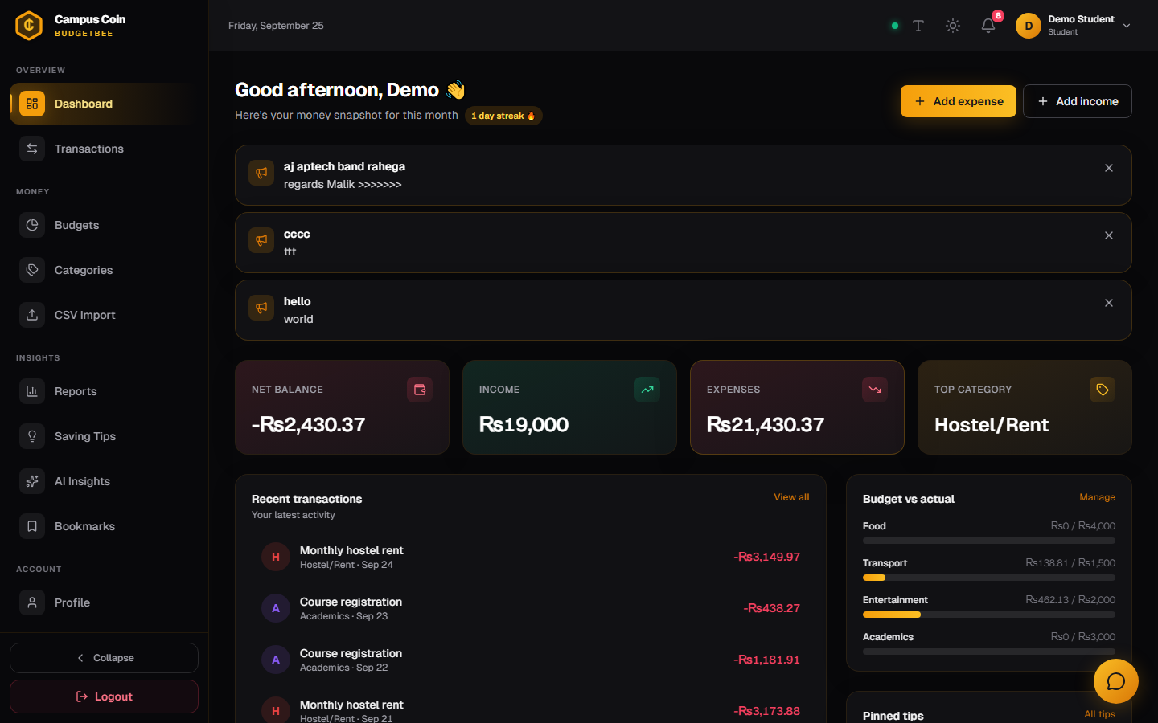
CAMPUS COIN
Dashboard — Student Home
BUILT FROM ONE API CALL
GET /dashboard returns:
• time-based greeting
• balance / income / expense
• top expense category
• 6 recent transactions
• 3 pinned tips
• 10 unread notifications
• budgets + spent %
• 180-day income/expense trend
UI extras:
• login streak badge 🔥
• announcement banner
• confetti when savings goal
is reached
• quick-add action cards
Campus Coin · NextGen BudgetBee — Full Project Walkthrough
17 / 26

Slide 18
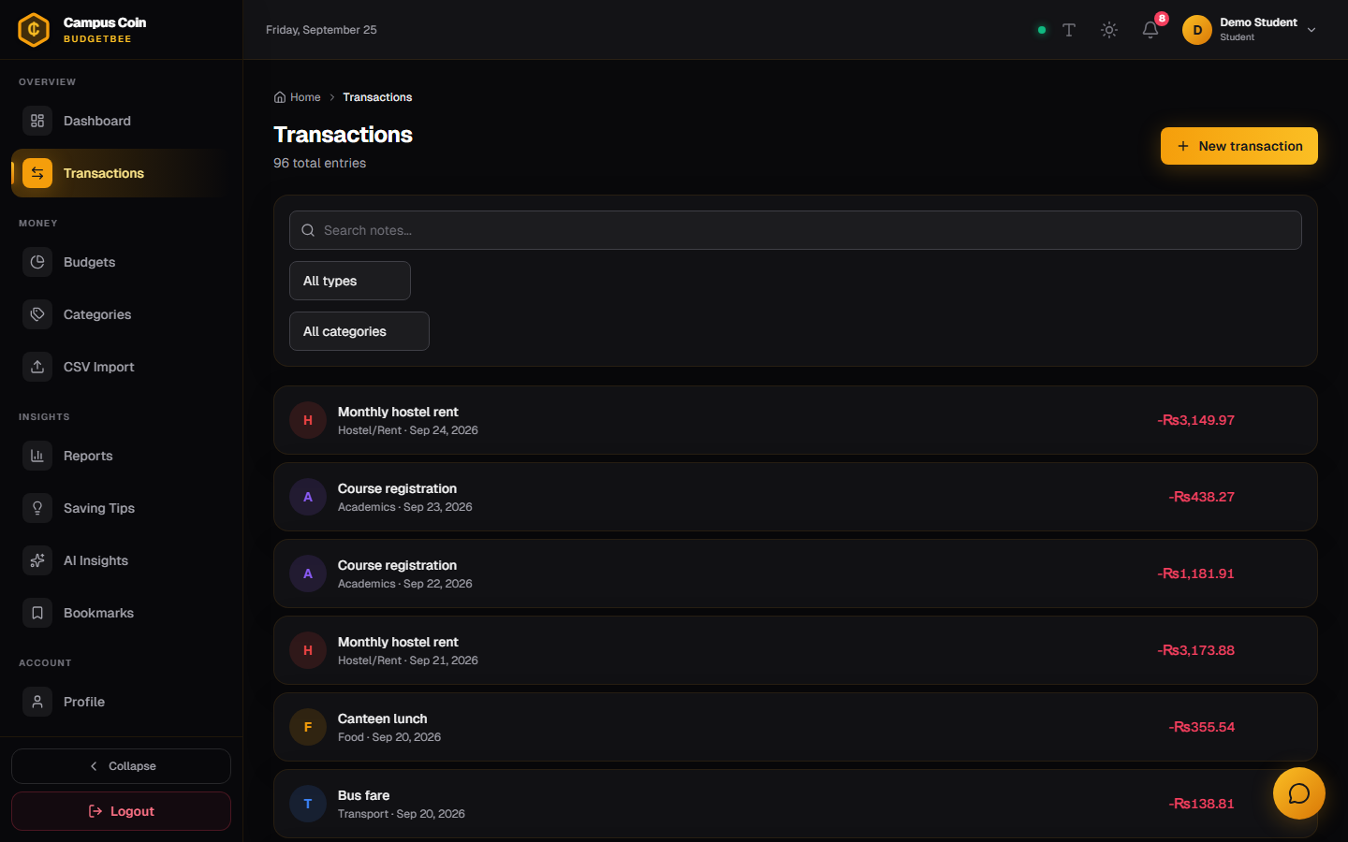
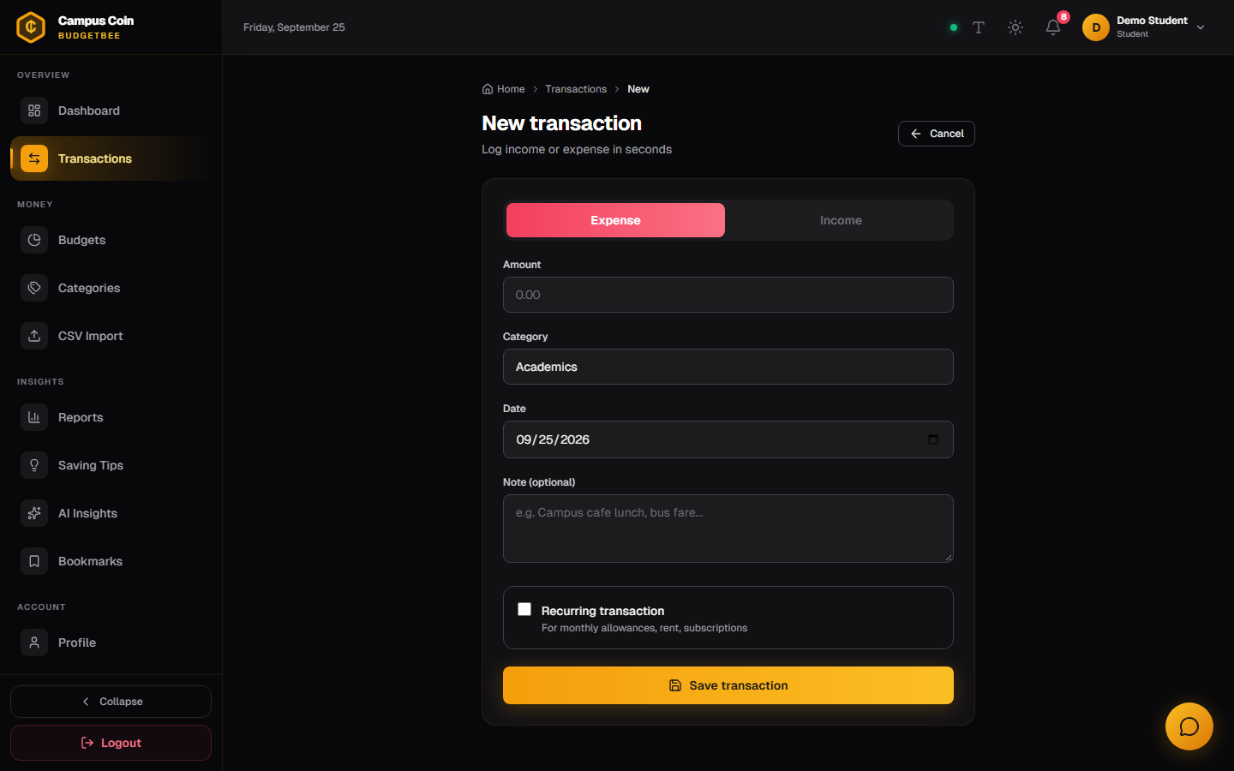
CAMPUS COIN
Transactions — List, AI Quick-Add, CSV Import
List — filters, pagination, edit/delete
New — live AI category suggestion
• type / category / date-range / text search
• recurring badge, populated category chip
• confirm dialogs on delete
• PATCH /transactions/:id clears aiSuggested on manual category change
• type a note → debounced POST /ai/categorize
• honey badge: “AI suggested”
• recurring toggle + day of month (1–31)
• expense triggers budget alert check + socket
Campus Coin · NextGen BudgetBee — Full Project Walkthrough
18 / 26

Slide 19
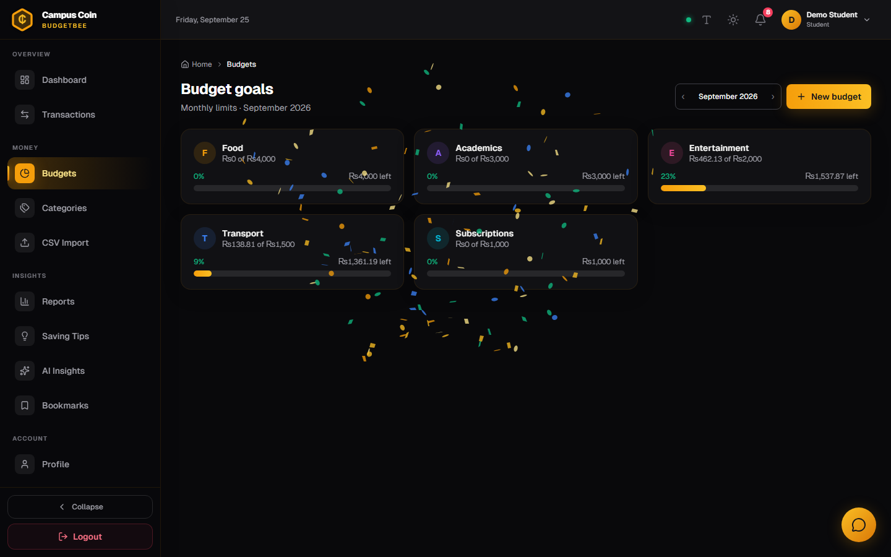
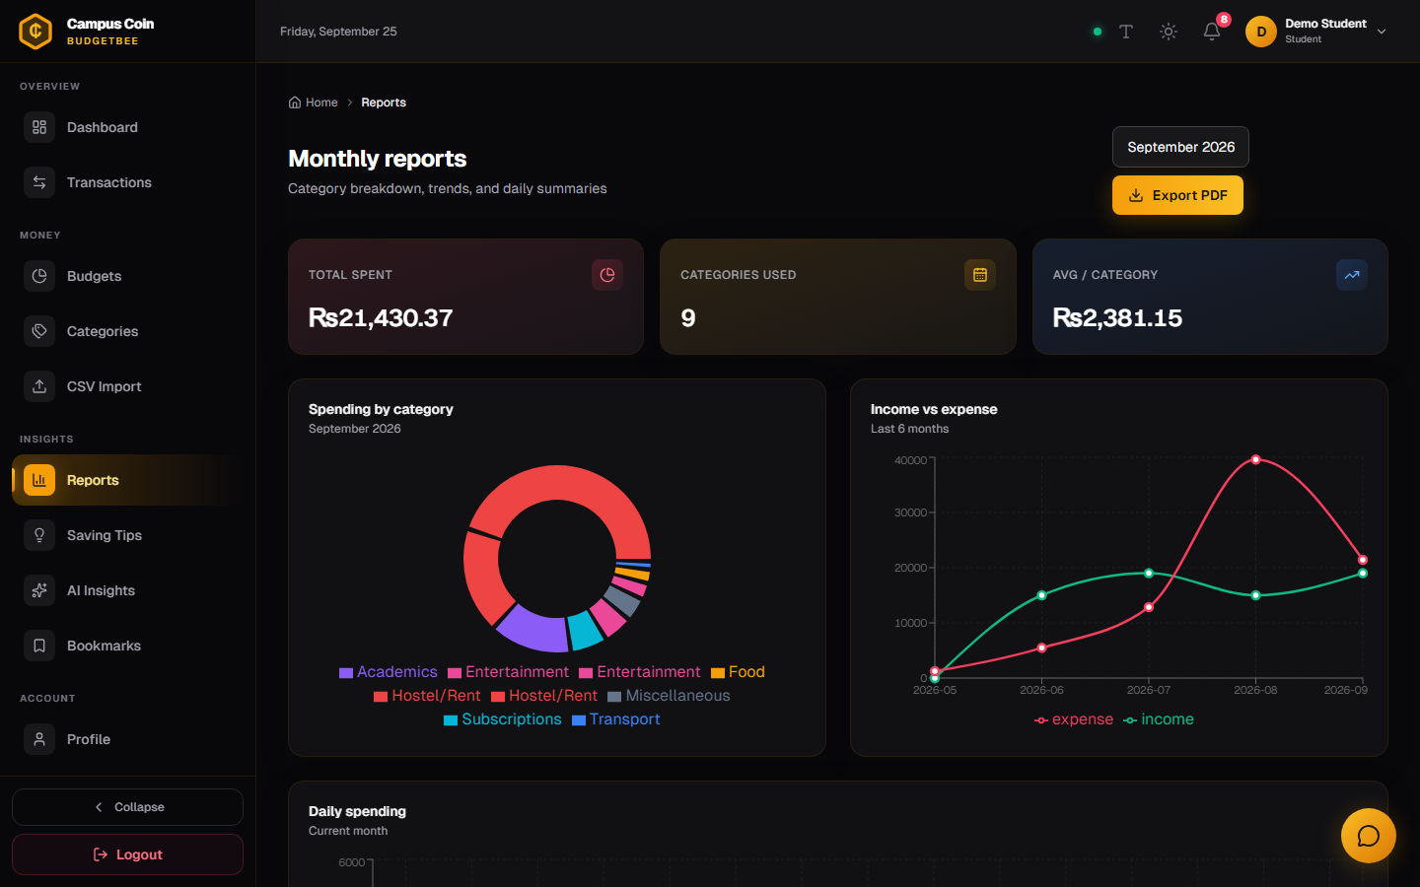
CAMPUS COIN
Budgets & Reports
Budgets — category limits per month
Reports — charts + PDF export
• unique (user, category, month) upsert
• progress bars: green → honey → rose at 80/100%
• live % updates via budget:updated socket
• confetti when all budgets stay safe
• donut: category-wise expense for a month
• line: 6-month income vs expense trend
• bars: daily + weekly summary
• Export PDF = html2canvas → jsPDF (client-side)
Campus Coin · NextGen BudgetBee — Full Project Walkthrough
19 / 26

Slide 20
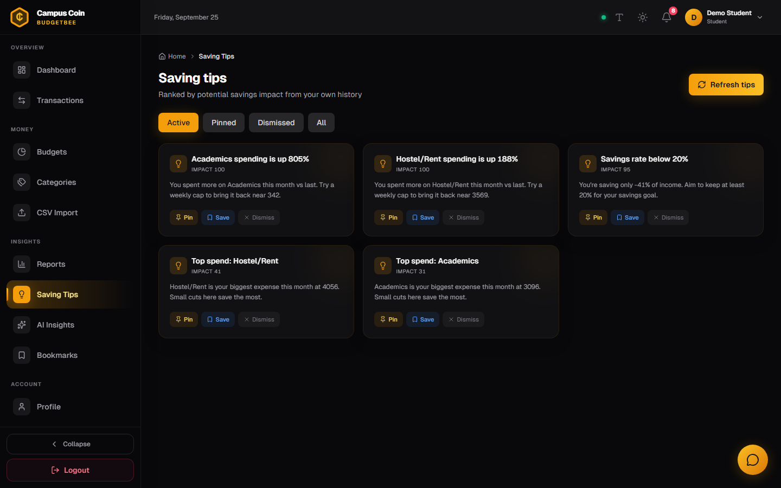
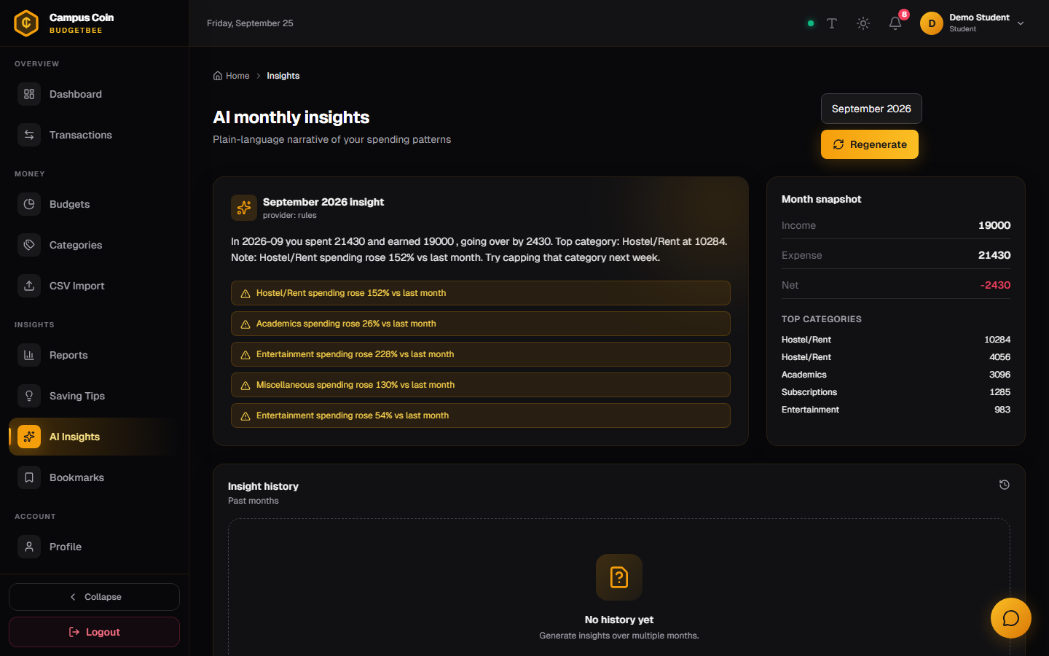
CAMPUS COIN
Saving Tips & AI Insights
Tips — ranked by impact
Insights — monthly narrative
• rule engine compares vs last month
• pin / dismiss / bookmark each tip
• “Refresh tips” re-runs the engine
• impactScore sorts the list
• warm 3–5 sentence story of your month
• flags: “Food rose 40%”, “budget exceeded”
• month picker + 12-month history
• regenerate button (force=true)
Campus Coin · NextGen BudgetBee — Full Project Walkthrough
20 / 26

Slide 21
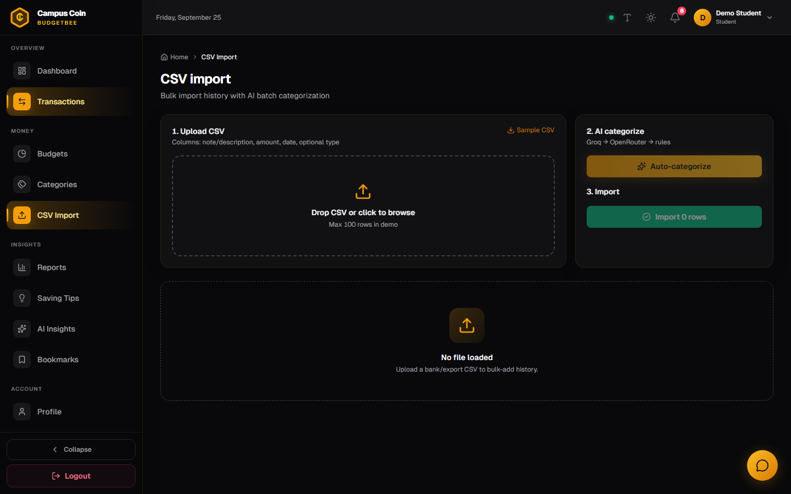
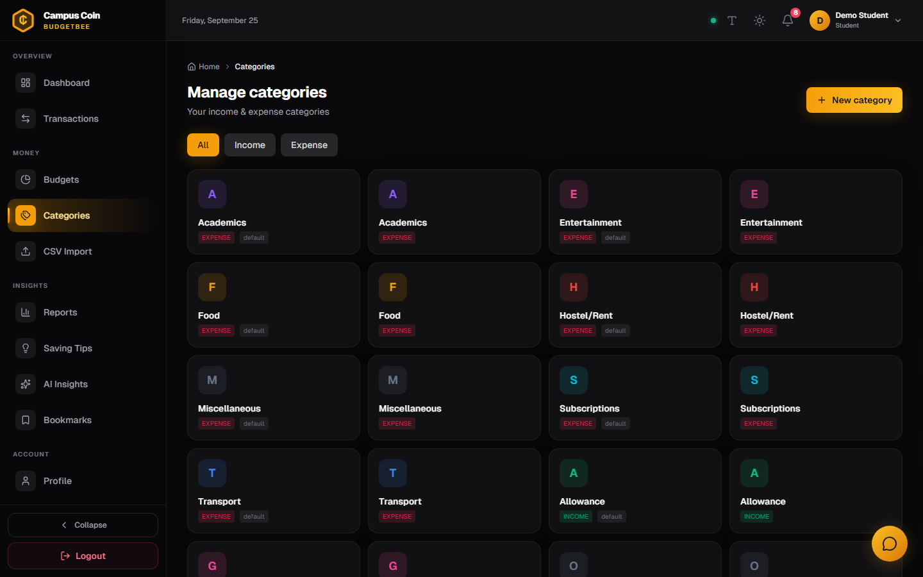
CAMPUS COIN
CSV Import & Category Management
CSV Import — PapaParse pipeline
Categories — personal + system defaults
• upload → map columns → preview table
• “AI categorize” = POST /ai/categorize-batch (≤100 rows)
• confirm → POST /transactions/import (≤500 rows)
• notification reports imported + skipped counts
• 12 seeded defaults (5 income / 7 expense)
• add custom, edit colors/icons, type filter
• delete blocked if transactions reference it
• admins manage system defaults at /admin/categories
Campus Coin · NextGen BudgetBee — Full Project Walkthrough
21 / 26

Slide 22
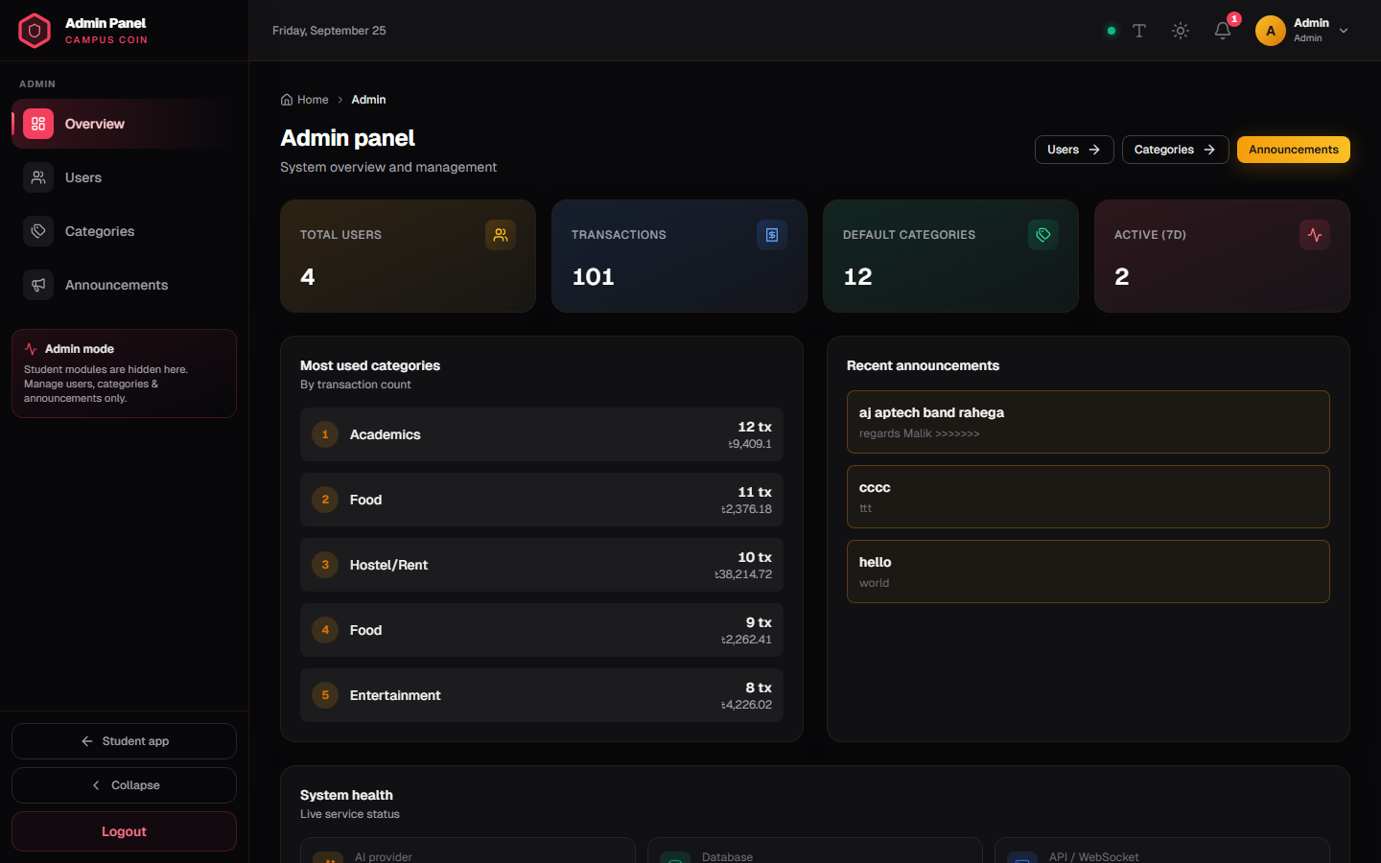
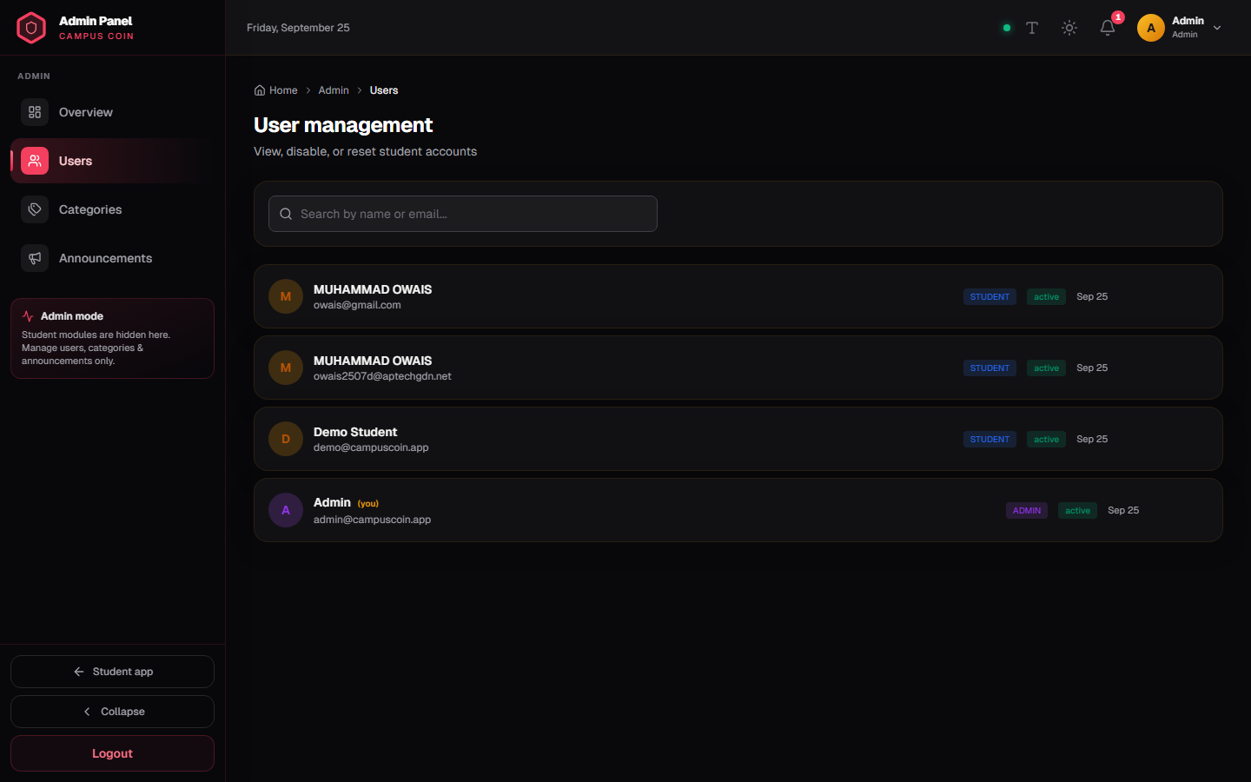
CAMPUS COIN · ROLE: ADMIN
Admin Panel
Overview — /admin
Users — /admin/users
• users / transactions / categories counts
• 7-day active users, top-5 expense categories
• AI provider status (groq / openrouter / rules)
• recent announcements
• search by name/email, pagination
• enable / disable account (isActive)
• reset password (default Reset@123)
• delete non-admin users · AdminSidebar layout
Campus Coin · NextGen BudgetBee — Full Project Walkthrough
22 / 26

Slide 23
CAMPUS COIN
Features — Tier 1 Core (20/20)
▸ 1 Register (OTP, profile, goal)
▸ 2 Login — student + admin
▸ 3 Secure sessions (JWT cookies)
▸ 4 Password recovery / reset
▸ 5 Editable user profile
▸ 6 Category management (12 seeds)
▸ 7 Transaction CRUD + filters
▸ 8 Recurring flag (day 1–31)*
▸ 9 Dashboard (balance, widgets)
▸ 10 Monthly reports (3 chart types)
▸ 11 Export PDF / image (jsPDF)
▸ 12 Budget goals per category
▸ 13 Budget alerts 80% / 100%
▸ 14 Saving-tips engine (impact rank)
▸ 15 Bookmark tips & insights
▸ 16 Admin panel (stats, users, CMS)
▸ 17 Dark mode + font-size toggle
▸ 18 Breadcrumbs on every page
▸ 19 Visual sitemap on homepage
▸ 20 Fully responsive (drawer sidebar)
* Recurring is stored & toggleable in the form; no cron clones it monthly yet. All other Tier-1 features are fully wired end-to-end (API + UI).
Campus Coin · NextGen BudgetBee — Full Project Walkthrough
23 / 26

Slide 24
CAMPUS COIN
Features — Tier 2 Wow & Tier 3 Extras
# | Feature | Status | How
21 | AI expense categorization | ✅ | LLM + keyword rules, live suggest, badge
22 | AI monthly insights | ✅ | Cached Insight narrative + flags
23 | CSV import w/ batch AI | ✅ | PapaParse → categorize-batch → bulk insert
24 | Next-month forecast | ⚡ | projectedEomExpense inside chat answers
25 | Duplicate / large detect | — | flags[] in schema, writer not implemented
27 / 28 / 29 | Pin-dismiss tips · insight history · PDF | ✅ | All live
31 | AI chatbot BudgetBee | ✅ | Context advisor + FAQ + LLM fallback
32 / 33 / 34 | Animated charts · confetti · streak | ✅ | Recharts/Framer · celebrate() · loginStreak
39 | Multi-currency | ⚡ | BDT/USD/EUR/… display + symbols (no FX)
Tier-3 extras not built: PWA, voice input, receipt OCR, auto light/dark by time, gamification badges. AI works rules-only until GROQ_API_KEY / OPENROUTER_API_KEY is added.
Campus Coin · NextGen BudgetBee — Full Project Walkthrough
24 / 26

Slide 25
CAMPUS COIN
How to Run — Commands, Ports, Environment
START (two terminals)
ENV (server/.env)
# API — port 5000
cd server
npm install
npm run dev # node --watch
# npm run seed # optional (runs on boot)
# Client — port 3000
cd client
npm install
npm run dev # next dev
# checks
GET :5000/api/v1/health → 200
UI :3000 → landing page
PORT=5000
NODE_ENV=development
CLIENT_URL=http://localhost:3000
MONGODB_URI=mongodb+srv://…Atlas…
TRY_ATLAS_FIRST=true → Atlas first,
local → mongodb-memory-server fallback
JWT_ACCESS_SECRET=… JWT_REFRESH_SECRET=…
GROQ_API_KEY=… OPENROUTER_API_KEY=…
client/.env.local:
NEXT_PUBLIC_API_URL=http://localhost:5000/api/v1
NEXT_PUBLIC_WS_URL=http://localhost:5000
DEMO ACCOUNTS (seeded on every boot)
🐝 Admin: admin@campuscoin.app / Admin@123 → lands on /admin
🎓 Student: demo@campuscoin.app / Demo@123 → lands on /dashboard
Login page has one-click demo fill buttons. Data persists in MongoDB Atlas (cluster0.wyyaakz).
Campus Coin · NextGen BudgetBee — Full Project Walkthrough
25 / 26

Slide 26
Thank You
TEAM BOMBERS
Bilawal · Owais · Esam · Muneeb · Haider
Campus Coin — NextGen BudgetBee is ready to demo
This deck covered: architecture · every route · all 11 controllers · 10 models · services (tips, alerts, notify) ·
AI layer (categorize / insights / chat) · Socket.IO realtime · 21 client pages · auth (OTP + JWT) ·
Tier 1/2/3 feature status · run instructions. Questions?
Campus Coin · NextGen BudgetBee — Full Project Walkthrough
26 / 26

