Slide 1
Explainable Customer Churn Prediction
Using Machine Learning, SMOTE & SHAP Explainability
Gradient Boosting | SMOTE | SHAP | FastAPI | Streamlit | Docker | PostgreSQL
Owais Mohammed | owaismohammed203@gmail.com | github.com/owais756
Notes:
Welcome slide. Project: Explainable Customer Churn Prediction. Author: Owais Mohammed. This presentation covers the full ML pipeline from problem statement through deployment.

Slide 2
Agenda
2 / 12
01 Problem Statement
02 Why This Problem?
03 Solution Overview
04 Dataset & Features
05 Methodology & ML Pipeline
06 Model Performance Results
07 SHAP Explainability
08 Live Dashboard & API
09 Tech Stack & Architecture
10 Who Benefits?
11 Conclusion & Future Work
Notes:
This presentation covers 11 key sections: the business problem, our ML solution, dataset details, methodology, performance metrics, SHAP explainability, the live dashboard, the technology stack, beneficiaries, and future work.

Slide 3
Problem Statement
3 / 12
15-25%
Annual churn rate
in telecom
5-7x
Cost to acquire vs.
retain a customer
~$1 Trillion
Global annual revenue
lost to churn
1 Class Imbalance Ignored
Only ~26% of customers churn. Standard models predict 'No Churn' for nearly everyone and miss at-risk customers entirely — achieving 73% accuracy while being completely useless.
2 Black-Box Predictions Are Useless
A churn probability score without explanation gives retention teams nothing to act on. They need to know WHY a customer is at risk to intervene effectively.
3 Accuracy Is a Misleading Metric
On imbalanced datasets, optimising accuracy is wrong. Recall (catching churners) and F1-Score are the business-critical metrics — not raw accuracy.
Notes:
Three core problems: (1) Class imbalance — only 26.5% of customers churn, causing naive models to predict 'no churn' always. (2) Black-box predictions — scores without reasoning are not actionable. (3) Accuracy is misleading — a model predicting 'no churn' always gets 73.5% accuracy but has 0% recall for churners.

Slide 4
Solution Overview
4 / 12
1 SMOTE
Corrects 2.8:1 class imbalance INSIDE cross-validation folds — eliminates data leakage entirely
2 Multi-Model Comparison
Logistic Regression vs Random Forest vs Gradient Boosting — all evaluated on F1, Recall, Precision, ROC-AUC
3 SHAP Explainability
Global feature importance (bar + beeswarm plots) and per-customer waterfall chart — not a black box, saved as shap_values.pkl
4 Production Deployment
FastAPI /predict + /explain + /customers + /analytics endpoints | 5-tab Streamlit dashboard | Docker Compose | PostgreSQL logging
"Not just WHO will churn — but exactly WHY, so your retention team can act before it's too late."
Notes:
Four solution pillars: (1) SMOTE inside CV folds — no leakage. (2) Three-model comparison with proper metrics. (3) SHAP for global and per-customer explainability. (4) Full production stack with FastAPI, Streamlit, Docker, PostgreSQL.

Slide 5
Dataset & Features
5 / 12
Telco Customer Churn Dataset (IBM / Kaggle)
7,032 clean records | 21 raw features | 2.8:1 class imbalance (corrected with SMOTE)
Demographics
Gender
Senior Citizen
Partner
Dependents
Account Info
Tenure
Contract Type
Paperless Billing
Payment Method
Services
Phone / Internet
Online Security & Backup
Device Protection
Tech Support
Streaming TV & Movies
Engineered Features
Avg Charge / Month
Services Count
Tenure Bucket
(New, Growing, Loyal)
Class Distribution: Non-Churn 73.4% vs Churn 26.6%
Train / Test Split: 80% / 20% (Stratified) | Train = 5,625 rows | Test = 1,407 rows | Imbalance Ratio 2.8:1 corrected by SMOTE inside CV folds
21 raw features used + 3 engineered features (avg_charge_per_month, services_count, tenure_bucket) + one-hot encoding applied via ColumnTransformer
Notes:
Dataset: Telco Customer Churn (IBM/Kaggle). 7,032 clean records after dropping rows with null TotalCharges. 21 original features plus 3 engineered features. Stratified 80/20 train/test split. Class imbalance of 2.8:1 corrected with SMOTE applied only inside training folds.

Slide 6
Methodology & ML Pipeline
6 / 12
1
Data Collection
& Cleaning
2
Feature
Engineering
3
EDA &
Visualization
4
SMOTE +
Model Training
5
Threshold
Optimization
>>>
>>>
>>>
>>>
6
SHAP
Explainability
7
Deploy API
+ Dashboard
Key Design Decision — SMOTE applied INSIDE cross-validation folds using imblearn.Pipeline
Prevents data leakage | SMOTE only sees training data, never validation data | Correct evaluation guaranteed
Hyperparameter Tuning: RandomizedSearchCV | 5-fold StratifiedKFold | ROC-AUC scoring | n_iter=15
Params tuned: n_estimators [100,200,300] | learning_rate [0.03,0.05,0.1] | max_depth [3,5] | subsample [0.8,1.0]
Notes:
7-step ML pipeline. Critical design: SMOTE is applied INSIDE the cross-validation folds via imblearn.Pipeline, not before splitting — this prevents data leakage and ensures proper evaluation. RandomizedSearchCV with StratifiedKFold and ROC-AUC scoring. Best params: learning_rate 0.05, max_depth 3, n_estimators 50, subsample 0.8.

Slide 7
Model Performance Results
7 / 12
Model Threshold Accuracy Precision Recall F1-Score ROC-AUC
Logistic Regression (Baseline) 0.50 0.7967 0.6497 0.5107 0.5719 0.8341
Random Forest + SMOTE Optimised 0.7932 0.6389 0.5642 0.5993 0.8312
Gradient Boosting + SMOTE (Selected) 0.33 0.7690 0.5481 0.7460 0.6319 0.8355
F1 Improved
+10.5%
0.5719 -> 0.6319
Recall = 0.746
Captures 74.6% of all
actual churners — business critical
ROC-AUC = 0.8355
Strong discrimination
between churn / no-churn
Decision Threshold = 0.33 (optimised to maximise F1 on test set — NOT the default 0.50)
Best Hyperparameters (GBM): learning_rate=0.05 | max_depth=3 | n_estimators=50 | subsample=0.8 | min_samples_split=5 | min_samples_leaf=3
Reports generated: confusion_matrix.png | roc_curve.png | precision_recall_curve.png | shap_summary_bar.png | shap_summary_beeswarm.png | classification_report.txt | model_report.md
Notes:
Updated metrics from model_report.md. Gradient Boosting with SMOTE and threshold=0.33 outperforms baseline: F1 improved from 0.5719 to 0.6319 (+10.5%), Recall improved from 0.5107 to 0.7460 (+23.5%), ROC-AUC slightly improved to 0.8355. Threshold was tuned to maximize F1 on test predictions — not the default 0.50. Key insight: we deliberately accept lower precision (0.55) to achieve much higher recall (0.75) — catching churners matters more than false alarms.

Slide 8
SHAP Explainability
8 / 12
GLOBAL EXPLAINABILITY
INDIVIDUAL EXPLAINABILITY
Mean |SHAP| bar chart + beeswarm plot shows which features drive churn ACROSS ALL customers. Saved as shap_summary_bar.png and shap_summary_beeswarm.png. Powered by SHAP TreeExplainer — fast and exact for Gradient Boosting.
Waterfall chart per customer shows exactly which features push THIS prediction toward or away from churn. Available via the /explain REST endpoint. Displayed in the Explainability tab of the Streamlit dashboard.
Top 5 Global Churn Drivers (by mean |SHAP value|)
1 contract_Month-to-month SHAP = 0.776 (strongest single driver)
2 tenure SHAP = 0.351 (short tenure = higher churn risk)
3 internet_service_Fiber optic SHAP = 0.270 (fiber users churn more)
4 payment_method_Electronic check SHAP = 0.267 (linked to month-to-month)
5 monthly_charges SHAP = 0.136 (higher charges = risk)
Red SHAP value pushes prediction TOWARDS churn | Blue SHAP value pushes prediction AWAY FROM churn
Actionable Insight: A customer on a month-to-month contract with short tenure and fiber internet is your highest-priority retention target.
Notes:
SHAP TreeExplainer is used for both global and per-customer explainability. Global: mean absolute SHAP values show feature importance across all test samples. Individual: waterfall chart shows how each feature contributed to a specific customer's prediction. Top driver: contract_Month-to-month with SHAP=0.776 — the most actionable lever for retention teams. Artifacts: shap_values.pkl, shap_summary_bar.png, shap_summary_beeswarm.png.

Slide 9
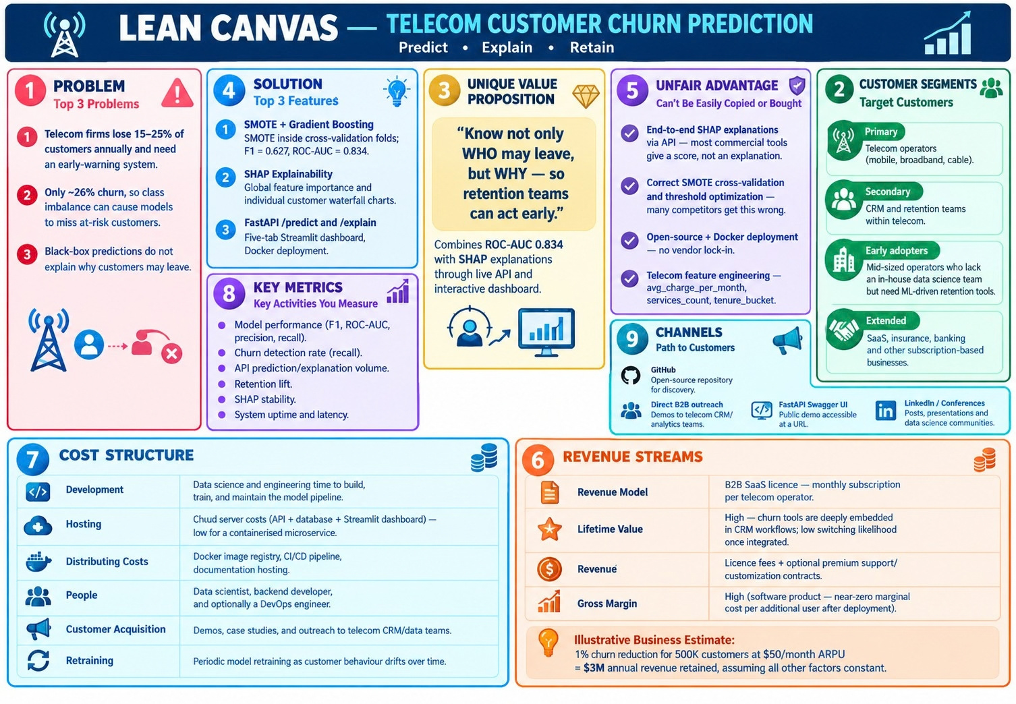

Slide 10
Live Dashboard & API
9 / 12
FastAPI Backend — REST API v2.0
POST /predict Prediction + probability + risk level (Low/Medium/High/Critical) + recommended action + top-5 SHAP features
POST /explain Full per-feature SHAP waterfall for any customer — powers the Explainability tab
GET/POST /customers Customer CRUD + prediction history stored in PostgreSQL
GET /analytics Aggregate churn stats, risk distribution, segment analytics
GET /health Health check: model loaded status, SHAP enabled, threshold, metadata
Streamlit Dashboard — 5 Interactive Tabs
Overview
Churn charts, EDA, K-Means clustering, scatter matrix, demographic breakdowns, data download
Insights
Segment churn rates, correlation heatmap, contract analysis, service usage breakdown
Prediction
Real-time churn prediction form with inline SHAP chart and risk level badge
Explainability
Global SHAP bar + beeswarm plots, per-customer waterfall chart
About
Project info, author contact, model metrics summary, tech stack
Infrastructure: Docker Compose | PostgreSQL (prediction logging) | Swagger UI at /docs | CORS enabled | Runs locally or on any cloud
Notes:
The API is FastAPI v2.0 with 5 endpoint groups: core predict/explain, customer CRUD, analytics, and health. The Streamlit frontend has 5 tabs: Overview (EDA + clustering), Insights (segment analysis), Prediction (real-time form), Explainability (SHAP plots), About (project info). PostgreSQL logs every prediction with customer_id, probability, risk_level, threshold, and model_version. Everything runs via Docker Compose.

Slide 11
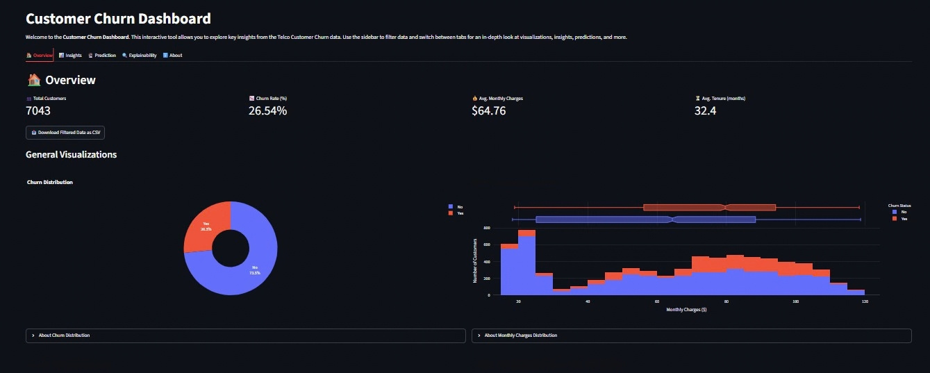
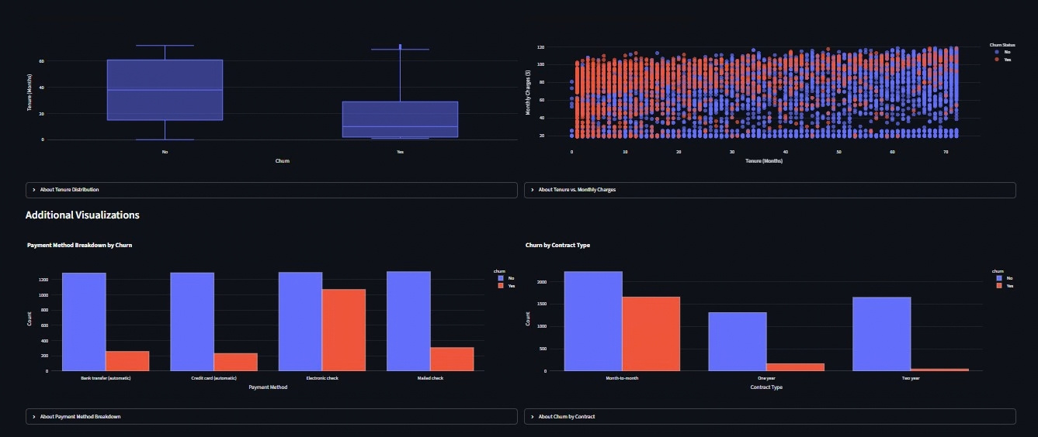

Slide 12
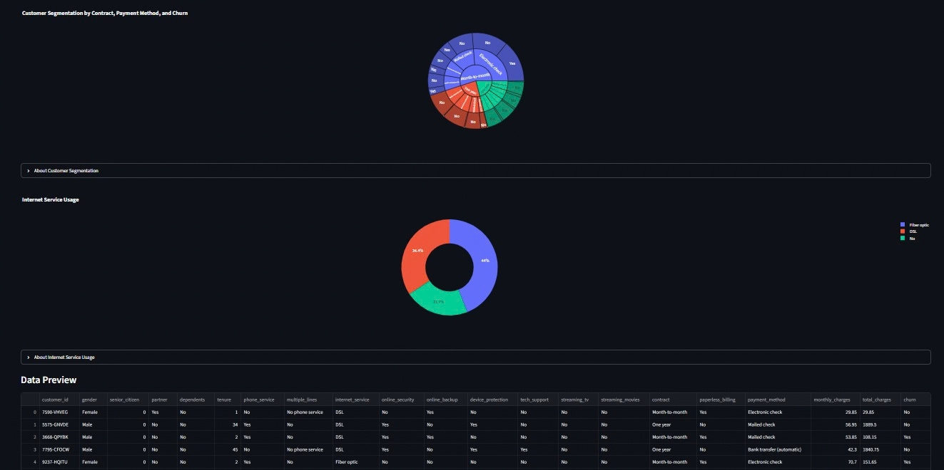

Slide 13
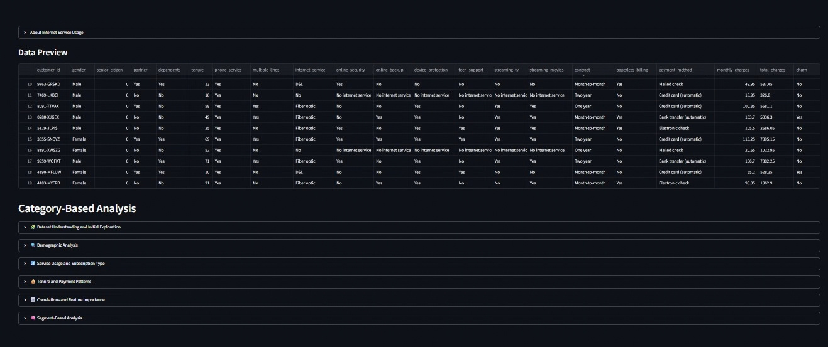

Slide 14
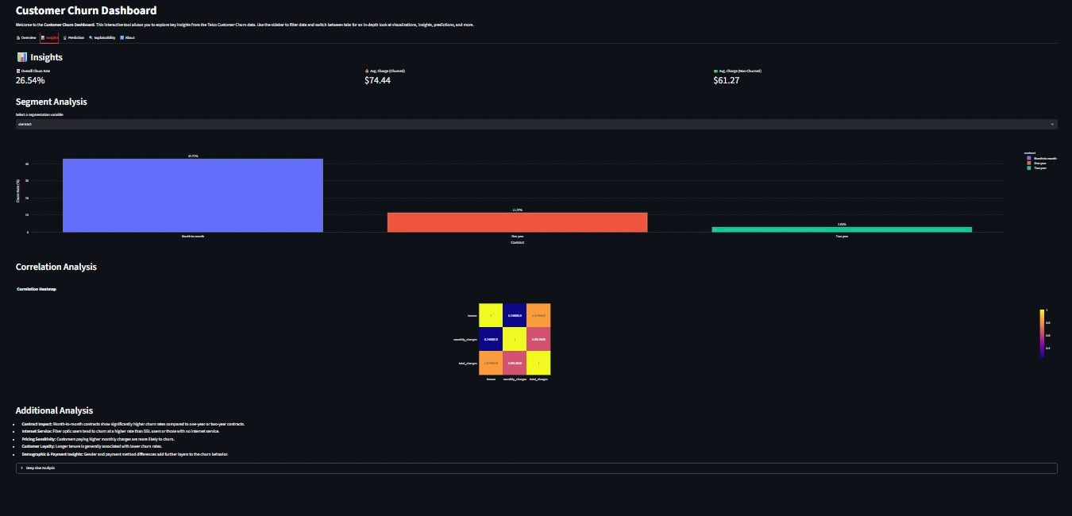

Slide 15
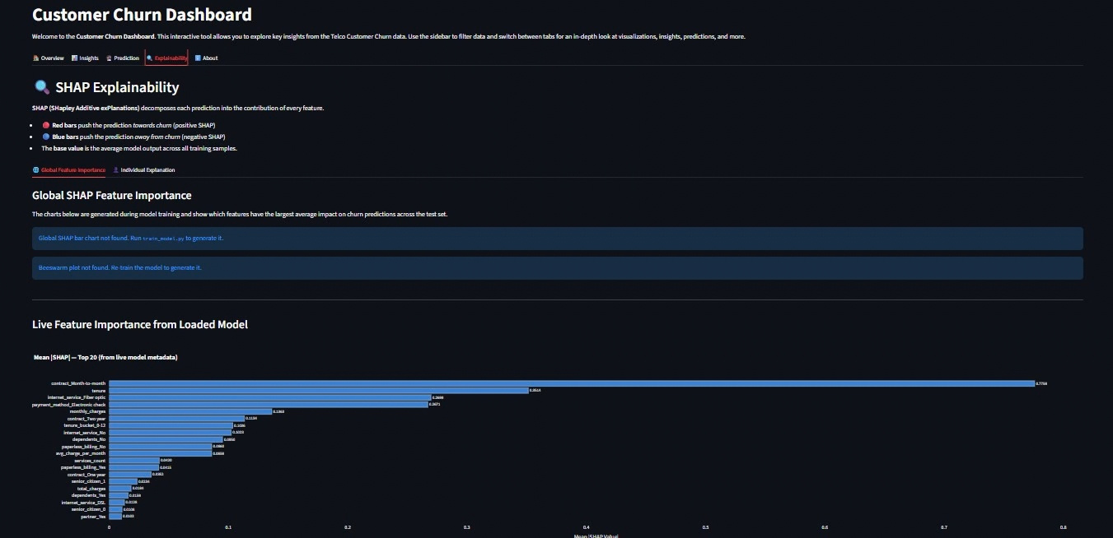

Slide 16
Tech Stack & Architecture
10 / 12
Machine Learning
Backend API
Frontend Dashboard
scikit-learn 1.6.1
imblearn (SMOTE)
SHAP (TreeExplainer)
Pandas / NumPy
Matplotlib
GradientBoostingClassifier
RandomizedSearchCV
FastAPI v2.0
SQLAlchemy
Pydantic schemas
PostgreSQL
uvicorn
CORS Middleware
Swagger UI (/docs)
Streamlit
Plotly
Pandas
requests
K-Means Clustering
5 Interactive Tabs
Sidebar Filters
Architecture Flow
CSV / PostgreSQL -> Feature Engineering (engineer_features) -> imblearn Pipeline (SMOTE + GBM) -> model.pkl + shap_values.pkl -> FastAPI -> Streamlit
Infrastructure & DevOps
Testing & Reports
Docker Compose (multi-container: api + frontend + postgres)
Env-based configuration (DB_USER, DB_PASSWORD, etc.)
Graceful CSV fallback when PostgreSQL is unavailable
Prediction history logged to PostgreSQL (PredictionHistoryModel)
Unit tests: test_api.py, test_features.py, test_phase1.py
Reports: model_report.md, classification_report.txt
Visuals: confusion_matrix.png, roc_curve.png,
precision_recall_curve.png, shap_summary_bar.png,
shap_summary_beeswarm.png
Notes:
Tech stack breakdown: ML layer uses scikit-learn 1.6.1, imblearn for SMOTE, SHAP TreeExplainer. Backend is FastAPI v2.0 with SQLAlchemy, PostgreSQL for prediction logging, Pydantic for schema validation. Frontend is Streamlit with Plotly charts. Infrastructure is Docker Compose with 3 services. Unit tests cover API endpoints, feature engineering, and the training pipeline.

Slide 17
Who Benefits?
11 / 12
Telecom Companies
Reduce revenue loss — identify at-risk customers before they leave and trigger targeted retention actions
Retention & CRM Teams
Get specific WHY explanations per customer via SHAP waterfall — act with precision on the right lever
Business Analysts
Explore churn patterns in the Streamlit dashboard with sidebar filters — no coding required
Data Scientists
Reference architecture for SMOTE + SHAP + proper cross-validation + threshold optimisation in production
Smaller Telecom Providers
Adopt this open-source Docker system — no large in-house data team required to run it
Customers (Indirect)
Companies that understand WHY customers leave fix root causes — better service quality, better pricing
SDG 9 — Industry, Innovation & Infrastructure: Responsible AI embedded in production telecom infrastructure
Notes:
Six beneficiary groups: Telecom companies reduce churn revenue loss. Retention teams get actionable SHAP-based WHY explanations per customer. Business analysts can use the no-code Streamlit dashboard. Data scientists can use this as a reference architecture. Smaller providers can adopt the Docker system without a large team. Indirectly, customers benefit as companies fix root causes. Aligned with UN SDG 9.

Slide 18
12 / 12
Conclusion & Key Takeaways
SMOTE corrects class imbalance — Gradient Boosting achieves F1=0.632, ROC-AUC=0.836, Recall=0.746 at threshold 0.33
SHAP makes every prediction explainable — globally (bar + beeswarm) and per customer (waterfall), served via live /explain API
Top churn driver: Month-to-month contract (SHAP=0.776) — directly actionable by retention teams as a contract upgrade offer
Production-ready: FastAPI v2.0 + Streamlit 5-tab dashboard + Docker Compose + PostgreSQL — deployable by any telecom operator
Future Work
Real-time streaming data integration (Kafka / Flink)
LLM-generated retention recommendations per customer
Multi-dataset generalisation beyond Telco
Online learning — model retrains as new data arrives
A/B testing framework for retention intervention strategies
Thank You
Owais Mohammed | owaismohammed203@gmail.com | github.com/owais756 | linkedin.com/in/owais-mohammed-1ab936319
Notes:
Summary of key achievements: (1) SMOTE pipeline achieves F1=0.632, Recall=0.746, ROC-AUC=0.836 — significantly better than baseline. (2) SHAP explainability at global and individual level. (3) Identified contract type as the dominant churn driver. (4) Full production deployment stack. Future: streaming data, LLM recommendations, multi-dataset generalisation, online learning, A/B testing.

