Slide 1
UNIT-I
OOP using Java

Slide 2
Procedure Oriented Programming
In POP, program is divided into small parts called functions.
POP does not have any access specifier.
In POP, overloading is not possible.
Example of POP are : C, VB, FORTRAN, Pascal

Slide 3
Object Oriented Programming
In OOP, program is divided into parts called objects.
OOP has access specifiers named Public, Private,Protected, etc.
In OOP, overloading is possible in the form of Function Overloading and Operator Overloading.
Example of OOP are : C++, JAVA, VB.NET, C#.NET

Slide 4
Object Oriented Programming (OOPs)
OOPs refers to languages that uses objects in programming.
The main aim of OOP is to bind together the data and the functions .
OOPs Concepts:
Polymorphism
Inheritance
Encapsulation
Abstraction
Message Passing
Class
Object
Method

Slide 5
Polymorphism
The word polymorphism means having many forms.
Polymorphism allows us to perform a single action in different ways.
The word “poly” means many and “morphs” means forms, So it means many forms.
Compile time polymorphism:
It is also known as static polymorphism. This type of polymorphism is achieved by function overloading.
Ex: sum(int x, int y),sum(int x, int y, int z) ;
Runtime polymorphism:
It is also known as Dynamic Method Dispatch. It is a process in which a function call to the overridden method is resolved at Runtime.
This type of polymorphism is achieved by Method Overriding.
sum(int x, int y)
{…….. }

Slide 6
Inheritance in Java
Inheritance is an important pillar of OOP(Object Oriented Programming).
It is the mechanism in java by which one class is allow to inherit the features(fields and methods) of another class.
Super class
Sub class
Reusability
Extends keyword
class derived-class extends base-class
{
//methods and fields
}

Slide 7
Encapsulation
binding object state(fields) and behaviour(methods) together.
Prevents the data from being accessed by the code outside .
Use of private,public etc;
Abstraction:
Show only “relevant” data and “hide” unnecessary details of an object from the user.
Ex: man driving a car.
interfaces and abstract classes

Slide 8
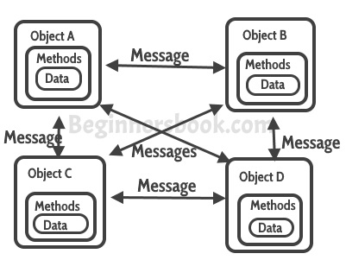
Message Passing
Objects communicate with one another by sending and receiving information to each other.
A message for an object is a request for execution of a procedure.

Slide 9
What is Java?
Java is a popular object oriented programming language, created in 1995, owned by Oracle.
Java is first programming language which is not attached with any particular hardware or operating system.
Program developed in Java can be executed anywhere and on any system.
It is used for:
Mobile applications (specially Android apps)
Web applications
Games
Database connection

Slide 10
Why Use Java?
Java works on different platforms (Windows, Mac, Linux, etc.)
It is one of the most popular programming language in the world
It is easy to learn and simple to use
It is open-source and free
It is secure, fast and powerful
It has a huge community support.
Types of java programs
1. Applications: These are standalone programs that run on a computer.
2. Applets : These are programs that run on a web browser.
3. Servlets : These are programs that run at the server side.

Slide 11
JAVA HISTORY
James Gosling, Mike Sheridan, and Patrick Naughton started the Java language project in June 1991. The tiny team of sun engineers called Green Team.
In the beginning, it is designed for small, embedded systems in electronic appliances like set-top boxes.
First of all, it was known as "Greentalk" by James Gosling and .gt was the file extension.
Later, it was known as Oak and was developed as a piece of the Green project.

Slide 12
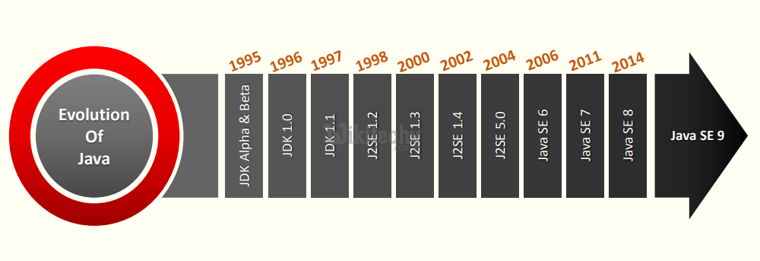
JAVA HISTORY

Slide 13
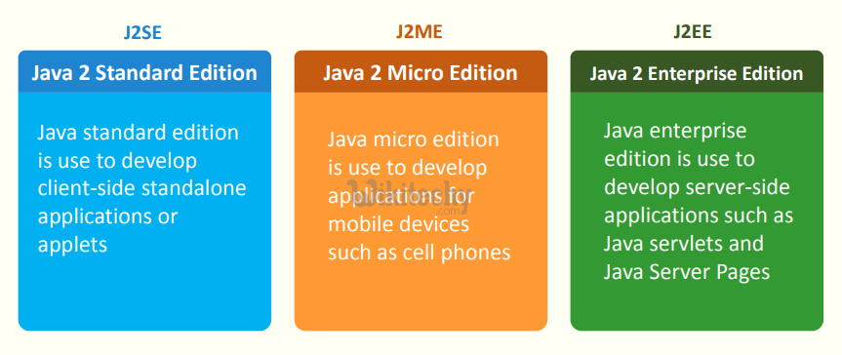
Java Platforms

Slide 14
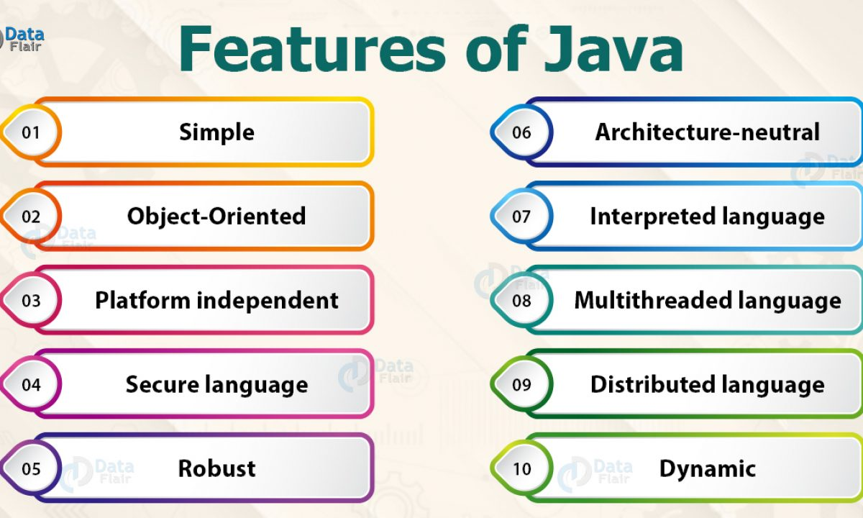
Features of Java

Slide 15
Features of Java
Simple and small
Java is very small and simple language.
Java does not use pointer and header files, goto statements, etc.
It eliminates operator overloading and multiple inheritance.
Object- oriented
Java is truly object-oriented language.
In Java, almost everything is an Object.
All program code and data exist in objects and classes.
Java comes with an extensive set of classes; organize in packages that can be used in program by Inheritance

Slide 16
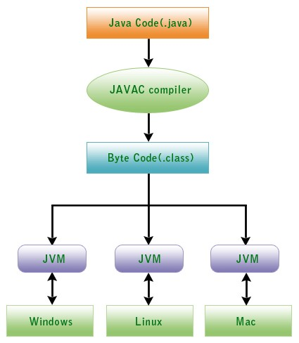
Features of Java
Platform Independent and portable
Java supports the feature portability.
Java programs can be easily moved from one computer system to another and anywhere.
Changes and upgrades in operating systems, processors and system resources will not force any alteration in Java programs.
This is reason why Java has become a trendy language for programming on Internet which interconnects different kind of systems worldwide.
Java certifies portability in two ways.
First way is, Java compiler generates the bytecode and that can be executed on any machine
Second way is, size of primitive datatypes are machine independent.

Slide 17
Features of Java
Architecture-neutral
Compiler generates bytecodes, which have nothing to do with a particular computer architecture, hence a Java program is easy to intrepret on any machine.
Secure
With Java's secure feature it enables to develop virus-free, tamper-free systems. Authentication techniques are based on public-key encryption.
Robust
Robust simply means strong. Java is robust because:
It uses strong memory management.
There is a lack of pointers that avoids security problems.
There is automatic garbage collection in java which runs on the Java Virtual Machine to get rid of objects which are not being used by a Java application anymore.
There are exception handling and the type checking mechanism in Java.

Slide 18
Features of Java
Compiled and Interpreted
Basically a computer language is either compiled or interpreted.
Java comes together both these approach thus making Java a two-stage system.
Java compiler translates Java code to Bytecode instructions .
Java Interpreter generates machine code that can be directly executed by machine that is running the Java program.
Multithreaded and Interactive
Multithreaded means managing multiple tasks simultaneously.
Java maintains multithreaded programs. That means we need not wait for the application to complete one task before starting next task.

Slide 19
Features of Java
Distributed
Java is called as Distributed language for construction of applications on networks which can contribute both data and programs.
RMI and EJB are used for creating distributed applications.
Dynamic and Extensible
Java is also dynamic language.
Java is capable of dynamically linking in new class, libraries, methods and objects.
Java program provides support functions written in other language such as C and C++, known as native methods

Slide 20
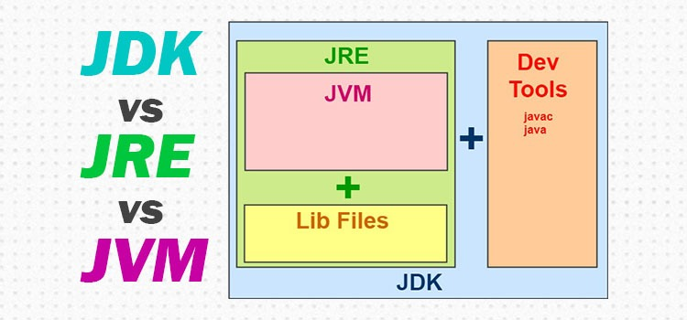
JAVA Environment Components

Slide 21
JAVA Environment Components
JDK – Java Development Kit (in short JDK) is Kit which provides the environment to develop and execute(run) the Java program.
JDK is a kit(or package) which includes two things
Development Tools(to provide an environment to develop your java programs)
JRE (to execute your java program).
Note : JDK is only used by Java Developers.
JRE – Java Runtime Environment (to say JRE) is an installation package which provides environment to only run(not develop) the java program(or application)onto your machine.
JRE is only used by them who only wants to run the Java Programs i.e. end users of your system.
JVM – Java Virtual machine(JVM) is a very important part of both JDK and JRE because it is contained or inbuilt in both.
Whatever Java program you run using JRE or JDK goes into JVM and JVM is responsible for executing the java program line by line hence it is also known as interpreter.

Slide 22
What is a class in Java
A class is a group of objects which have common properties. It is a template or blueprint from which objects are created.
It is a logical entity.
It can't be physical.
A class in Java can contain:
Fields
Methods
Constructors
Blocks
Nested class and interface
Syntax to declare a class:
class <class_name>
{
field;
method;
}

Slide 23
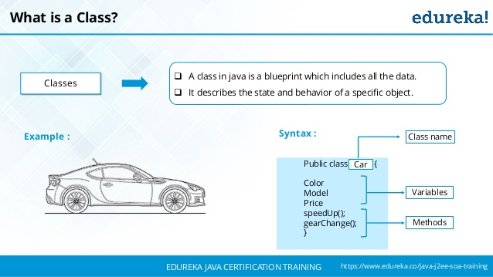
What is a class in Java

Slide 24
What is an object in Java
An object in Java is the physical as well as a logical entity, whereas, a class in Java is a logical entity only.
An entity that has state and behavior is known as an object e.g., chair, bike, pen, table, car, etc.
It can be physical or logical (tangible and intangible).
The example of an intangible object is the banking system.
An object has three characteristics:
State: represents the data (value) of an object.
Behavior: represents the behavior (functionality) of an object such as deposit, withdraw, etc.
Identity: An object identity is typically implemented via a unique ID. The value of the ID is not visible to the external user.
However, it is used internally by the JVM to identify each object uniquely.

Slide 25
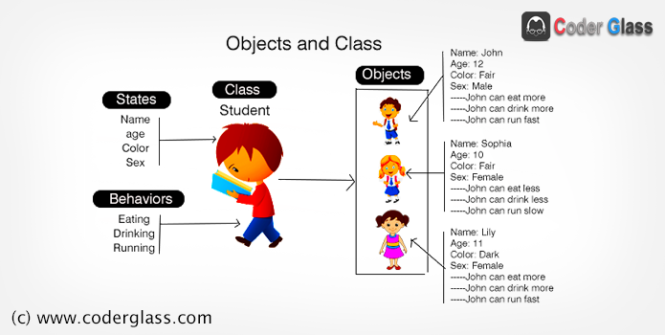
What is an object in Java

Slide 26
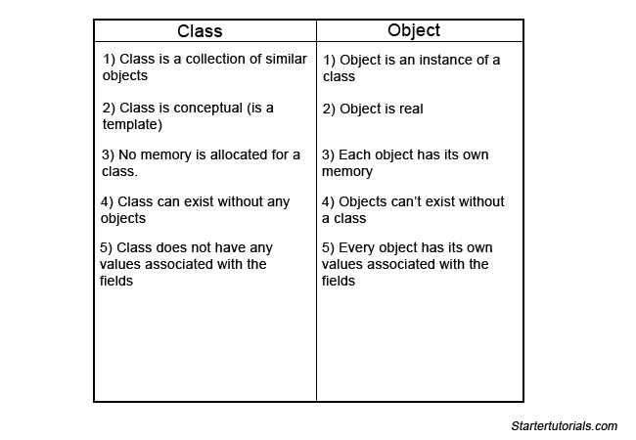

Slide 27
First Java Program
class FirstProgram
{
public static void main(String args[])
{
System.out.println (“This is my first program”);
}
}

Slide 28
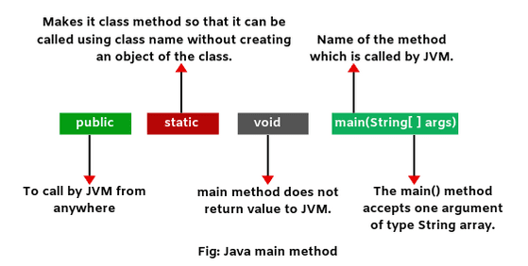
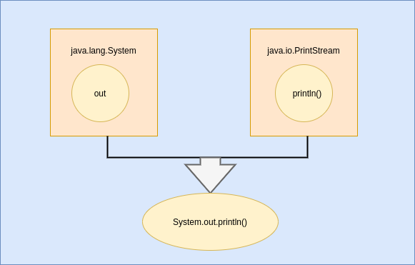
First Java Program
System is the class name, out is an instance of the System class and is of type PrintStream.

Slide 29
First Java Program
The file must be named “FirstProgram.java” to equivalent the class name containing the main method.
Java is case sensitive. This program defines a class called “FirstProgram”.
A Java class is defined by its class name, an open curly brace, a list of methods and fields, and a close curly brace.
The name of the class is made of alphabetical characters and digits without spaces, the first character must be alphabetical.
The line “public static void main (String [] args )” shows where the program will start running.
The JVM starts running any program by executing this method first.

Slide 30
First Java Program
Creating and Executing Java program
Edit the program by the use of Notepad.
Save the program using . java extension.
Compile the program with the javac command.(Java compiler)
If there are syntax errors, go back to Notepad and edit the program.
Run the program with the java command.(Java Interpreter)
If it does not run correctly, go back to Notepad and edit the program.
When it shows result then stop

Slide 31
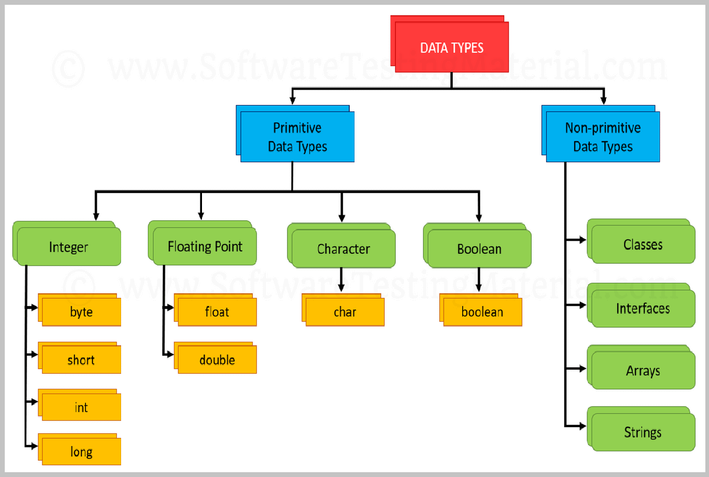
Data Types

Slide 32
Data Types
Data types are divided into two groups:
•Primitive data types – includes byte, short, int, long, float, double, boolean and char
•Non-primitive data types - such as String, Arrays, Interface and Classes .
A primitive data type specifies the size and type of variable values, and it has no additional methods.
Non-primitive data types are called reference types because they refer to objects.
Primitive types are predefined (already defined) in Java.
Non-primitive types are created by the programmer and is not defined by Java (except for String).
Non-primitive types can be used to call methods to perform certain operations, while primitive types cannot.
A primitive type has always a value, while non-primitive types can be null.
A primitive type starts with a lowercase letter, while non-primitive types starts with an uppercase letter

Slide 33
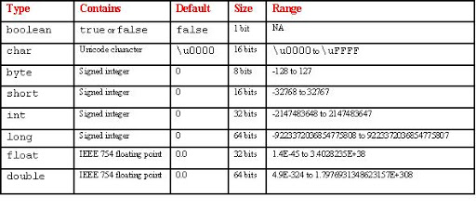
Data Types

Slide 34
JAVA VARIABLES
Variables are containers for storing data values.
Syntax
type variable = value;
Where type is one of Java's types (such as int or String), and variable is the name of the variable (such as x or name). The equal sign is used to assign values to the variable.
Examples
Create a variable called name of type String and assign it the value "John":
String name ="John";
System.out.println(name);
Create a variable called myNum of type int and assign it the value 15:
int myNum=15;
System.out.println(myNum);

Slide 35
Java - Basic Operators
Java provides a rich set of operators to manipulate variables. We can divide all the Java operators into the following groups −
• Arithmetic Operators
• Unary Operator
• Relational Operators
• Bitwise Operators
• Logical Operators
• Assignment Operators
• Misc Operators

Slide 36
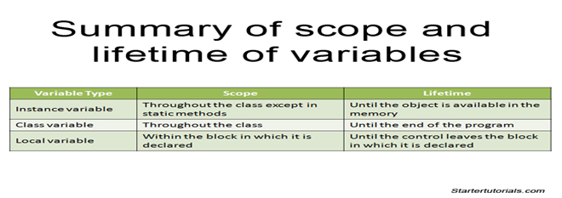

Slide 37
The Arithmetic Operators and Unary Operators
Arithmetic operators are used in mathematical expressions in the same way that they are used in algebra. The following table lists the arithmetic operators −
Assume integer variable A holds 10 and variable B holds 20, then
Operator | Description | Example
+ (Addition) | Adds values on either side of the operator. | A + B will give 30
- (Subtraction) | Subtracts right-hand operand from left-hand operand. | A - B will give -10
* (Multiplication) | Multiplies values on either side of the operator. | A * B will give 200
/ (Division) | Divides left-hand operand by right-hand operand. | B / A will give 2
% (Modulus) | Divides left-hand operand by right-hand operand and returns remainder. | B % A will give 0
++ (Increment) | Increases the value of operand by 1. If you use the ++ operator as a prefix like: ++var, the value of var is incremented by 1; then it returns the value. If you use the ++ operator as a postfix like: var++, the original value of var is returned first; then var is incremented by 1. | B++ gives 21
-- (Decrement) | Decreases the value of operand by 1. The -- operator works in a similar way. | B-- gives 19

Slide 38
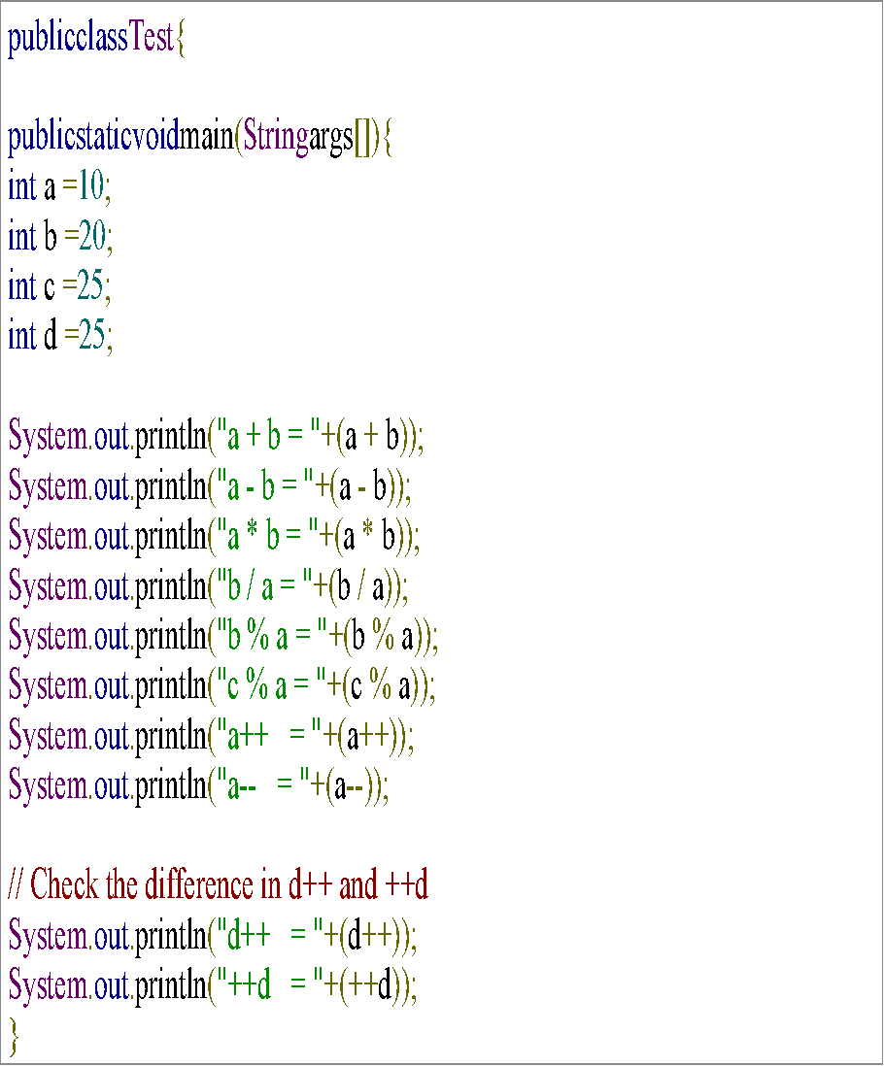
The Arithmetic Operators and Unary Operators
a + b = 30
a - b = -10
a * b = 200
b / a = 2
b % a = 0
c % a = 5
a++ = 10
a-- = 11
d++ = 25
++d = 27

Slide 39
The Relational Operators
There are following relational operators supported by Java language.
Assume variable A holds 10 and variable B holds 20, then
Operator | Description | Example
== (equal to) | Checks if the values of two operands are equal or not, if yes then condition becomes true. | (A == B) is not true.
!= (not equal to) | Checks if the values of two operands are equal or not, if values are not equal then condition becomes true. | (A != B) is true.
> (greater than) | Checks if the value of left operand is greater than the value of right operand, if yes then condition becomes true. | (A > B) is not true.
< (less than) | Checks if the value of left operand is less than the value of right operand, if yes then condition becomes true. | (A < B) is true.
>= (greater than or equal to) | Checks if the value of left operand is greater than or equal to the value of right operand, if yes then condition becomes true. | (A >= B) is not true.
<= (less than or equal to) | Checks if the value of left operand is less than or equal to the value of right operand, if yes then condition becomes true. | (A <= B) is true.

Slide 40
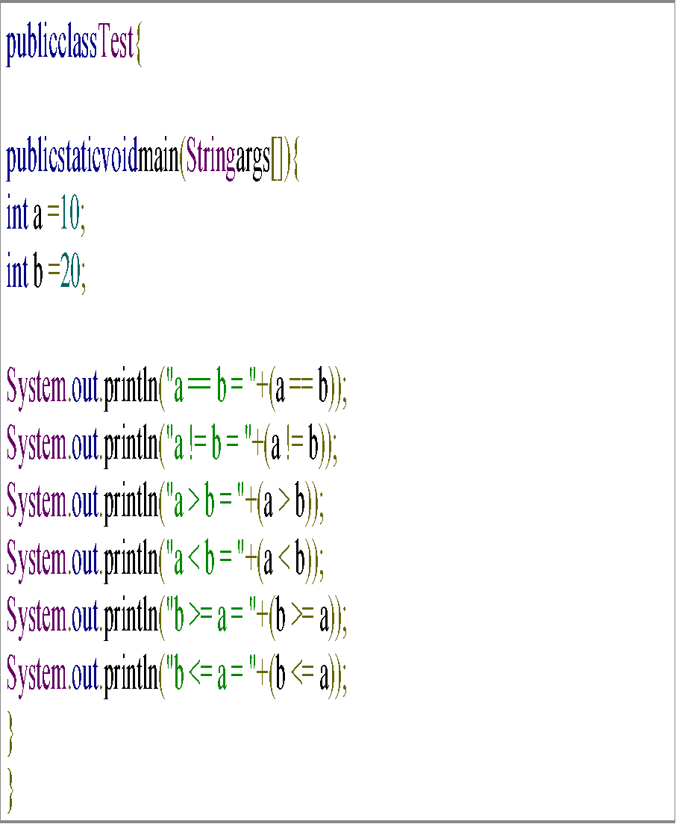
The Relational Operators
Output
a == b = false
a != b = true
a > b = false
a < b = true
b >= a = true
b <= a = false

Slide 41
The Bitwise Operators
Java defines several bitwise operators, which can be applied to the integer types, long, int, short, char, and byte.
Bitwise operator works on bits and performs bit-by-bit operation. Assume if a = 60 and b = 13; now in binary format they will be as follows −
a = 0011 1100
b = 0000 1101
---------------------------------
a&b = 0000 1100
a|b = 0011 1101
a^b = 0011 0001
~a = 1100 0011

Slide 42
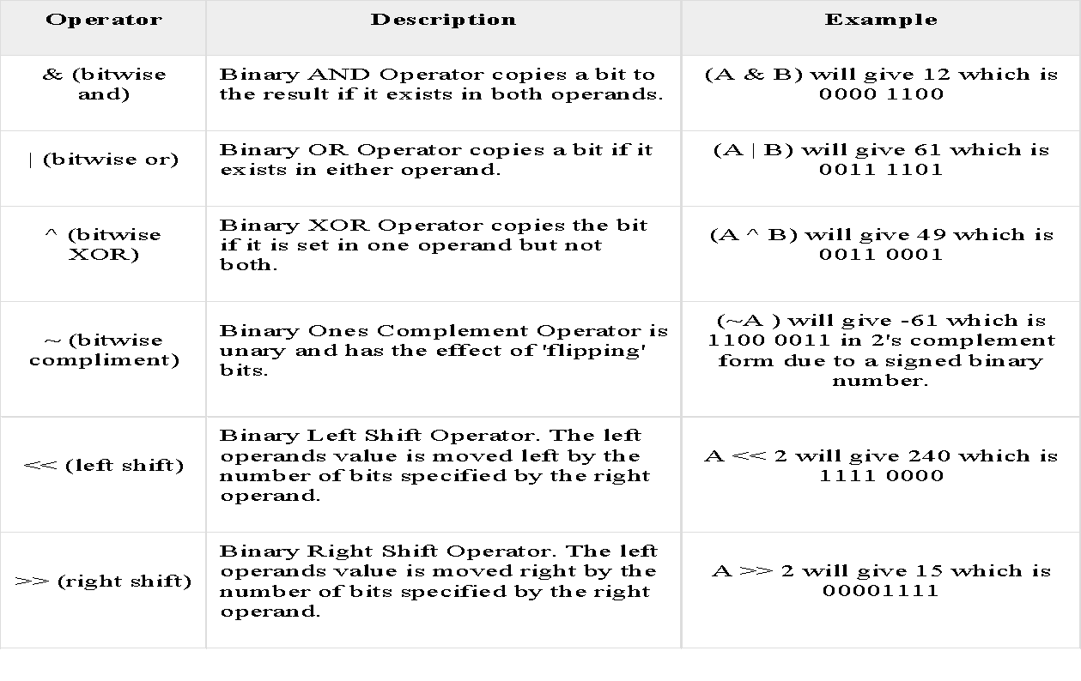
The Bitwise Operators

Slide 43
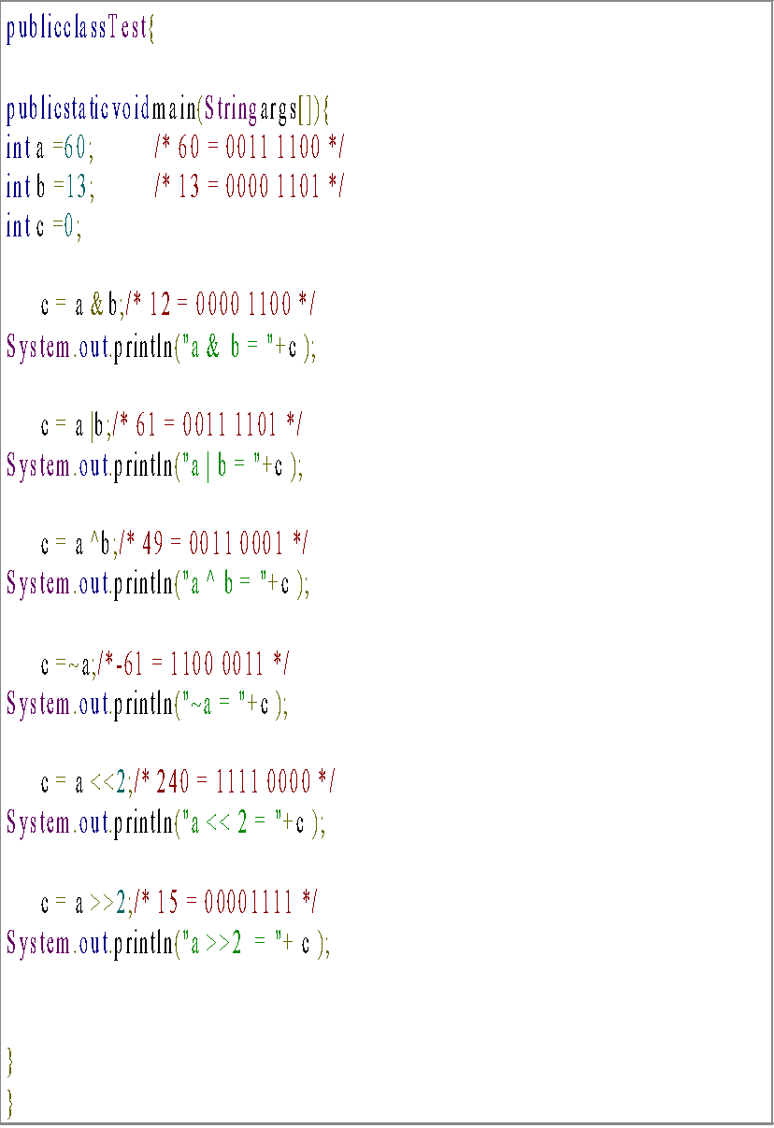
The Bitwise Operators
Output
a & b = 12
a | b = 61
a ^ b = 49
~a = -61
a << 2 = 240
a >>2 = 15

Slide 44
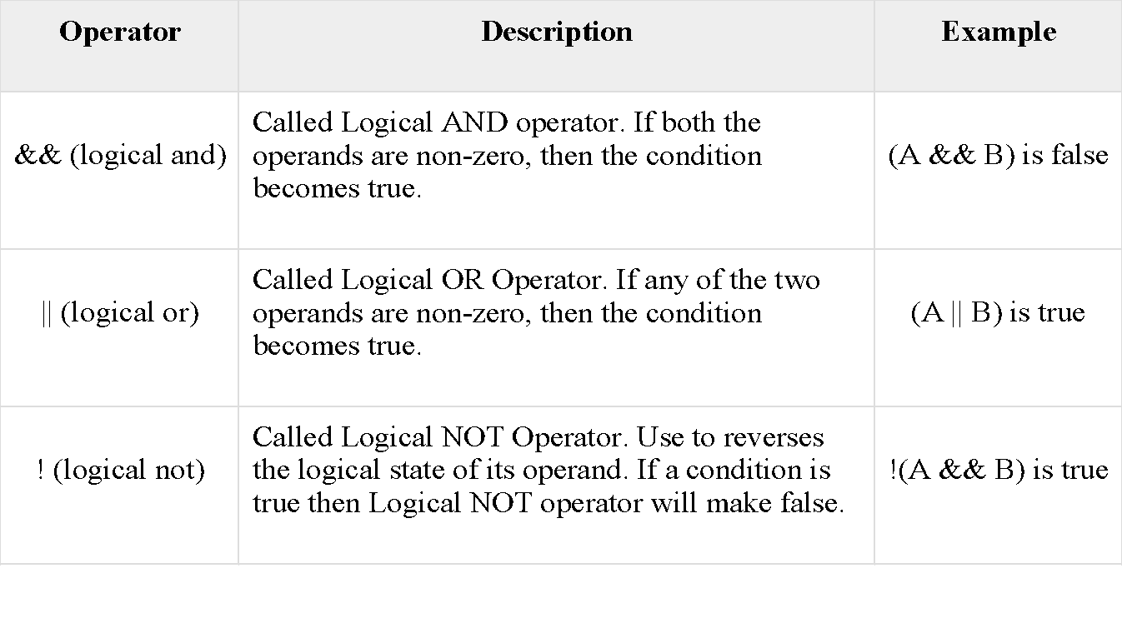
The Logical Operators

Slide 45
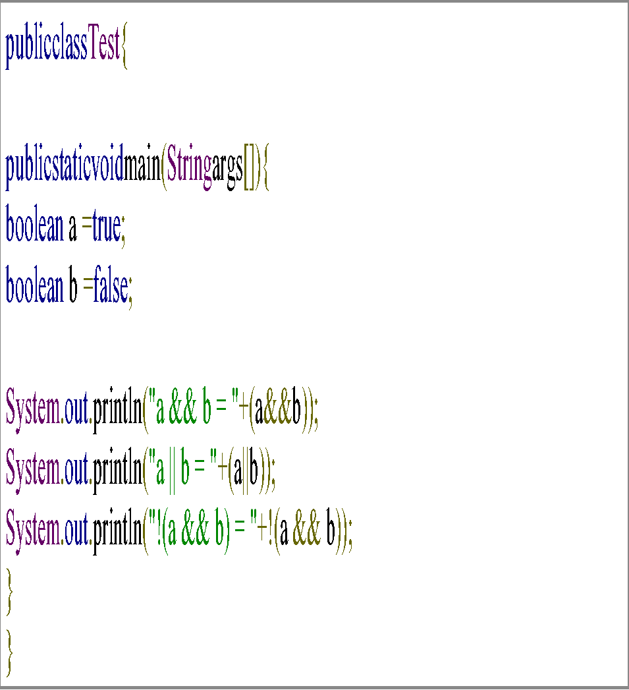
The Logical Operators
Output
a && b = false
a || b = true!
(a && b) = true

Slide 46
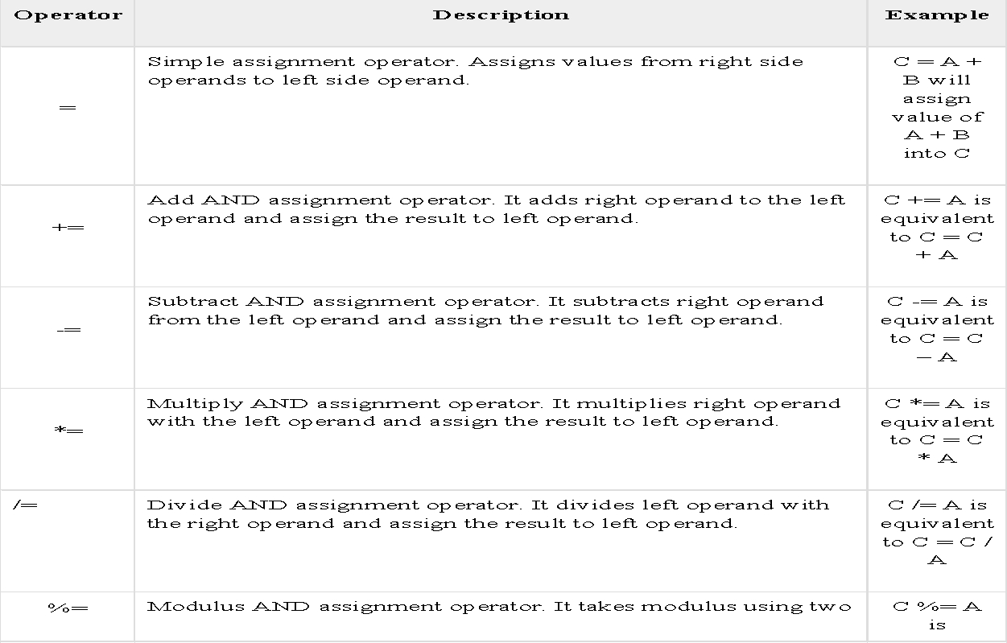
The Assignment Operators

Slide 47
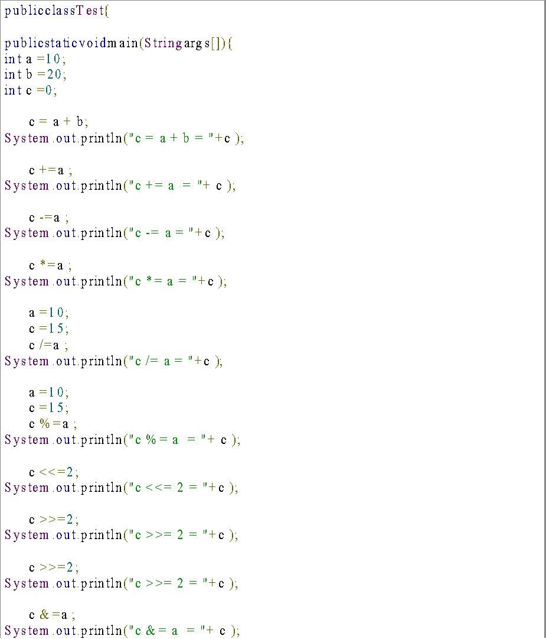
The Assignment Operators
c = a + b = 30
c += a = 40
c -= a = 30
c *= a = 300
c /= a = 1
c %= a = 5
c <<= 2 = 20
c >>= 2 = 5
c >>= 2 = 1
c &= a = 0
c ^= a = 10
c |= a = 10

Slide 48
Conditional Operator ( ? : )
Public class Test
{
Public static void main(String args[])
{
int a, b; a =10; b=(a==1)?20:30;
System.out.println("Value of b is : "+ b );
b=(a==10)?20:30;
System.out.println("Value of b is : "+ b);
}
}
Conditional operator is also known as the ternary operator.
variable x = (expression) ? value if true : value if false
Output
Value of b is : 30
Value of b is : 20

Slide 49
instanceof Operator
This operator is used only for object reference variables.
The operator checks whether the object is of a particular type (class type or interface type)
( Object reference variable ) instanceof (class/interface type)
public class Test{
public static void main(String args[])
{
String name ="James";
// following will return true since name is type of String
boolean result = name instanceof String;
System.out.println( result);
}
}
Output
true

Slide 50
Control Statements
• Selection Statements
• Iteration statements
• Jump statements
Selection Statements
Statements allow your program to choose different paths of execution based upon the outcome of an expression or the state of a variable.
Simple if statement
If..else statement
Nested if statement
if-else-if ladder statement
Switch statement

Slide 51
Simple if statement
The if statement determines whether a code should be executed based on the specified condition.
Syntax:
if (condition) {
Statement 1; //executed if condition is true
}
Statement 2; //executed irrespective of the condition

Slide 52
If..else statement
 | public class IfElse { public static void main(String args[]) { int a = 15; if (a > 20) System.out.println("a is greater than 10"); else System.out.println("a is less than 10"); System.out.println("Hello World!"); } } }
In this statement, if the condition specified is true, the if block is executed. Otherwise, the else block is executed.
Output: a is less than 10 Hello World!

Slide 53
Nested if statement
An if present inside an if block is known as a nested if block.
It is similar to an if..else statement, except they are defined inside another if..else statement.
if (condition1) {
Statement 1; //executed if first condition is true
if (condition2) {
Statement 2; //executed if second condition is true
}
else {
Statement 3; //executed if second condition is false
}
}
Output:
s is an even number and greater than 10!
Hello World
class NestedIf
{
public static void main(String args[])
{
int s = 18;
if (s > 10)
{
if (s%2==0)
System.out.println("s is an even number and greater than 10!");
else
System.out.println("s is a odd number and greater than 10!");
}
else
{
System.out.println("s is less than 10");
}
System.out.println("Hello World!");
} }

Slide 54
if-else-if ladder statement
An if can have zero or one else's and it must come after any else if's.
An if can have zero to many else if's and they must come before the else.
Once an else if succeeds, none of the remaining else if's or else's will be tested.
Syntax
if(Boolean_expression 1) {
// Executes when the Boolean expression 1 is true
}else if(Boolean_expression 2) {
// Executes when the Boolean expression 2 is true
}else if(Boolean_expression 3) {
// Executes when the Boolean expression 3 is true
}else {
// Executes when the none of the above condition is true.
}
class ElseIf {
public static void main(String args[]) {
int x = 30;
if( x == 10 ) {
System.out.print("Value of X is 10");
}else if( x == 20 ) {
System.out.print("Value of X is 20");
}else if( x == 30 ) {
System.out.print("Value of X is 30");
}else {
System.out.print("This is else statement");
}
}
}
Output
Value of X is 30

Slide 55
Switch statement
One or N number of case values can be specified for a switch expression.
Case values that are duplicate are not permissible. A compile-time error is generated by the compiler if unique values are not used.
The case value must be constant. Variables are not permissible.
The variable used in a switch statement can only be integers, byte, short, char, strings and enums.
public class Music {
public static void main(String[] args)
{
int instrument = 4;
String musicInstrument;
// switch statement with int data type
switch (instrument) {
case 1:
musicInstrument = "Guitar";
break;
case 2:
musicInstrument = "Piano";
break;
case 3:
musicInstrument = "Drums";
break;
case 4:
musicInstrument = "Flute";
break;
default:
musicInstrument = "Invalid";
break;
}
System.out.println(musicInstrument);
}
} Output:
Flute

Slide 56
Looping Statements
Statements that execute a block of code repeatedly until a specified condition is met are known as looping statements. Java provides the user with three types of loops:
While
Do..while
For
For-Each

Slide 57
While
The condition to be specified in the while loop must be a Boolean expression.
An error will be generated if the type used is int or a string.
Syntax:
while (condition)
{
statementOne;
}
Example
public class whileTest
{
public static void main(String args[])
{
int i = 5;
while (i<= 15)
{
System.out.println(i);
i = i+2;
}
} }
Output:
5
7
9
11
13
15

Slide 58
Do..while
The do-while loop is similar to the while loop, the only difference being that the condition in the do-while loop is evaluated after the execution of the loop body.
This guarantees that the loop is executed at least once.
Syntax:
do{
//code to be executed
}while(condition);
Example:
public class DoWhile
{
public static void main(String args[])
{
int i = 20;
do
{
System.out.println(i);
i = i+1;
} while (i<= 20);
}
}
Output:
20

Slide 59
for loop
Example:
public class ForLoop
{
public static void main(String args[])
{
for (int i = 1; i<= 10; i++)
System.out.println(i);
}
}
Output:
1
2
3
4
5
6
7
8
9
10
The for loop in java is used to iterate and evaluate a code multiple times.
When the number of iterations is known by the user, it is recommended to use the for loop.
Syntax:
for (initialization; condition; increment/decrement)
{
statement;
}

Slide 60
For-Each
The traversal of elements in an array can be done by the for-each loop.
The elements present in the array are returned one by one.
It must be noted that the user does not have to increment the value in the for-each loop.
Output
10, 20, 30, 40, 50,
James, Larry, Tom, Lacy
class ForEach{
Public static void main(String args[]){
int[] numbers ={10,20,30,40,50};
for(int x : numbers )
{
System.out.print( x);
System.out.print(",");
}
System.out.print("\n");
String[] names ={"James","Larry","Tom","Lacy"};
for(String name : names ){
System.out.print( name);
System.out.print(",");
}
}
}

Slide 61
Branching Statements
Branching statements in java are used to jump from a statement to another statement, thereby the transferring the flow of execution.
Break
The break statement in java is used to terminate a loop and break the current flow of the program.
The break statement in Java programming language has the following two usages −
When the break statement is encountered inside a loop, the loop is immediately terminated and the program control resumes at the next statement following the loop.
It can be used to terminate a case in the switch statement
public class Test {
public static void main(String args[]) {
int [] numbers = {10, 20, 30, 40, 50};
for(int x : numbers )
{
if( x == 30 )
{
break;
}
System.out.print( x );
System.out.print("\n");
}
}
}
Output
10
20

Slide 62
Branching Statements
Continue
To jump to the next iteration of the loop, we make use of the continue statement. This statement continues the current flow of the program and skips a part of the code at the specified condition.
In a for loop, the continue keyword causes control to immediately jump to the update statement.
In a while loop or do/while loop, control immediately jumps to the Boolean expression
public class Test {
public static void main(String args[]) {
int [] numbers = {10, 20, 30, 40, 50};
for(int x : numbers )
{
if( x == 30 ) {
continue;
}
System.out.print( x );
System.out.print("\n");
}
}
}
Output
10
20
40
50

Slide 63
Class Fundamentals
A class is a template for an object, and an object is an instance of a class.
The data, or variables, defined within a class are called instance variables.
the methods and variables defined within a class are called members of the class.
Variables defined within a class are called instance variables because each instance of the class (that is, each object of the class) contains its own copy of these variables.
The general formot a class does not specify a main( )method. Java classes do not need to have a main( )method.
You only specify one if that class is the starting point for your program.
A simplified general form of a class definition is shown here:
class classname{
type instance-variable1;
type instance-variable2;
// ...
type instance-variableN;
type methodname1(parameter-list) {
// body of method
}
type methodname2(parameter-list) {
// body of method
}
// ...
type methodnameN(parameter-list) {
// body of method
}
}

Slide 64
Class Fundamentals
class Box {
double width;
double height;
double depth;
}
class BoxDemo2 {
public static void main(String args[]) {
Box mybox1 = new Box();
Box mybox2 = new Box();
double vol;
// assign values to mybox1's instance variables
mybox1.width = 10;
mybox1.height = 20;
mybox1.depth = 15;
/* assign different values to mybox2's
instance variables */
mybox2.width = 3;
mybox2.height = 6;
mybox2.depth = 9;
// compute volume of first box
vol = mybox1.width * mybox1.height * mybox1.depth;
System.out.println("Volume is " + vol);
// compute volume of second box
vol = mybox2.width * mybox2.height * mybox2.depth;
System.out.println("Volume is " + vol);
}
}
output
Volume is 3000.0
Volume is 162.0
To access these variables, you will use the dot (.) operator. The dot operator links the name of the object with the name of an instance variable.
new allocates memory for an object during run time. It has thisgeneral form:
class-var = new classname( );

Slide 65
Introducing Methods
class Box {
double width;
double height;
double depth;
// compute and return volume
double volume() {
return width * height * depth;
} }
class BoxDemo{
public static void main(String args[]) {
Box mybox1 = new Box();
Box mybox2 = new Box();
double vol;
// assign values to mybox1's instance variables
mybox1.width = 10;
mybox1.height = 20;
mybox1.depth = 15;
/* assign different values to mybox2's
instance variables */
mybox2.width = 3;
mybox2.height = 6;
mybox2.depth = 9;
// get volume of first box
vol = mybox1.volume();System.out.println("Volume is " + vol);
// get volume of second box
vol = mybox2.volume();
System.out.println("Volume is " + vol);
}
}
The type of data returned by a method must be compatible with the return type specified by the method. For example, if the return type of some method is boolean, you could not return an integer.
• The variable receiving the value returned by a method (such as vol, in this case) must also be compatible with the return type specified for the method.

Slide 66
Constructors
A constructor initializes an object immediately upon creation.
Rules defined for the constructor.
1. Constructor name must be the same as its class name
2. A Constructor must have no explicit return type
3. A Java constructor cannot be abstract, static, final, and synchronized
The default constructor automatically initializes all instance variables to zero.
class Box {
double width;
double height;
double depth;
// This is the constructor for Box.
Box() {
System.out.println("Constructor Box");
width = 10;
height = 10;
depth = 10;
} // compute and return volume
double volume() {
return width * height * depth; } }
class BoxDemo6 {
public static void main(String args[]) {
// declare, allocate, and initialize Box objects
Box mybox1 = new Box();
Box mybox2 = new Box();
double vol;
// get volume of first box
vol = mybox1.volume();
System.out.println("Volume is " + vol);
// get volume of second box
vol = mybox2.volume();
System.out.println("Volume is " + vol);
}
}
output
Constructor Box
Constructor Box
Volume is 1000.0
Volume is 1000.0

Slide 67
Parameterized Constructors
class BoxDemo {
public static void main(String args[]) {
// declare, allocate, and initialize Box objects
Box mybox1 = new Box(10, 20, 15);
Box mybox2 = new Box(3, 6, 9);
double vol;
// get volume of first box
vol = mybox1.volume();
System.out.println("Volume is " + vol);
// get volume of second box
vol = mybox2.volume();
System.out.println("Volume is " + vol);
}
}
output
Volume is 3000.0
Volume is 162.0
class Box {
double width;
double height;
double depth;
// This is the constructor for Box.
Box(double w, double h, double d) {
width = w;
height = h;
depth = d;
}
// compute and return volume
double volume() {
return width * height * depth;
}}

Slide 68
Method Overloading in Java
If a class has multiple methods having same name but different in parameters, it is known as Method Overloading.
If we have to perform only one operation, having same name of the methods increases the readability of the program.
Overloading is an example of compiler-time polymorphism .
a(int,int) for two parameters, and b(int,int,int) for three parameters then it may be difficult.
There are two ways to overload the method in java
1. By changing number of arguments
2. By changing the data type
public class Sum {
public int sum(int x, int y)
{ return (x + y); }
public int sum(int x, int y, int z)
{ return (x + y + z);
}
public double sum(double x, double y)
{ return (x + y);
}
public static void main(String args[])
{
Sum s = new Sum();
System.out.println(s.sum(10, 20));
System.out.println(s.sum(10, 20, 30));
System.out.println(s.sum(10.5, 20.5));
}
}

Slide 69
Method Overloading in Java
class Adder{
static int add(int a, int b){return a+b;}
static double add(double a, double b){return a+b;}
}
class TestOverloading2{
public static void main(String[] args){
//Adder a =new Adder();
//a.add(11,11);
System.out.println(Adder.add(11,11));
System.out.println(Adder.add(12.3,12.6));
}}

Slide 70
Constructor Overloading in Java
Constructor overloading in Java is a technique of having more than one constructor with different parameter lists.
If we want to have different ways of initializing an object using different number of parameters, then we must do constructor overloading.
class Student{
int id;
String name;
int age;
Student(int i,String n)
{
id = i;
name = n; }
Student(int i,String n,int a){
id = i; name = n; age=a;
}
void display()
{
System.out.println(id+" "+name+“ "+age);}
public static void main(String args[]){
Student s1 = new Student5(111,"Karan");
Student s2 = new Student5(222,"Aryan",25); s1.display();
s2.display();
}
}
Output:
111 Karan 0
222 Aryan 25

Slide 71
Type Casting/Type conversion
When you assign value of one data type to another, the two types might not be compatible with each other.
If the data types are compatible, then Java will perform the conversion automatically known as Automatic Type Conversion and if not then they need to be casted or converted explicitly.
For example, assigning an int value to a long variable.
Converting one primitive datatype into another is known as type casting (type conversion) in Java. You can cast the primitive datatypes in two ways namely, Widening and, Narrowing.
Widening − Converting a lower datatype to a higher datatype is known as widening. In this case the casting/conversion is done automatically therefore, it is known as implicit type casting. In this case both datatypes should be compatible with each other.
For Example, in java the numeric data types are compatible with each other but no automatic conversion is supported from numeric type to char or boolean. Also, char and boolean are not compatible with each other.

Slide 72
Type Casting/Type conversion
Class TypeConversion
{
public static void main(String[] args)
{
inti = 100;
// automatic type conversion
Long l = i;
// automatic type conversion
float f = l;
System.out.println("Int value "+i);
System.out.println("Long value "+l);
System.out.println("Float value "+f);
}
}
Output:
Int value 100
Long value 100
Float value 100.0

Slide 73
Type Casting/Type conversion
Narrowing − Converting a higher datatype to a lower datatype is known as narrowing.
In this case the casting/conversion is not done automatically, you need to convert explicitly using the cast operator “( )” explicitly. Therefore, it is known as explicit type casting.

Slide 74
Type Casting/Type conversion
//Java program to illustrate explicit type conversion
Class NarrowConversion
{
public static void main(String[] args)
{
double d = 100.04;
//explicit type casting
long l = (long)d;
//explicit type casting
int i = (int)d;
System.out.println("Double value "+d);
//fractional part lost
System.out.println("Long value "+l);
//fractional part lost
System.out.println("Int value "+i);
}
}
Output:
Double value 100.04
Long value 100
Int value 100

Slide 75
THIS keyword
The this keyword refers to the current object in a method or constructor.
The most common use of the this keyword is to eliminate the confusion between class attributes and parameters with the same name .
Box(double w, double h, double d) {
this.width = w;
this.height = h;
this.depth = d;}
// Use this to resolve name-space collisions.
Box(double width, double height, double depth) {
this.width = width;
this.height = height;
this.depth = depth;
}

Slide 76
‘This’ to invoke current class constructor
Class ConstructorDemo
{
int a;
int b;
//Default constructor
ConstructorDemo()
{
this(10, 20);
System.out.println("Inside default constructor \n");
}
//Parameterized constructor
ConstructorDemo(int a, int b)
{
this.a = a;
this.b = b;
System.out.println("Inside parameterized constructor");
}
public static void main(String[] args)
{
ConstructorDemo object = new ConstructorDemo();
}
}
Output:
Inside parameterized constructor
Inside default constructor

Slide 77
Java code for using this to invoke current class method
class Test {
void display()
{
// calling function show()
this.show();
System.out.println("Inside display function");
}
void show() {
System.out.println("Inside show funcion");
}
public static void main(String args[]) {
Test t1 = new Test();
t1.display();
}
}
Inside show funcion
Inside display function

Slide 78
Garbage Collection
In java, garbage means unreferenced objects.Garbage Collection is process of reclaiming the runtime unused memory automatically. In other words, it is a way to destroy the unused objects.
To do so, we were using free() function in C language and delete() in C++. But, in java it is performed automatically. So, java provides better memory management.
Advantage of Garbage Collection
o It makes java memory efficient because garbage collector removes the unreferenced objects from heap memory.
o It is automatically done by the garbage collector(a part of JVM) so we don't need to make extra efforts.
How can an object be unreferenced?
o By nulling the reference
o By assigning a reference to another

Slide 79
Garbage Collection
finalize() method
The finalize() method is invoked each time before the object is garbage collected. This method can be used to perform cleanup processing. This method is defined in Object class as:
void finalize() { }
gc() method
found in System and Runtime classes.
public static void gc(){ }
Simple Example of garbage collection in java
public class TestGarbage1{
public void finalize()
{
System.out.println("object is garbage collected");}
public static void main(String args[]){
TestGarbage1 s1=new TestGarbage1();
TestGarbage1 s2=new TestGarbage1();
s1=null;
s2=null;
System.gc();
//s1=s2 ;
}
}
Output:
object is garbage collected
object is garbage collected

Slide 80
Parameter Passing Techniques in Java with Examples
There are different ways in which parameter data can be passed into and out of methods and functions. Let us assume that a function A() is calling another function B(). In this case A is called the “caller function” and B is called the “called function or callee function”.
In pass-by-value technique, the actual parameters in the method call are copied to the dummy parameters in the method definition. So, whatever changes are performed on the dummy parameters, they are not reflected on the actual parameters as the changes you make are done to the copies and not to the originals.
In pass-by-reference technique, reference (address) of the actual parameters are passed to the dummy parameters in the method definition. whatever changes are performed on the dummy parameters.
Note: In Java, parameters of primitive types are passed by value which is same as pass-by-value and parameters of reference types are also passed by value (the reference is copied) which is same as pass-by-reference. So, in Java all parameters are passed by value only. Non-primitive data types are called reference types because they refer to objects.

Slide 81
Parameter Passing Techniques in Java with Examples
Pass By Value by primitive type:
class Swapper
{
int a;
int b;
Swapper(int m, int n)
{
a = m;
b = n;
}
void swap(int x, int y)
{
int temp;
temp = x;
x = y;
y = temp;
}
}
class SwapDemo
{
public static void main(String[] args)
{
Swapper obj = new Swapper(10, 20);
System.out.println("Before swapping value of a is "+obj.a+" value of b is "+obj.b);
obj.swap(obj.a, obj.b);
System.out.println("After swapping value of a is "+obj.a+" value of b is "+obj.b);}}
Output:
Before swapping value of a is 10 value of b is 20
After swapping value of a is 10 value of b is 20
ass-by-value technique

Slide 82
Parameter Passing Techniques in Java with Examples
Pass By Value with reference type
class Swapper
{
int a;
int b;
Swapper(int x, int y)
{
a = x;
b = y;
}
void swap(Swapper ref)
{
int temp;
temp = ref.a;
ref.a = ref.b;
ref.b = temp;
}
}
class SwapDemo
{
public static void main(String[] args)
{
Swapper obj = new Swapper(10, 20);
System.out.println("Before swapping value of a is "+obj.a+" value of b is "+obj.b);
obj.swap(obj);
System.out.println("After swapping value of a is "+obj.a+" value of b is "+obj.b);
}
}
output
Before swapping value of a is 10 value of b is 20
After swapping value of a is 20 value of b is 10

Slide 83
Arrays
An array is a group of like-typed variables that are referred to by a common name.
Arrays of any type can be created and may have one or more dimensions. A specific element in an array is accessed by its index.
one-dimensional array
Ex: int month_days[] = new int[12];
month_days will refer to an array of 12 integers, Further all elements in the array will be initialized to zero.
Arrays can be initialized when they are declared.
An array initializer is a list of comma-separated expressions surrounded by curly braces. The commas separate the values of the array elements.
The array will automatically be created large enough to hold the number of elements you specify in the array initializer. There is no need to use new.
If you try to access elements outside the range of the array (negative numbers or numbers greater than the length of the array), you will cause a exception.

Slide 84
Arrays
class Average
{
public static void main(String args[])
{
double nums[] = {10.1, 11.2, 12.3, 13.4, 14.5};
double result = 0; int i;
for(i=0; i<5; i++)
result = result + nums[i];
System.out.println("Average is " + result / 5);
}
}
Output:
Average is 12.299999999999999

Slide 85
Arrays of Objects
class Student
{
public int roll_no;
public String name;
Student(int roll_no, String name)
{
this.roll_no = roll_no;
this.name = name;
} }
public class GFG
{
public static void main (String[] args)
{
Student[] arr;
// allocating memory for 5 objects of type Student.
arr = new Student[5];
// initialize first elements of the array
arr[0] = new Student(1,"aman");
arr[1] = new Student(2,"vaibhav");
arr[2] = new Student(3,"shikar");
arr[3] = new Student(4,"dharmesh");
arr[4] = new Student(5,"mohit");
// accessing the elements of the specified array
for (int i = 0; i < arr.length; i++)
System.out.println("Element at " + i + " : " +
arr[i].roll_no +" "+ arr[i].name);
} }
Output:
Element at 0 : 1 aman
Element at 1 : 2 vaibhav
Element at 2 : 3 shikar
Element at 3 : 4 dharmesh
Element at 4 : 5 mohit

Slide 86
Multidimensional Arrays
// Demonstrate a two-dimensional array.
class TwoDArray {
public static void main(String args[]) {
int twoD[][]= new int[4][5];
int i, j, k = 0;
for(i=0; i<4; i++)
for(j=0; j<5; j++) {
twoD[i][j] = k;
k++;
}
for(i=0; i<4; i++) {
for(j=0; j<5; j++)
System.out.print(twoD[i][j] + " ");
System.out.println();
}
}
}
This program generates the following output:
0 1 2 3 4
5 6 7 8 9
10 11 12 13 14
15 16 17 18 19
// Initialize a two-dimensional array.
class Matrix {
public static void main(String args[]) {
double m[][] = {
{ 0*0, 1*0, 2*0, 3*0 },
{ 0*1, 1*1, 2*1, 3*1 },
{ 0*2, 1*2, 2*2, 3*2 },{ 0*3, 1*3, 2*3, 3*3}
};
int i, j;
for(i=0; i<4; i++) {
for(j=0; j<4; j++)
System.out.print(m[i][j] + " ");
System.out.println();
}
}
}
When you run this program, you will get the following output:
0.0 0.0 0.0 0.0
0.0 1.0 2.0 3.0
0.0 2.0 4.0 6.0
0.0 3.0 6.0 9.0

Slide 87
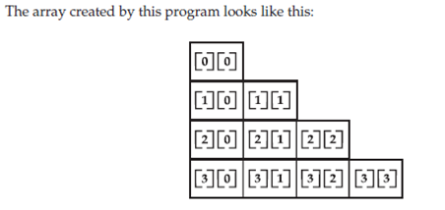
Multidimensional Arrays
// Manually allocate differing size second dimensions.
class TwoDAgain {
public static void main(String args[]) {
int twoD[][] = new int[4][];
twoD[0] = new int[1];
twoD[1] = new int[2];
twoD[2] = new int[3];
twoD[3] = new int[4];
int i, j, k = 0;
for(i=0; i<4; i++)
for(j=0; j<i+1; j++) {
twoD[i][j] = k;
k++;
}
for(i=0; i<4; i++) {
for(j=0; j<i+1; j++)
System.out.print(twoD[i][j] + " ");
System.out.println();
} } }
This program generates the following output:
0
1 2
3 4 5
6 7 8 9

Slide 88
Multidimensional Arrays
// Demonstrate a three-dimensional array.
class ThreeDMatrix {
public static void main(String args[]) {
int threeD[][][] = new int[3][4][5];
int i, j, k;
for(i=0; i<3; i++)
for(j=0; j<4; j++)
for(k=0; k<5; k++)
threeD[i][j][k] = i * j * k;
for(i=0; i<3; i++) {
for(j=0; j<4; j++) {
for(k=0; k<5; k++)
System.out.print(threeD[i][j][k] + " ");
System.out.println();
}
System.out.println();
}
}
}
0 0 0 0 0
0 0 0 0 0
0 0 0 0 0
0 0 0 0 0
0 0 0 0 0
0 1 2 3 4
0 2 4 6 8
0 3 6 9 12
0 0 0 0 0
0 2 4 6 8
0 4 8 12 16
0 6 12 18 24

Slide 89
Multidimensional Arrays
// This program demonstrates the length array member.
class Length
{
public static void main(String args[])
{
int a1[] = new int[10];
int a2[] = {3, 5, 7, 1, 8, 99, 44, -10};
int a3[] = {4, 3, 2, 1};
System.out.println("length of a1 is " + a1.length);
System.out.println("length of a2 is " + a2.length);
System.out.println("length of a3 is " + a3.length); } }
// Java program to demonstrate cloning of one-dimensional arrays
class Test
{
public static void main(String args[])
{
int intArray[] = {1,2,3};
int cloneArray[] = intArray.clone();
for (int i = 0; i < cloneArray.length; i++)
{
System.out.print(cloneArray[i]+" ");
}
} }

Slide 90
String Handling
Unlike many other languages that implement strings as character arrays, Java implements strings as objects of type String.
String objects are immutable. The key benefits of keeping this class as immutable are caching, security, synchronization, and performance.
When you create a String object, you are creating a string that cannot be changed. That is, once a String object has been created, you cannot change the characters that comprise that string.
Each time you need an altered version of an existing string, a new String object is created that contains the modifications.
The main advantage of string immutability is that Java compiler can save space in the memory by sharing strings.
For those cases in which a modifiable string is desired, Java provides two options: StringBuffer and StringBuilder. Both hold strings that can be modified after they are created.
The String, StringBuffer, and StringBuilder classes are defined in java.lang. Thus, they are available to all programs automatically.
All are declared final, which means that none of these classes may be subclassed.
Notes:
https://www.scientecheasy.com/2020/05/java-immutable-string.html/
https://www.freetimelearning.com/java/java-immutability-of-string.php

Slide 91
String Handling
The String Constructors
String with no characters in it
String s = new String();
String(char chars[ ])
Here is an example:
char chars[] = { 'a', 'b', 'c' };
String s = new String(chars);
This constructor initializes s with the string “abc”.
subrange of a character array
String(char chars[ ], int startIndex, int numChars)
Here is an example:
char chars[] = { 'a', 'b', 'c', 'd', 'e', 'f' };
String s = new String(chars, 2, 3);
This initializes s with the characters cde.
String(String strObj)
Here, strObj is a String object.
// Construct one String from another.
class MakeString {
public static void main(String args[]) {
char c[] = {'J', 'a', 'v', 'a'};
String s1 = new String(c);
String s2 = new String(s1);
System.out.println(s1);
System.out.println(s2);
}
}
The output from this program is as follows:
Java
Java

Slide 92
String Handling
String Length
int length( )
example
The following fragment prints “3”, since there are three characters in the string s:
char chars[] = { 'a', 'b', 'c' };
String s = new String(chars);
System.out.println(s.length());
length can be used for int[], double[], String[] to know the length of the arrays.
length() can be used for Strings.
String Concatenation
Example
String age = "9";
String s = "He is " + age + " years old.";
System.out.println(s);
This displays the string “He is 9 years old.”
Example
String s = "four: " + 2 + 2;
System.out.println(s);
This fragment displays
four: 22
Example
String s = "four: " + (2 + 2);
Now s contains the string
“four: 4”.

Slide 93
String Handling
public String toString() {//overriding the toString() method
return rollno+" "+name+" "+city;
}
public static void main(String args[]){
Student s1=new Student(101,"Raj","lucknow");
Student s2=new Student(102,"Vijay","ghaziabad");
System.out.println(s1);//compiler writes here s1.toString()
System.out.println(s2);//compiler writes here s2.toString()
}
}
Output:101 Raj lucknow
102 Vijay ghaziabad
If you print any object, java compiler internally invokes the toString() method on the object. So overriding the toString() method, returns the desired output, it can be the state of an object etc. depends on your implementation.
class Student{
int rollno;
String name;
String city;
Student(int rollno, String name, String city){
this.rollno=rollno;
this.name=name;
this.city=city; }

Slide 94
String Handling
class Gfg1 {
public static void main(String args[])
{
String str = "Welcome! to Computer Science Department";
char[] destArray = new char[30];
try {
str.getChars(12, 39, destArray, 0);
System.out.println(destArray);
}
catch (Exception ex) {
System.out.println(ex);
} } }
Output:
Computer Science Department
The java string getChars() method copies characters from the given string into the destination character array.
Syntax:
public void getChars(int srhStartIndex, int srhEndIndex, char[] destArray, int destStartIndex)
Parameters:
srhStartIndex : Index of the first character in the string to copy.
srhEndIndex : Index after the last character in the string to copy.
destArray : Destination array where chars wil get copied.
destStartIndex : Index in the array starting from where the chars will be pushed into the array.
Return: It does not return any value.
Exception: StringIndexOutOfBoundsException – If srhStartIndex, srhEndIndex are not in proper range.

Slide 95
String Handling
String Comparison
boolean equals(Object str)
Here, str is the String object being compared with the invoking String object. It returns true if the strings contain the same characters in the same order, and false otherwise. The comparison is case-sensitive.
it compares two strings, it considers A-Z to be the same as a-z. It has this general form:
Boolean equalsIgnoreCase(String str)
startsWith( ) and endsWith( )
boolean startsWith(String str)
boolean endsWith(String str)
Here, str is the String being tested. If the string matches, true is returned. Otherwise, false is returned.
For example,
"Foobar".endsWith("bar")
and
"Foobar".startsWith("Foo")
are both true.

Slide 96
Changing the Case of Characters Within a String
String toLowerCase( )
String toUpperCase( )
equals( ) Versus ==
It is important to understand that the equals( ) method and the == operator perform two different operations.
the equals( ) method compares the characters inside a String object.
The == operator compares two object references to see whether they refer to the same instance.
public class Test {
public static void main(String[] args)
{
String s1 = new String("HELLO");
String s2 = new String("HELLO");
System.out.println(s1 == s2);
s1=s2;
System.out.println(s1.equals(s2));
System.out.println(s1 == s2);
} }
Output:
false
true
true

Slide 97
// Demonstrate indexOf() and lastIndexOf().
class indexOfDemo {
public static void main(String args[]) {
String s = "Now is the time for all good men " +
"to come to the aid of their country.";
System.out.println(s);
System.out.println("indexOf(t) = " +s.indexOf('t'));
System.out.println("lastIndexOf(t)=“+s.lastIndexOf('t'));
System.out.println("indexOf(the) = " +s.indexOf("the"));
System.out.println("lastIndexOf(the)="s.lastIndexOf("the"));
System.out.println("indexOf(t, 10) = " + s.indexOf('t',10));
System.out.println("lastIndexOf(t, 60) ="+s.lastIndexOf('t', 60));
System.out.println("indexOf(the, 10) = " +
s.indexOf("the", 10));
System.out.println("lastIndexOf(the, 60) = " +
s.lastIndexOf("the", 60));
}
}
Here is the output of this program:
Now is the time for all good men to come to the aid of their country.
indexOf(t) = 7
lastIndexOf(t) = 65
indexOf(the) = 7
lastIndexOf(the) = 55
indexOf(t, 10) = 11
lastIndexOf(t, 60) = 55
indexOf(the, 10) = 44
lastIndexOf(the, 60) = 55
Changing the Case of Characters Within a String
String toLowerCase( )
String toUpperCase( )

Slide 98
concat( )
You can concatenate two strings using concat( ), shown here:
String concat(String str)
This method creates a new object that contains the invoking string with the contents of str appended to the end.
concat( ) performs the same function as +.
For example,
String s1 = "one";
String s2 = s1.concat("two");
puts the string “onetwo” into s2. It generates the same result as the following sequence:
String s1 = "one";
String s2 = s1 + "two";
replace( )
String replace(char original, char replacement)
For example,
String s = "Hello".replace('l', 'w');
puts the string “Hewwo” into s.
trim( )
The trim( ) method returns a copy of the invoking string from which any leading and trailing whitespace has been removed.
It has this general form:
String trim( )
Here is an example:
String s = " Hello World ".trim();
This puts the string “Hello World” into s.

Slide 99
Scope and lifetime of variables in Java
Scope of a variable refers to in which areas or sections of a program can the variable be accessed and lifetime of a variable refers to how long the variable stays alive in memory.
General convention for a variable’s scope is, it is accessible only within the block in which it is declared. A block begins with a left curly brace { and ends with a right curly brace }.
Three types of variables:
1) instance variables
2) class variables
3) local variables.

Slide 100
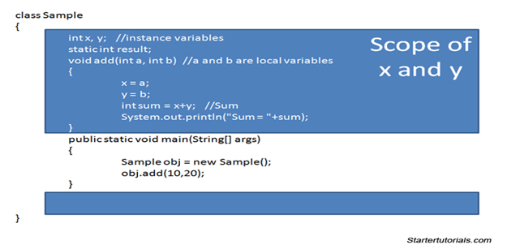
Instance Variables
A variable which is declared inside a class and outside all the methods and blocks is an instance variable.
General scope of an instance variable is throughout the class except in static methods. Lifetime of an instance variable is until the object stays in memory.

Slide 101
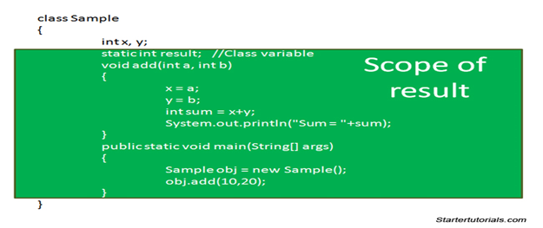
Class Variables
A variable which is declared inside a class, outside all the blocks and is marked static is known as a class variable.
General scope of a class variable is throughout the class and the lifetime of a class variable is until the end of the program .

Slide 102
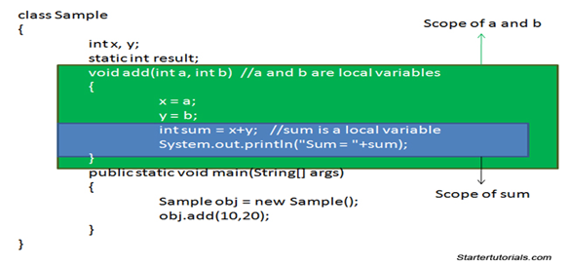
Local Variables
Scope of a local variable is within the block in which it is declared and the lifetime of a local variable is until the control leaves the block in which it is declared.

