Slide 1

Note: The data and information in this document is reflective of a hypothetical situation and client. This document is to be used for KPMG Virtual Internship purposes only.
Sprocket Central Pty Ltd
Data analytics approach
[Data Analytics Team] - [M.Owais], [Data Analyst]

Slide 2
Note: The data and information in this document is reflective of a hypothetical situation and client. This document is to be used for KPMG Virtual Internship purposes only.
Agenda
Introduction
Data Exploration
Model Development
Interpretation

Slide 3
Note: The data and information in this document is reflective of a hypothetical situation and client. This document is to be used for KPMG Virtual Internship purposes only.
Introduction
Place headline insight or information here. This should be the most important point for this slide.
Outline of Problem
Sprocket Central is a company that specializes in high-quality bikes and cycling accessories.
Their marketing team is looking to boost business sales by analyzing the past datasets.
Using 3 datasets provided, the aim is to target the customers from top 1000 new customers that are more likely to contribute in value of the company.
Content of Data Analysis
No of transaction based on gender.
Bike related purchase over last 3 year based on gender.
State wise no of car owns
Job industry distribution
Wealth segment distribution by age group

Slide 4
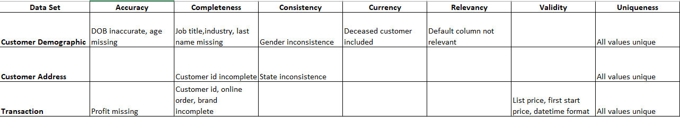
Note: The data and information in this document is reflective of a hypothetical situation and client. This document is to be used for KPMG Virtual Internship purposes only.
Data Exploration
Data Quality Assessment and Clean Up
Key Issues for Data Quality Assessment.
Accuracy: Correct Values
Completeness: Data Fields with Values
Consistency: Values Free from Contradictions.
Currency: Values up to Date
Relevancy: Data Item with Value Meta Data
Validity: Data Containing with in Allowable Limits.
Uniqueness: Records that are Duplicated.
An in-depth analysis had already been shared via email
.

Slide 5
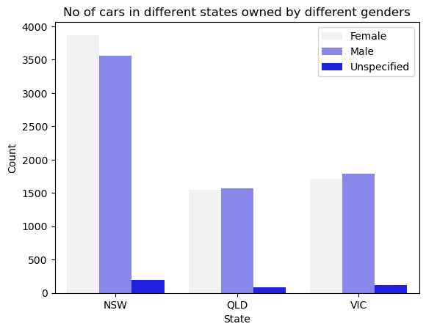
Note: The data and information in this document is reflective of a hypothetical situation and client. This document is to be used for KPMG Virtual Internship purposes only.
Data Exploration
Cars Owned State and Gender Wise
No of cars owned by different genders of different state.
Here we can see that NSW has more female owned car.
.

Slide 6
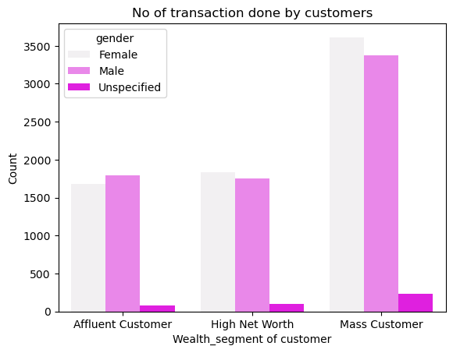
Note: The data and information in this document is reflective of a hypothetical situation and client. This document is to be used for KPMG Virtual Internship purposes only.
Data Exploration
No. Of Transactions By Customer Segment and Gender
Majority of transactions are done by Mass Customer (Female) followed by Mass Customer (Male).
.

Slide 7
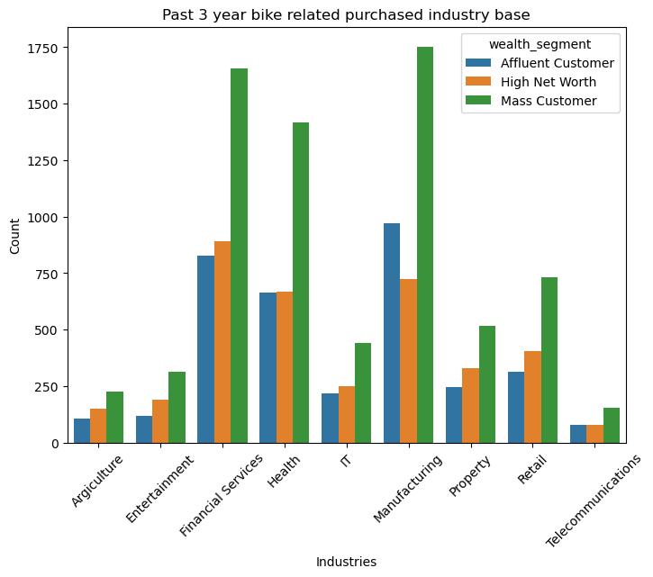
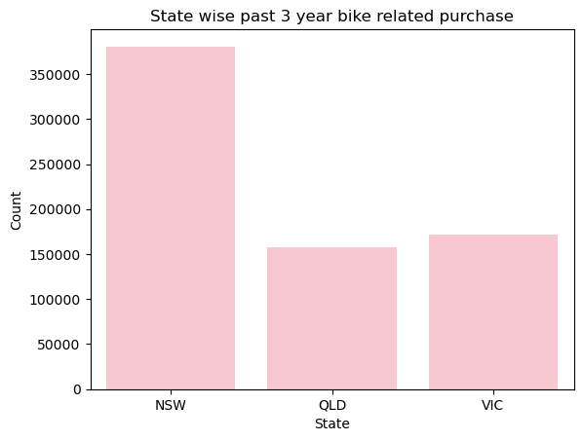
Note: The data and information in this document is reflective of a hypothetical situation and client. This document is to be used for KPMG Virtual Internship purposes only.
Data Exploration
Past 3 Year Bike Related Purchases by Industries and State Wise
Major bike related purchases are done by Manufacturing Industries followed by Financial Services and Health industry.
Again Mass Customer are In lead.
State wise NSW had the most no of past 3 year bike related purchase.
.

Slide 8
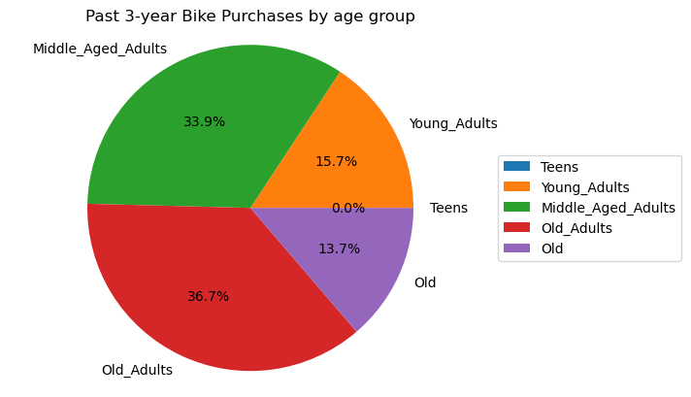
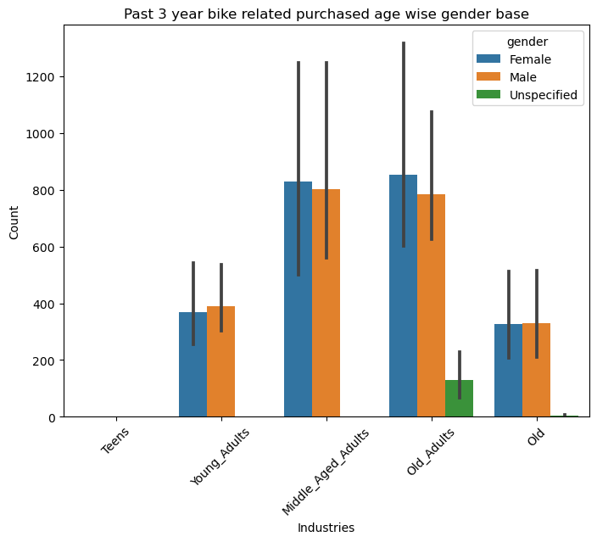
Note: The data and information in this document is reflective of a hypothetical situation and client. This document is to be used for KPMG Virtual Internship purposes only.
Data Exploration
Past 3 Year Bike Related Purchases by Age-Group
Here age grouping are done as follows
0 to 18 Teens
19 to 30 Young_Adults
31 to 45 Middle_Aged_Adults.
46 to 60 Old_Adults.
61+ Old.
No bike related purchases are being done by Teens, Majority of purchases are being done by Old_Adults followed by Middle_Aged_Adults.
.

Slide 9
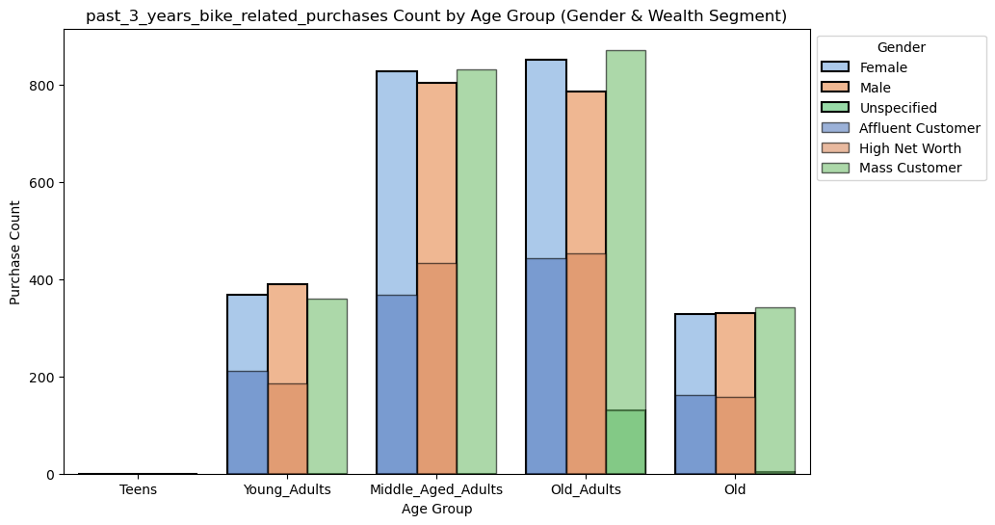
Note: The data and information in this document is reflective of a hypothetical situation and client. This document is to be used for KPMG Virtual Internship purposes only.
Model Development
Which Customers To Target From 1000 Available Customers
As per our analysis we know that following customers are more likely to do bike related purchase based on past data.
Female
NSW
Mass Customer
Old Adults
Place any supporting images, graphs, data or extra text here.

Slide 10
Note: The data and information in this document is reflective of a hypothetical situation and client. This document is to be used for KPMG Virtual Internship purposes only.
Interpretation
Top Customer
Following customers are top customers that are Females from NSW with wealth segment of Mass Customer and belong to age group of old adults, followed by male of same categories

Slide 11
Note: The data and information in this document is reflective of a hypothetical situation and client. This document is to be used for KPMG Virtual Internship purposes only.
Thank you

