Slide 1
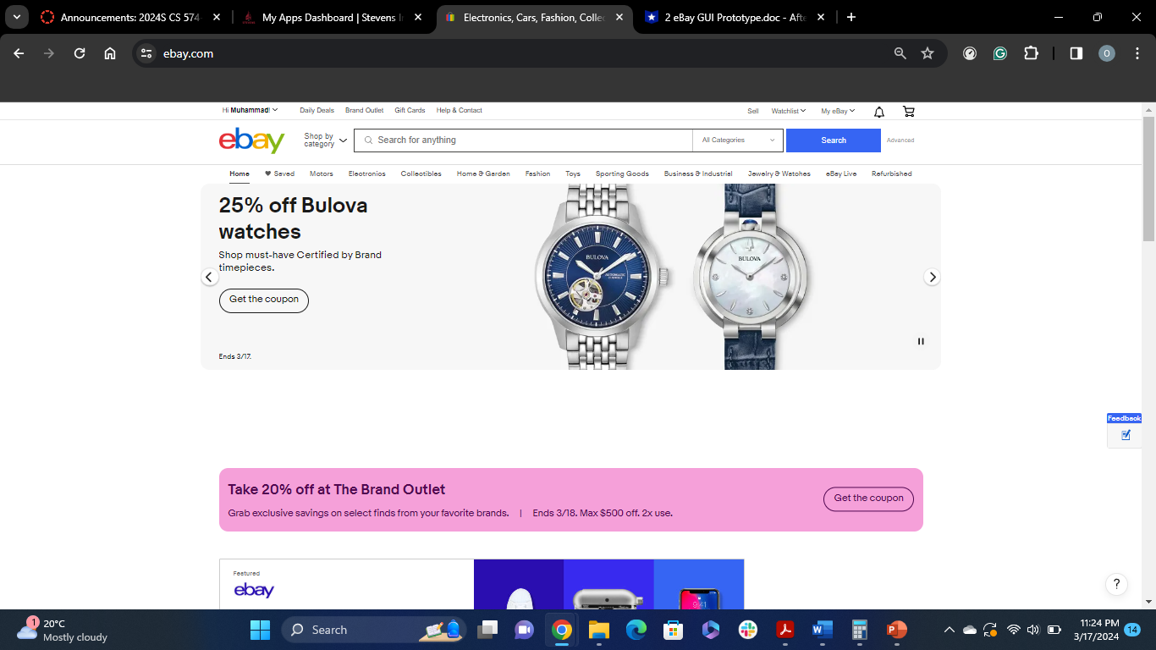
After user starts the application, the main interface appears

Slide 2
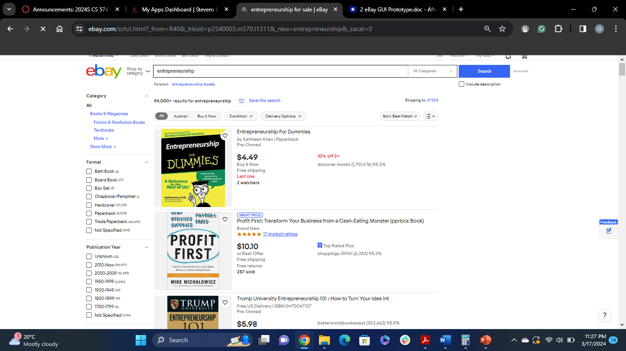
Perform a New Search:
The user fills in the desired keyword(s) in the search field, once the user is done adding the keywords, it clicks on Search button, the system then returns the result against those searches.
Search field

Slide 3
Save a Search:
The user decides to save a search for future use, after performing a search, it clicks on Save this Search button
Search Save Button

Slide 4
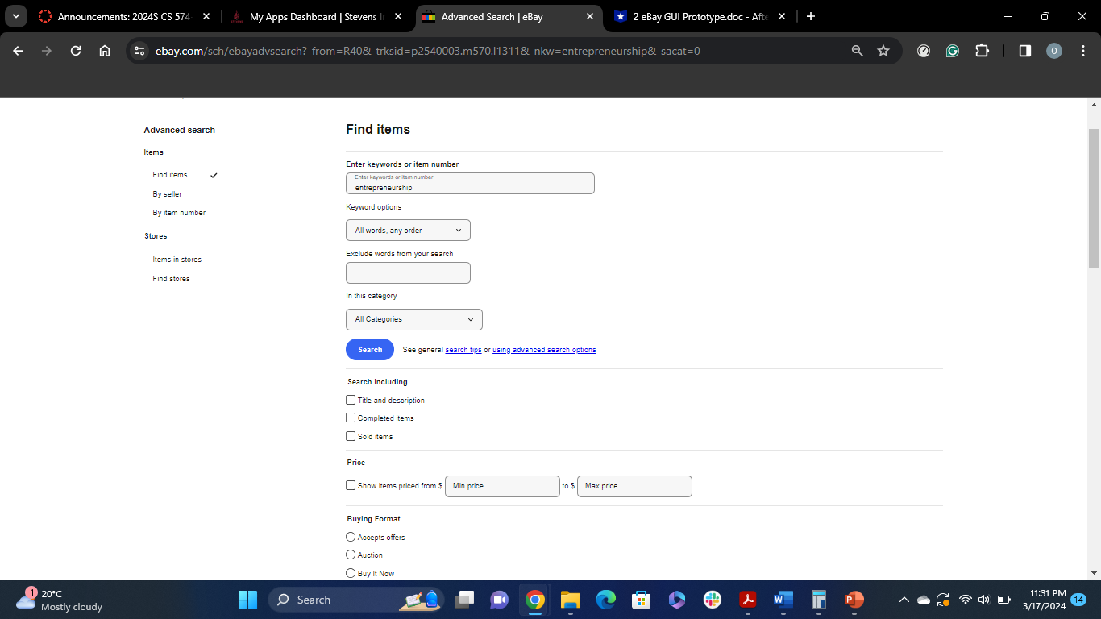
Perform an Advanced Search:
The user needs to perform a search with some more filters and details, it clicks on Advanced button, next to the search field, and fills in the details for advanced search and click on Search to perform the search operations

