Slide 1
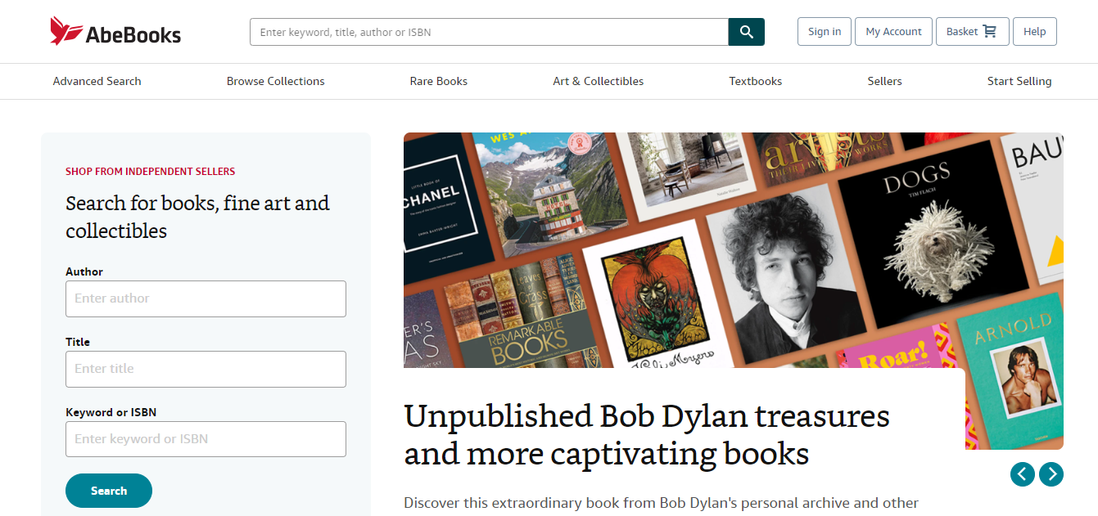
The user clicks on Sign in button on the abebooks.com homepage

Slide 2
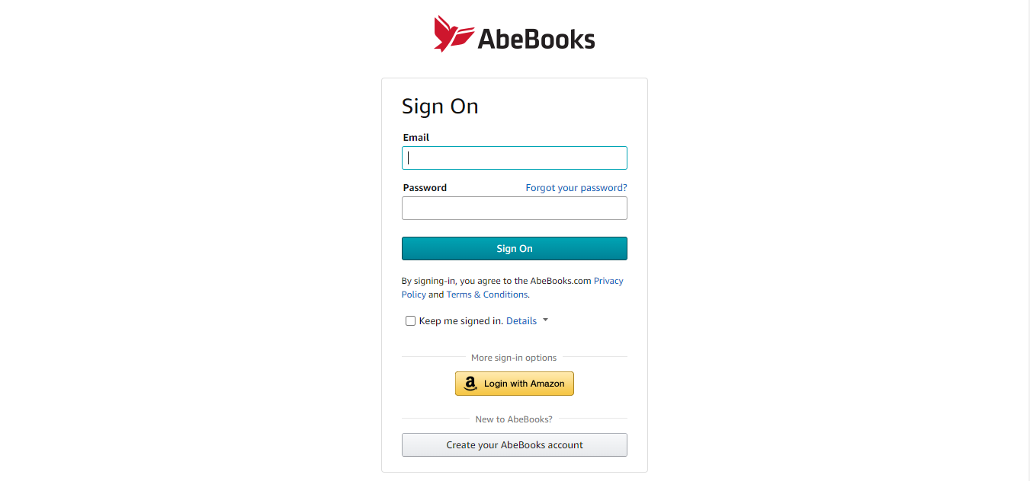
The user fills in the field of
- email address
- password
And clicks on “Sign On” Button, once the user clicks, the system validates the user input email address and password against the persistent login information stored in the database, if the validation is successful, the user is redirected to the home page and the control is transferred to the home page use case.
[Optional]
If the user clicks on Keep me signed in, the user account will remain logged in for a finite duration.

Slide 3
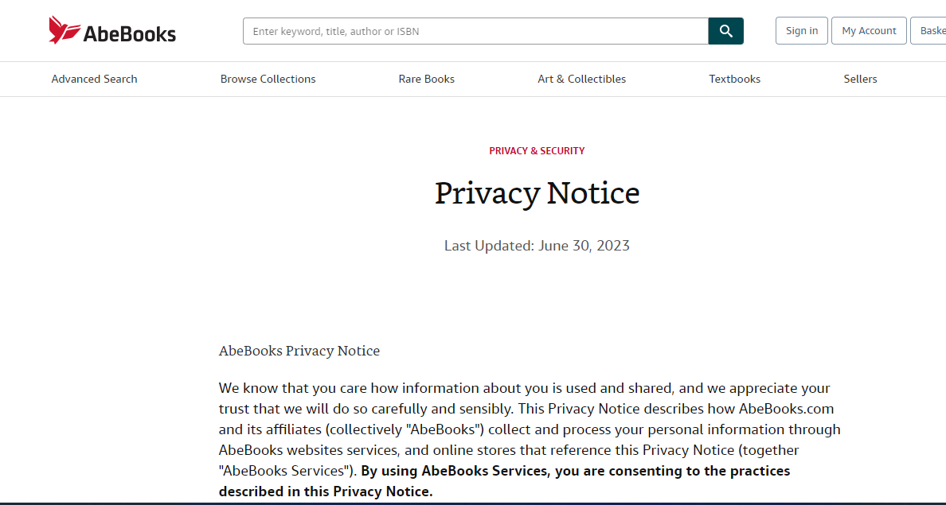
If the user clicks on Privacy Policy, abebooks.com privacy policy page loads (screenshot attached below)

Slide 4
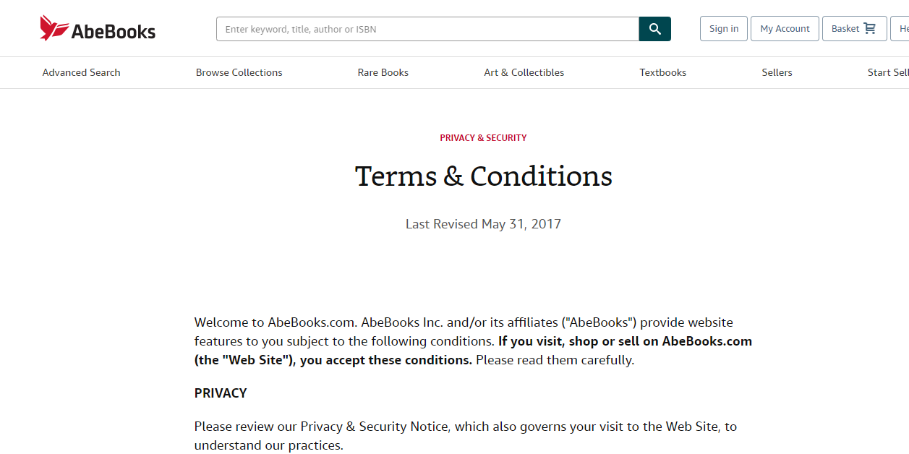
If the user clicks on Terms and Conditions, abebooks.com Terms and Condition page loads (screenshot attached below)

Slide 5
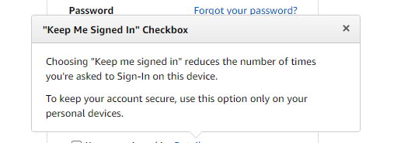
If the user clicks on Details, a floating box appears on the screen to give the user information about what “Keep me Signed in” means. Screenshot attached below

Slide 6
Alternate Course
- if the user does not type in any email and/or password, the system reacts to the effect and displays and error prompt
- if the user validation against the provided email and/or password fails, the system reacts to the effect and displays the appropriate error message along with the possible course of action.
- if the user clicks on forget password link, the control is transferred to the password recovery use case.
- if the user clicks on Create your Abebooks account, control is transferred to Create an Account use case.
- if the user clicks on Login with Amazon, the control is transferred to Login via Amazon use case.

