Slide 1
WELCOME

Slide 2


Slide 4
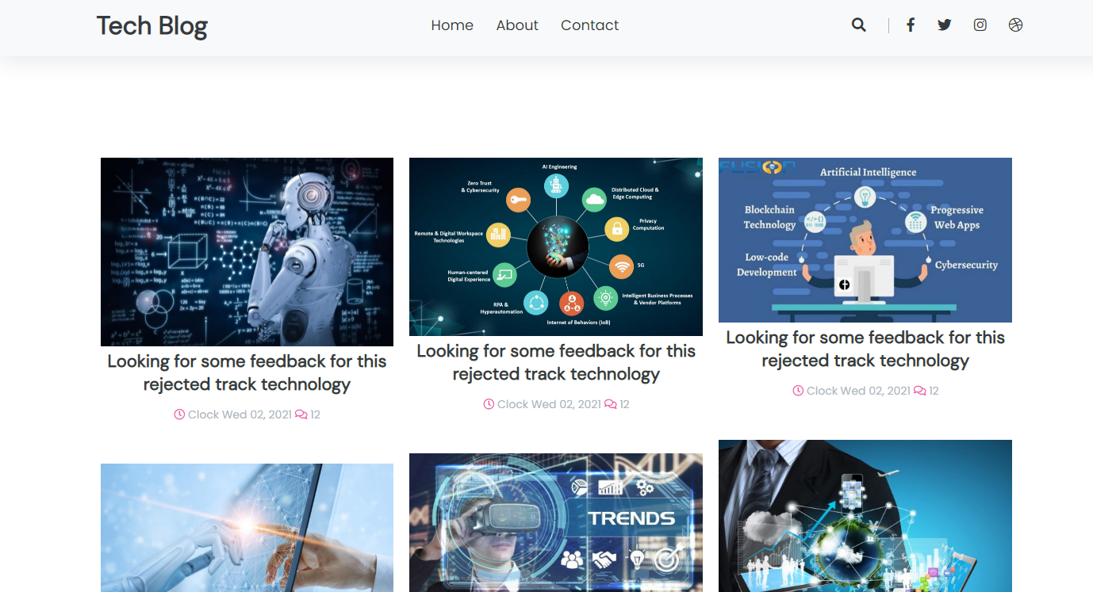

Slide 5


Slide 6
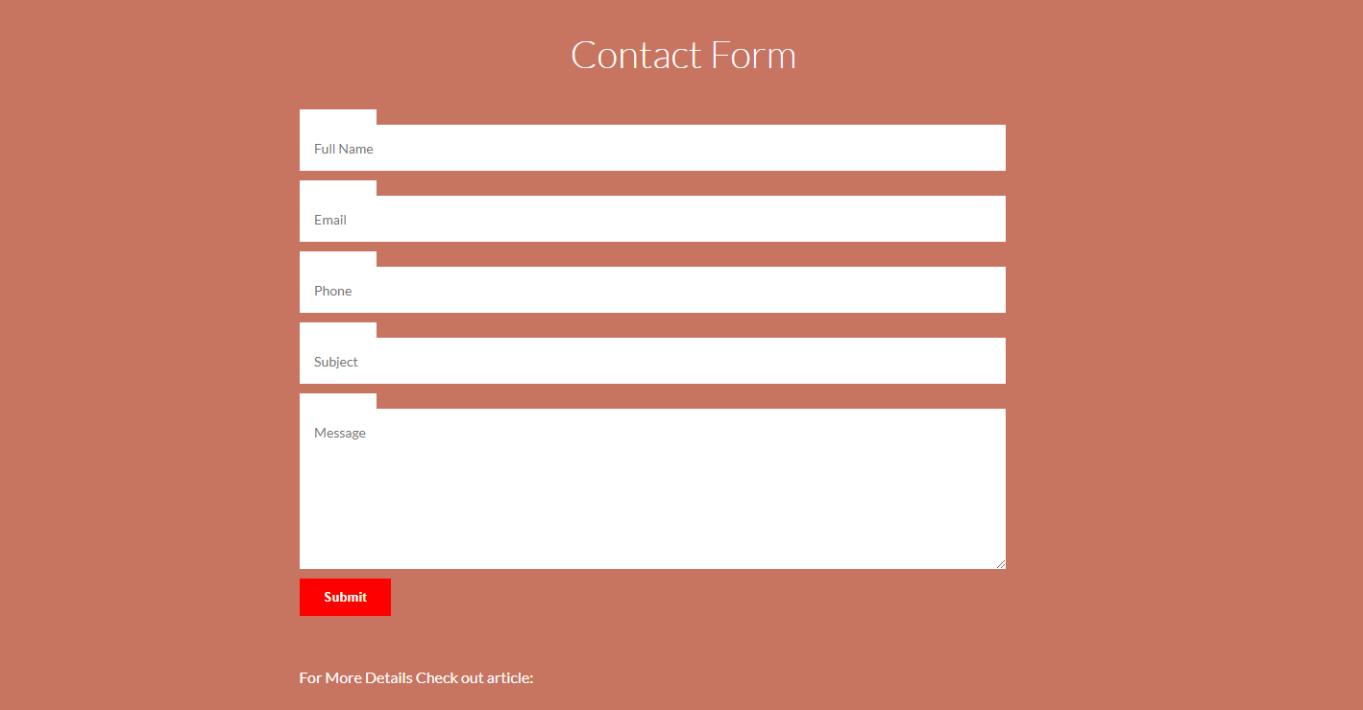

Slide 7
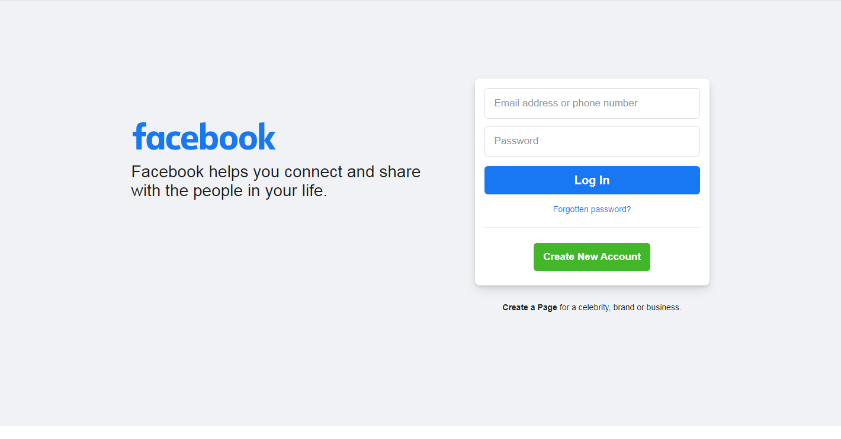

Slide 8
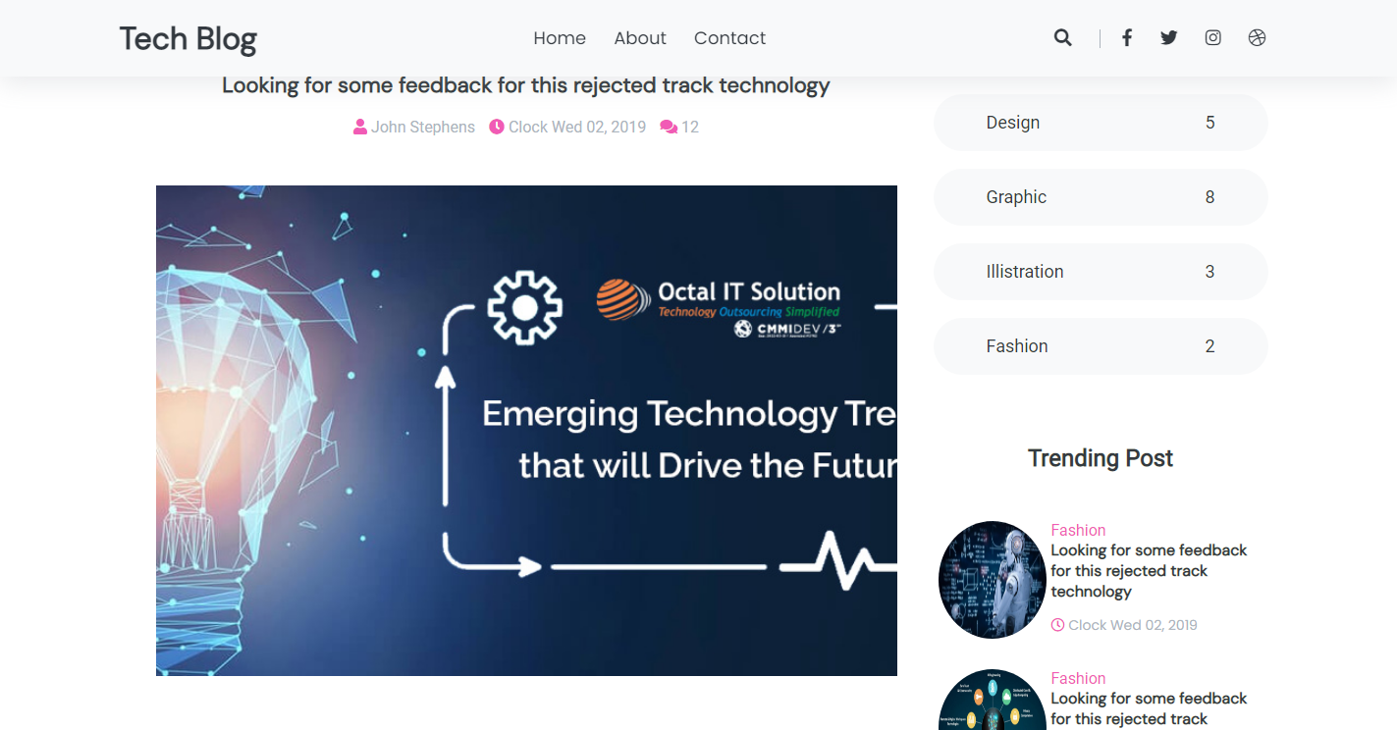

Slide 9
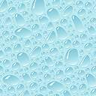
TRENDING TECHNOLOGIES
Blog website
TEAM MEMBERS:
1.Faiz Mohammed Khan-1604-19-733-309 (C.S.E (B))
2.Abdul Nayeem Sufyaan-1604-19-733-104 (C.S.E (B))
3.Mohammed Shahbaz Kareem-1604-19-733-102 (C.S.E (B))
Designed Under The Mentorship Of:-
Mr.Mohammed Faraaz

Slide 10
Domain And Technologies Used:
The content for domain was web development
We have designed a blog website using visual studio code
We used HTML(Hyper Text Markup Language)
We used CSS(Cascading Style Sheet)
We used JS(Java Script)
We used many new trending technologies pictures for designing our blog website
We have displayed new and trending technologies which are in use as of today

Slide 11
We created many pages using HTML .
HTML is the standard markup language for creating web pages.
CSS is the language we use to style an HTML document.
We used CSS for styling the HTML web pages.
CSS describes how HTML elements should be displayed.
HTML provides the basic structure of sites, which is enhanced and modified by other technologies like CSS and JavaScript.
JavaScript is the world's most popular programming language.

Slide 12
JavaScript is commonly used to dynamically modify HTML and CSS to update a user interface by the DOM API.
JavaScript is a text-based programming language used both on the client-side and server-side that allows you to make web pages interactive.
We have displayed many trending technologies in our blog website like:-
Artificial intelligence,
Cybersecurity,
Robotic process automation,
Emerging technology,
Online education,etc,.

