Slide 1
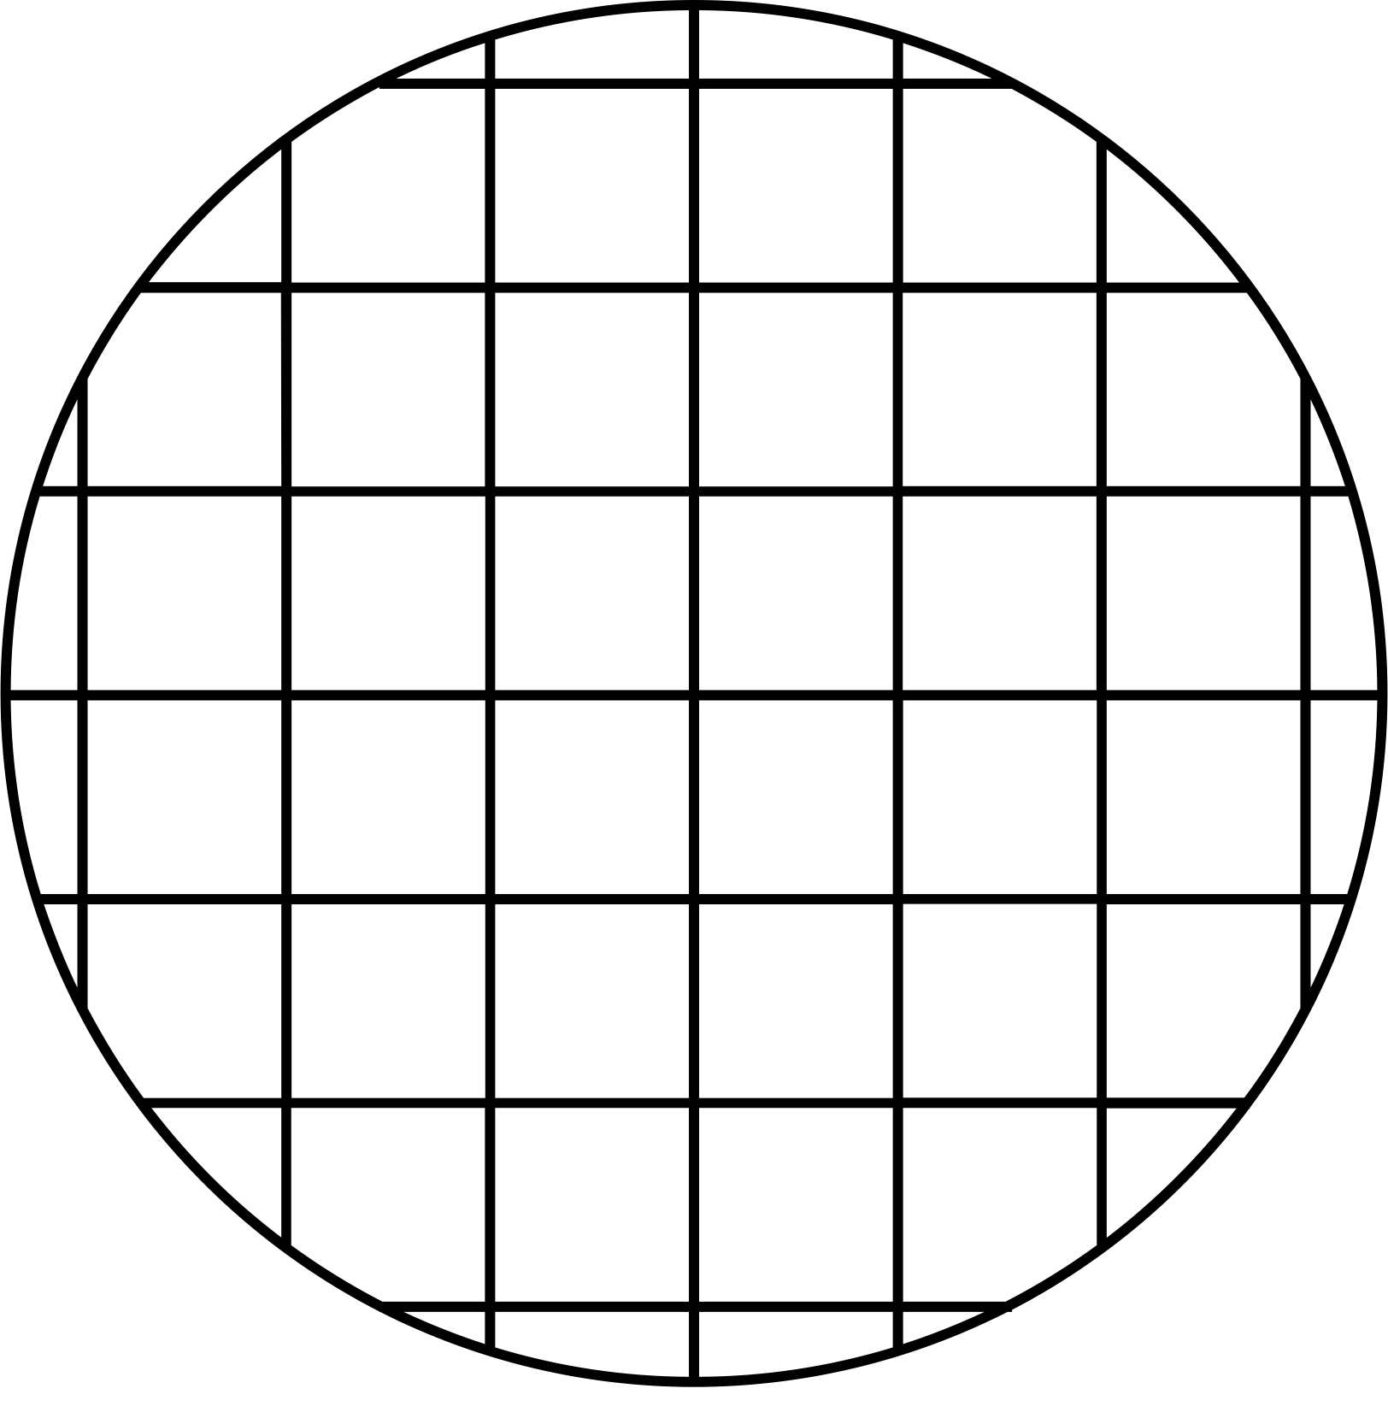



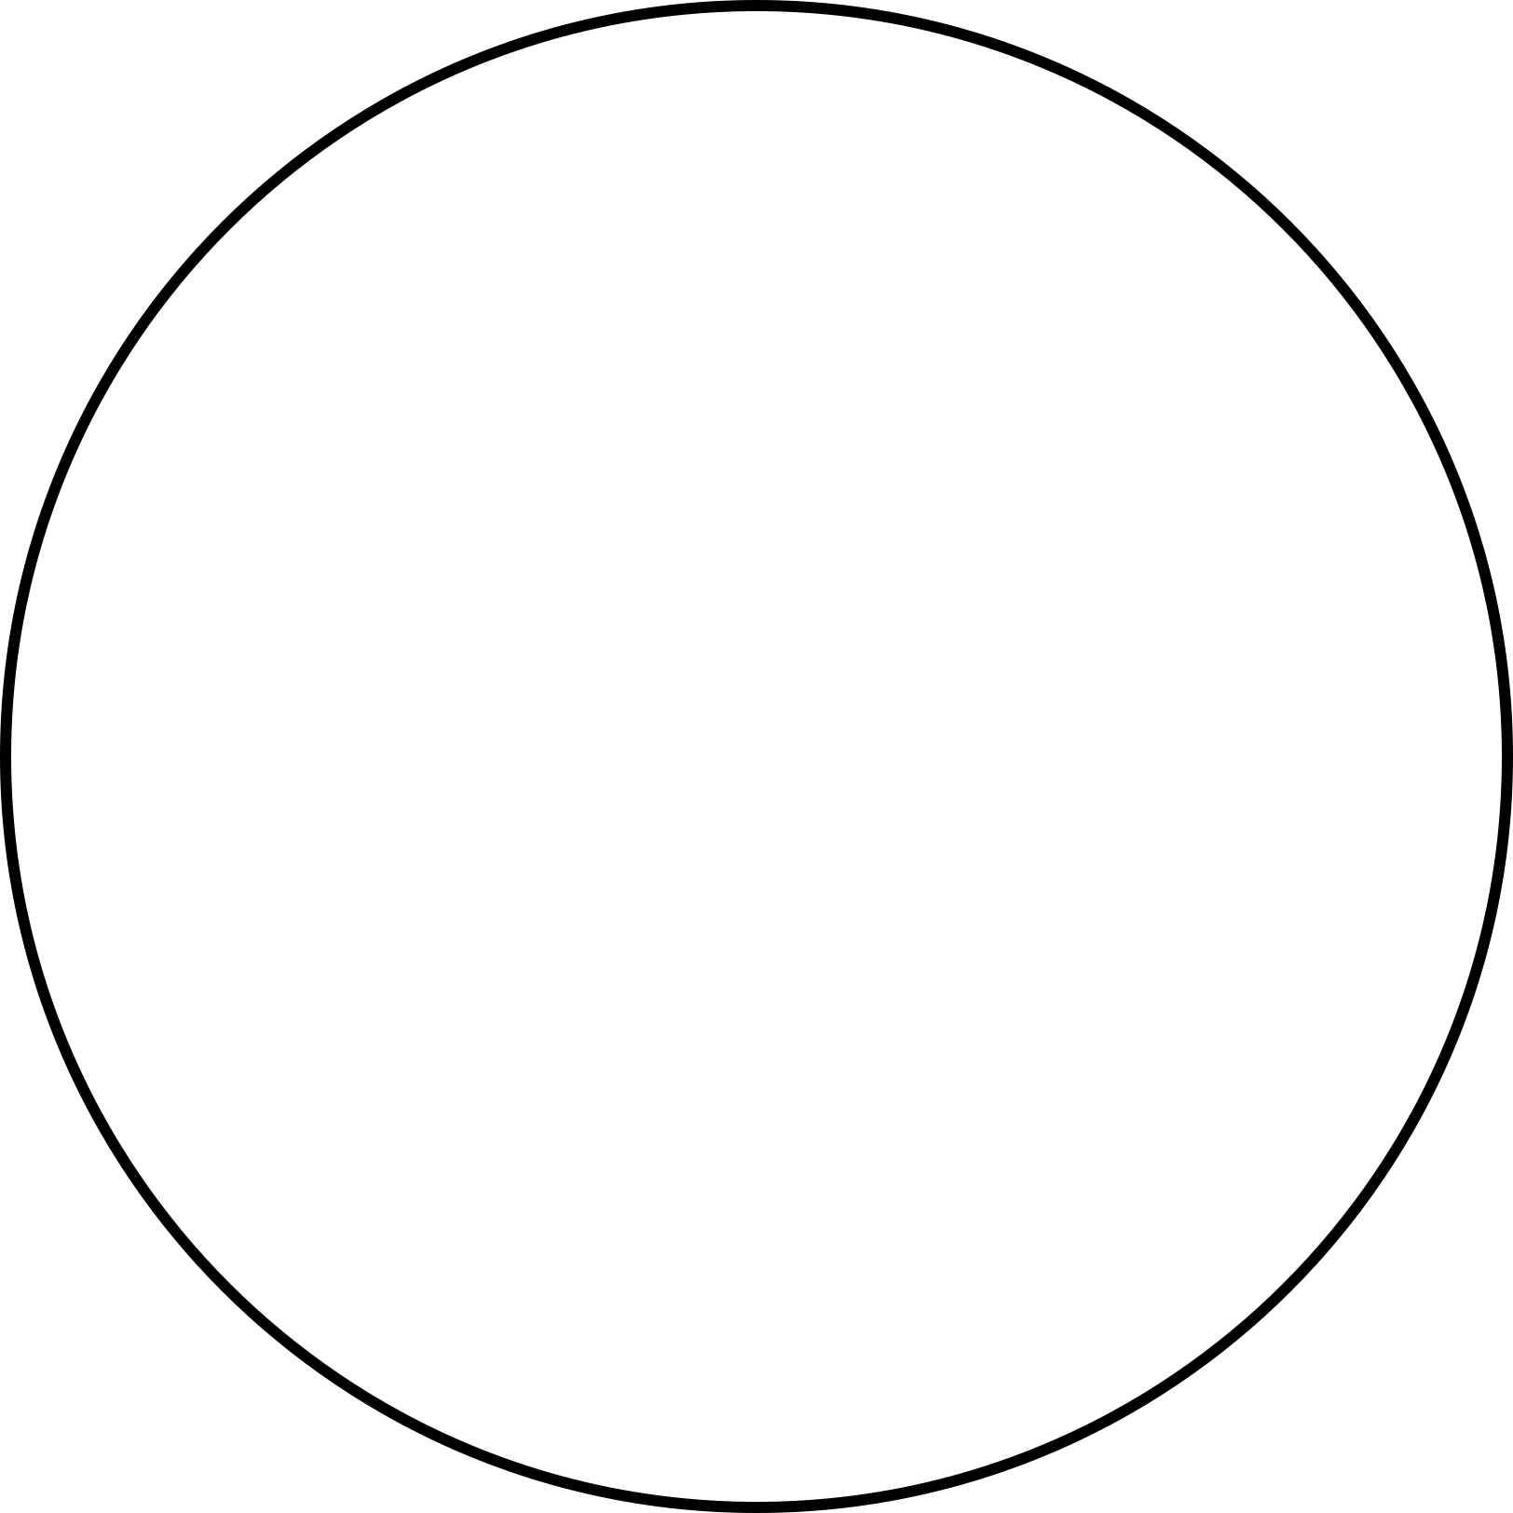
Let's Start
Modeling Housing Price Movements in Melbourne

Slide 2
Team Members
1
Krishna Bisoi
2
Satyaki Mitra
3
Muhammad Owais Khan

Slide 3
Introduction
Research questions
General analysis
Model selection
Residual analysis
Model transformation
Solution
Conclusion
Contents

Slide 4
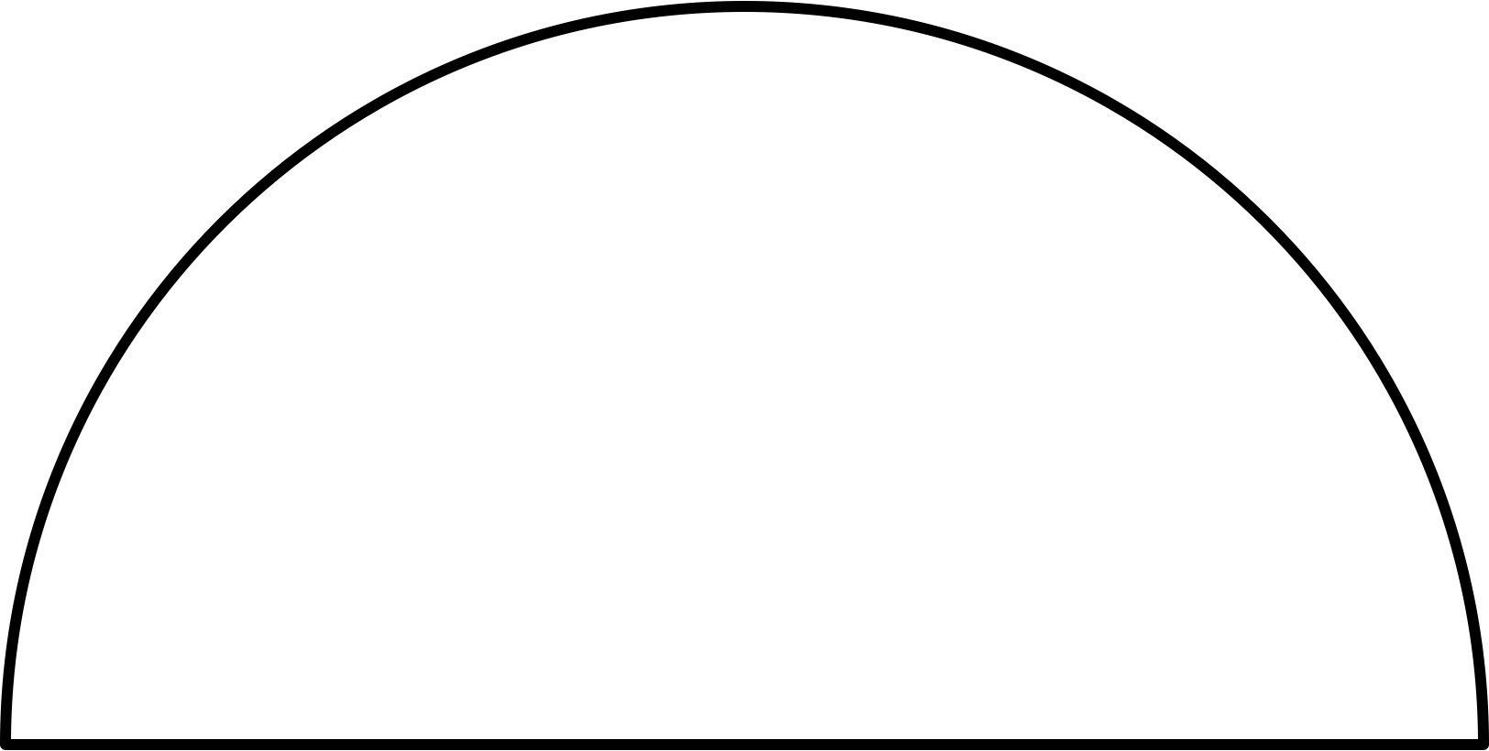




Introduction
House prices surged dramatically in 2017!
Interest rates hit rock-bottom, making loans cheaper.
After a boom, the market cooled down in 2018.
Melbourne’s home prices soared to new heights by 2018.

Slide 5
Performance Factors
200 random records/8000
Price (Dependent Variable)
House Type
Number of rooms
Number of bedrooms
Number of bathrooms
Parking space
Land size
Building area
Distance

Slide 6
Research Questions
Which model will be best to predict house prices?
How do room count and city distance affect prices?
Do property types show different pricing patterns?
How does bathroom count influence prices?
Is there an interaction between room count and property region?

Slide 7
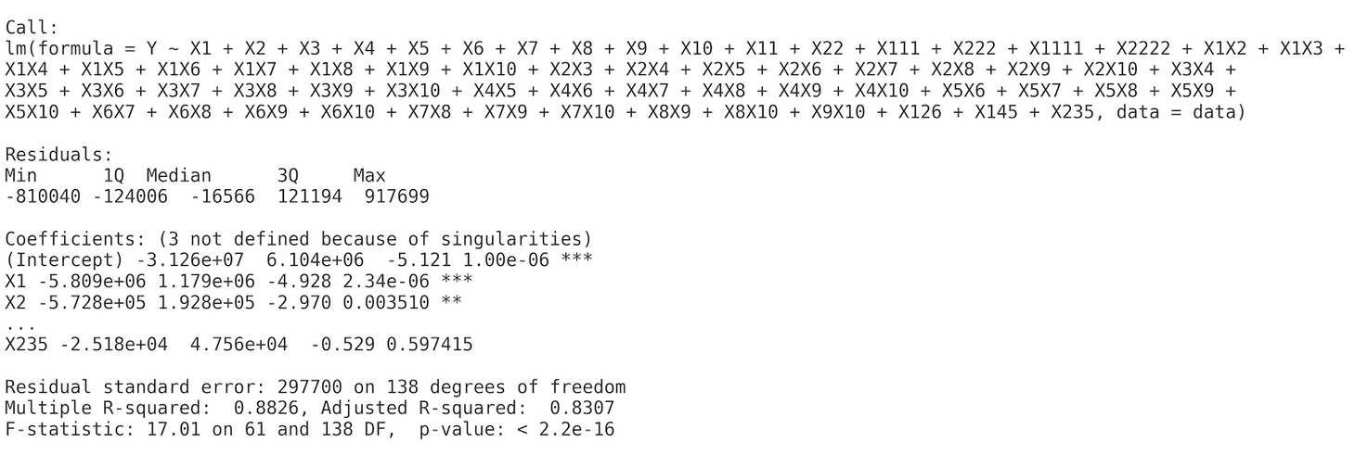
General Analysis
Room Features Matter: Room count, bedrooms, bathrooms, parking, and building area show strong ties to price.
Bathroom Boost: Bathrooms have a solid 0.59 correlation with price.
Model Power: The full model explains 88% of price variation (R² = 0.88)

Slide 8
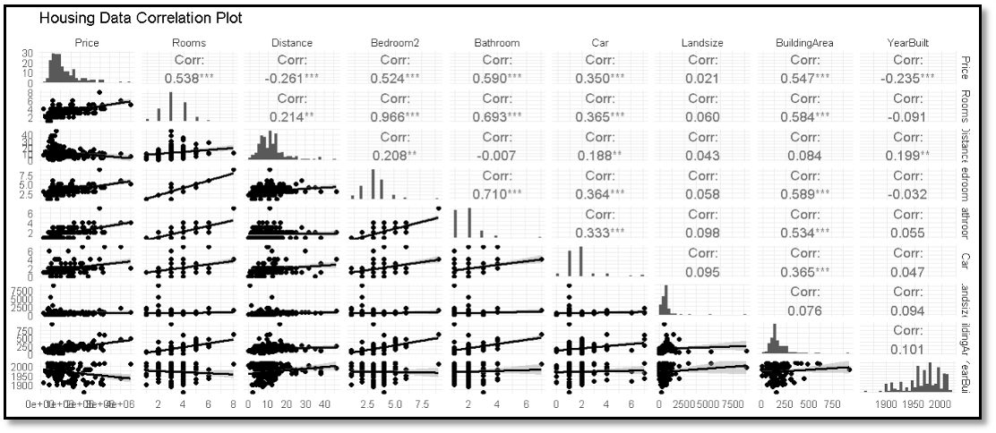
Correlation Plot

Slide 9
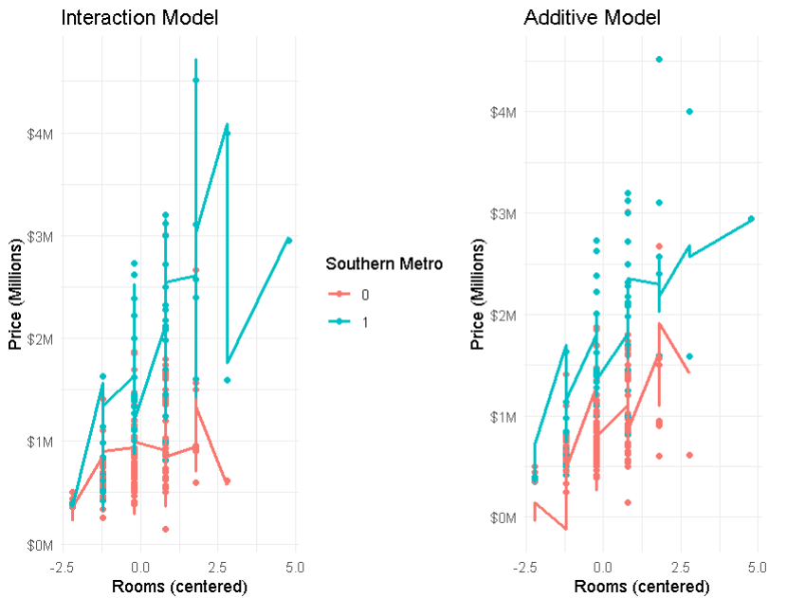
Interaction vs. Additive

Slide 10
Interaction vs. Additive
Interaction Model: Room count impact varies by location.
Southern Metro: More rooms = bigger price jump in Southern Metro.
Additive Model: Room effect is the same, no matter the location.
Flexibility: Interaction Model is flexible; Additive is simpler.

Slide 11
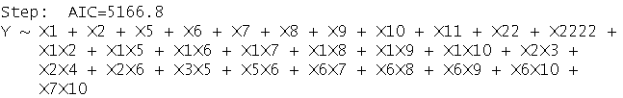

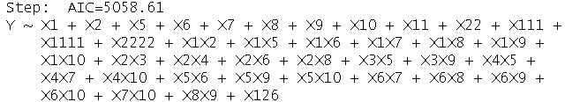
Model Selection
Selection Process | AIC | R2 | Code Output
Backward elemination | 5166.8 | 0.85
Forward selection | 5093.2 | 0.81
Stepwise regression | 5058.61 | 0.87

Slide 12
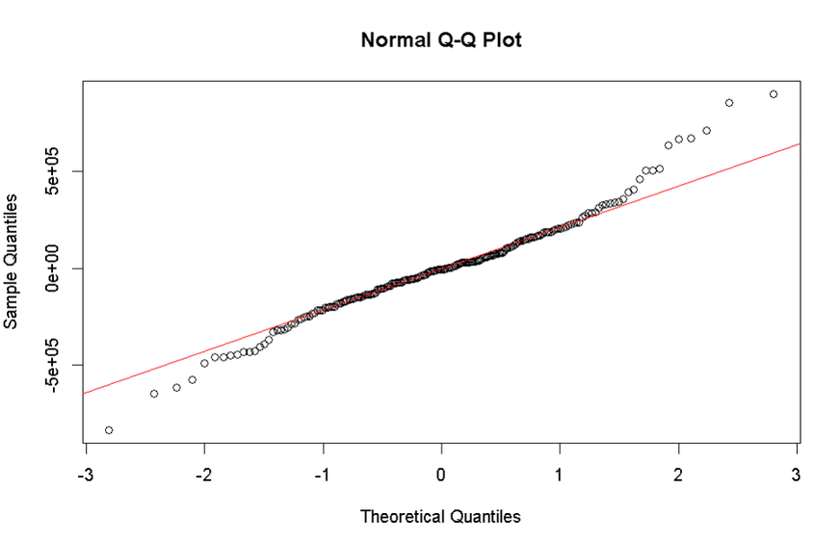
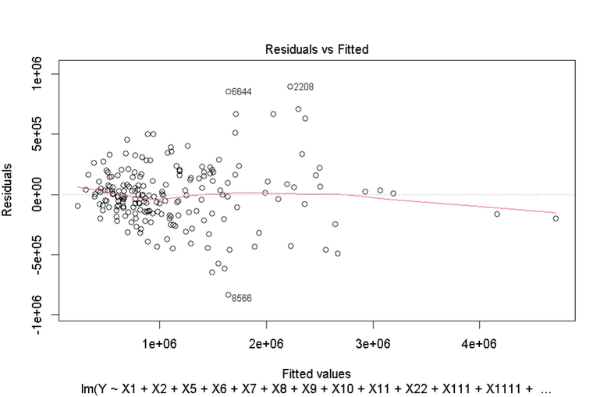
Residual Analysis
Normality Assumption Check
Good Normality: Residuals follow the red line in the center (between -1 and +1).
Left Tail: Negative residuals deviate below the line (heavy lower tail).
Right Tail: Positive residuals deviate above the line (heavy upper tail).
Linearity Assumption Check
Linearity Violation: Mild deviation from the linearity assumption.
Heteroscedasticity: Residual spread increases with fitted values.
Influential Outliers: Outliers may be impacting model performance.

Slide 13
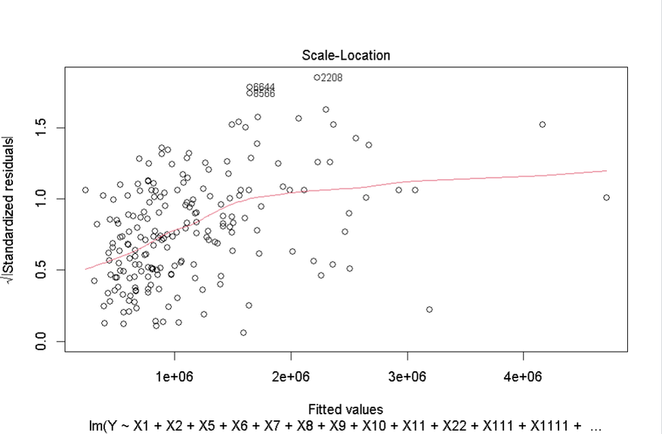
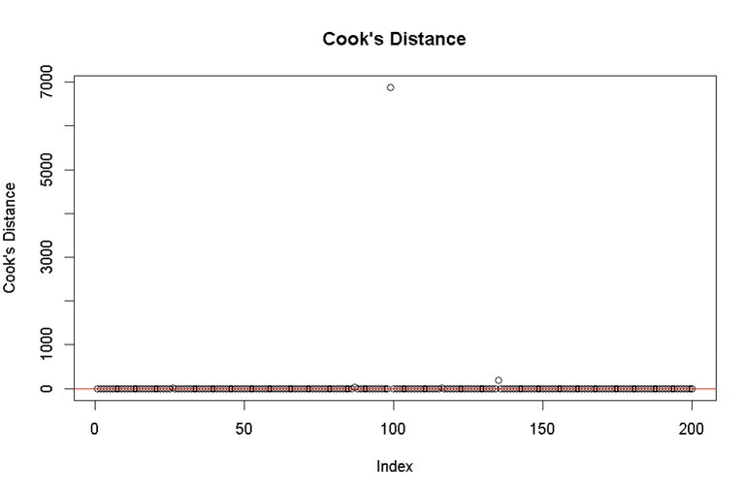
Homoscedasticity Assumption Check
Heteroscedasticity: Residual variability increases with fitted values.
Left Tail: Negative residuals deviate below the line (heavy lower tail).
Outliers: Potential outliers observed in the plot.
Cook’s Distance
High Cook's Distance: One point (index ~90-100) is highly influential.
Majority Cluster: Most points are near zero, indicating low influence.
Potential Impact: One extreme point may skew model coefficients.

Slide 14
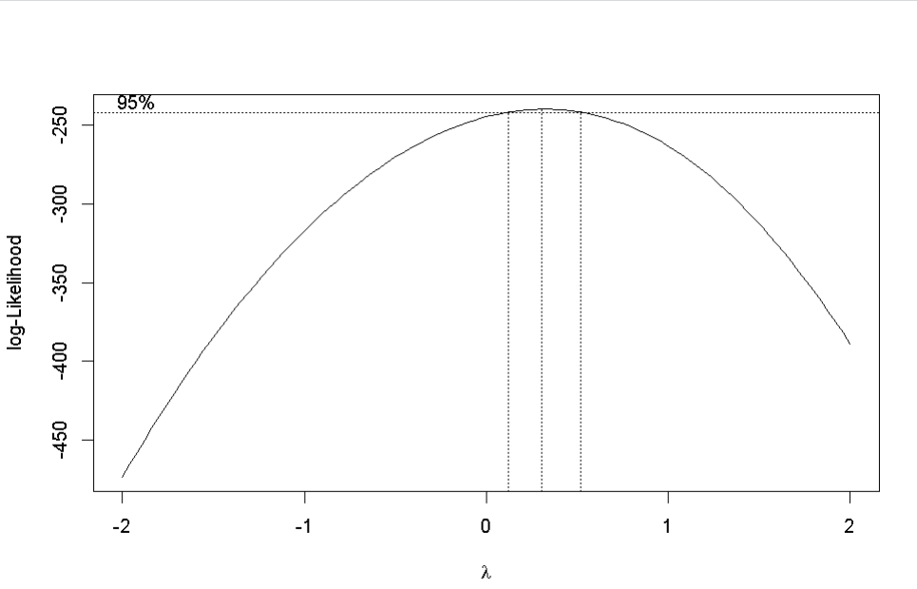
Model Transformation
BoxCox Plot
Model | DF | AIC
stepwise_model | 41 | 5628.18184
stepwise_model_log | 41 | 79.32107
stepwise_model_sqrt | 41 | 2551.33110

Slide 15
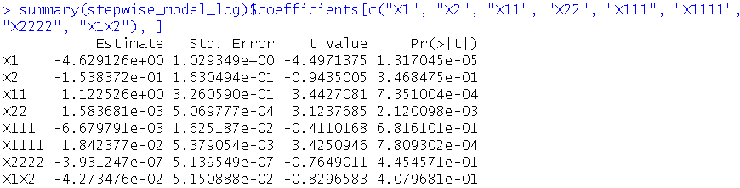
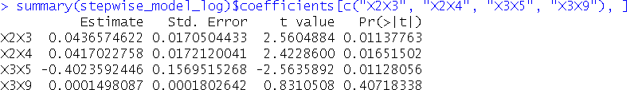
Solution
Room Count and City Distance Impact on Prices
Room Count Effect: More rooms initially lower prices, but eventually increase them significantly.
Distance Impact: Distance slightly increases price after a point, but not a strong predictor.
No Interaction: No significant relationship between room count and distance.
Impact of Property Type on Pricing Patterns
Property Type Matters: Units and townhouses price differently by location.
Southern Metro Pricing: Units are priced lower than houses and townhouses.
Land Size Impact: Land size has less effect on unit prices compared to others.

Slide 16
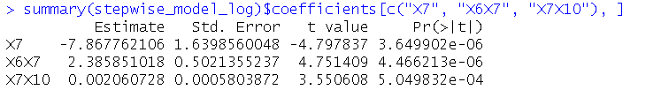

Bathroom Count and Its Effect on Prices
More bathrooms boost value in bigger, better homes.
In small houses, extra bathrooms might hurt value.
Bathroom upgrades shine when paired with space and bedrooms.
Room Count and Property Region Interaction
Extra rooms matter less in Southern Metro.
Adding rooms = smaller price boost down South.
Southern Metro buyers want more than just space.

Slide 17
Prediction Analysis
"fit" = predicted house price (mean prediction from the model).
"lwr" = lower bound of the prediction interval.
"upr" = upper bound of the prediction interval.
The predicted price of first house is $1,005,246.80.
95% prediction interval ($578,409.90 and $1,747,068.00)

Slide 18
Conclusion
House size and features drive price: Larger homes with more bedrooms, bathrooms, and bigger areas command higher prices.
Bathrooms add value strategically: Extra bathrooms boost price mainly in larger houses, but can hurt smaller ones.
Location matters: The Southern Metro region shows a weaker price impact from adding rooms compared to other areas.
Model performance: The final model explains about 83% of the variation in house prices, showing strong predictive ability.

Slide 19
Key Takeaways
Home Features Matter: Larger homes with more bedrooms and bathrooms generally command higher prices.
Bathrooms Impact Value: Extra bathrooms add value to larger homes but can reduce value in smaller ones.
Regional Differences: Southern Metro area shows a weaker price impact from added rooms compared to other regions.

Slide 20
End
Thank you
Do you have any questions?

