Slide 1
Android App Developement
Google
Mohd Owais Naim
CSJMA15001390163

Slide 2
Android:The Android Ecosystem
  An open source platform for mobile, embedded and wearable devices.
  Google is the principle maintainer.
  Other companies contribute to the system.
  Each device manufacturer can customize Android to suite their needs.

Slide 3
Android Features
  Application Framework
  Dalvik
  Integrated (webkit) browser
  2D and 3D graphics APIs with HW
  SQLite
  Video and audio codecs
  Bluetooth, EDGE, 3G, and WiFi
  Camera, GPS, compass, and accelerometer

Slide 4
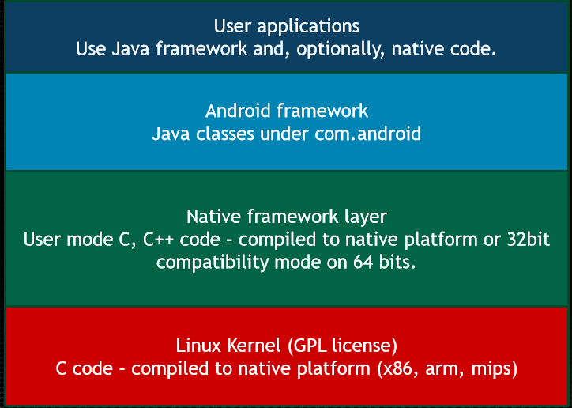
Android Architecture

Slide 5
Application Fundamentals
Apps are written in Java
Bundled by Android Asset Packaging Tool
Every App runs its own Linux process
Each process has it’s own Java Virtual Machine
Each App is assigned a unique Linux user ID
Apps can share the same user ID to see each other’s files

Slide 6
Opportunities for App Development
  100s of millions of mobile phone users
  Very high growth, esp. in Asia
  "Wild wild west" of application development
    think 1985 on the desktop (if you were born by then)
    no dominant 3rd party developers.... yet
    what will the killer app categories be?
    what does it mean to have any app + the internet in your pocket?
  You can develop for it today!

Slide 7
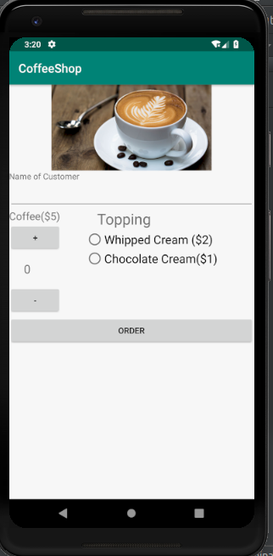
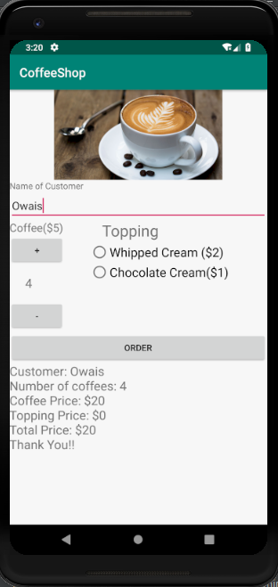
Project : Coffee Shop

Slide 8
About Project
In this Project I have created an App for simple Coffee Ordering.
It tells about the customer name
How many coffees he/she ordered
Price of Coffee
Price of Topping
Total payment what he/she have to pay after ordering coffee from the app

Slide 9
Thank You!

