Slide 1
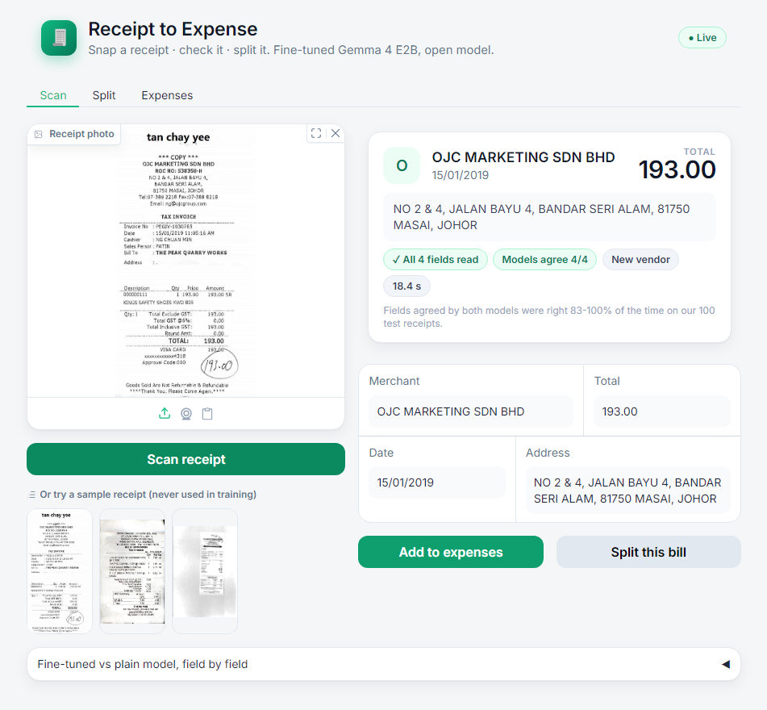
THEME 3B · HACKTOBERFEST HACK DAY · 24 OCT 2026
Receipt to Expense.
Snap a receipt. Our fine-tuned Gemma 4 reads it, logs the expense and splits the bill with friends.
Team Come_Join_Qarc · SSIT Tumkur
Lead: Mohammed Owais
Members: Mohammed Muzakkir, Mohammad Tariq Afzal, Mohammed Ayaan, Mohammed Younus
10x
more receipts read perfectly than the base model
Receipt to Expense · Team Come_Join_Qarc · Theme 3B
01
Notes:
0:00-0:15. Hold up a real receipt. 'Riya's hostel flat splits groceries every week; the receipts end up in a WhatsApp photo pile and someone types them in. We built Receipt to Expense: our fine-tuned open Gemma 4 reads the photo, logs the expense and splits the bill. It reads ten times more receipts perfectly than the same model without our fine-tune.' (Swap in a real story from the team if you have one.)

Slide 2
SAAM · BHED — THE PROBLEM
Students still type receipts in by hand.
Expense apps today
Receipt to Expense
Closed, paid, cloud OCR
Open model + one small adapter file
Built for company cards
One model from photo to fields, no OCR step
Never say which field to trust
Says what to double-check, then splits the bill
For hostel flats splitting groceries, clubs reimbursing fest bills and small shops logging purchases.
Receipt to Expense · Team Come_Join_Qarc · Theme 3B
02
Notes:
0:15-0:30. 'Expense apps exist, but they are closed, paid, cloud OCR products for company cards, and they never tell you which field to trust. Most receipt hacks chain OCR plus an LLM. Ours is one fine-tuned open model, photo to fields, built for students who share bills.'

Slide 3
HOW IT WORKS
One open model, from photo to expense.
01
02
03
Snap
Read
Log and split
A phone photo goes straight to the model, image first, at high resolution. No OCR step.
Gemma 4 E2B with our LoRA adapter, trained on public labelled receipts (SROIE) and tested on receipts it never saw.
Edit the fields, add them to expenses, or split equally or by item; everyone settles up in the fewest payments.
What made the difference: doubling image resolution beat doubling the model size.
Receipt to Expense · Team Come_Join_Qarc · Theme 3B
03
Notes:
0:30-0:45. 'Three steps. The photo goes straight in, image first, no OCR. A small open Gemma 4 with our LoRA adapter, trained on public labelled receipts, reads the four fields. Then you log or split. And what moved accuracy most: giving the model twice the image resolution beat using a model twice the size.'

Slide 4
METHOD — HOW WE TRAINED IT
How we trained it.
01
02
03
04
05
Data
Model
LoRA fine-tune
Check
Sharpen
626 public receipts with labelled merchant, date, address and total (SROIE). 100 test receipts kept aside, never trained on.
Gemma 4 E2B, an open 2B-class vision-language model. The receipt image goes first, then a one-line instruction.
Small rank-32 adapters on the vision and language layers: about 1% of the weights. One pass over the data, minutes on one GPU (Unsloth).
A pixel-level check caught the trainer silently shrinking receipts to 512 px. Fixed: training now sees exactly what the app sees.
Doubled the image resolution (1120 visual tokens): the biggest single gain. Every model compared on the same settings.
Output: one JSON line with merchant, date, address and total. Greedy decoding, so the same photo always gives the same answer.
Receipt to Expense · Team Come_Join_Qarc · Theme 3B
04
Notes:
Optional, 10-15 s (or keep for questions). 'We took 626 public labelled receipts and kept 100 aside for testing. We taught an open Gemma 4 with LoRA: small add-on weights, about one percent of the model, in one pass over the data. A pixel-level check caught the trainer shrinking receipts, which we fixed, and sharper images were the biggest single win.'

Slide 5
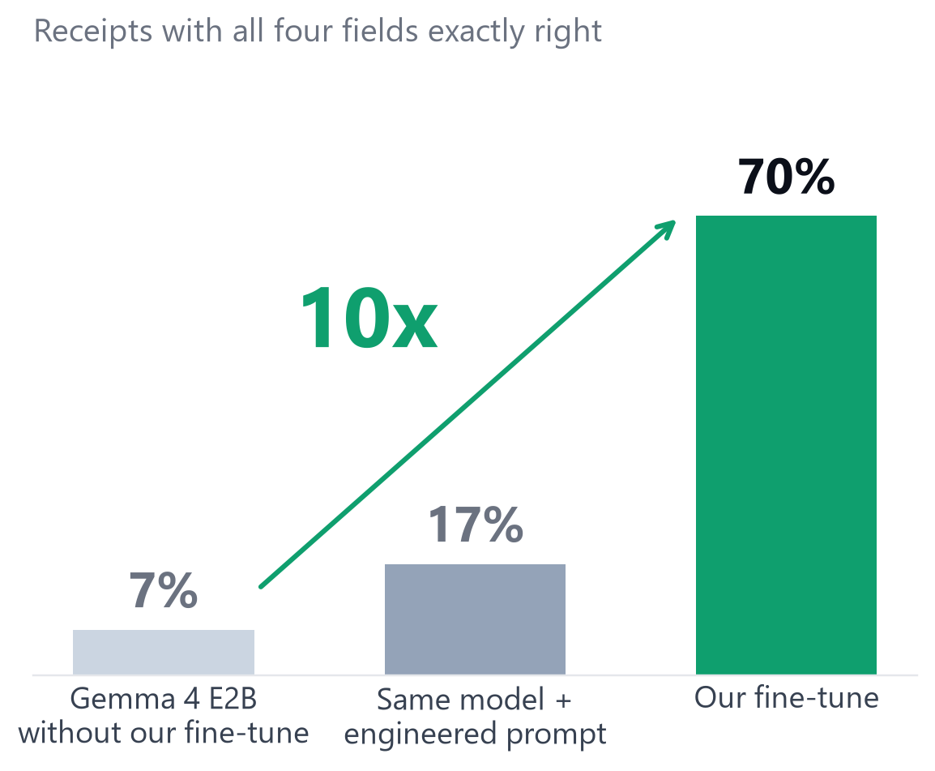
DAND — THE RESULT
10x more receipts read perfectly.
Same Gemma 4 model, same settings, same 100 receipts it never saw.
Without our fine-tune: 7 in 100 read perfectly.
With it: 70 in 100.
100 held-out receipts · McNemar p < 1e-10
Fine-tuned version shown: best of 5 configurations, same test set.
Receipt to Expense · Team Come_Join_Qarc · Theme 3B
05
Notes:
0:45-1:05. 'Same model, same settings, a hundred receipts it never saw. Without our fine-tune it reads 7 of 100 receipts perfectly, all four fields exact. A carefully engineered prompt gets 17. Our fine-tune gets 70. Ten times. McNemar p is below one in ten billion.' (For questions: the engineered prompt was measured at the 560 budget; at 1120 the plain model scores lower, not higher, so the comparison is conservative.)

Slide 6
DAND — READING ERRORS
3/4
fewer reading errors.
Field accuracy goes from 70% to 92% on the same model. Totals are right 98% of the time.
Receipt to Expense · Team Come_Join_Qarc · Theme 3B
06
Notes:
1:05-1:15. 'Field by field, our fine-tune removes three quarters of the reading errors: 70 percent of fields right becomes 92. Totals, the field you actually pay, are right 98 percent of the time.'

Slide 7
BHED — WHY FINE-TUNE AT ALL
2x
better than prompt engineering.
A carefully engineered prompt gets 37% of receipts fully right. Our fine-tune gets 76%.
Receipt to Expense · Team Come_Join_Qarc · Theme 3B
07
Notes:
1:15-1:25. 'Could we just write a better prompt? We tried: a carefully engineered prompt gets 37 percent of receipts fully right; our fine-tune gets 76. Fine-tuning doubles it. Now let's try yours.'

Slide 8
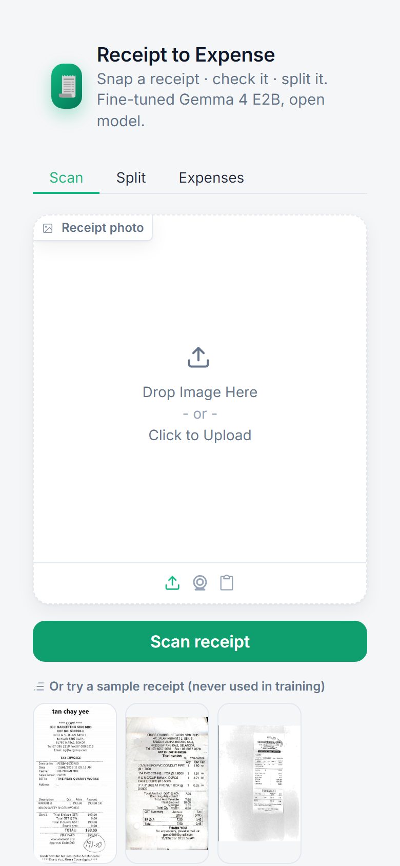

DAAM — LIVE DEMO
Snap it. Check it. Split it.
Judges: lend us a receipt.
Scan the code to try it on your phone.
f6753b53a276c78344.gradio.live
Trust check on every field
Split equally or by item
Expenses to CSV
On the projector: the polished UI. On phones: the public link, same fine-tuned model.
Receipt to Expense · Team Come_Join_Qarc · Theme 3B
08
Notes:
1:25-2:35. Live. Do one warm-up scan before the talk. 'Could one of you lend us a receipt?' Scan it. 'Merchant, date, address and total, plus a trust check that says which field to double-check.' Press Split this bill: 'Split equally or by item; tax is shared fairly; everyone settles up in the fewest payments.' Add to expenses, download the CSV. If anything stalls for more than 15 seconds, switch to the screenshots.

Slide 9

DELIVERED
Everything required, plus every bonus.
Required
Bonus
Model card
✓
Fine-tuned model + training settings
✓
Prompted baseline
✓
Dataset description
✓
Training experiments
✓
Plain vs fine-tuned comparison
✓
Overfitting check
✓
Model size comparison (E4B)
✓
Working app, live
huggingface.co/owaisnoe/
gemma4-e2b-sroie-lora
✓
Combined with retrieval (RAG)
✓
Where it helps, limits and why
✓
Published on Hugging Face
Next
Indian receipts
UPI requests from the split
On-device: receipts stay on the phone
✓
Error analysis
Helps, limits, why: learns receipt layouts fast; next, Indian receipts.
✓
Line items
Receipt to Expense · Team Come_Join_Qarc · Theme 3B
09
Notes:
2:35-3:00. 'Everything required is delivered, plus all eight bonus items; the adapters and model card are on Hugging Face. It learns receipt layouts fast; next we train on Indian receipts, add UPI requests straight from the split, and run it on-device so receipts never leave the phone. Thank you.'

Slide 10
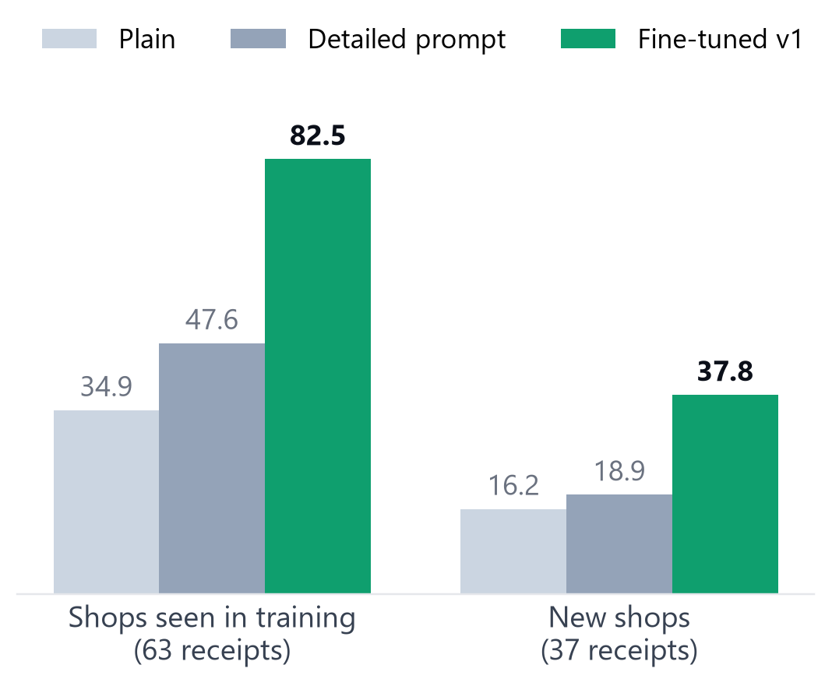
APPENDIX — FOR QUESTIONS
Robustness.
Seen vs new shops (first model, budget 560): 63 of the 100 test receipts come from shops that also appear in training; on brand-new shops the fine-tune still doubles the prompt (37.8% vs 18.9%).
Other receipt styles (never trained on): WildReceipt, all labelled fields 58% plain vs 56% fine-tuned (not significant); CORD totals 87.5% vs 91.7% (not significant). No significant loss.
Retrieval (vendor memory from training labels): fine-tuned 66% to 69%; prompt 37% to 47%.
Line items, zero-shot on CORD: item F1 71% plain vs 79% fine-tuned.
Receipt to Expense · Team Come_Join_Qarc · Theme 3B
10
Notes:
Appendix, for questions about generalisation.

Slide 11
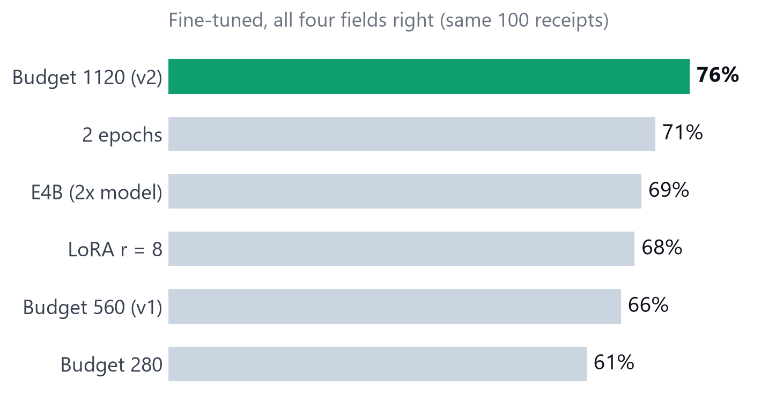
APPENDIX — FOR QUESTIONS
Experiments and one silent bug.
Each arm changes one setting, on the same 100 receipts. Only resolution was significant: 1120 vs 560 tokens, 11 receipts better and 1 worse (p = 0.006). Doubling the model (E4B) gave 69%.
The collator bug: Unsloth's default collator shrank every receipt to 512 px and snapped it to 32 px, with the same token count but different pixels (max difference 0.68). Fixed with images as a dataset column and resize="max" (difference 0.0000).
Trust check: when fine-tuned and plain agree on a field, it was right 83-100% of the time (first model).
Receipt to Expense · Team Come_Join_Qarc · Theme 3B
11
Notes:
Appendix, for questions about method. The 1120 version is the best of 5 configurations on the same test set.

Slide 12
APPENDIX — DATA AND SETTINGS
Data and settings.
Data
SROIE (ICDAR 2019, CC BY 4.0): 626 training receipts; 100 fixed test receipts (seed 0) from the 361-receipt test split; none trained on
Base model
unsloth/gemma-4-E2B-it, 16-bit LoRA adapters (never merged); r = 32, vision + language layers, 1.15% of weights
Training
lr 2e-4, cosine, adamw_8bit, batch 1 x grad-accum 4, 5 smoke + 157 steps (1 epoch), 2.5 min on a Colab G4
Versions
v1: 560 visual tokens (66% receipts, 89.5% fields) · v2: 1120 visual tokens (76% / 92%, best of 5 configurations)
Evaluation
image-first prompt, greedy decoding, batch size 1; strict + normalized scoring; exact McNemar tests
Baselines
plain model, same settings; engineered prompt measured at 560 tokens (at 1120 the plain model scores lower)
Compute
Colab G4 for speed; E2B LoRA needs about 8-10 GB per Unsloth's docs, so it should fit a free T4 (not tested)
Receipt to Expense · Team Come_Join_Qarc · Theme 3B
12
Notes:
Appendix: dataset description and settings (required deliverables).

