Slide 1
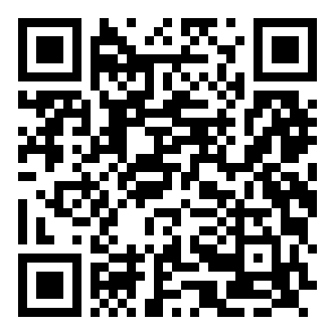
Receipt to Expense
A fine-tuned Gemma 4 E2B that reads receipts and splits the bill
Team Come_Join_Qarc · SSIT Tumkur · Theme 3B · Hacktoberfest Hack Day · 24 Oct 2026
Lead: Mohammed Owais Members: Mohammed Muzakkir · Mohammad Tariq Afzal · Mohammed Ayaan · Mohammed Younus
66 %
2.5 min
5/5 + 8/8
all four fields right
(prompted Gemma: 37 %)
LoRA training on
one GPU (626 receipts)
deliverables +
bonus items
Adapters + model card
huggingface.co/owaisnoe/
gemma4-e2b-sroie-lora
Gemma 4 E2B + LoRA (Unsloth) · SROIE receipts · Gradio app with a public link
Notes:
TALK 0:00-0:12 (~38 words; opener story + hook)
[Use a real story from the team if you have one; otherwise this example persona.]
"Riya's hostel flat splits groceries every week. The receipts end up in a WhatsApp photo pile, and someone types them into a spreadsheet. Our fine-tuned Gemma takes that from 6 to 63 percent of receipts read perfectly."
(6 -> 63 % = all four fields exactly right, strict, plain vs fine-tuned, 100 SROIE test receipts.)
Run order for the 3-minute talk: slides 1 > 2 > 3 > 4 > 5 (live demo) > 6 > 7. Slides 8-13 are backup for Q&A.
Whole talk: about 365 spoken words, about 2:40 at 140 words/min plus demo actions. Rehearse with a timer.

Slide 2
Problem: receipts are still typed in by hand
SAAM · BHED
Who: students sharing meals and trips, and small shops logging purchases.
Typing receipts in by hand is slow and error-prone.
Today's expense apps
Receipt to Expense
built for companies, not for students
what we built today
• Closed, paid, cloud OCR
• Built for company cards
• Never say which field to trust
• Free, open 2B-class Gemma 4 E2B you can self-host + one LoRA file
• Proven: baselines, significance tests, 3 datasets
• Says which field to double-check, and splits the bill
No OCR step. Most receipt hacks chain OCR + an LLM; ours is one fine-tuned open vision-language model from photo to fields, measured with McNemar and out-of-distribution tests.
Receipt to Expense · Gemma 4 E2B + LoRA · Theme 3B, Hacktoberfest Hack Day
2 / 13
Notes:
TALK 0:12-0:24 (~27 words). SAAM (relate) then BHED (set us apart)
"Every student has a receipt pile. Today's expense apps are paid, cloud-only, and never say which field to trust. Ours is a free, open model you can self-host, and it splits the bill."
Pitch structure for the whole talk: SAAM = relate (the receipt pile, slide 2) · DAAM = the value we give (free, open, split the bill; the demo, slide 5) · DAND = the proof (6 -> 63 %, p = 1e-6; slides 4 and 6) · BHED = what sets us apart (no OCR step, a measured trust check; slide 2).

Slide 3
Data and method
dataset description and training settings
Data: SROIE (ICDAR 2019, CC BY 4.0)
Method: LoRA on Gemma 4 E2B
• 626 train / 361 test scanned receipts
• Labels: company, date, address, total
• Test set: fixed 100 receipts (seed 0); keys asserted disjoint from training
• Never trained on test, external or local receipts
• LoRA r = 32 on vision + language layers: 59.8 M trainable (1.15 %)
• 5 smoke + 157 steps = 1 epoch: 2.5 min on one G4 GPU, peak 13 GB
• Image first, 560 visual tokens (525-544 measured)
• Greedy decoding, batch size 1, for every configuration
Receipt photo
Gemma 4 E2B + LoRA
image first, 560 tokens
JSON: company, date,
address, total
App: check, split,
add to expenses
Receipt to Expense · Gemma 4 E2B + LoRA · Theme 3B, Hacktoberfest Hack Day
3 / 13
Notes:
TALK 0:24-0:32 (~18 words)
"Data: SROIE, 626 training and 361 test receipts; we test on a fixed 100 we never trained on."
Compute (if asked): trained on a Colab G4 for speed (2.5 min). Unsloth's docs put E2B LoRA at about 8-10 GB, so the recipe should also fit a free T4, more slowly; we did not test this.

Slide 4
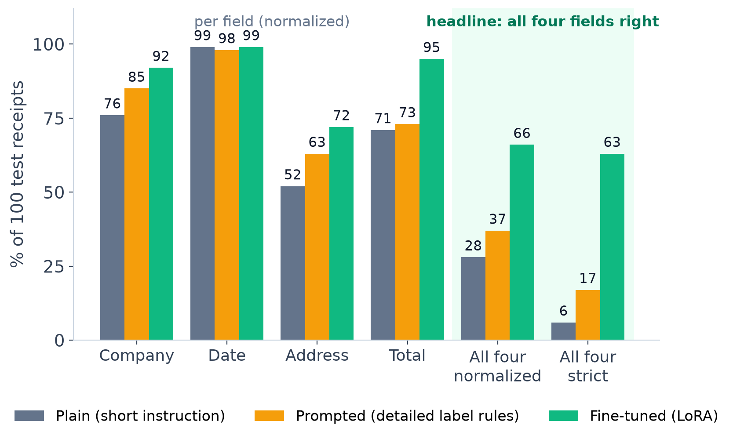
Fine-tuning beats prompting on every field
DAND
66 %
all four fields, normalized
prompted 37 % · plain 28 %
63 %
all four fields, strict
prompted 17 % · plain 6 %
p = 1e-6
McNemar vs prompted:
33 receipts better, 4 worse
Same 100 test receipts, same 560-token image budget, greedy batch 1. Normalized forgives case, spacing, currency and date format, so it measures reading, not formatting.
Receipt to Expense · Gemma 4 E2B + LoRA · Theme 3B, Hacktoberfest Hack Day
4 / 13
Notes:
TALK 0:32-1:12 (~85 words)
"One chart: same 100 receipts, same image budget, greedy decoding. Plain Gemma with a short instruction; the same model with a detailed prompt that spells out the label rules; and our LoRA fine-tune. Normalized scoring forgives case, currency and date format, so it measures reading, not formatting. All four fields right: plain 28 percent, prompted 37, fine-tuned 66. Against the prompted baseline, McNemar gives p of about one in a million: not just formatting. The biggest jump is the total, 73 to 95."
Exact values: McNemar fine-tuned vs prompted, normalized 33 better / 4 worse, p = 1.1e-6; strict 48 / 2, p = 2.3e-12. Vs plain: normalized 42 / 4, p = 5.1e-9; strict 60 / 3, p = 9e-15.

Slide 5
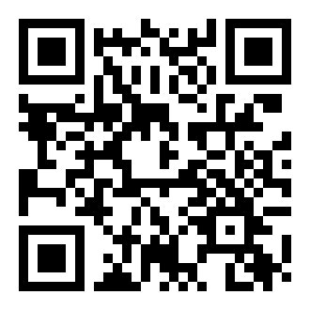
Live demo: snap a receipt, check it, split it
DAAM
working application built around the fine-tuned model
Snap or upload
Fine-tuned fields
Try it on your phone
1
phone camera, webcam or a file
2
editable; plain model beside it; trust check: "agree on N/4 fields, double-check X"
Known-vendor badge
Split the bill
3
vendor memory from the training labels (RAG)
4
equally or item by item; items auto-filled by zero-shot line items; shared by names or 'all'
f6753b53a276c78344.gradio.live
Judges: lend us a receipt!
Extract about 7 s (fine-tuned + plain); "please check" when a date or total does not parse
Group balances
Expenses + CSV
5
tax, service and rounding shared in proportion; settle up with the fewest payments
6
running total of expenses; download the ledger as CSV
Open model: Gemma 4 E2B (2B-class) + one LoRA adapter file: no cloud OCR, no subscription.
Built for students: split equally or by item, tax shared fairly, everyone settled in the fewest payments.
Receipt to Expense · Gemma 4 E2B + LoRA · Theme 3B, Hacktoberfest Hack Day
5 / 13
Notes:
TALK 1:12-2:20 (~100 words + actions)
"Now yours: could one of you lend me a receipt?" [photograph it, press Extract]
"This runs on a Colab GPU behind a public link; scan the QR to try it on your phone. The fine-tuned model fills the form, with the plain model beside it; when they disagree, it tells you which field to double-check. If the shop is in our vendor memory, it says so. Then split the bill: equally or item by item, with the items read off the receipt; tax and service are shared in proportion, and it settles up with the fewest payments. Add to expenses keeps a running total and a CSV."
Trust check (measured on 100 test receipts, see the backup slide): when both models agree on all four fields (29 % of receipts) the fine-tuned answer is fully right 83 % of the time, vs 59 % otherwise; it flags 75 % of company and 64 % of address errors but only 40 % of total errors. Extract takes about 7 s (both models).
Split details: 'shared by' takes names or 'all'; tax, service and rounding go into an 'Others' row shared in proportion, with a 'make sure this amount is correct' warning when it is large; a 'Left to split 0.00' check; the group ledger settles up with the fewest payments (e.g. 'Arjun pays Me 40.00') and downloads as CSV.
Fallbacks: if a judge's receipt reads badly, say what failed and click a built-in example; if the link is dead, play the backup video. App link: https://f6753b53a276c78344.gradio.live

Slide 6
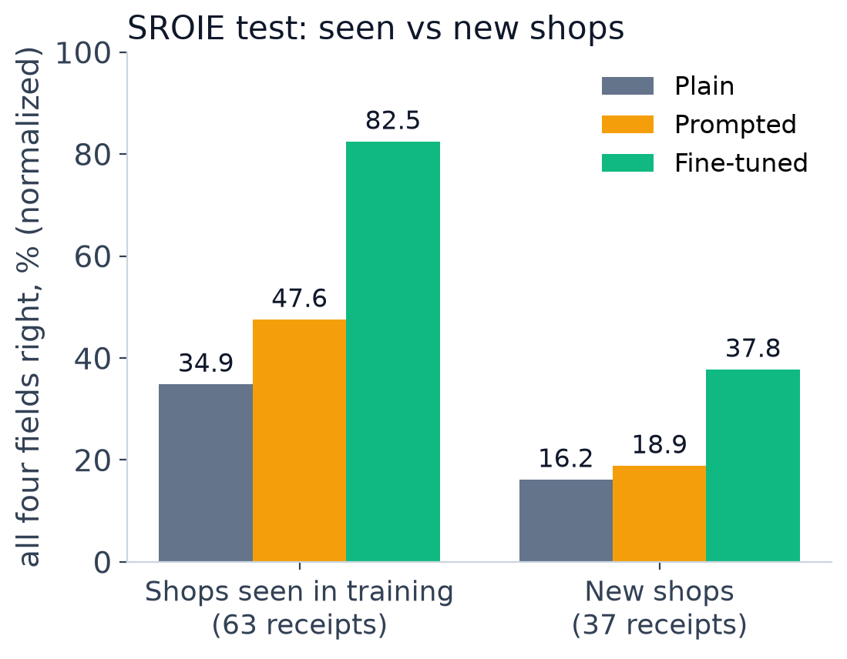
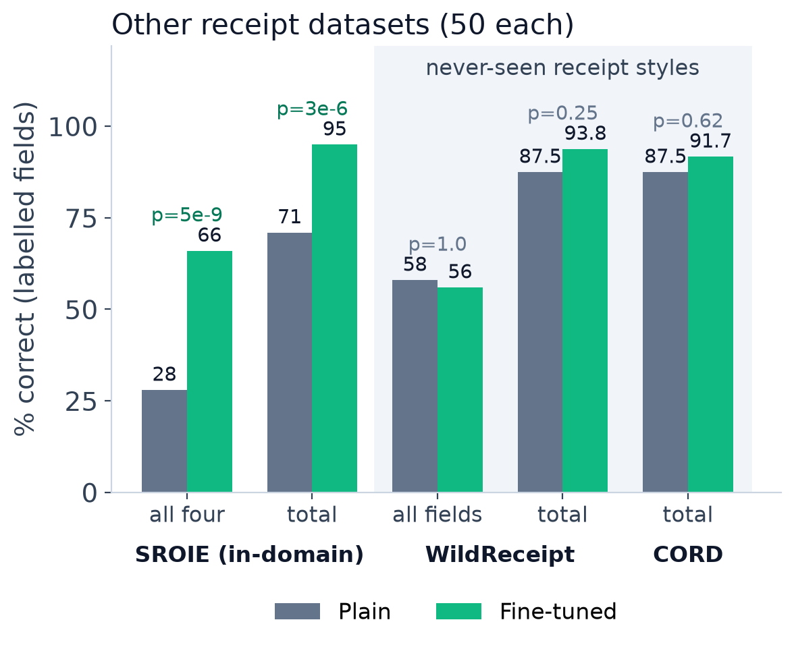
Wins on new shops too, and stays safe on other receipts
DAND
where fine-tuning helps, its limits, and why
Helps most: totals (73 -> 95 %), addresses and receipt conventions; on brand-new shops it still doubles prompting (38 vs 19 %). Next frontier: other countries' receipts, safe today (totals up on all 3 datasets); Indian receipts next.
Receipt to Expense · Gemma 4 E2B + LoRA · Theme 3B, Hacktoberfest Hack Day
6 / 13
Notes:
TALK 2:20-2:45 (~60 words). DAND (proof that it generalises)
"It wins on shops it has never seen: 38 percent versus 19 for the prompted model. On other countries' receipts it stays safe: totals improve on all three datasets. It was trained on Malaysian receipts, so Indian receipts are our next step. It even catches label errors: the gold label says B1750, the receipt says 81750."
Numbers: seen vs new shops, all four normalized: fine-tuned 82.5 vs 37.8; prompted 47.6 vs 18.9; plain 34.9 vs 16.2. WildReceipt all labelled fields 58 -> 56 (p = 1.0); total 87.5 -> 93.8 (p = 0.25). CORD total 87.5 -> 91.7 (p = 0.62). Total-field change from fine-tuning: SROIE +24, WildReceipt +6.3, CORD +4.2.
If asked for prior evidence: our research brief cites arXiv 2609.15706 as finding that fine-tuned small open VLMs beat zero-shot commercial systems on templated extraction. We could not re-verify it today; check before quoting.

Slide 7
Delivered: 5 / 5 required, 8 / 8 bonus
DELIVERED
Bonus item | Status | Evidence
Prompted baseline | Done | 37 % vs fine-tuned 66 % (p = 1e-6)
Training experiments | Done | budget 280 / 560 / 1120, rank 8, 2 epochs, curve
Overfitting check | Done | WildReceipt + CORD: no loss; wins on new shops
Model size (E4B) | Done | 69 vs 66 % (n.s.); 3.46 vs 3.0 s; 17.4 vs ~11 GB
Combined with RAG | Done | vendor memory: 66 -> 69 %, prompted 37 -> 47 %
Publishing on HF | Done | adapters + model card on Hugging Face
Error analysis | Done | 9 categories, fixes proposed
3B: line items | Done (zero-shot) | CORD item F1 71 -> 79 %
Required: 5 / 5 ✓
• Fine-tuned model + settings (HF)
• Dataset description (slide 3)
• Comparison + examples (slide 4)
• Working app, live (slide 5)
• Helps / limits / why (slide 6)
Next
• Retrain at 1120 visual tokens (76 %)
• Indian receipts + local photos
• UPI payment requests from the settle-up list
• On-device 4-bit E2B: receipts stay on the phone
• Calibrated trust score (totals)
Receipt to Expense · Gemma 4 E2B + LoRA · Theme 3B, Hacktoberfest Hack Day
7 / 13
Notes:
TALK 2:45-3:00 (~38 words)
"All eight bonus items are done. The biggest lever was resolution: 1120 visual tokens reach 76 percent, more than model size or rank. Next: Indian receipts, on-device, and a better trust score. Adapters and model card are on Hugging Face."
HF: https://huggingface.co/owaisnoe/gemma4-e2b-sroie-lora

Slide 8
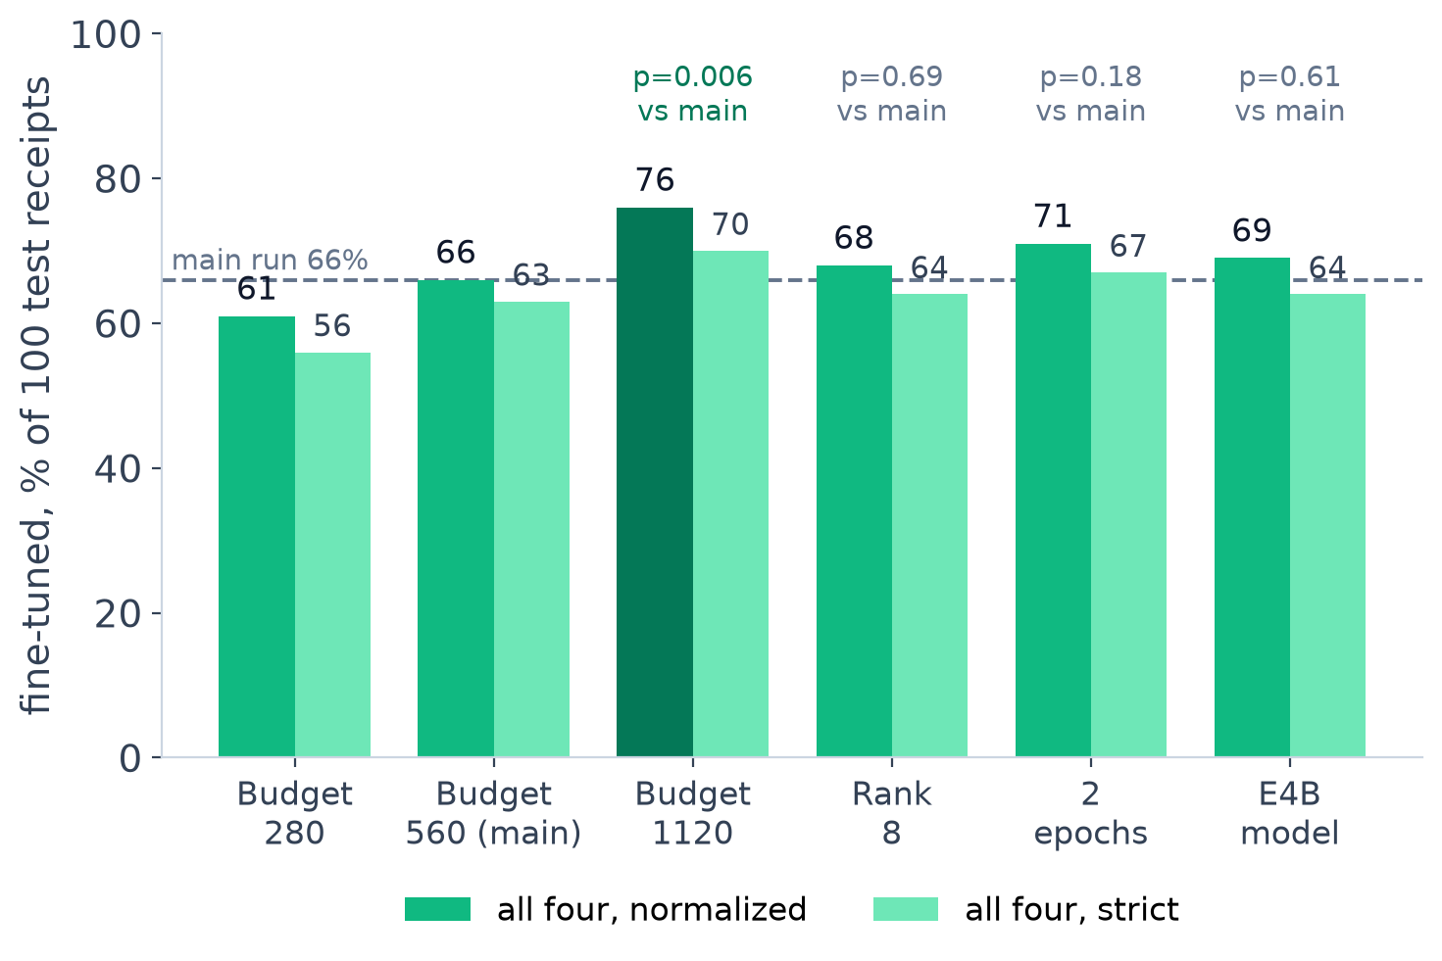
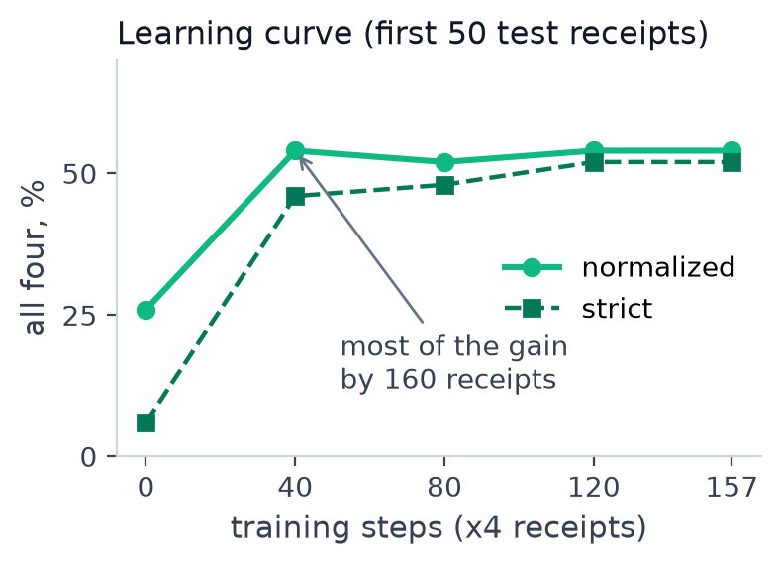
What moves accuracy: resolution, not size
BACKUP
training experiments + model size, same 100 test receipts
• 1120 tokens: 76 % vs 66 % (p = 0.006)
• Rank 8 = rank 32 (68 vs 66 %, n.s.)
• 2 epochs: 71 % (n.s.)
• E4B: 69 % (n.s.); 3.46 vs 3.0 s per receipt, 17.4 vs ~11 GB peak
Each budget arm is trained and tested at its own budget. Plain gets worse with more visual tokens (33 -> 28 -> 22 %) while fine-tuned gets better (61 -> 66 -> 76 %): an observation, not yet explained.
Receipt to Expense · Gemma 4 E2B + LoRA · Theme 3B, Hacktoberfest Hack Day
8 / 13
Notes:
BACKUP (Q&A): training experiments and the E4B size comparison.
All on the same 100 SROIE test receipts, all-four normalized / strict, exact McNemar vs the main fine-tuned E2B (r32, 157 steps, budget 560: 66 / 63).
- Visual budget: 280 -> 61 / 56; 560 -> 66 / 63; 1120 -> 76 / 70 (+11 / -1 vs 560, p = 0.0063). Plain: 33 / 10, 28 / 6, 22 / 7.
- LoRA rank 8: 68 / 64 (+4 / -2, p = 0.69): rank 8 is enough.
- 2 epochs (314 steps): 71 / 67 (+7 / -2, p = 0.18, n.s.). The 1-epoch learning curve plateaus by step 40 (first 50 receipts: 26 / 6 -> 54 / 46 at step 40 -> 54 / 52 at 157).
- E4B (r32, 157 steps, 560): plain 42 / 16, prompted 44 / 32, fine-tuned 69 / 64; vs fine-tuned E2B +9 / -6, p = 0.61 (n.s.); vs its own prompted baseline +28 / -3, p = 4.6e-6. Clean inference speed (idle GPU, 20 receipts): E4B fine-tuned 3.46 s/receipt and 17.4 GB peak vs E2B fine-tuned 3.0 s/receipt and ~11 GB. Training peak 17.9 GB (E4B) vs 13.0 GB (E2B); training 6.35 min (2.43 s/step, GPU shared) vs 2.5 min (0.96 s/step, idle GPU).
Message: resolution matters more than model size, rank or epochs; 1120 is the recommended next configuration (the demo app uses the main 560 model).

Slide 9
Trust check: which field to double-check
BACKUP
fine-tuned vs plain agreement, measured on the 100 SROIE test receipts
Field | Models agree | Fine-tuned right when they agree | Fine-tuned right when they differ | Errors flagged by "differ"
Company | 76 % | 97 % | 75 % | 75 %
Date | 99 % | 100 % | 0 % | 100 %
Address | 59 % | 83 % | 56 % | 64 %
Total | 72 % | 96 % | 93 % | 40 %
29 %
of receipts: all four fields agree
83 % vs 59 %
all four right when they agree
vs when any field differs
Useful but imperfect. A disagreement flags 3 in 4 company errors and about 2 in 3 address errors, but only 40 % of total errors: both models can agree on the same wrong total. The app shows it as "agree on N/4 fields; double-check X".
Receipt to Expense · Gemma 4 E2B + LoRA · Theme 3B, Hacktoberfest Hack Day
9 / 13
Notes:
BACKUP (Q&A): the trust check shown in the app.
For each field we compare the fine-tuned and plain answers (normalized). On the 100 test receipts: company agrees on 76 % of receipts (fine-tuned right 97 % when they agree, 75 % when they differ; 75 % of fine-tuned company errors are flagged by a disagreement); date 99 % / 100 % / 0 % / 100 %; address 59 % / 83 % / 56 % / 64 %; total 72 % / 96 % / 93 % / 40 %. Receipt level: all four fields agree on 29 % of receipts, which are 83 % all-four right vs 59 % when any field differs. Present it honestly: a cheap, useful signal, weakest for totals. A calibrated score is a next step.

Slide 10
Error analysis: most misses are one-character slips
BACKUP
fine-tuned model, 100 test receipts
Category | Company | Date | Address | Total
correct | 91 | 99 | 71 | 92
format only | 1 | 0 | 1 | 3
punctuation / spacing | 3 | 0 | 9 | 0
near miss (1-2 chars) | 2 | 0 | 11 | 0
OCR-confusable (8/B) | 0 | 0 | 3 | 0
extra text | 2 | 0 | 1 | 0
truncated | 0 | 0 | 1 | 0
rounding (<= 0.05) | 0 | 0 | 0 | 3
different value | 1 | 1 | 3 | 2
Address: gold ...B1750 MASAI
read ...81750 MASAI
label noise: 81750 is Masai's real postcode
Total: gold 7.42
read RM7.40
rounding adjustment printed on the receipt
Total: gold 6.40
read 6.04
digit swap
Company: gold THONG RECIPE
read 16G BLOCK B, ZENITH CORPORATE PARK
read the address line as the name
Fixes: punctuation-tolerant address matching · vendor memory (RAG) · higher visual budget (1120: 76 %)
Receipt to Expense · Gemma 4 E2B + LoRA · Theme 3B, Hacktoberfest Hack Day
10 / 13
Notes:
BACKUP (Q&A): error analysis of the fine-tuned model (section 13b categories, one per field).
Address is the weak field: of 28 wrong addresses, 9 are punctuation or spacing only, 11 are near misses of one or two characters (e.g. KEWASAN vs KAWASAN, 61200 vs 81200), and 3 involve OCR-confusable characters, including the gold-label error B1750 (both models read 81750, the real postcode of Masai, Johor). Totals improved the most: the plain model had 13 missing and 13 wrong amounts; the fine-tuned model has 2 different amounts (one digit swap, 6.04 vs 6.40) and 3 Malaysian rounding adjustments (7.40 vs 7.42). Date: 1 truncated (11/16 vs 11/11/16).

Slide 11
What we found under the hood
BACKUP
understanding how it works: a hidden bug caught and fixed
A silent resolution bug (fixed)
Known SDPA bug: checked
80 of 718 LoRA tensors never trained
• Unsloth's collator shrank receipts to 512 px and snapped them to 32 px
• Token count identical (525 = 525), pixels not: max difference 0.68
• Fix: images column + resize="max": difference 0.0000
• torch <= 2.13 corrupts prompts of length 1 mod 32
• 0 / 100 of our prompts affected (both instructions)
• Eager attention matched SDPA exactly on 3 + 3 receipts
• They stayed identical across every checkpoint
• Our explanation (not verified): k/v projections in E2B's KV-shared layers get no gradient
• Smoke run said 12.5 s/step (warm-up); real 0.96 s/step
Gates passed before every run: budget applied (525-544 image tokens), pixel parity, labels contain the JSON answer, finite losses (first loss 2.56).
Receipt to Expense · Gemma 4 E2B + LoRA · Theme 3B, Hacktoberfest Hack Day
11 / 13
Notes:
BACKUP (Q&A): engineering findings.
1) The collator bug: training and inference showed the same image-token count, 525 vs 525, but Unsloth's UnslothVisionDataCollator by default resizes images to 512 px wide (resize='min', the model config has no default size) and, for images inside the messages, snaps sizes to multiples of 32 px. Max pixel difference 0.34 on a 463x1013 receipt and 0.68 on a 4961x7016 receipt. Fix: an images column plus resize='max' -> identical pixel_values (0.0000) on six receipts. Without it, the model would train on blurrier receipts than it reads at test time.
2) SDPA prefill bug (torch <= 2.13, prompt length = 1 mod 32): lengths were 541-587 and 663-709, none affected; eager matched SDPA on 3 + 3 receipts.
3) 80 of 718 LoRA tensors were identical in every checkpoint; our explanation (not verified) is the KV-shared layers.
Also: the smoke run's 12.5 s/step included compile warm-up; 157 steps took 2.5 min (0.96 s/step).

Slide 12
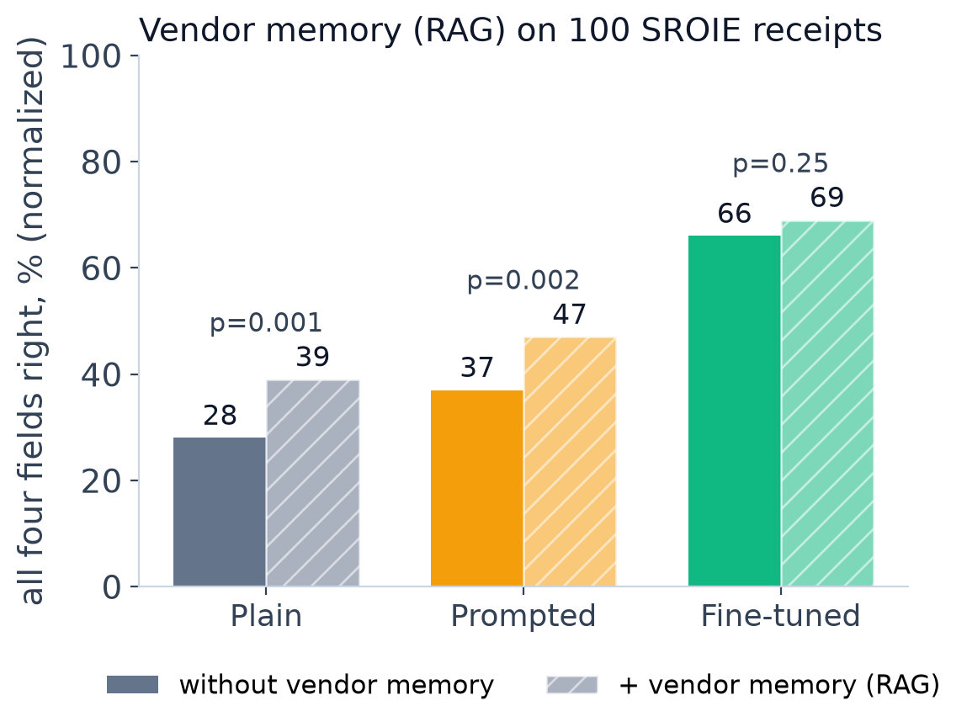
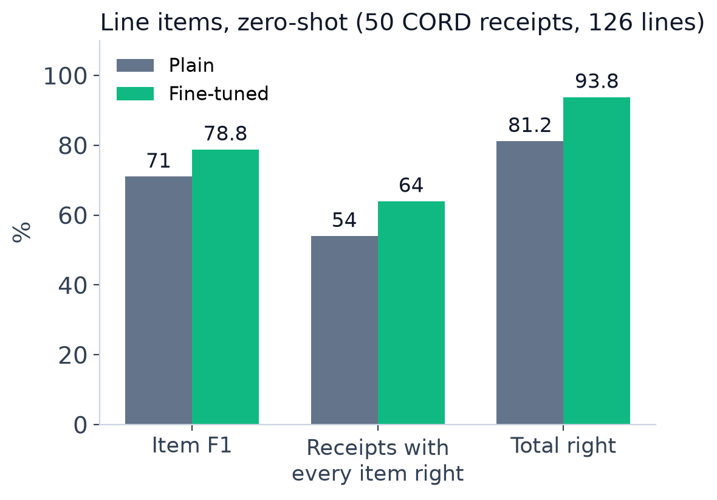
Bonus: vendor memory (RAG) and line items
BACKUP
276 shops from the training labels only; match threshold 0.85 fixed in advance. Fine-tuning had already learned most of what retrieval adds.
Zero-shot: SROIE has no line-item labels, so we scored on CORD. No forgetting; the fine-tuned model writes names in capitals and once shifted prices by a row.
Receipt to Expense · Gemma 4 E2B + LoRA · Theme 3B, Hacktoberfest Hack Day
12 / 13
Notes:
BACKUP (Q&A): RAG and line items.
RAG = retrieval-augmented post-correction: the predicted company and address are matched against a vendor memory of 276 (company, address) pairs from 625 TRAIN receipts (test labels never used; threshold 0.85 fixed a priori). All four normalized: plain 28 -> 39 (11 better / 0 worse, p = 0.001), prompted 37 -> 47 (10 / 0, p = 0.002), fine-tuned 66 -> 69 (3 / 0, p = 0.25, n.s.).
Line items, zero-shot on 50 CORD receipts (126 gold item lines): item precision 62.8 vs 75.4, recall 81.7 vs 82.5, F1 71.0 vs 78.8; receipts with every item right 54 vs 64 % (10 / 5, p = 0.3); total right 81.2 vs 93.8 %; quantities right on all matched items. Failure example: on one long receipt the fine-tuned model dropped a line and shifted every later price up by one row.

Slide 13
Appendix: settings and reproducibility
APPENDIX
Setting | Value
Base model / load | unsloth/gemma-4-E2B-it, 16-bit LoRA (load_in_4bit = False)
LoRA | r 32, alpha 32, dropout 0; vision + language, attention + MLP; 59.8 M / 5.18 B (1.15 %)
Optimiser | adamw_8bit, lr 2e-4, cosine, warm-up 0.03, weight decay 0.001, grad norm 0.3
Batch / steps | 1 x grad-accum 4; 5 smoke + 157 steps (1 epoch over 626 receipts)
Visual budget / prompt | max_soft_tokens 560 (525-544 tokens); image first, then instruction
Instruction | Extract the company, date, address and total from this receipt. Reply with JSON only.
Decoding | greedy, batch size 1, max_new_tokens 256 (every configuration)
Test set | 100 of 361 SROIE test receipts, random.Random(0); keys in test_keys.json
Hardware / time | RTX PRO 6000 Blackwell (Colab G4, 95 GB); 2.5 min training, peak 13.0 GB
Speed (idle GPU) | plain 2.4 s, prompted 2.0 s, fine-tuned 3.0 s per receipt
Software | torch 2.11 cu130, transformers 5.5.0, unsloth 2026.10.8, trl 1.16.0, peft 0.21.2
Compute: trained on a Colab G4 for speed (2.5 min). Unsloth's docs put E2B LoRA at about 8-10 GB, so the recipe should also fit a free T4, more slowly; we did not test this.
Receipt to Expense · Gemma 4 E2B + LoRA · Theme 3B, Hacktoberfest Hack Day
13 / 13
Notes:
APPENDIX: the training-settings deliverable (also saved as summary.json in the notebook and in the model card).
Gates on the runtime: B (560 budget applied: 525-544 image tokens), B2 (training collator pixels = inference pixels, max difference 0.0000), C (the trained text contains the JSON answer; image tokens masked; the instruction is also trained, the Unsloth default), D (finite losses: smoke 2.56 -> 1.16; main run 0.98 at step 5, 0.016 at step 155). Adapters saved with save_pretrained, never merged. HF: https://huggingface.co/owaisnoe/gemma4-e2b-sroie-lora

