Slide 1


SecureCredit
AI-FEST
Project Evaluation
Muhammad Owais Mahmood
Suhaib Ahmed Sharif
Sana Muhammad Yusuf
Muhammad Ateeb
Instructor: Zahid Hussain
Industry Partner: Israr Ahmed (UBL)
Department of Computer Science - DHA Suffa University

Slide 2


Summary
Project Brief Introduction
Problem Statement
Dataset Description
Project Scope
ML/DL/NLP Model Details
Results and Discussions
Tools and Technologies Learnt During the Project Implementation (Individual Skills Set)
Project Demo
References (last accessed)
Can have
maximum 20 slides.
If you want to add any other slide other than this you can but listed heading are required.

Slide 3
Project Brief Introduction
Project Name:
SecureCredit
Introduction:
Addresses the urgent need for a robust fraud detection system in the banking sector.
Focuses on mitigating risks and protecting customers' financial assets.
Implements advanced machine learning techniques to identify and prevent fraudulent transactions.

Slide 4
Problem Statement
Online fraud leads to significant financial losses and compromised customer trust.
Current detection systems are often inadequate in preventing sophisticated fraud techniques.
A robust fraud detection system is needed to mitigate these risks and enhance customer confidence.

Slide 5
Dataset Description
Comprehensive dataset from Kaggle, containing diverse transaction data.
Includes distance metrics, purchase methods, and purchase price comparisons.
meticulously founded by our industry partner to provide insights for accurate fraud detection and prevention.

Slide 6
Project Scope
Develop an end-to-end credit card fraud detection system.
Covers data collection, preprocessing, EDA, feature engineering, model training, evaluation, and deployment.
Aiming for real-time detection and scalability to handle large volumes of transactions.

Slide 7
ML/DL/NLP Model Details
Primary focus on logistic regression and decision tree algorithms.
Address class imbalance and ensure model robustness and scalability.
Plan to experiment with additional algorithms like random forests and neural networks.

Slide 8
Results and Discussions
Evaluate the model's performance using appropriate metrics like accuracy, precision, recall, and F1-score.
Conduct fine-tuning and optimization to ensure model effectiveness in detecting fraudulent activities.
Discuss potential improvements and future work to enhance the system's accuracy and reliability.

Slide 9
Tools and Technologies Learnt During the Project Implementation
Data preprocessing techniques for handling missing values, and handling class imbalance, using Python, Numpy and Pandas.
Exploratory Data Analysis (EDA) for insights and feature engineering.
Machine learning algorithms for classification of fraudulent activities using scikit-learn.
Developing the backend using Django and Model deployment.
Leveraging Python libraries such as Pandas, Scikit-learn, and Matplotlib for implementation.

Slide 10
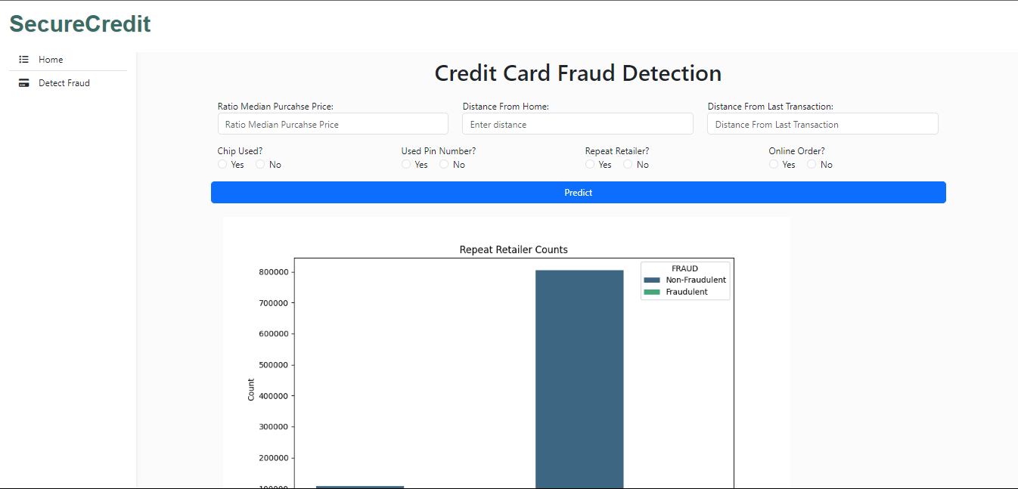
Project Demo
https://drive.google.com/file/d/1g729Rtzu5YdN4WBhpTbH_KX0Ynf2mBsy/view

Slide 11
8- Reference
Book reference
Machine Learning for Absolute Beginners, Oliver Theobald, 2017.
Website reference
Fraud Detection in Credit Cards using Logistic Regression , (IJACSA) International Journal of Advanced Computer Science and Applications, Vol. 11, No. 12, 2020
https://thesai.org/Downloads/Volume11No12/Paper_65-Fraud_Detection_in_Credit_Cards.pdf
Credit Card Fraud Detection Using Machine Learning Algorithms, Computing and Informatics, Bournemouth University, Bournemouth, United Kingdom.
https://www.researchgate.net/publication/376482000_Credit_Card_Fraud_Detection_Using_Machine_Learning_Algorithms

