Slide 1
BA-Analysis- Key insights

Slide 2
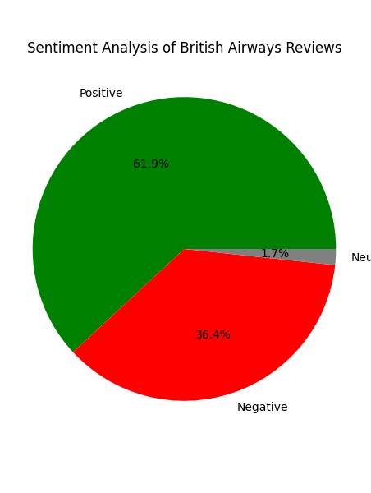
British Airways Review Analysis - Key Insights
🔹 Sentiment Analysis:
- Positive: 619 reviews
- Negative: 364 reviews
- Neutral: 17 reviews

Slide 3

🔹 Key Topics Identified:
- Flight experience
- Customer service
- Seat comfort
- Food quality
🔹 Most Frequently Mentioned Words:
Word cloud shows common themes from reviews.

