Slide 1
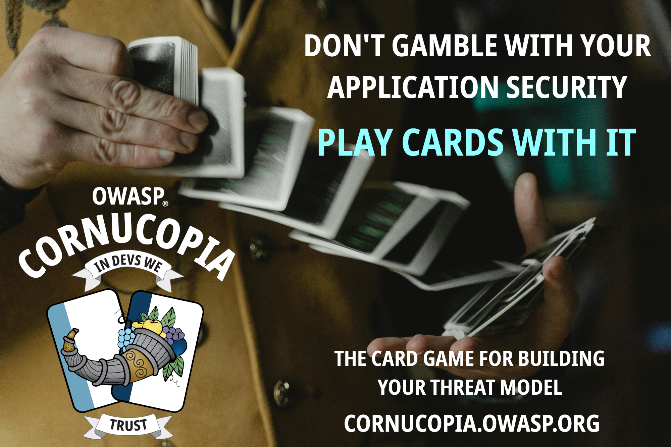
Notes:
I would like to introduce you to a card game called OWASP Cornucopia. OWASP® Cornucopia is a threat modeling tool in the form of a card game to assist software development teams in identifying security requirements in Agile, conventional, and formal development processes. Threat modeling is a method for identifying security weaknesses in our applications. You can also use threat modeling before building an application to ensure that you mitigate against common security weaknesses, thereby ensuring that application security is implemented by design.

Slide 2
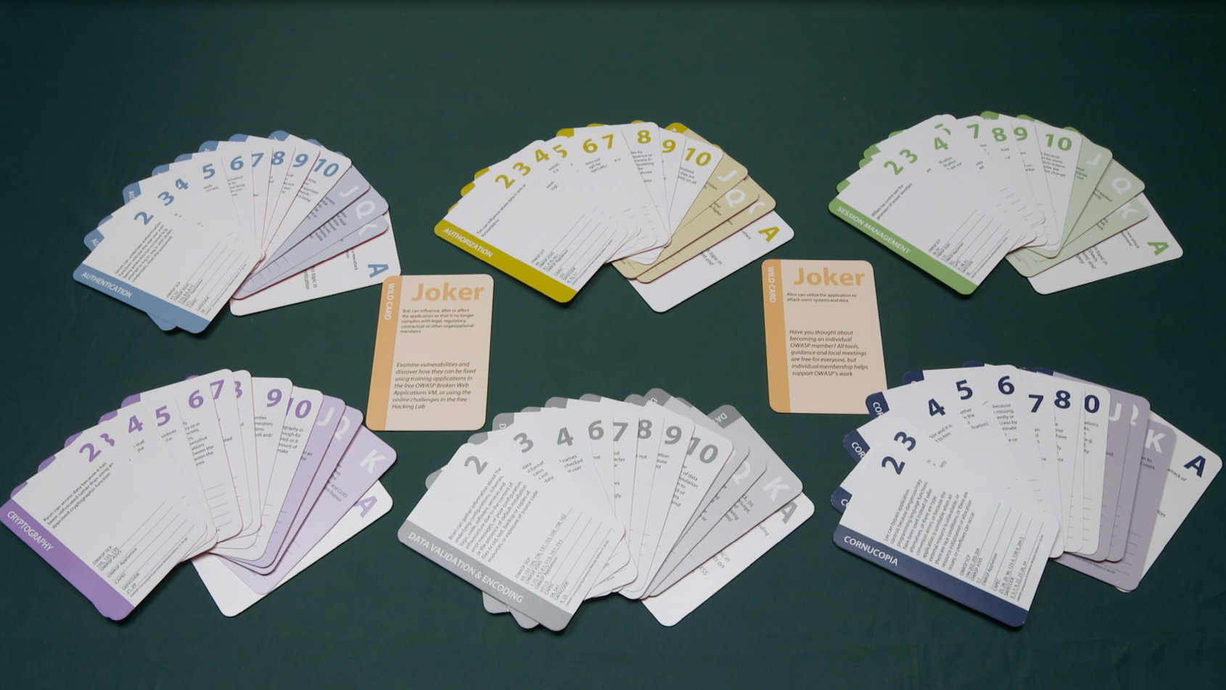

Authentication
Authorization
(Spoofing & Repudiation)
(Elevation of privilege)
Session Management
80
potential threats
Cryptography
Data Validation & Encoding
Cornucopia
(Information Disclosure)
(Tampering)
(All STRIDE categories)
Notes:
The original card game that was created 14 years ago, by Colin Watson, were made for threat modeling Web applications. It consists of 80 cards plus two jokers, each representing an attack. There are six suites in total, covering five categories of attack: light blue is authentication (who you are), gold is authorization (what you can do), green is session management (the period between verifying those two), purple is cryptography (encryption/hashing/obfuscation), grey is data validation & encoding (understanding trust boundaries and validating across them), and dark blue is Cornucopia, the trump suite, which is made up of all the other categories of attacks. The suites are broken down just like regular cards, ranging from 2 through Ace. On each card is an attack. The lower the card, the easier it is to defend against the attack. The higher the card, the more severe the threat is. The Aces works like Jokers in the way that you need to come up with an attack yourself within the suit’s category.

Slide 3
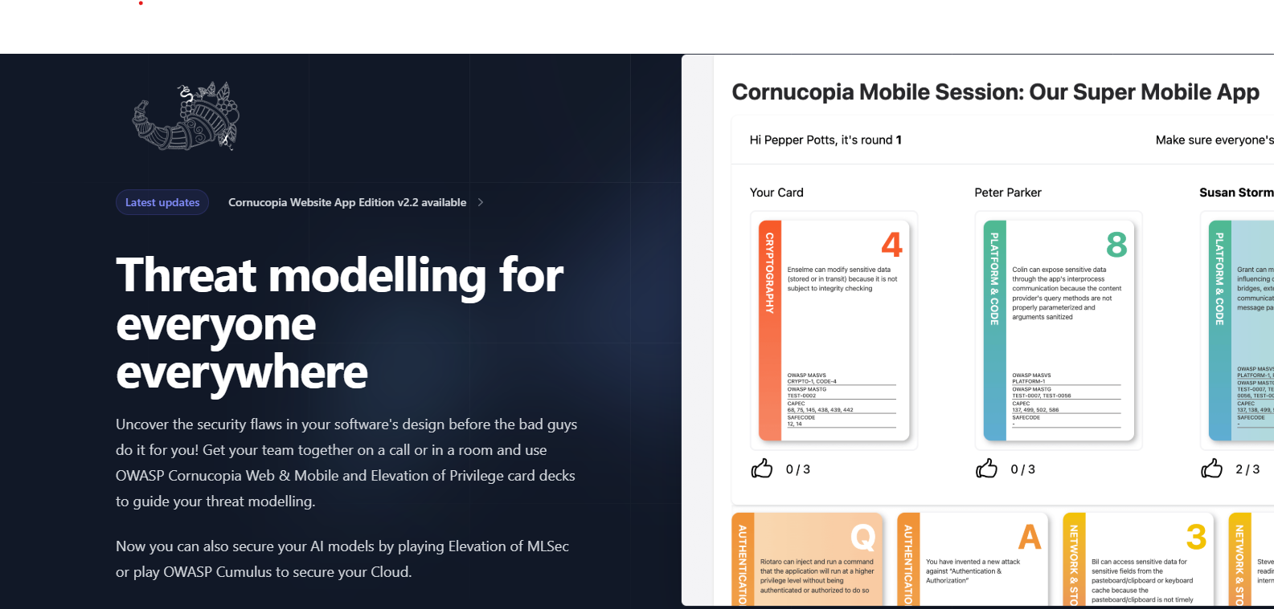
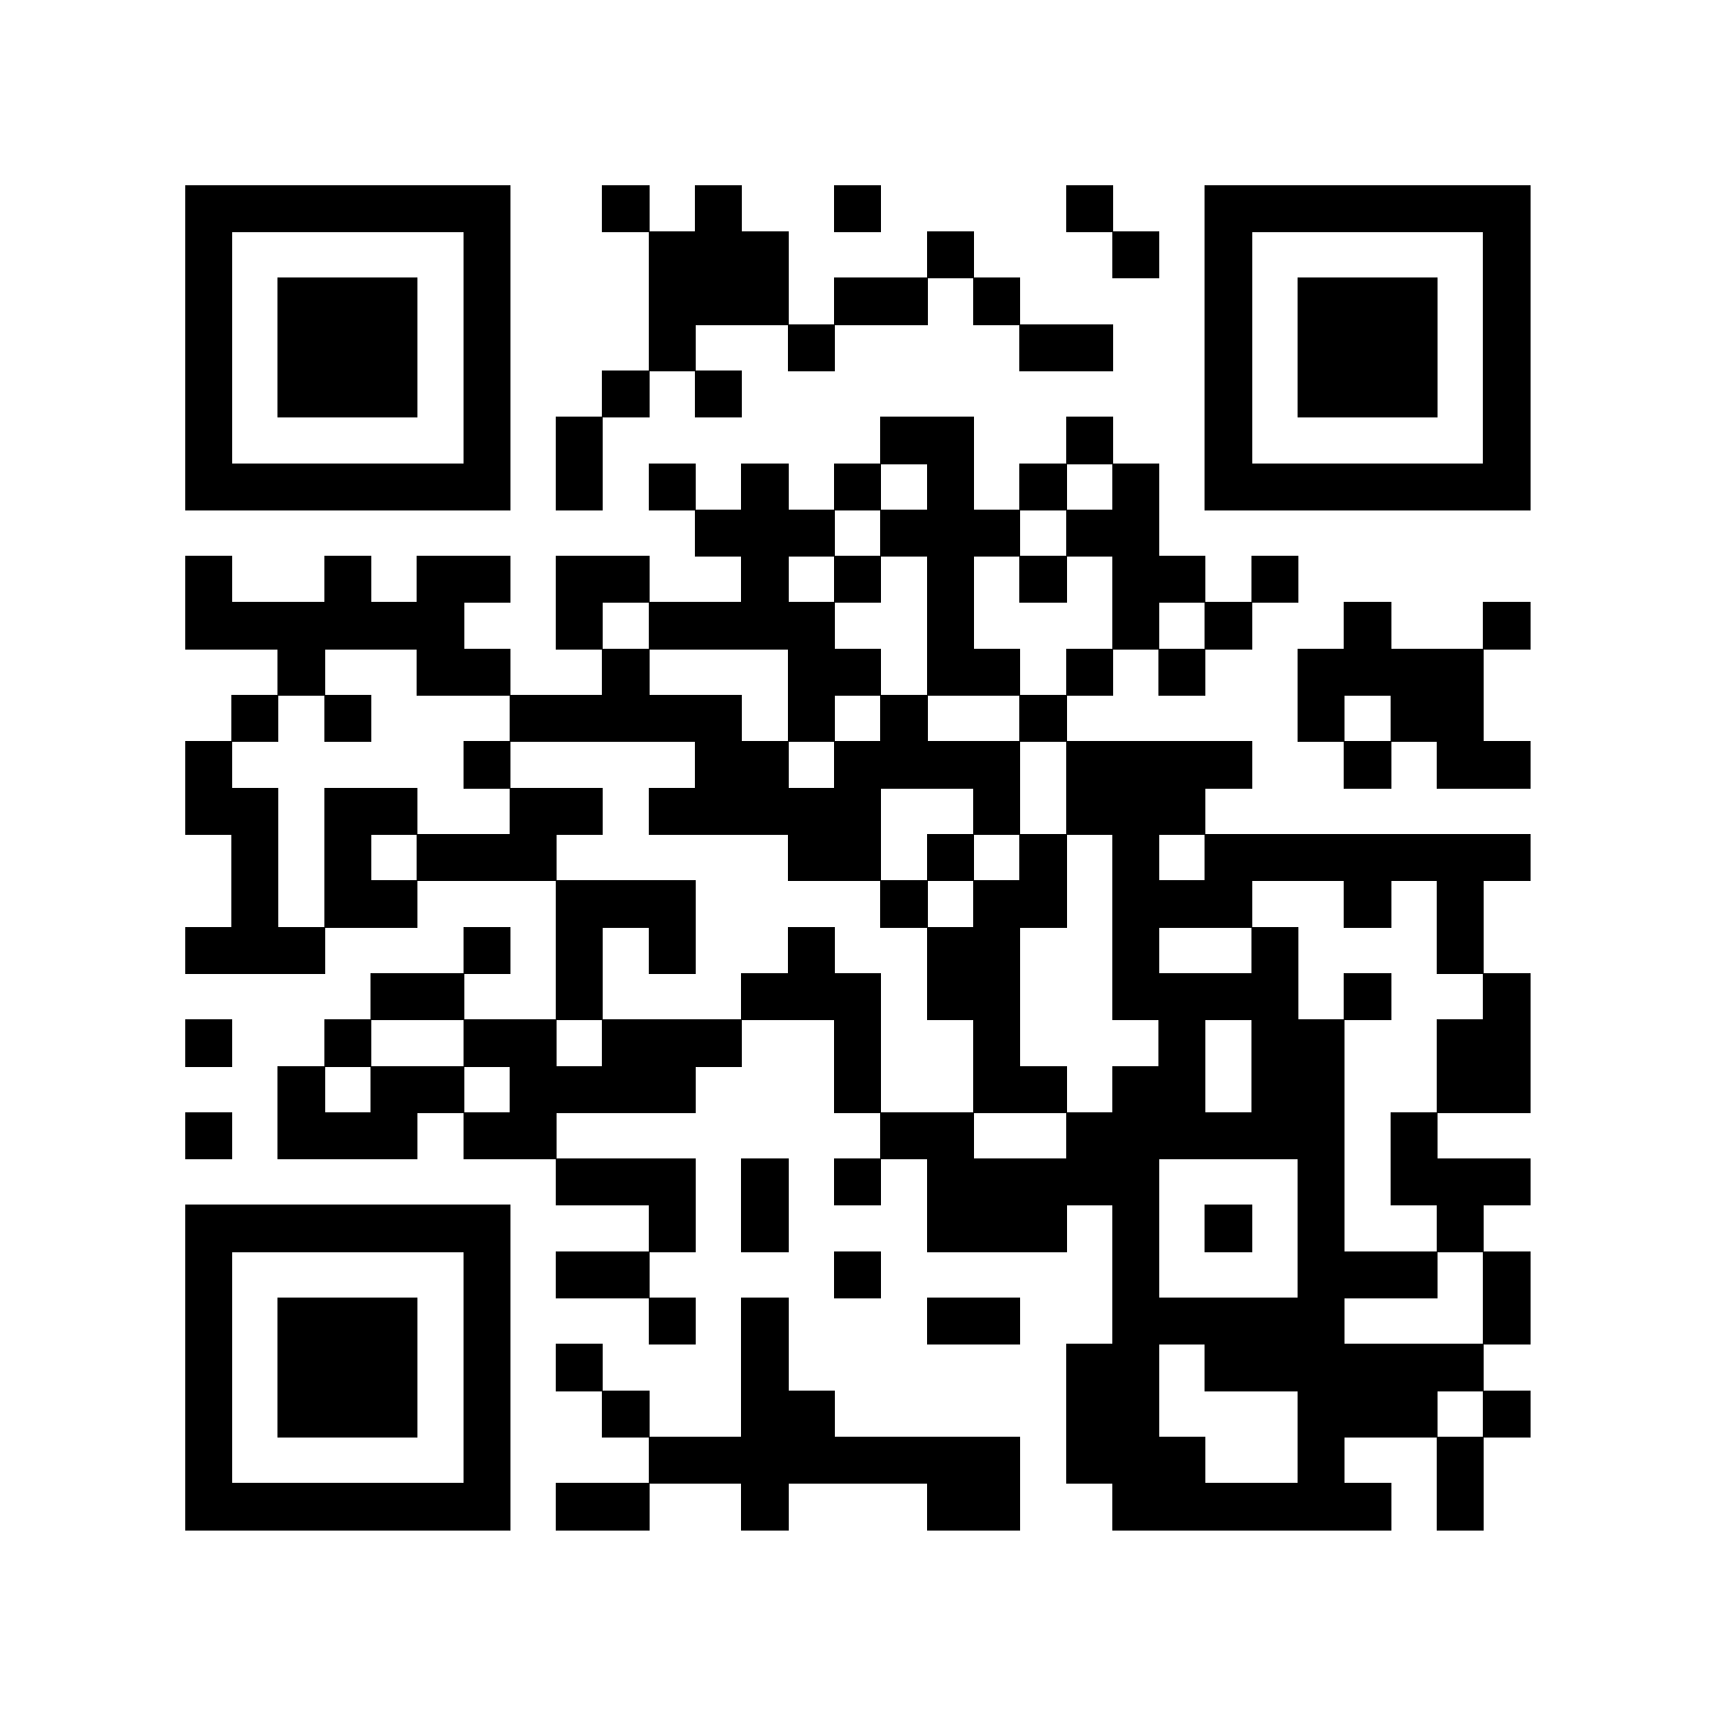

Cornucopia -More games!
copi.owasp.org
Notes:
There is also an online game engine at copi.owasp.org where you can play games with your teams if you are working distributed.
Besites the Website App edition, you can also play games for threat modling and security requirement analysis of..
mobile applications,
AI applications,
Cloud infrastructure
and you also will find the original Elevation or Privilege game which all the other games are based on.

Slide 4
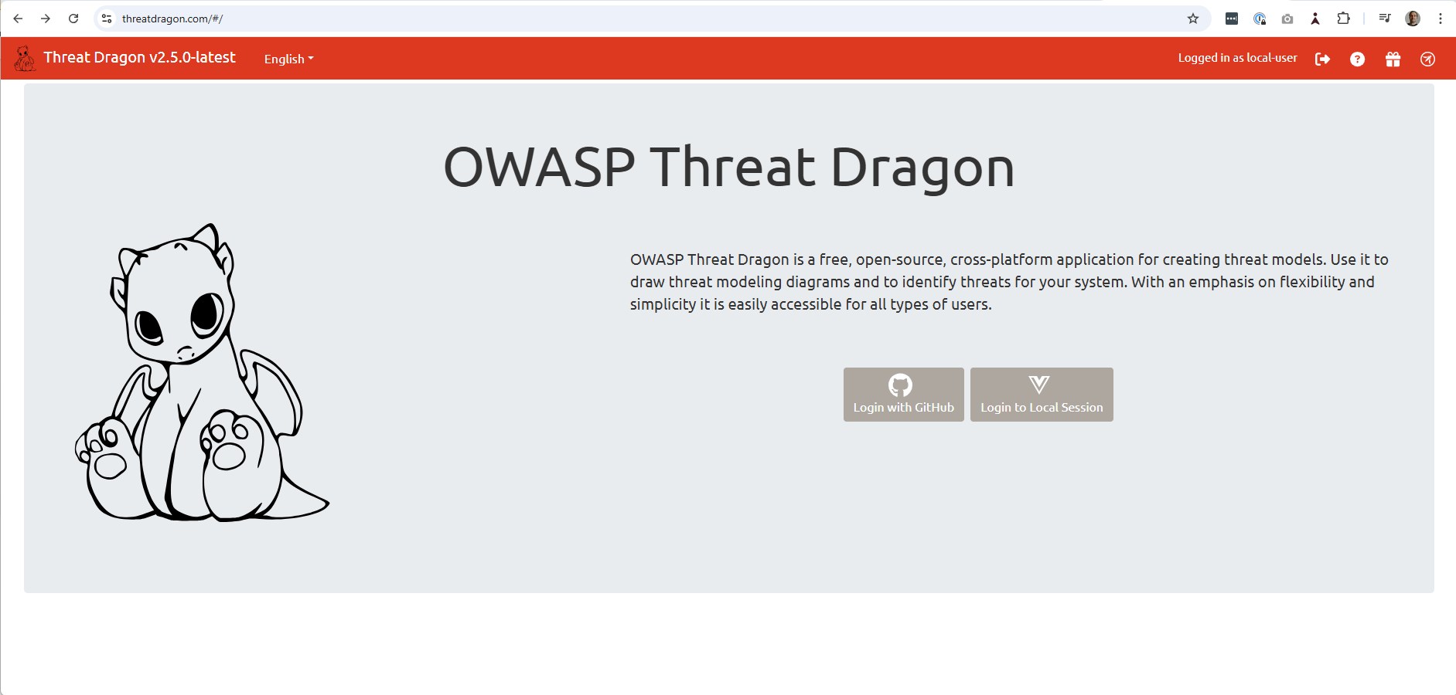
Notes:
OWASP Threat Dragon has an integration between OWASP Cornucopia and Threat Dragon.
OWASP Threat Dragon is a free, open-source, cross-platform threat modeling application. It is used to create threat modeling diagrams and list threats for elements within those diagrams.

Slide 5
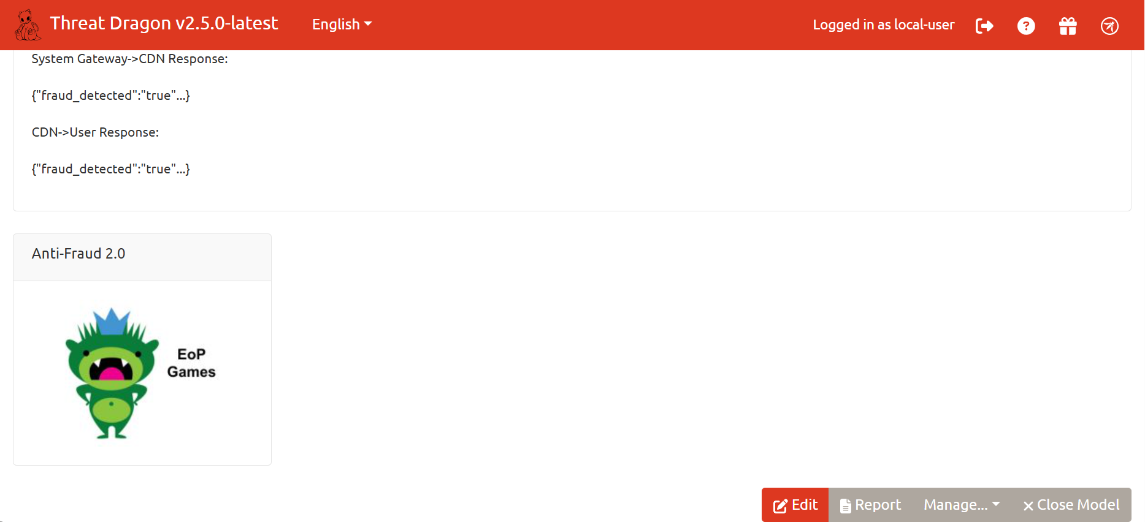
Notes:
It’s possible to create a diagram called «EoP Games» specificly for your OWASP Cornucopia threat modeling session within Threat Dragon in order to do threat modeling using OWASP Cornucopia.

Slide 6
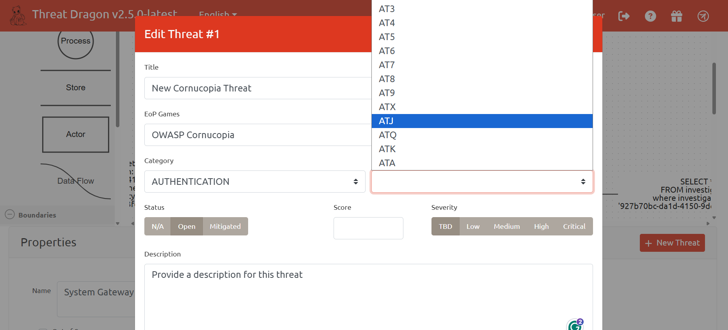
Notes:
After you have created the diagram, you can attach cards from OWASP Cornucopia directly to your threat model. So lets say you have created a threat model in OWASP Threat Dragon, but then you want to take your threat model together with all the security requirements related to the OWASP Cornucopia threats that you have identified and create Jira issues and tests from these under the Epic the development team will be working on.

Slide 7
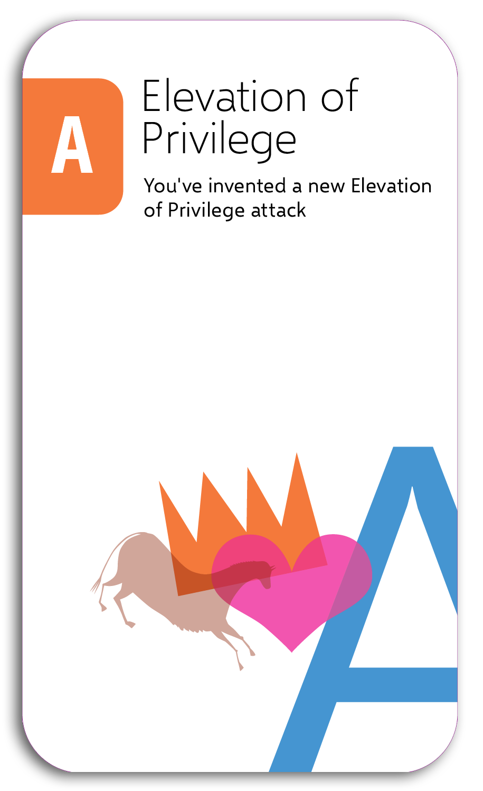
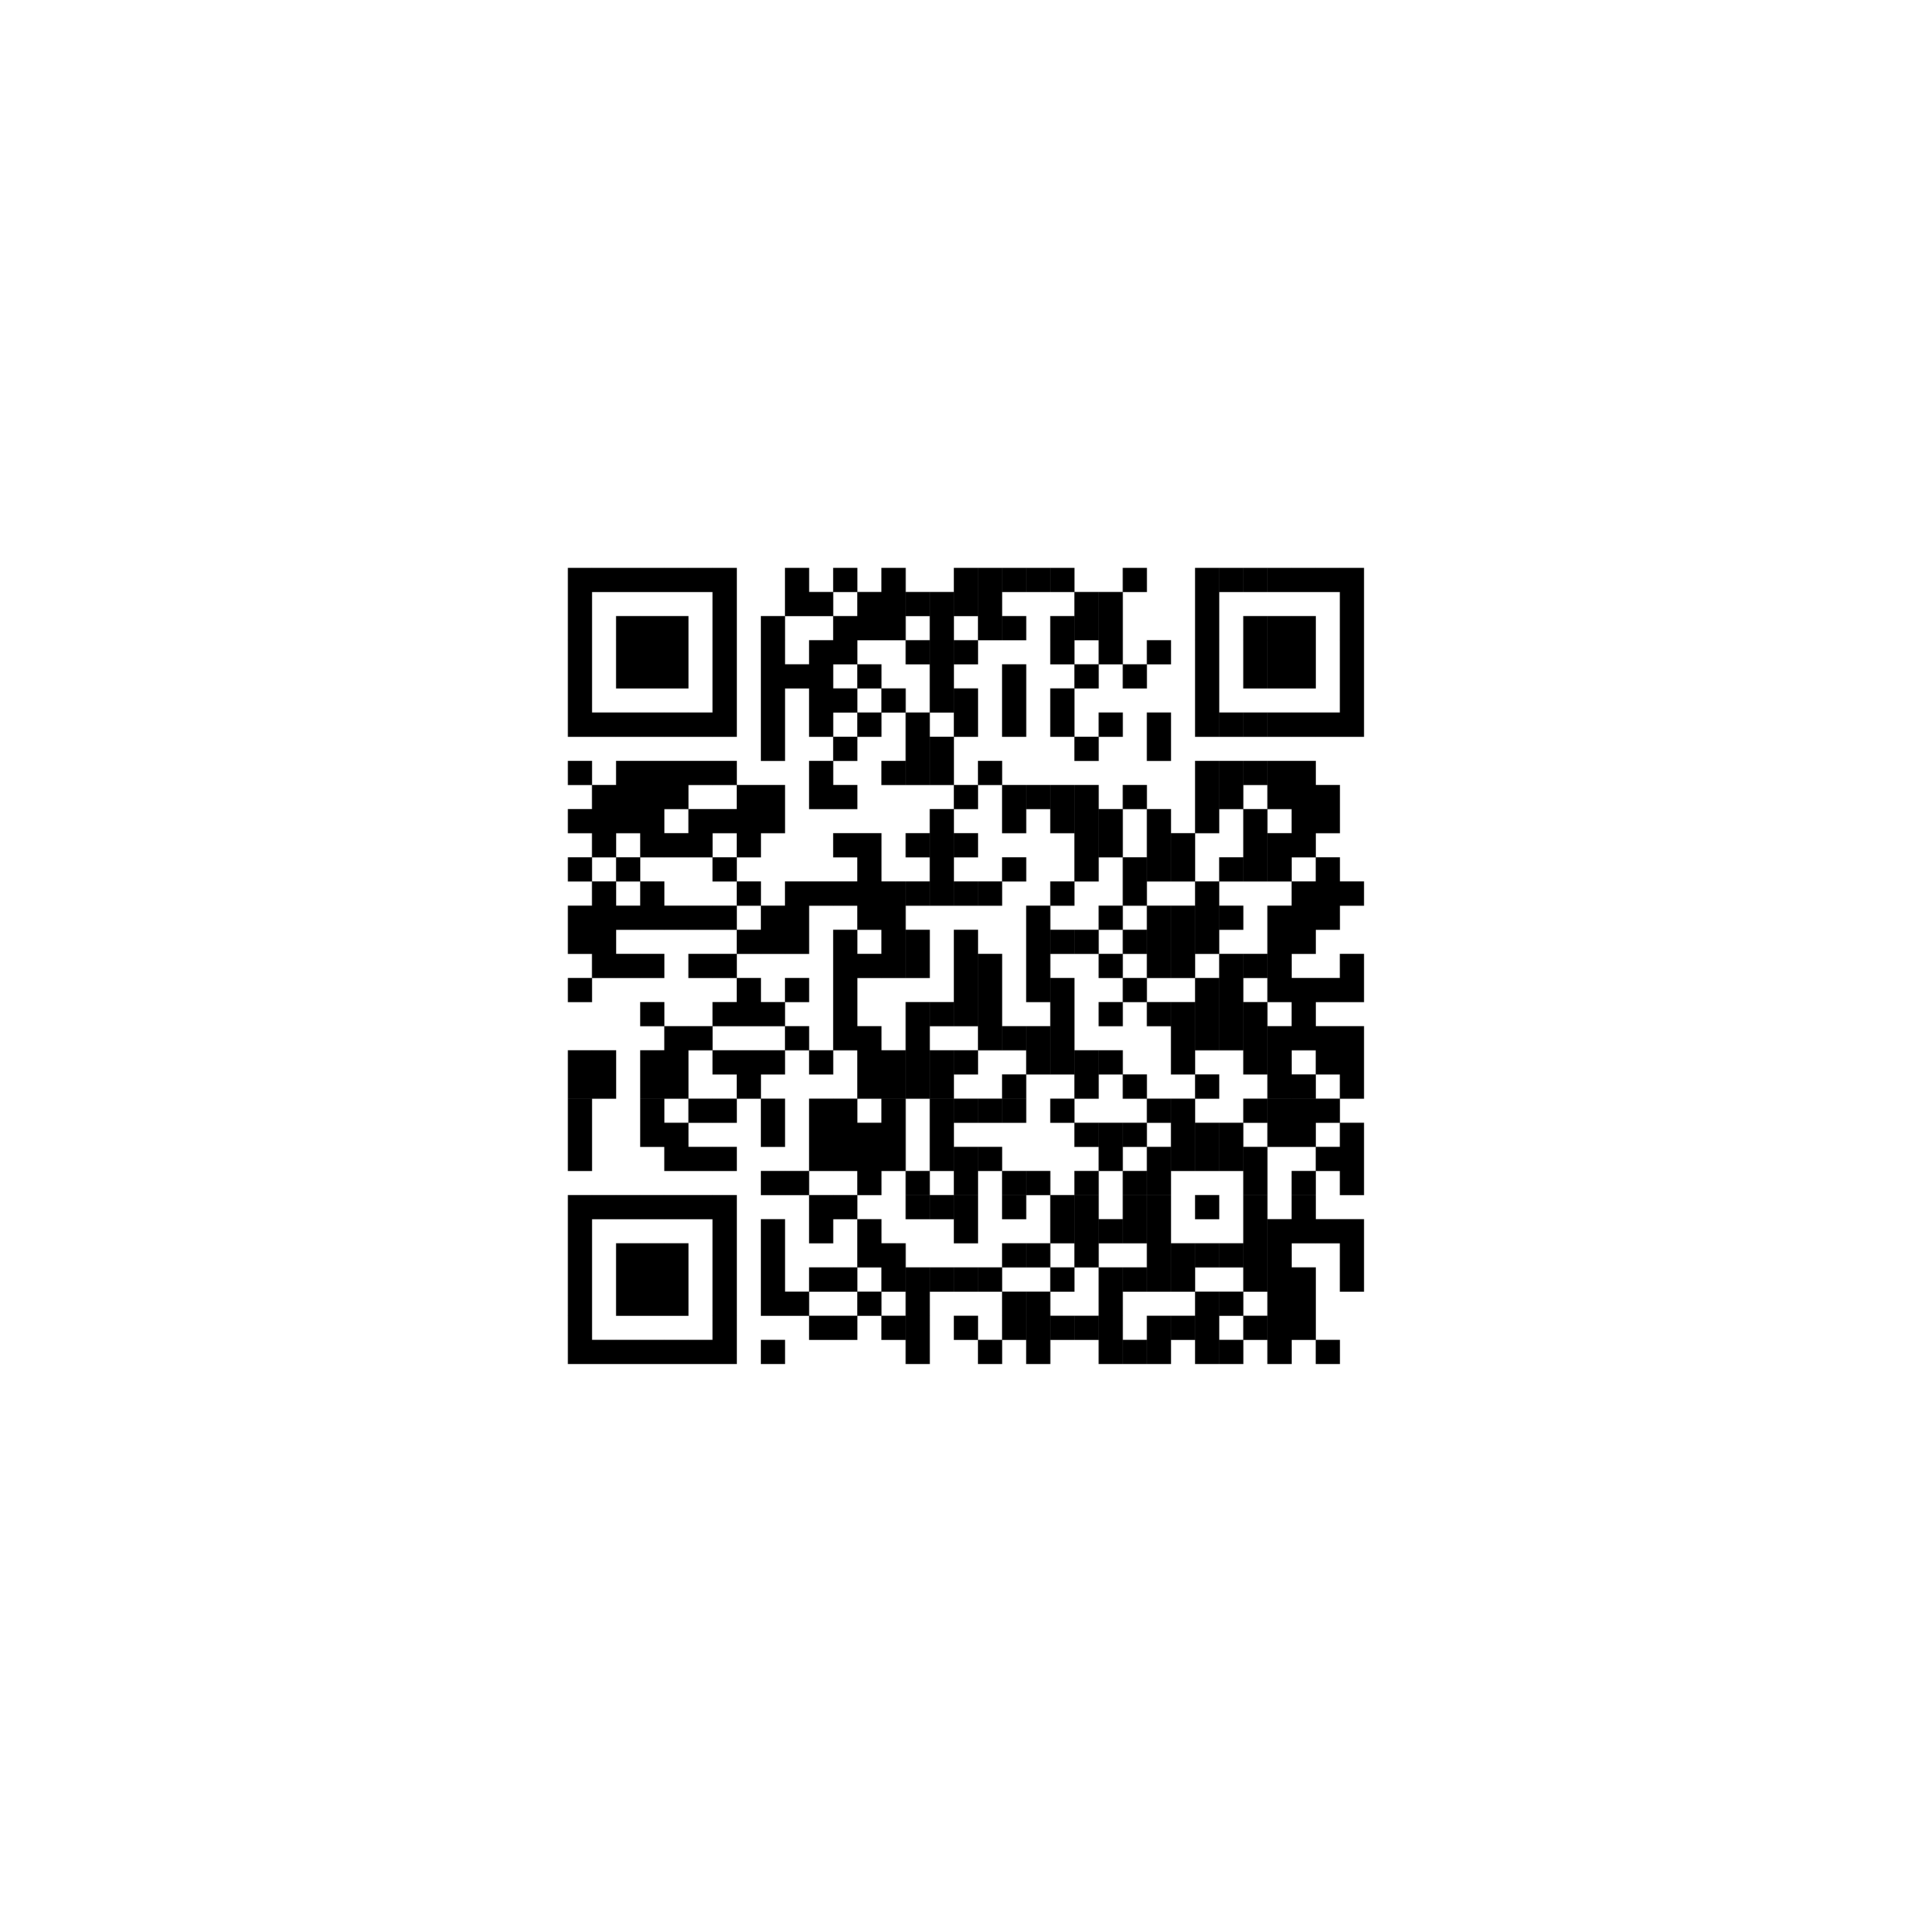
Adam Shostack’s
4 Question Frame
for Threat Modeling
1. What are we working on?
2. What can og wrong?
3. What are we going to do about it?
4. Did we do a good job?
https://github.com/adamshostack/4QuestionFrame
Notes:
How can OWASP Cornucopia be used for threat modeling?
First of all, Cornucopia is based on another game called Elevation of Privilege which were created by Adam Shostack while he was working at Microsoft to make threat modeling accessible and engaging for developers. Elevation of Privilege teaches security principles by having players identify vulnerabilities based on the STRIDE model during the design phase. The game uses a deck of cards to prompt discussions about Spoofing, Tampering, Repudiation, Information Disclosure, Denial of Service, and Elevation of Privilege, and OWASP Cornucopia does the same, but it also identify concrete things that you can do at the same time by pointing out the concrete security requirements that you need to implement through discussions and gamifications.
Those discussions then help the team to identify
1. What we are working on?
2. What can go wrong?
3. What we can do about it?
4. And whether we did a good job?

Slide 8
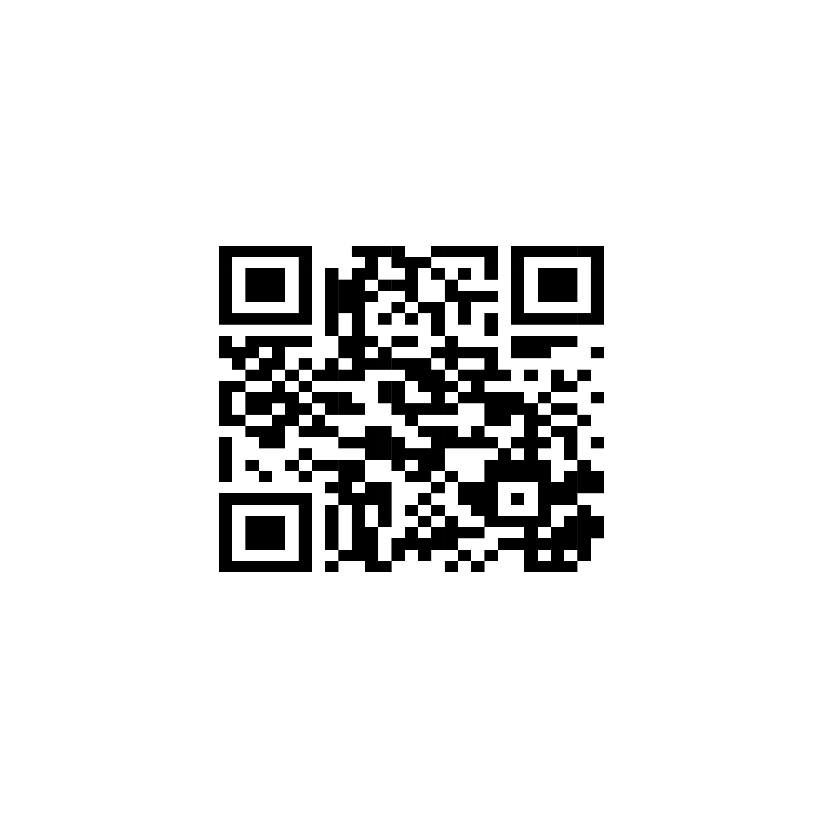
Values
We have come to value:
A culture of finding and fixing design issues over checkbox compliance
People and collaboration over processes, methodologoes and tools
A journey of understanding over a security or privacy snapshot
Doing threat modeling over talking about it
Continous refinement over a single delivery
https://www.threatmodelingmanifesto.org/
Notes:
Those questions are also parts of what is called the Threat Modeling Manifesto which also talks about a set of values meant to make threat modeling agile and better integrated into organizations doing agile software development. So to conclude, Cornucopia works by lowering the bar to threat modeling and requirement analysis which makes it easier to just get started by playing the game.

Slide 9
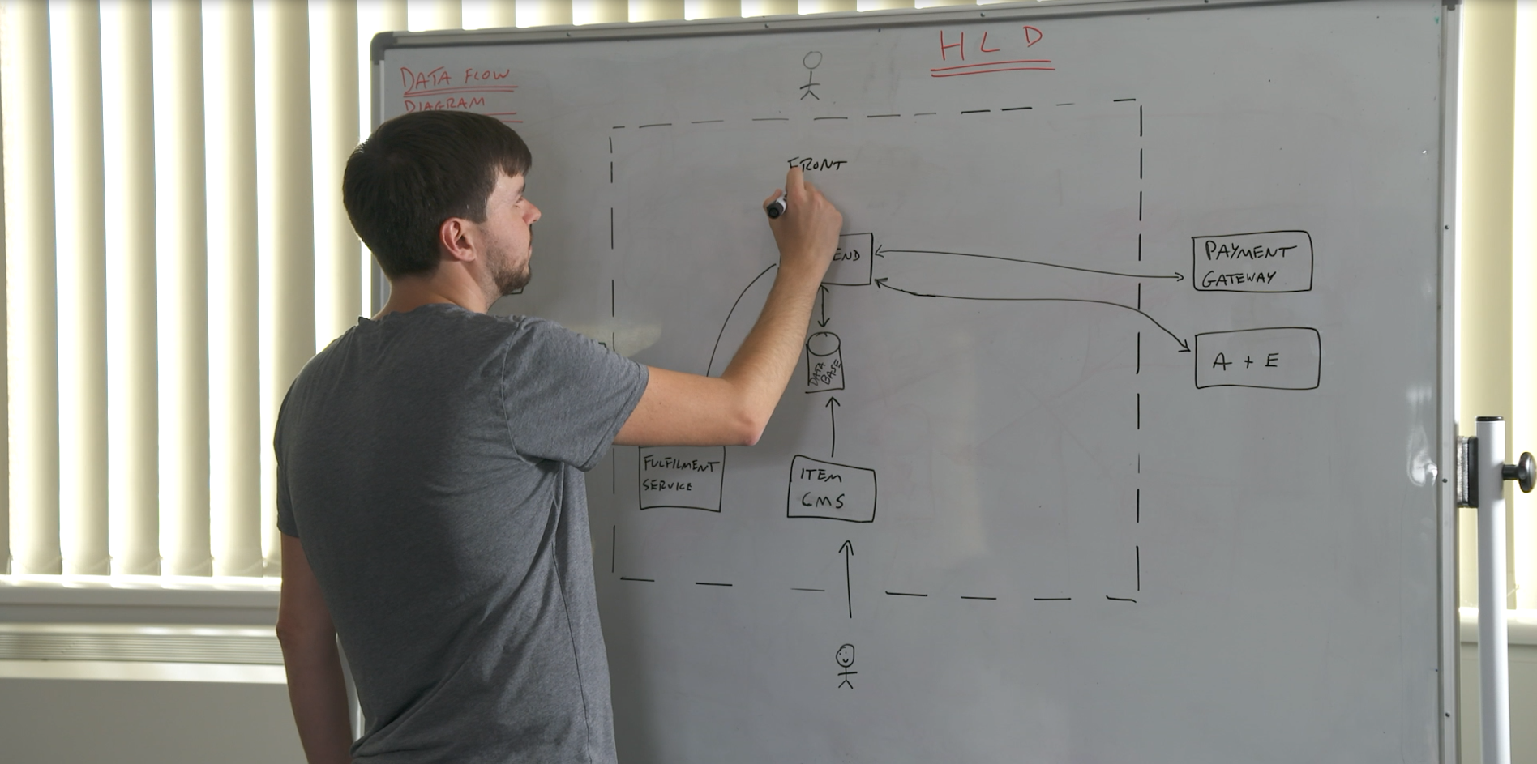
WHAT ARE WE
WORKING ON?
Notes:
Before the game begins, the players present a high-level diagram that describes the features that are developed. It can be several components, an api endpoint, a web page, or a mobile app. This diagram will then be annotated during the game, and threats added to it. The cards are then shuffled and dealt out evenly until all the cards have been distributed.

Slide 10
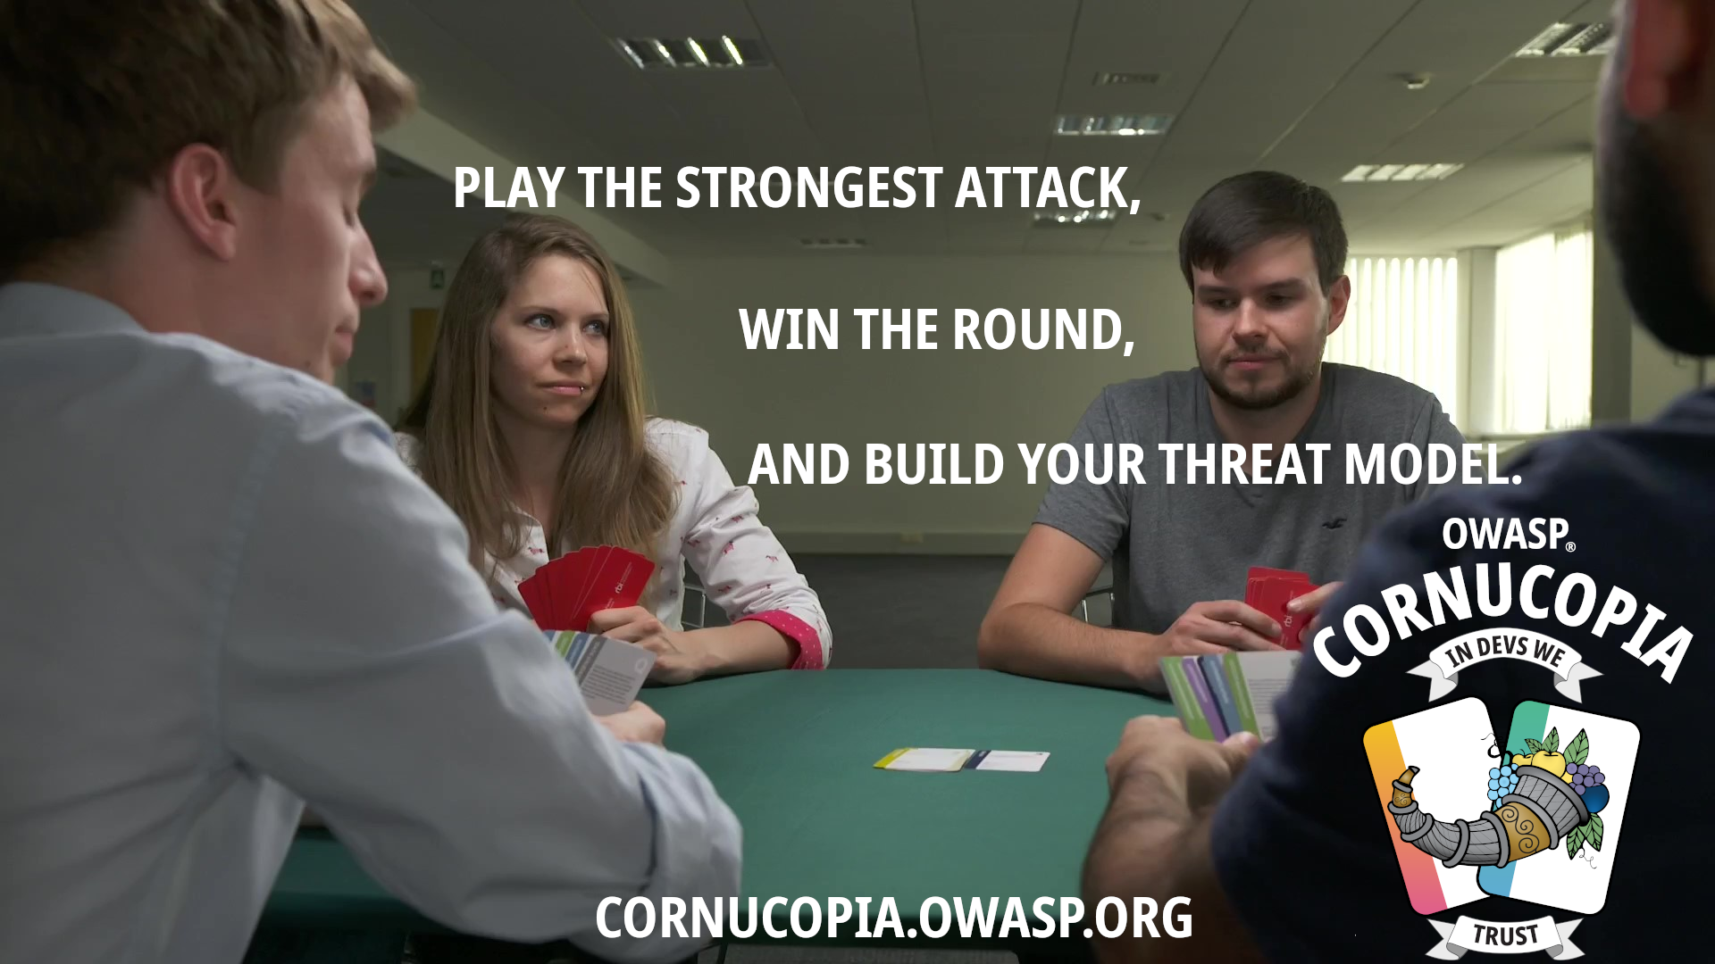
WHAT CAN GO WRONG?
Notes:
To score points, you must play a card and argue that the attack on that card poses a potential threat to the application. If the other players agree that the threat needs to be mitigated, then the player earns a point. The player with the highest applicable threat during the round gets an additional point. Any card that scores points will be discussed and noted on your model in OWASP Threat Dragon, along with any mitigation that need to be completed to mitigate the threat. These threats will then become backlog items for the upcoming sprint. The winner of the game is the player with the highest score at the end of the threat modeling session.

