Slide 1
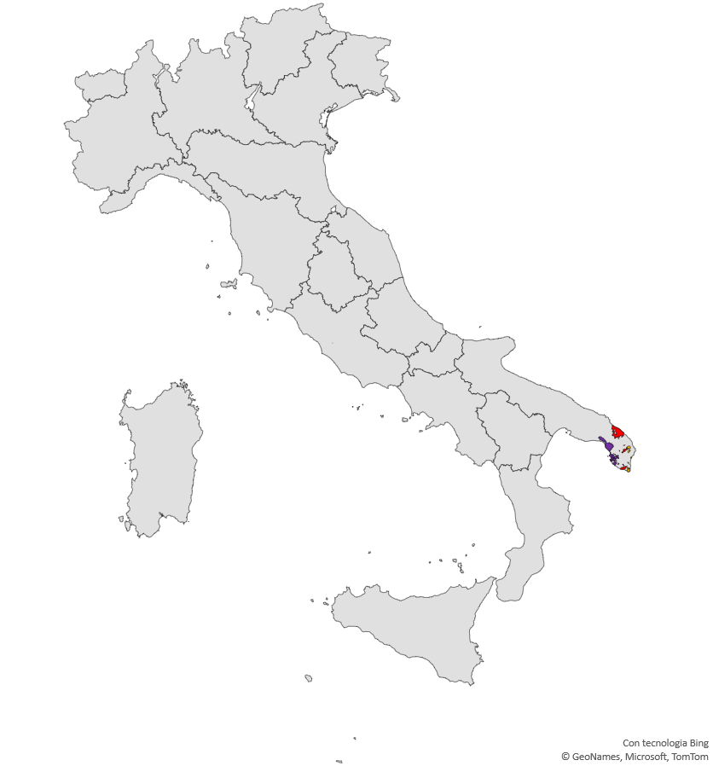
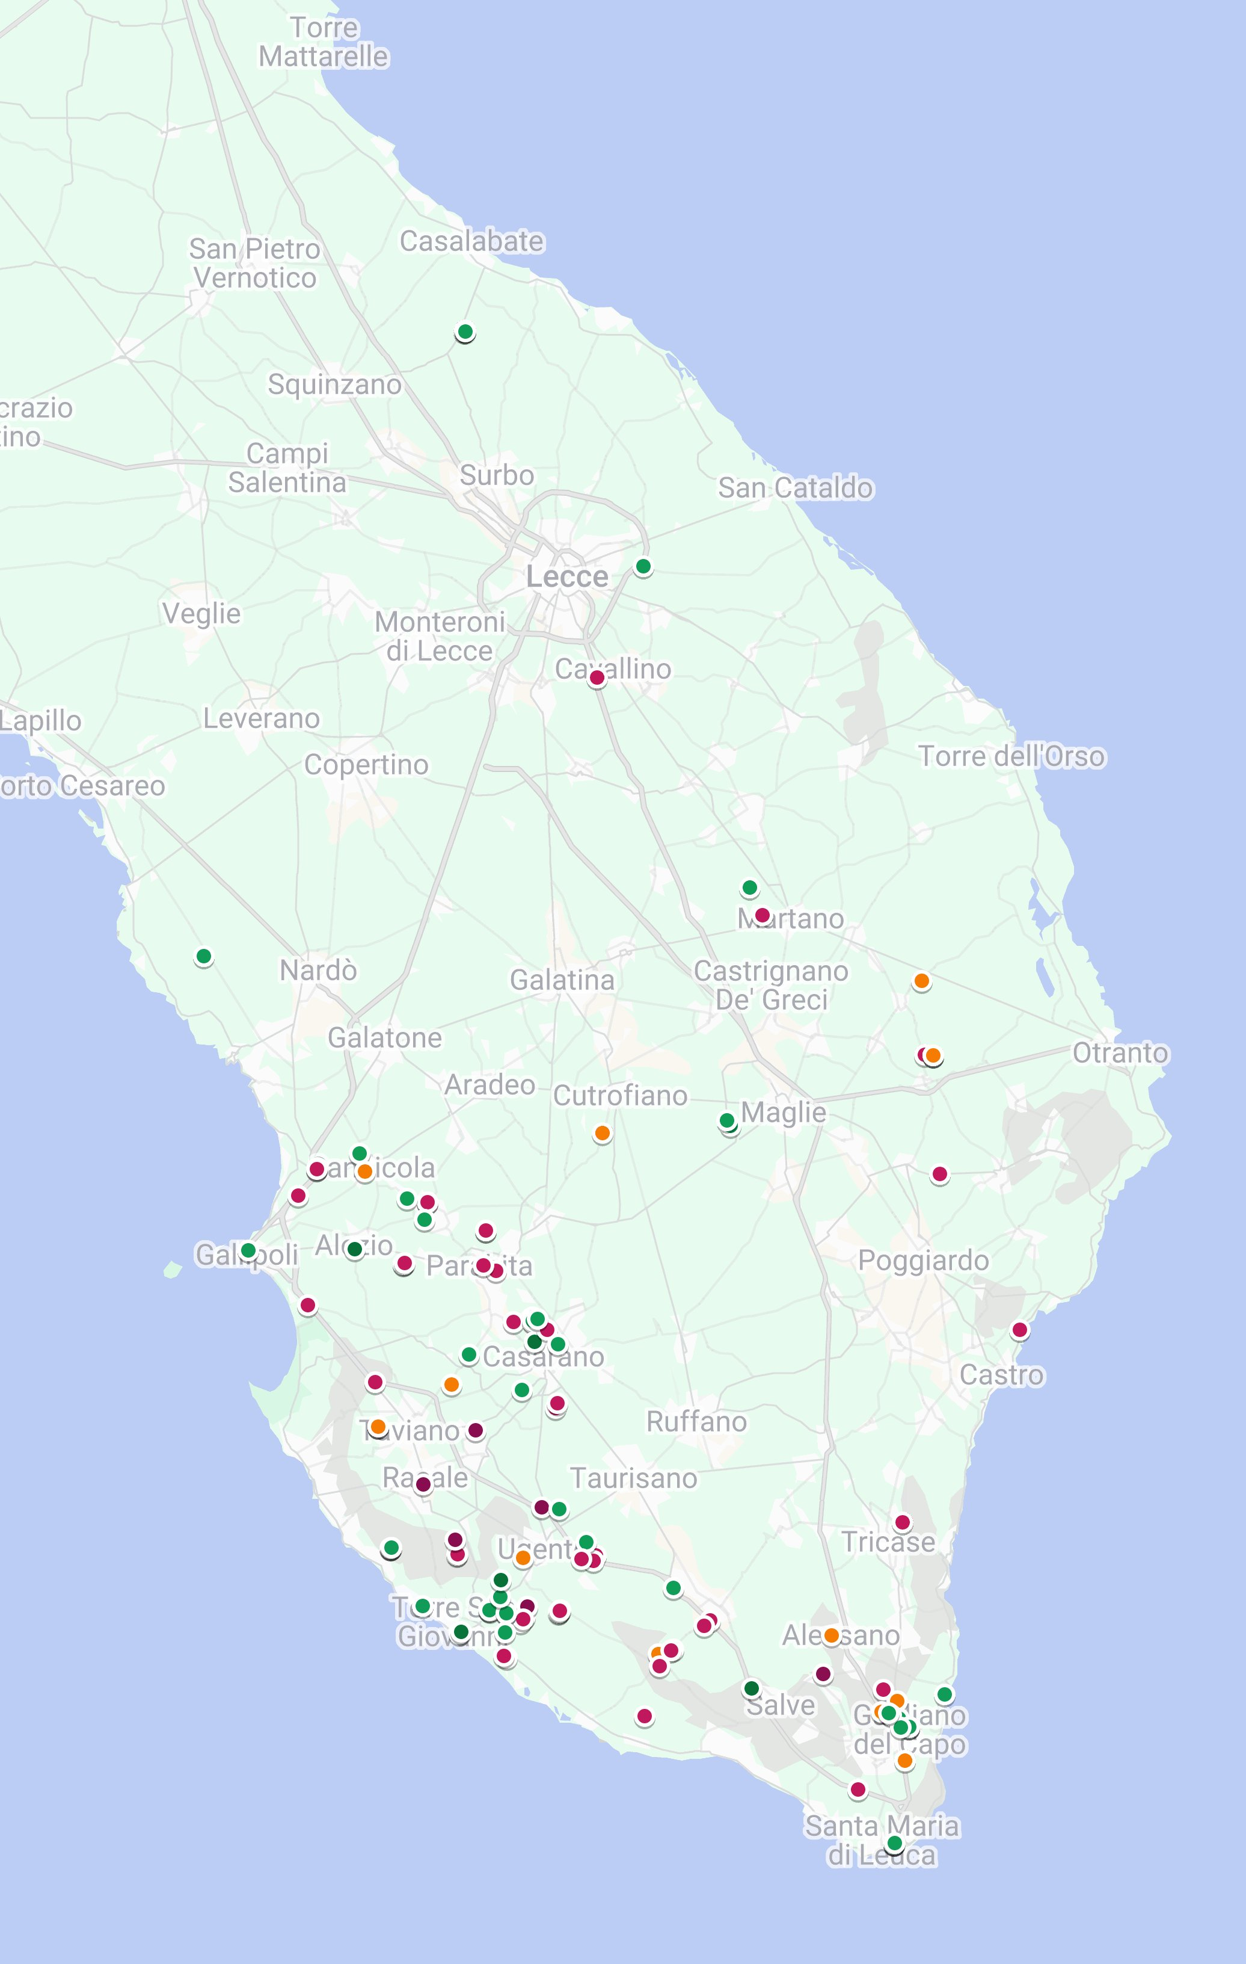
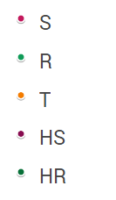
Supplementary Figure 1
A
B
Year of identification | Location's score |  |  | N. of tree identified
Year of identification | 1 | 2 | 3
2016 | 1 | 3 | 9 | 13
2017 | 2 | 1 | 31 | 34
2018 | 2 |  | 7 | 9
2019 | 2 | 5 | 5 | 12
2020 | 2 |  | 7 | 9
2021 | 4 | 12 | 12 | 28
2022 |  | 13 | 21 | 34
Total | 13 | 34 | 92 | 139
C
Phenotype | Location’s score |  |  | N. of tree identified
 | 1 | 2 | 3
HS |  | 1 | 10 | 11
S | 6 | 9 | 38 | 53
T | 3 | 7 | 12 | 22
R | 3 | 17 | 27 | 47
HR | 1 |  | 5 | 6
Total | 13 | 34 | 92 | 139
Notes:
Supplementary Figure 1. Geographic location of 139 olive spontaneous genotype. a) Localization of the 139 spontaneous selected genotypes during the survey surrounding the first outbreak in Italy (discovered in 2013); genotypes were represented on the map with different colors according to their phenotype: Highly Resistant (HR); Resistant (R); Tolerant (T); Susceptible (S) and Highly Susceptible (HS); b) Number of genotypes were empirically categorized in three different classes according to the year when infections were firstly discovered and to the location: location score “3” assigned to the first outbreak areas (purple), location score “2” to the second area (red) and location score “1” to the most distant areas from the initial outbreaks (orange). c) Distribution of the 139 spontaneous genotypes according to the location’s score and to the phenotype.

