Slide 1
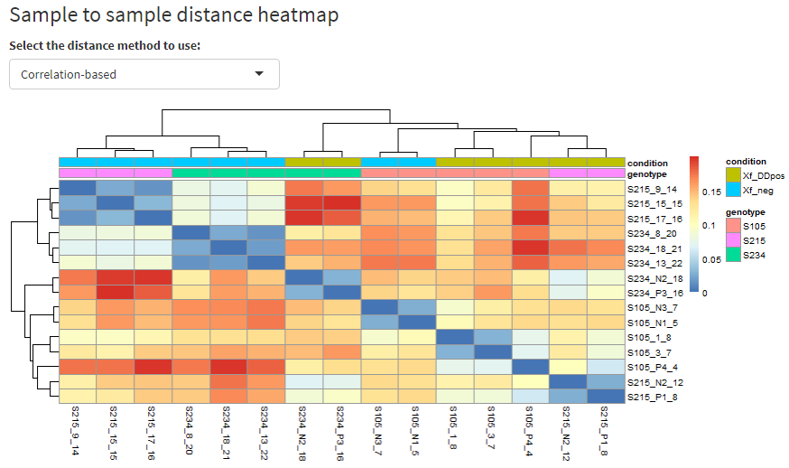
Supplementary Figure 3
Notes:
Supplementary Figure 3. Sample to sample distance analysis by correlation distance method on the RNASeq data mapped on the cv. Farga genome

