Slide 1
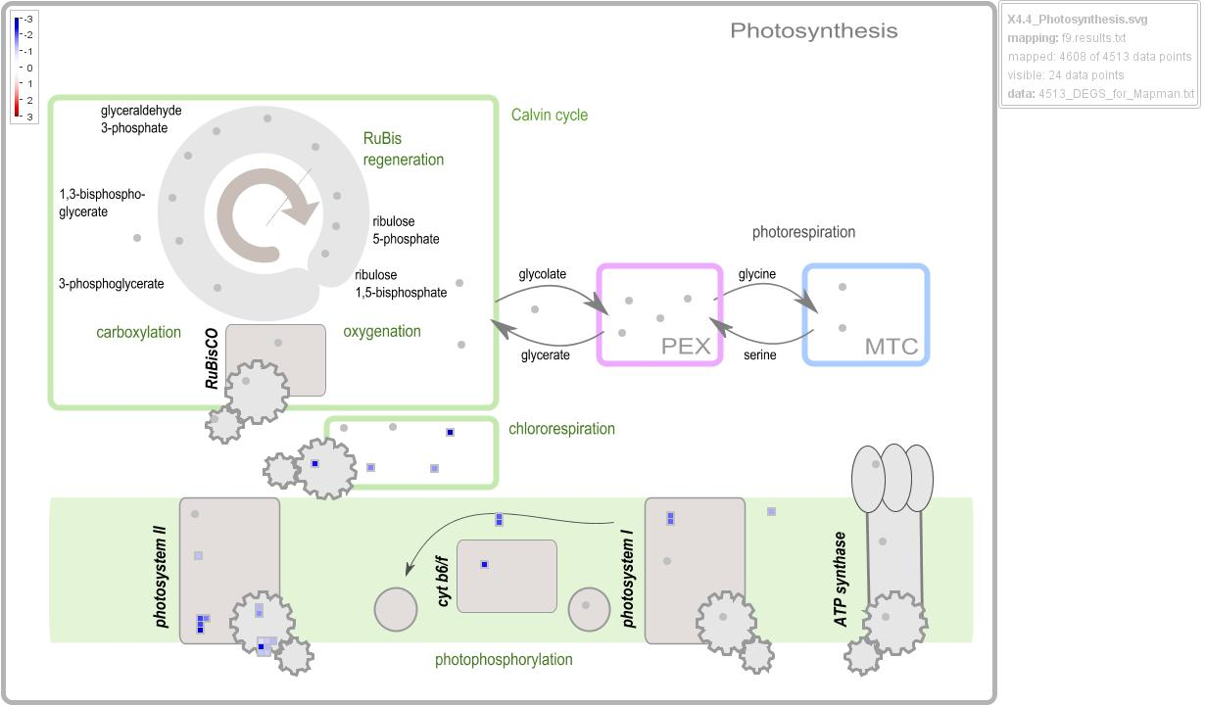
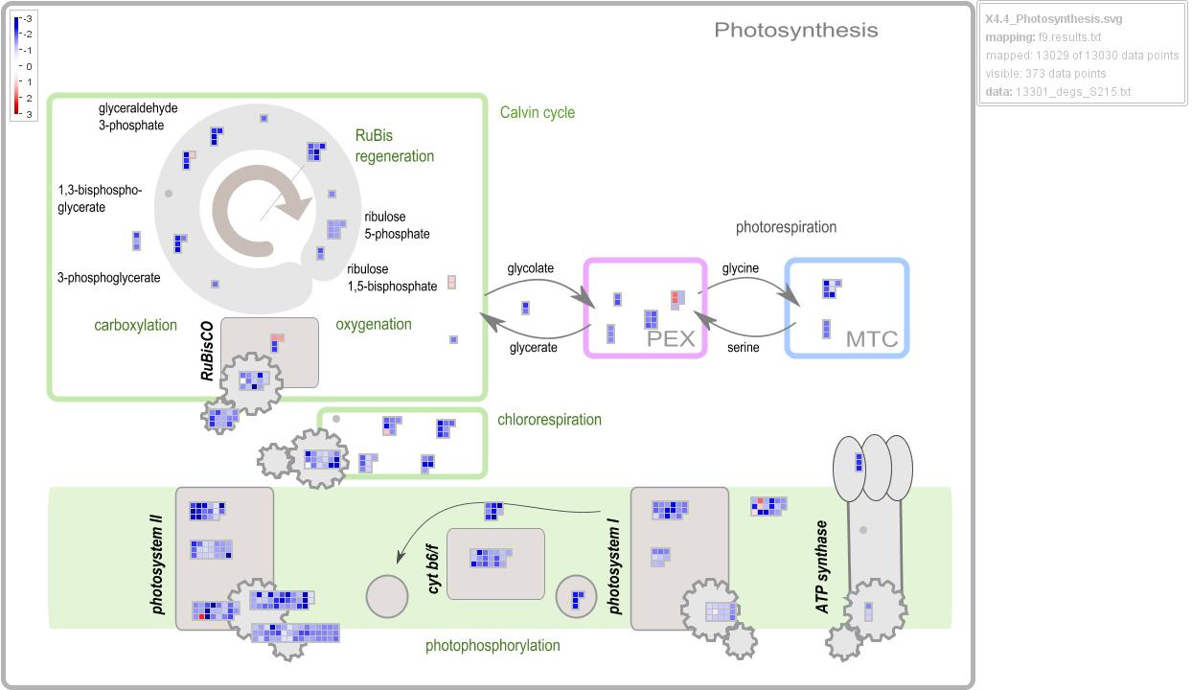
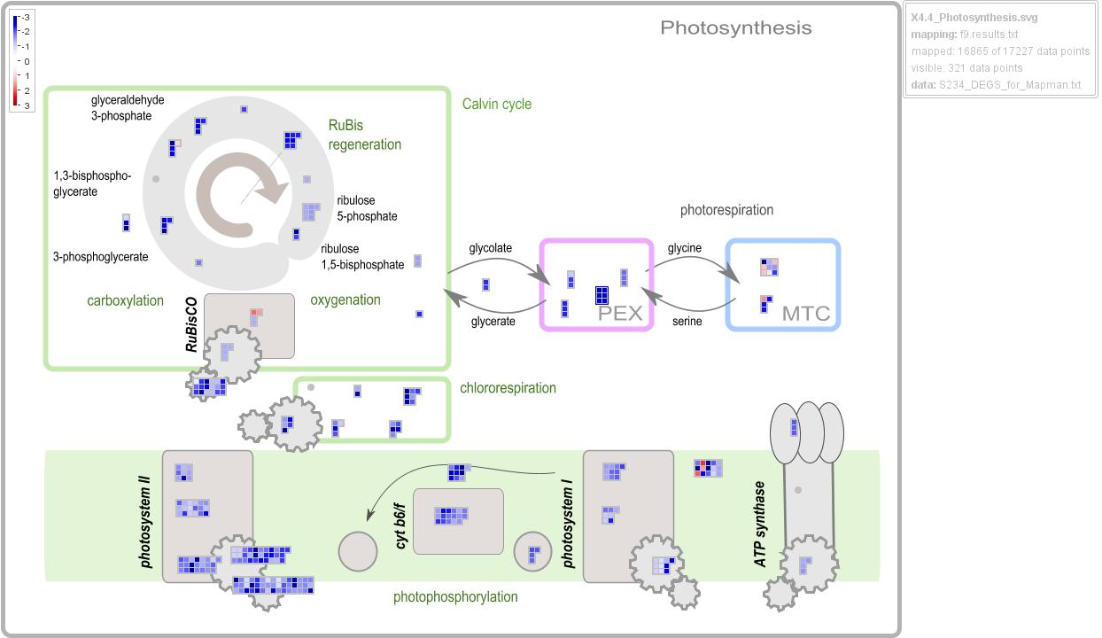
S105
(4,513_DEGS)
Supplementary
Figure 4
S215
(13,030_DEGS)
S234
(17,227_DEGS)
Figure S6
Notes:
Supplementary Figure 4. Visualization of photosynthesis. MapMan was used to visualize differentially expressed genes (DEGs) involved in photosynthesis process in the three genotypes infected by Xf

