Slide 1
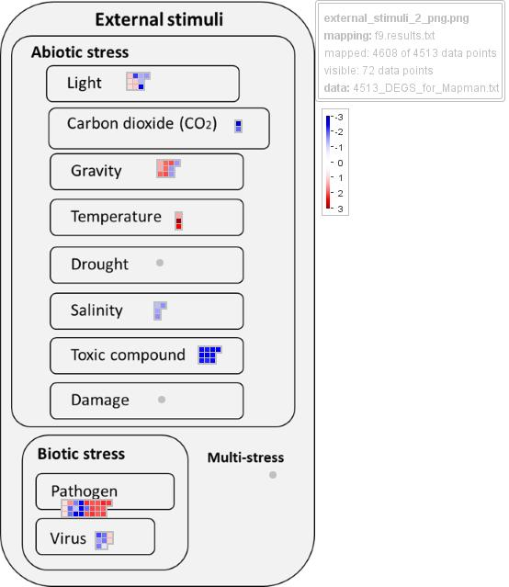
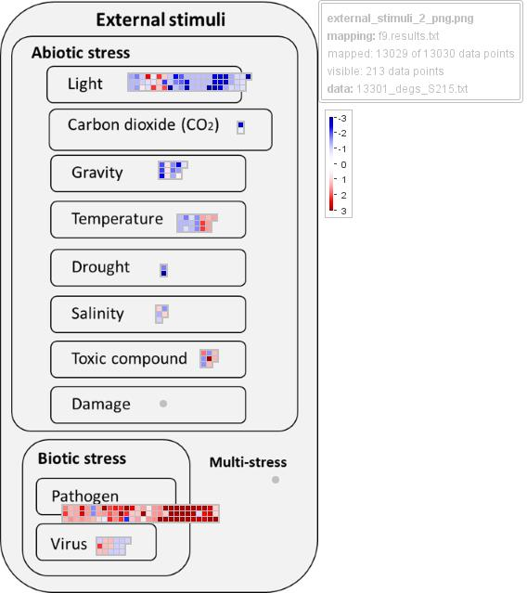
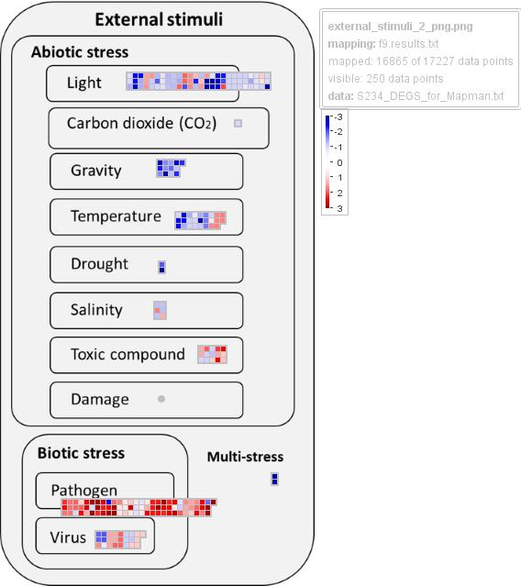
Supplementary Figure 5
S105
(4,513_DEGS)
S215
(13,030_DEGS)
S234
(17,227_DEGS)
Notes:
Supplementary Figure 5. Custom overview of “External stimuli response” BIN by MapMan4 representing genes responding to Abiotic and Biotic stresses. The different colors represent the shrunked log2 fold change values of the gene expression levels in response to Xf infection, blue and red represent downregulated and upregulated DEGs.

