Slide 1
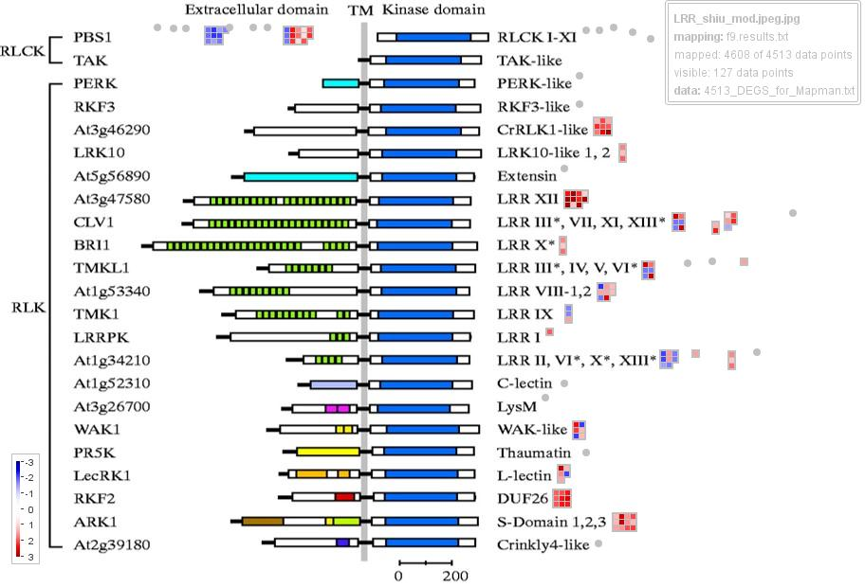
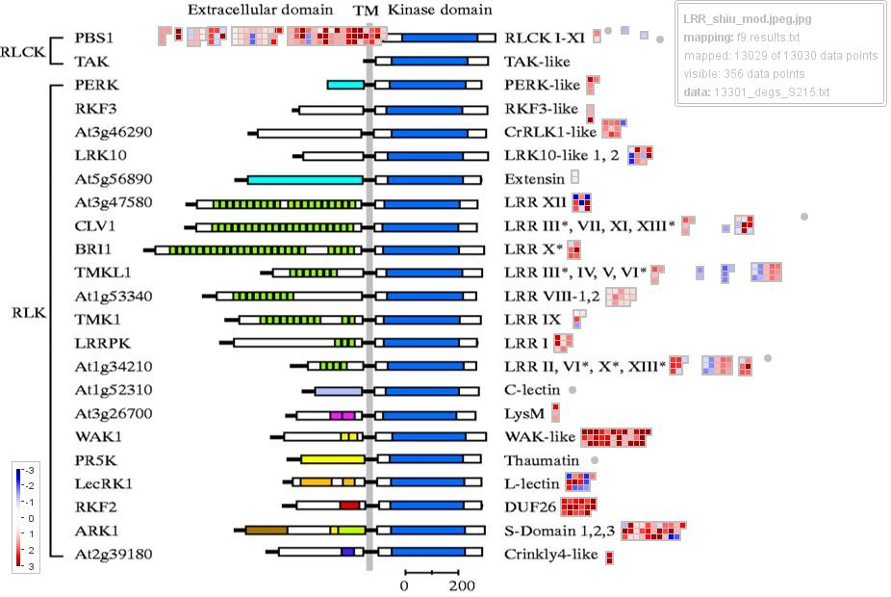
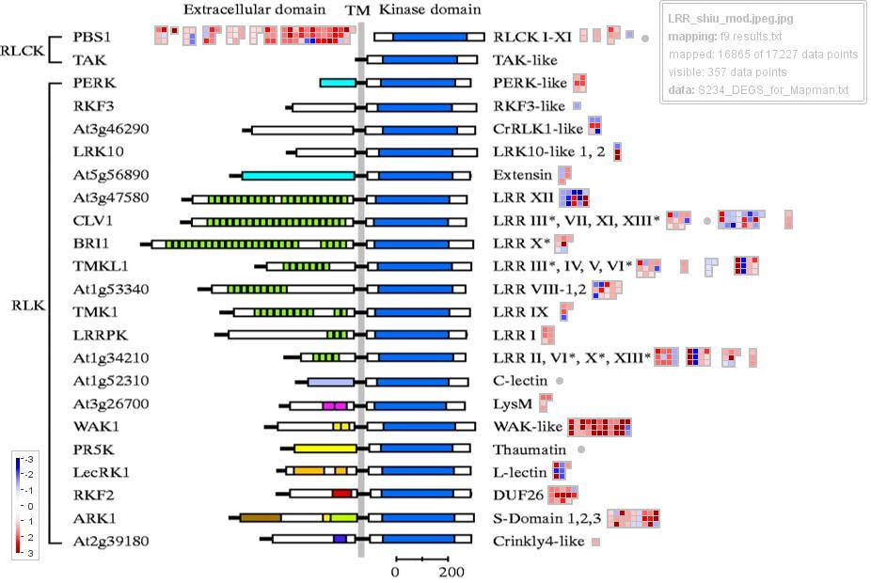
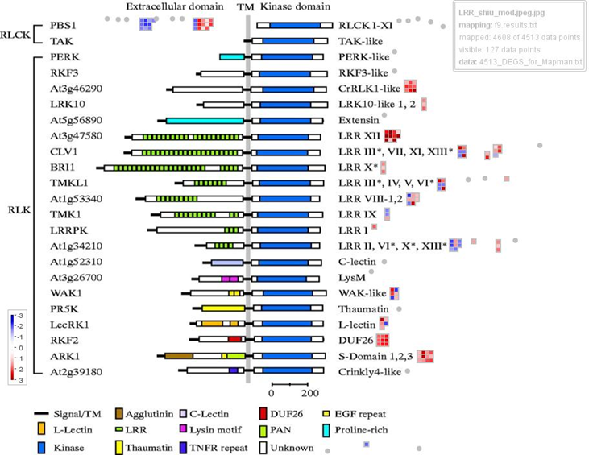
Supplementary
Figure 6
S105
(4,513_DEGS)
S215
(13,030_DEGS)
S234
(17,227_DEGS)
Notes:
Supplementary Figure 6. Visualization of differentially expressed receptor-like kinase genes with MapMan4. The receptor kinase BINs 18.4.1 was illustrated according Shiu et al 2001. (a) S105 (b) S215 and (c) S234 . The figure was constructed using log2-transformed ratios of infected versus healthy. Blue represents downregulated DEGs, and red represents upregulated DEGs.

