Slide 1
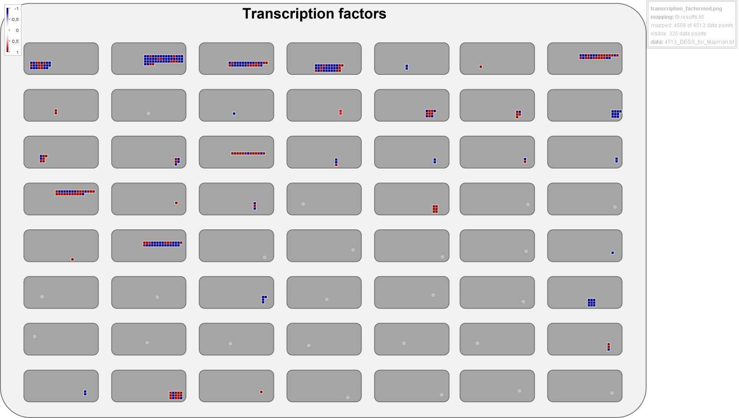
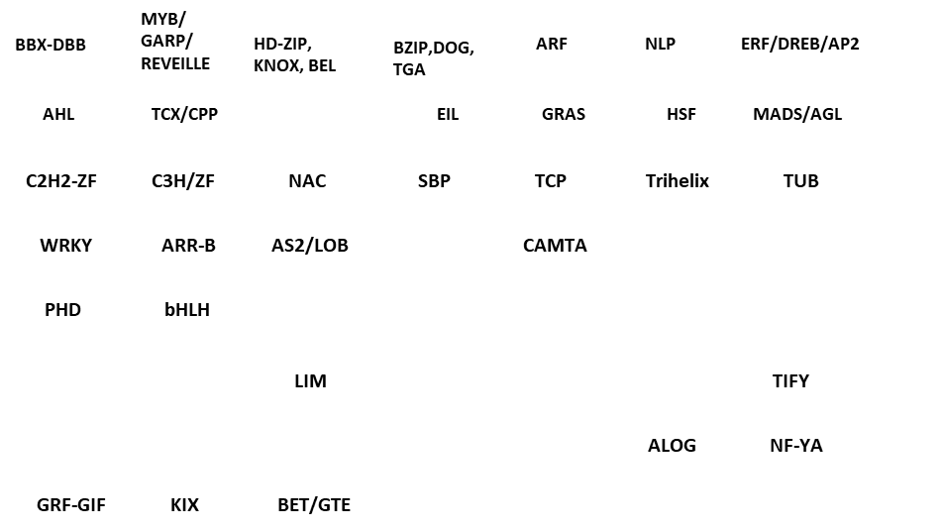
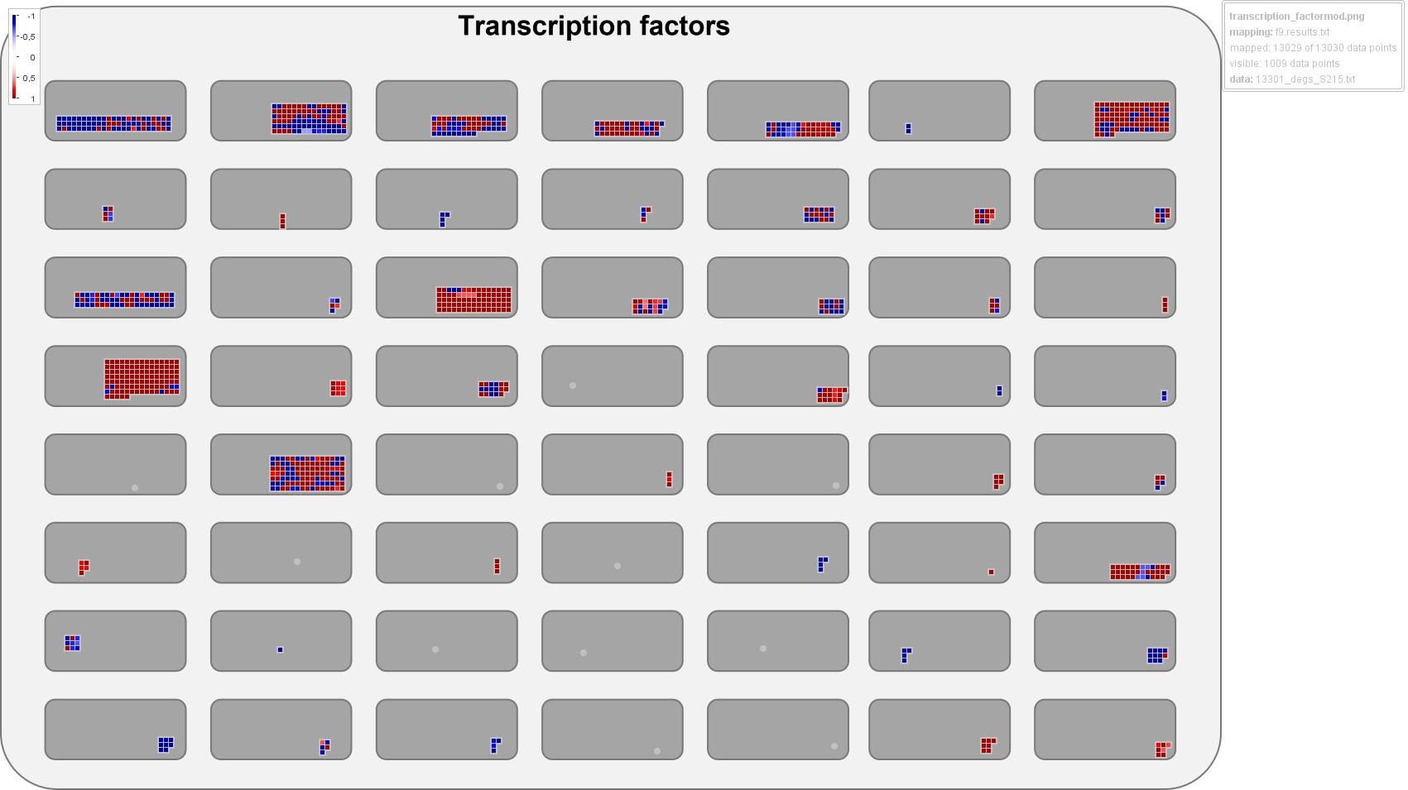
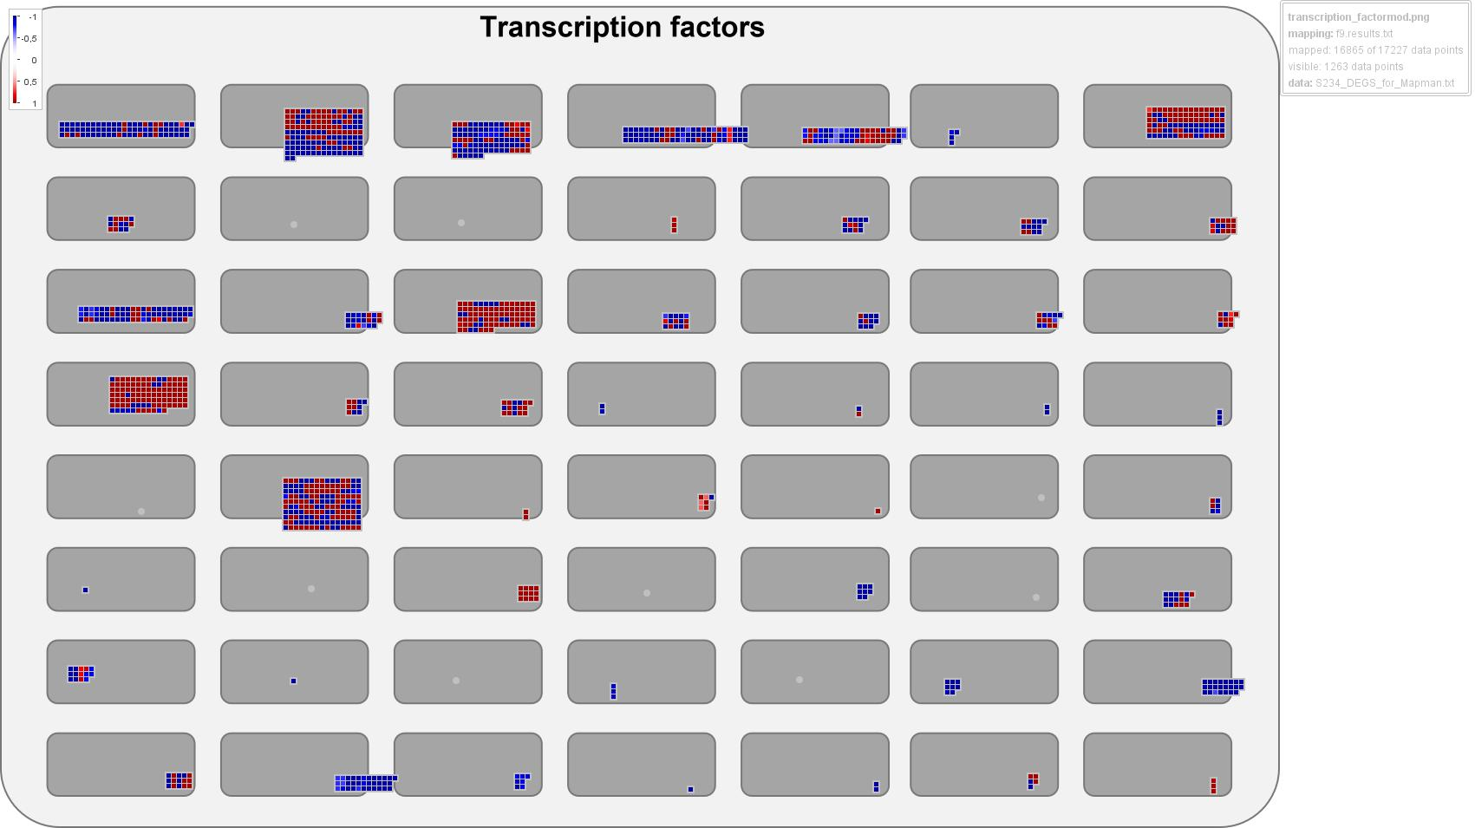
S105
(4,513_DEGS)
Supplementary Figure 7
S215
(13,030_DEGS)
S234
(17,227_DEGS)
Notes:
Supplementary Figure 7. MapMan4 overview showing the differentially expressed genes (DEGs) annotated as Transcription factors in the S105, S215 and S234) genotypes. Modules indicate bins of the different Transcription factor families. The different colors represent the shrunked log2 fold change values of the gene expression levels in response to Xf infection, blue and red represent downregulated and upregulated DEGs.

