Slide 1
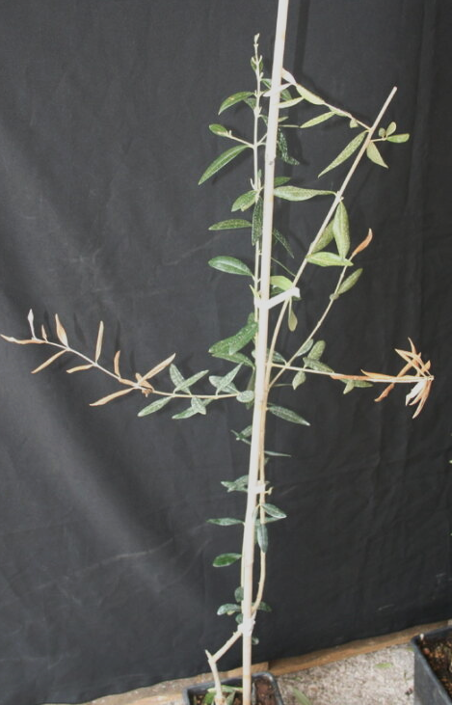
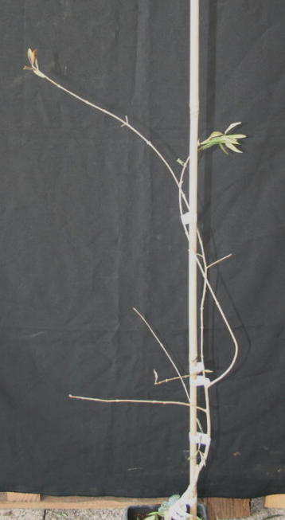
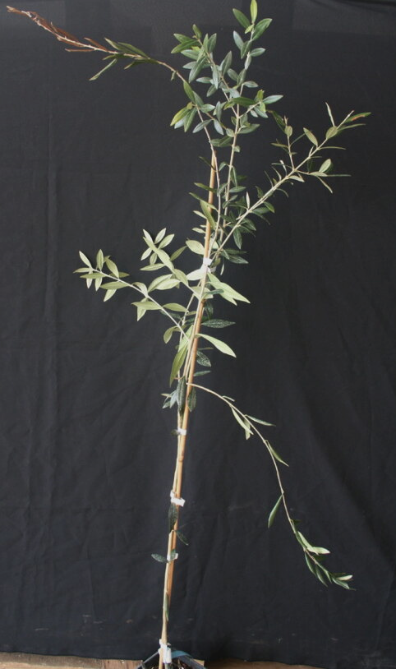
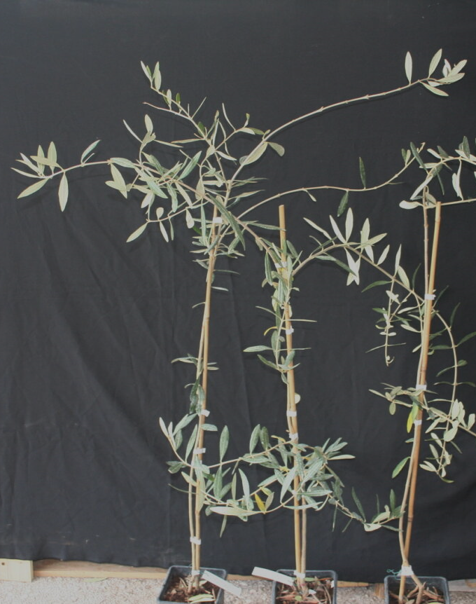
Supplementary Figure 8. Symptoms recorded on the Xfp-infected plants 16 months (16mvpi)
A
B
Cellina di Nardò
Cellina di Nardò
C
D
S218 (Leccino X Cellina di N.ardò)
S234 (Leccino X Ogliarola s.)
Notes:
Supplementary Figure 8. Onset of symptoms recorded on few Xfp-inoculated replicates 16 months after vector inoculation. a) Plant of Cellina di Nardò showing dieback and withering; b) Plant of Cellina di Nardò with severe desiccation; c) Plant of the genotype S218 with initial shoot dieback; d) Plants of the genotype S234 showing only defoliation.

