Slide 1
Computer Graphics Project Presentation Helicopter Game Group Members Name Seat No. S. Abu Owais Bin Nasar B10101086 M. Umair Khan B10101067 Class: VI Semester BS(CS)-Morning Sec.: B Course Supervisor : Miss Humera Tariq

Slide 2
Content
Game Screenshot
Game Scenario
Game Features
Special Effect
Collision
Gravity

Slide 3
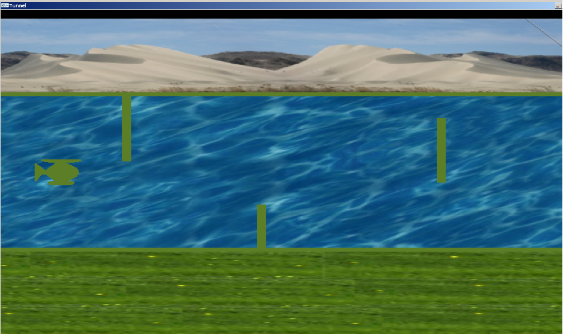
Game Screenshot

Slide 4
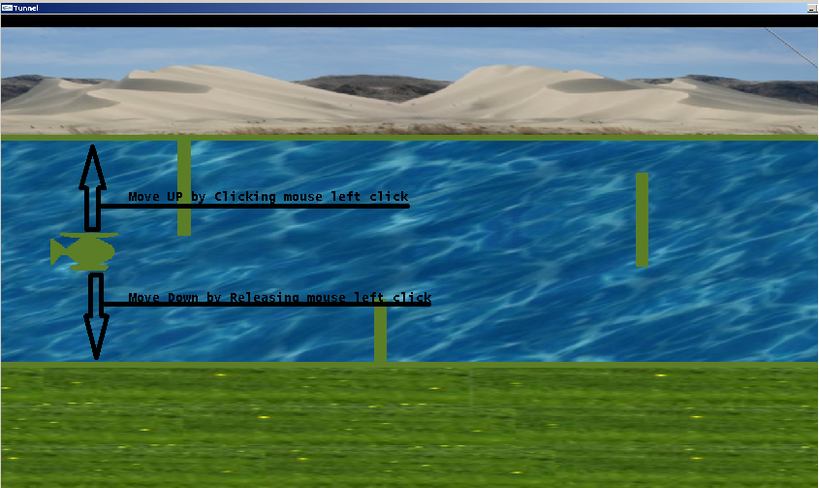
GAME SCENARIO
By using mouse left click helicopter move upward
Releasing mouse left click helicopter move downward

Slide 5
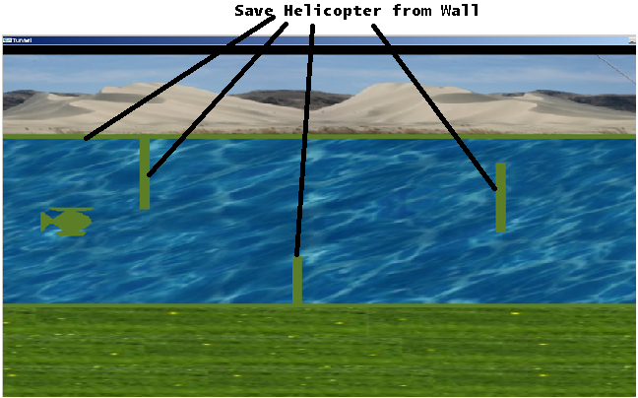
Game Features
User have to flying helicopter in track and save it from upcoming wall

Slide 6
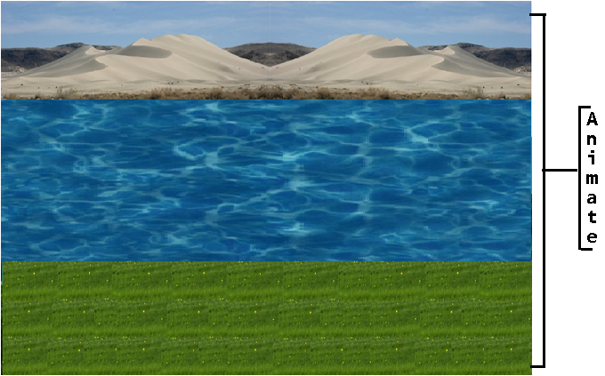
Special Effect

Slide 7
Special Effect Code
void drawHill(int id)
glBegin(GL_QUADS);
glTexCoord2f(0.0f+sin(hillMovement/10.0),0.0f); glVertex2i(1400,730); // right top corner
glTexCoord2f(1.0f+sin(hillMovement/10.0),0.0f); glVertex2i(0,730); // left top corner
glTexCoord2f(1.0f+sin(hillMovement/10.0),1.0f); glVertex2i(0,550); // left bottom corner
glTexCoord2f(0.0f+sin(hillMovement/10.0),1.0f); glVertex2i(1400,550); // right bottom corner
glEnd();
void drawWater(int id)
glBegin(GL_QUADS);
glTexCoord2f(0.0f+sin(waterMovement/10.0),1.0f); glVertex2i(1400,550); // right top corner
glTexCoord2f(1.0f+sin(waterMovement/10.0),0.0f); glVertex2i(0,550); // left top corner
glTexCoord2f(1.0f+sin(waterMovement/10.0),1.0f); glVertex2i(0,200); // left bottom corner
glTexCoord2f(0.0f+sin(waterMovement/10.0),0.0f); glVertex2i(1400,200); // right bottom corner
glEnd();
void drawGrass(int id)
glBegin(GL_QUADS);
glTexCoord2f(0.0f+sin(grassMovement/10.0),0.0f); glVertex2i(1400,200); // right top corner
glTexCoord2f(1.0f+sin(grassMovement/10.0),0.0f); glVertex2i(0,200); // left top corner
glTexCoord2f(1.0f+sin(grassMovement/10.0),1.0f); glVertex2i(0,0); // left bottom corner
glTexCoord2f(0.0f+sin(grassMovement/10.0),1.0f); glVertex2i(1400,0); // right bottom corner
glEnd();
void animate(void)
waterMovement-=0.001;
hillMovement-=0.001;
grassMovement-=0.001;

Slide 8
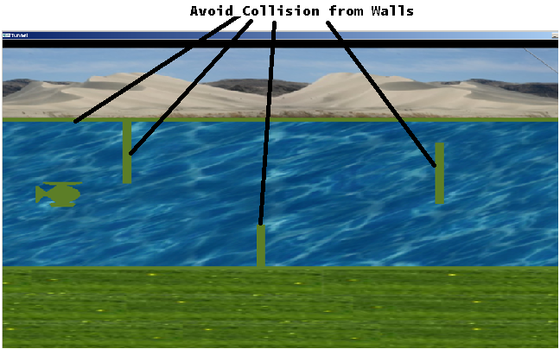
Collision
an instance of one moving object or person striking violently against another

Slide 9
Collision Code
void collision() //Collide from TOP Wall
{
if(heli.height>550|| heli.height<250) //stop game if copter hits a green box
gameover=true;
}

Slide 10
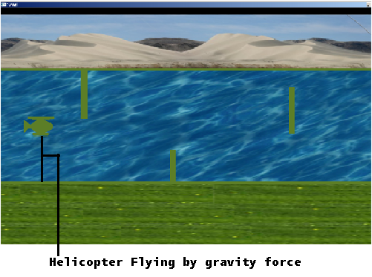
Gravity
the force that attracts a body towards the centre of the earth, or towards any other physical body having mass

Slide 11
Gravity Code
void movement()
{
//calculate the new velocity and height of the copter
heli.velocity+=forceGrav/100-heli.upwardThrust/100;
heli.height-=heli.velocity;
//limits the copters vertical speed
if(heli.velocity>maxVel)heli.velocity=maxVel;
if(heli.velocity<-maxVel)heli.velocity=-maxVel;
}
void mouse(int button, int state, int x, int y)
{
if(button==GLUT_LEFT_BUTTON && state==GLUT_DOWN)
heli.upwardThrust=2*forceGrav;
else if(button==GLUT_LEFT_BUTTON)
heli.upwardThrust=0;
}

