Slide 1


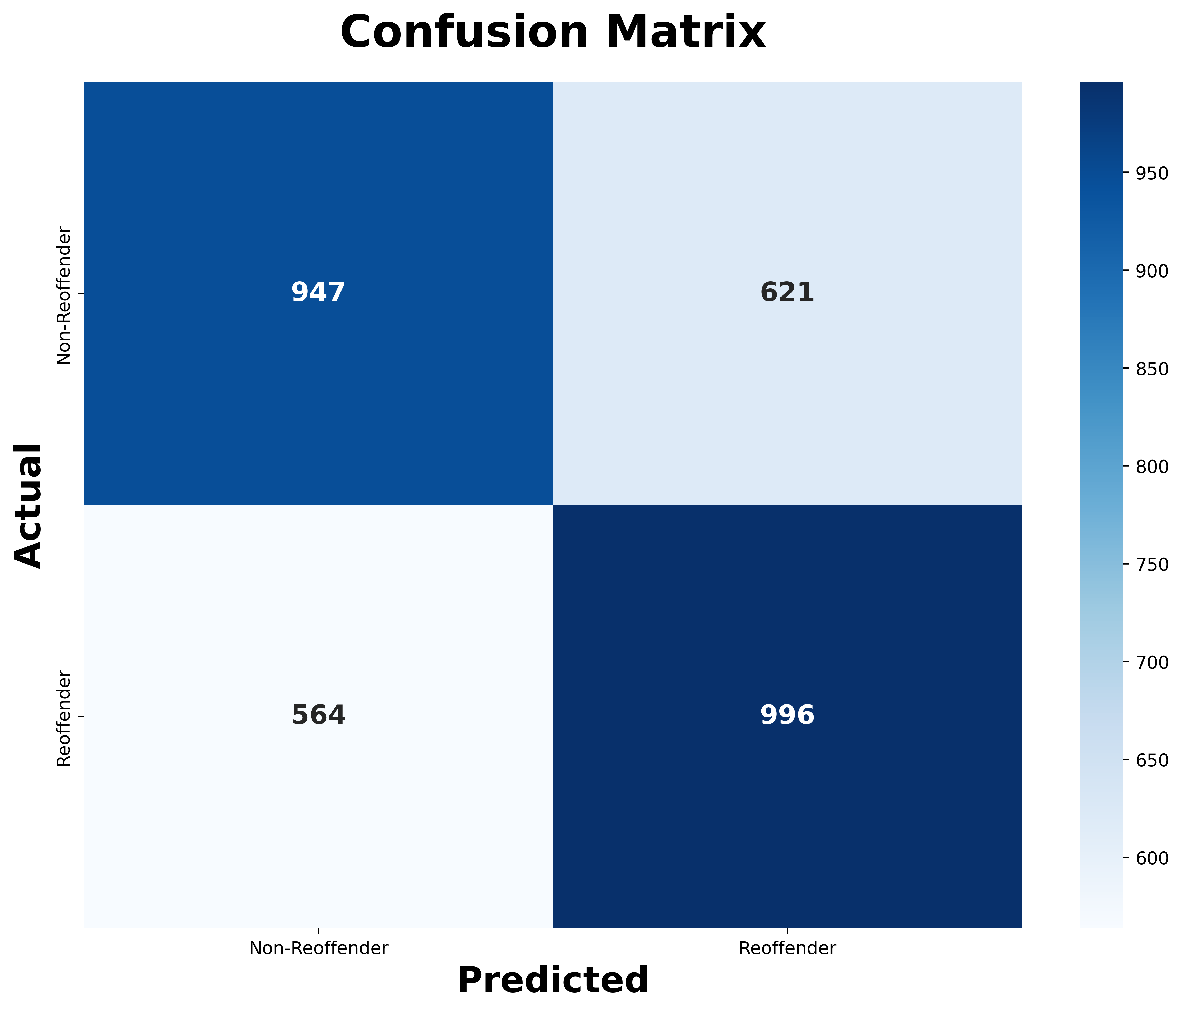
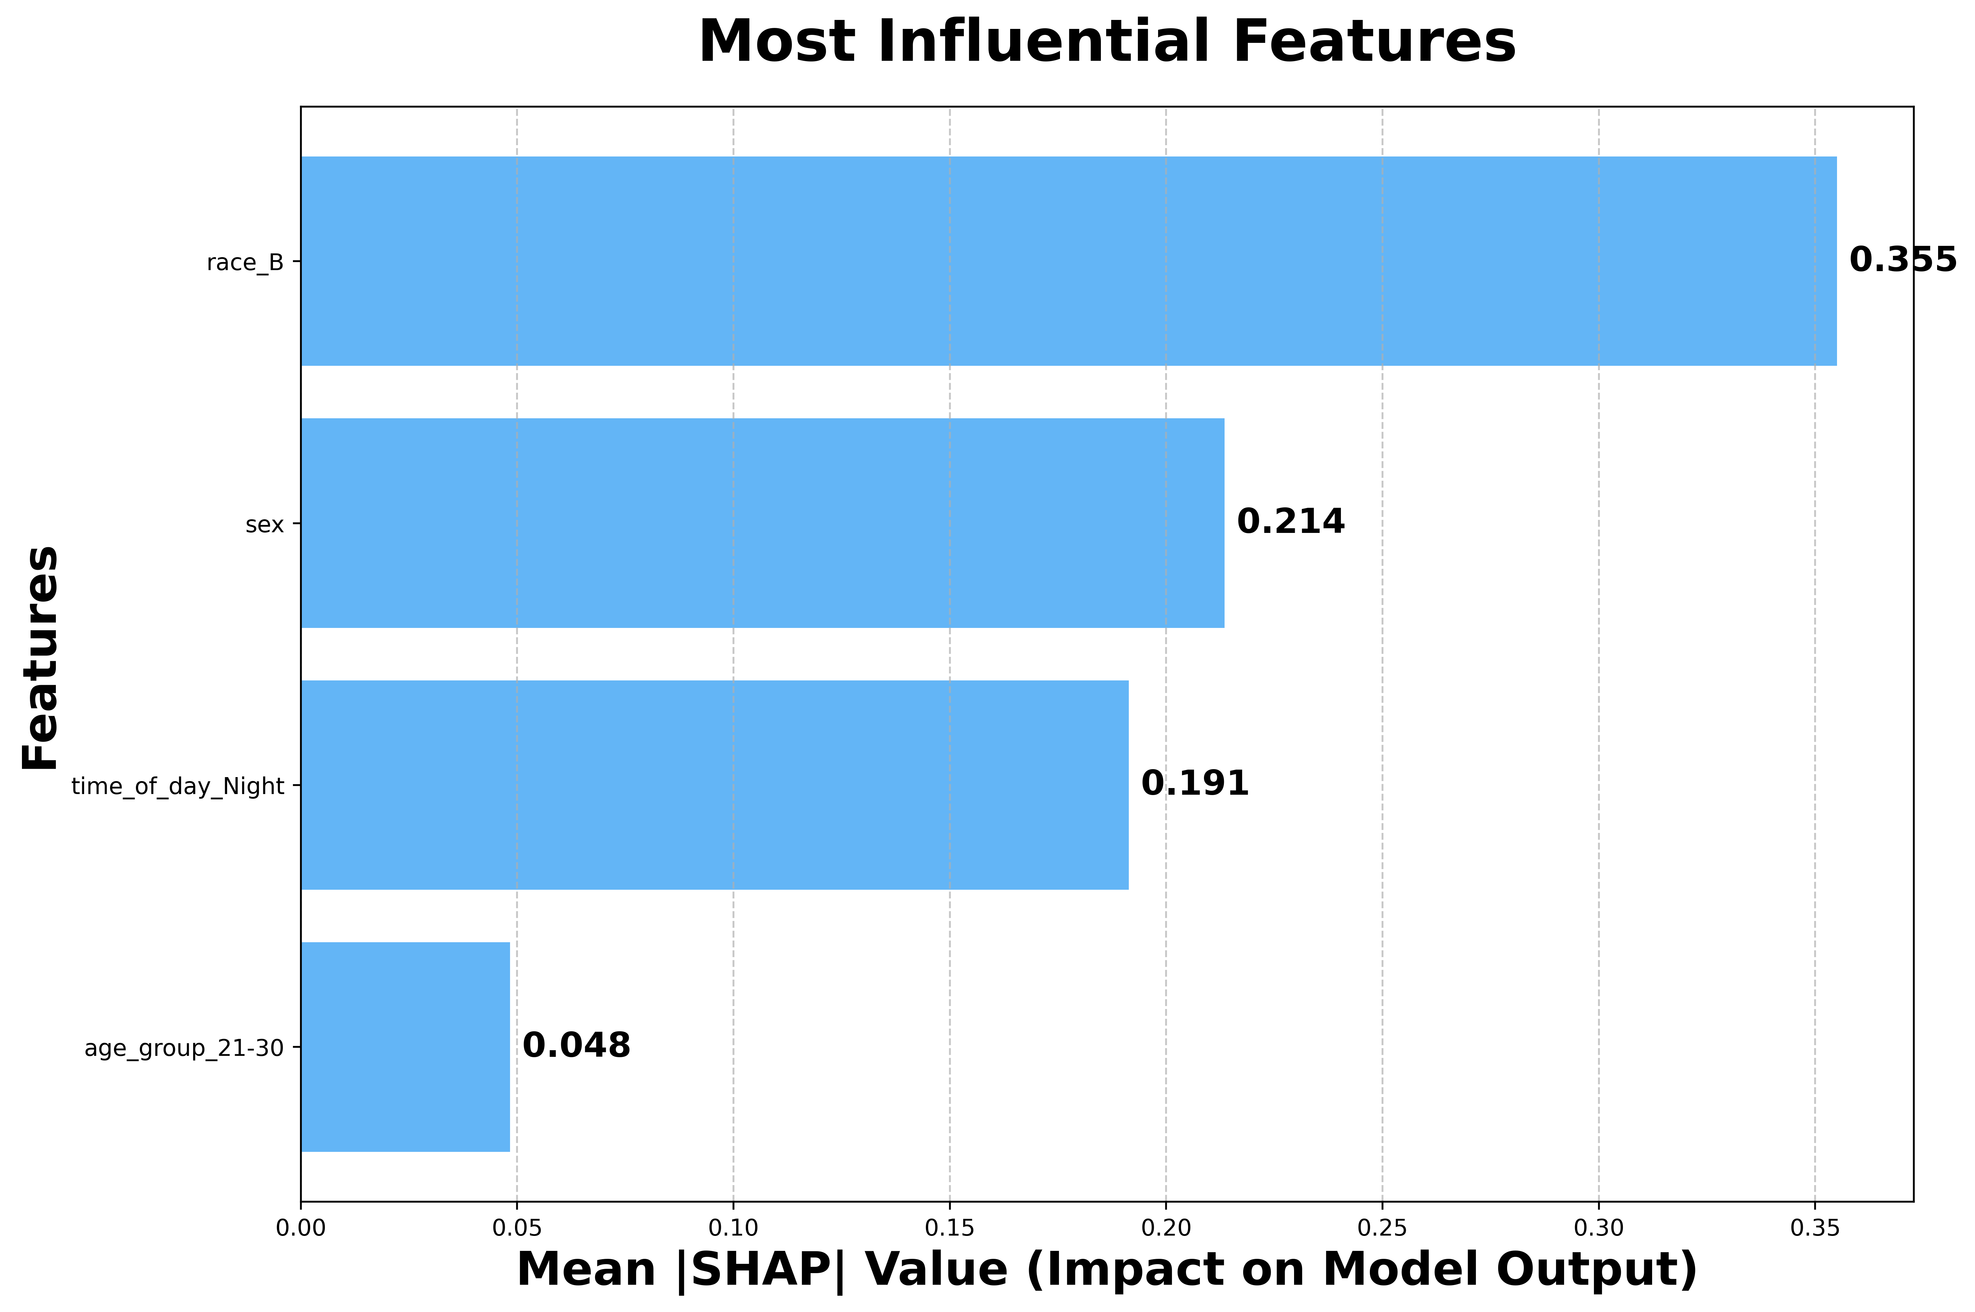
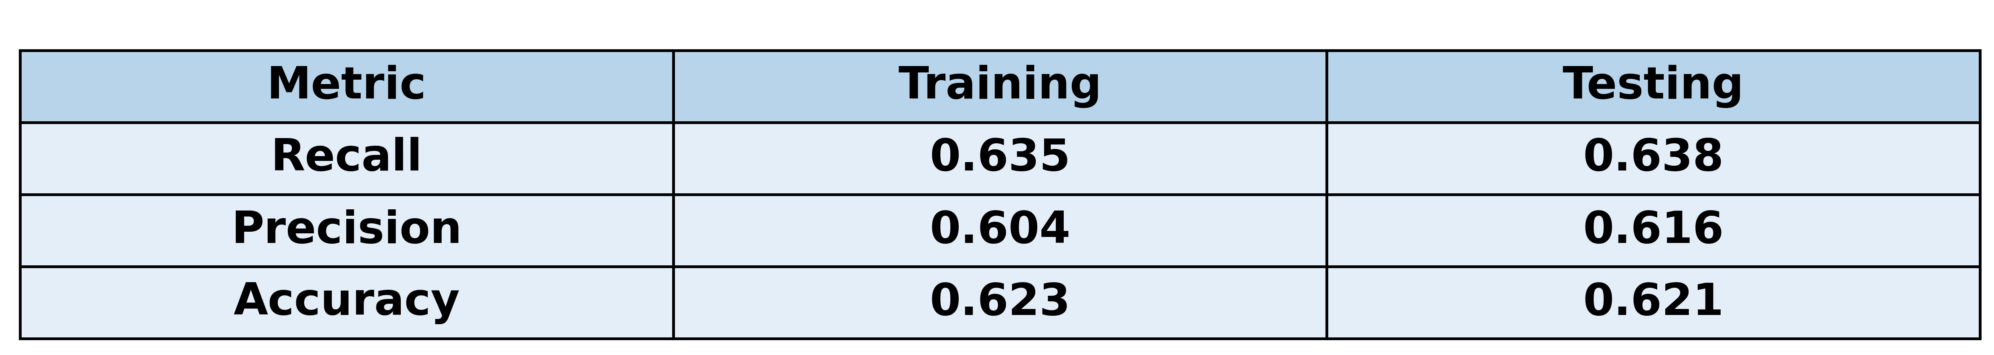
Data-Driven Prediction of Reoffending Patterns in Charleston, South Carolina
Owayne Owens - owenso@g.cofc.edu
INTRODUCTION
Recidivism (reoffending) is a major concern for the criminal justice system, with implications for public safety and police resource allocation.
Identifying individuals at higher risk of reoffending can support smarter interventions and rehabilitation efforts and create a safer society.
This project applies machine learning to classify individuals as likely or unlikely to reoffend, using arrest record data from the Charleston Police Department.
RESULTS
The objective was to predict the likelihood of reoffending, prioritizing recall to enhance the identification of potential reoffenders.
Model performance:
Recall: 64% — correctly identified 64% of actual reoffenders.
Precision: 62% — 62% of predicted reoffenders were correctly classified.
Accuracy: 62% — overall classification accuracy.
The confusion matrix showed the model identified most reoffenders but produced a considerable number of false positives.
SHAP analysis identified race as the most influential predictor, followed by sex.
Despite moderate predictive performance, bias and class imbalance remained key challenges.
CONCLUSIONS & NEXT STEPS
Predicting recidivism remains challenging, particularly due to the absence of key social, economic, and behavioral features.
The model achieved moderate performance but was sensitive to class imbalance and potential bias.
SHAP analysis identified race as a strong predictor, highlighting fairness concerns in the model's decision-making.
For future work, I will:
Try to enrich the dataset with features such as prior criminal history, employment status, family structure, and substance abuse history.
Implement formal bias mitigation techniques (e.g., reweighting, fairness-aware modeling) to reduce disparate impact.
Incorporate fairness metrics (e.g., demographic parity, equalized odds) to complement traditional performance evaluations and assess social implications.
METHODS
Dataset: 28,506 arrest records from the Charleston Police Department, including 7,592 labeled reoffenders.
Highly correlated features (correlation > 0.75) were removed to reduce multicollinearity and improve interpretability.
Class imbalance was addressed by under-sampling the non-reoffender class to match the number of reoffenders.
Model: Extreme Gradient Boosting (XGBoost) with early stopping, max-depth tuning, and scale_pos_weight adjustment to mitigate class imbalance.
Hyperparameters were tuned via cross-validation on an 80/20 train-test split (random seed = 42) to prevent overfitting.
Evaluation prioritized Precision, Recall, Accuracy, and Confusion Matrices due to the high social cost of false positives and false negatives.
SHAP (SHapley Additive exPlanations) was used to interpret model predictions and identify key predictors of recidivism.
REFERENCES
Charleston Police Department, Arrest Data - https://charleston-sc.maps.arcgis.com/apps/MapJournal/index.html?appid=1d87740b38ac4aa89795e87f7bc0faf6
Buikhuisen, W., & Hoekstra, H. A. (1974). FACTORS RELATED TO RECIDIVISM. The British Journal of Criminology, 14(1), 63–69. http://www.jstor.org/stable/23636091
Glazebrook, J. S. (2009). Risky Business: Predicting Recidivism. Psychiatry, Psychology and Law, 17(1), 88–120. https://doi.org/10.1080/13218710903040421
DISCUSSION & LIMITATIONS
SHAP values provided interpretability by quantifying each feature's contribution to predictions; race emerged as the most influential predictor, raising concerns about bias and fairness.
Initial models without resampling under-predicted reoffenders due to class imbalance, favoring the majority non-reoffender class.
Under-sampling improved recall and balanced predictions, though false positives remained prevalent.
XGBoost outperformed other models in handling tabular data and class imbalance but remained constrained by limited feature availability.
The absence of key recidivism predictors such as prior convictions, substance use, employment status, and social support likely limited model accuracy and fairness.

