Slide 1

Know where to go, before it becomes urgent.
Symptom-to-Specialist Triage · AI-Assisted Care Navigation
PeddieHacks 2026 · Health Track

Slide 2

The Problem
140M+
1 in 5
~19%
ER visits occur in the U.S. every year
adults visits an ER at least once a year
of recent ER visits were driven by a closed doctor's office or lack of other access — not medical urgency
Source: CDC, NCHS Data Brief 478 (2021)
Source: CDC, NHSR (2014 survey data)
Source: CDC, NHSR (2014 survey data)
Without a clear signal for urgency, people either overload emergency rooms with non-critical concerns — or delay care for something that couldn't wait. Meridian closes that gap.
MERIDIAN · PEDDIEHACKS 2026
2

Slide 3




The Solution
Meridian turns a plain-language symptom description into two things: which type of care to seek, and how urgent it is.
Plain-language input
No forms, no dropdowns — just describe what you're feeling, by typing or speaking.
Hybrid AI + rules
A deterministic rule engine keeps every recommendation safe and explainable; Gemini AI extends it to free-form, real-world phrasing.
Routes, never diagnoses
Meridian tells you where to go and how fast — the diagnosis itself always stays with a licensed clinician.
MERIDIAN · PEDDIEHACKS 2026
3

Slide 4


How It Works
1. Describe symptoms
›
2. Rule engine matches
›
3. Gemini AI enriches
›
4. Take action
Free text, plain language — typed or spoken.
12+ symptom clusters map to a specialist and urgency tier.
Handles open-ended phrasing; generates rationale and a checklist.
One tap surfaces real, nearby care on the map.
No network call sits on the critical path for the rule-based core — recommendations resolve instantly, even offline.
MERIDIAN · PEDDIEHACKS 2026
4

Slide 5
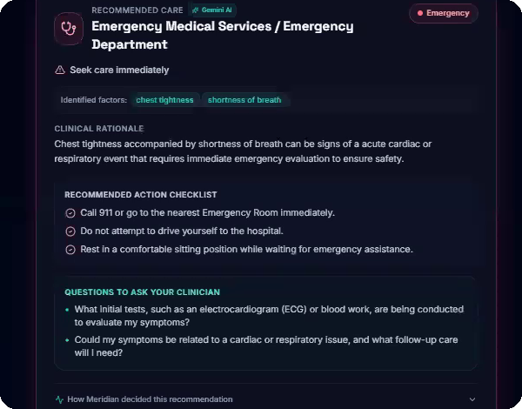
In Action — the Emergency Case
INPUT
"Chest tightness and shortness of breath"
RESULT
Emergency Medical Services — seek care immediately
WHAT'S INCLUDED
Clinical rationale, a 3-step action checklist, and questions to bring to a clinician
MERIDIAN · PEDDIEHACKS 2026
5

Slide 6
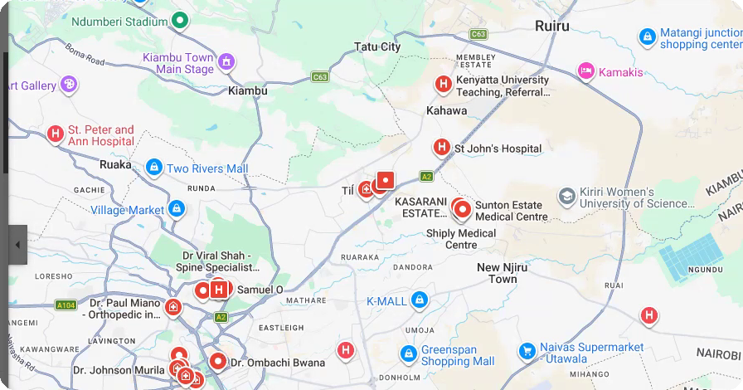
In Action — Routine Case & Real-World Next Step
INPUT
"Ankle pain when walking"
RESULT
Primary Care Physician or Orthopedic Specialist — Routine, schedule an appointment
NEXT STEP
One tap on “Find near you” opens live, nearby results — no separate search needed
Live Google Maps results — real clinics, real distances, zero extra steps.
MERIDIAN · PEDDIEHACKS 2026
6

Slide 7



What We Built
Text or voice input
Hybrid AI + rules engine
4-tier urgency system
Type freely or speak your symptoms aloud.
Deterministic core, extended by Gemini AI for open-ended language.
Emergency, Soon, Routine, Monitor — color-coded and unambiguous.
Rationale + checklist
Real-world care lookup
Purpose-built interface
Explains the “why” and what to do next, plus clinician questions.
One tap opens live, nearby results on Google Maps.
A calm, glassmorphic design built for a stressful moment.
MERIDIAN · PEDDIEHACKS 2026
7

Slide 8



Tech Stack
Frontend
Icons & Design
AI Layer
React + Tailwind CSS
lucide-react, custom glass UI system
Gemini API — free-text symptom parsing
Core Logic
Hosting
Version Control
Deterministic rule engine — zero network dependency
Vercel / local dev server
Public GitHub repository
MERIDIAN · PEDDIEHACKS 2026
8

Slide 9



Impact & What's Next
Meridian doesn't just answer “what's wrong” — it answers “what do I do now.”
Fewer wrong-door visits
Clearer routing means fewer non-emergency ER visits, and faster action on the real ones.
Built to scale
The same rule-engine architecture extends to insurance-aware routing, multiple languages, and real provider directories.
Designed for the moment
Calm, jargon-free guidance for people who are stressed, scared, or just unsure — exactly when clarity matters most.
MERIDIAN · PEDDIEHACKS 2026
9

Slide 10
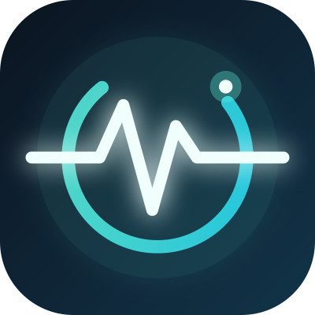


Thank You
Meridian — know where to go, before it becomes urgent.
Source Code
Demo Video
Devpost Submission
PeddieHacks 2026 · Health Track

