Slide 1
Software Innovation Studio
ClaimTrace — the academic citation audit engine
Market & Competitor Analysis
Group 18 · Sichen Liu · Hongyang Chen · Siyuan Sun · Jun Li · Yi Jiang · Zheng Fu · Sam
41129 Software Innovation Studio · 22 Oct 2026
Notes:
Cover. One line: this is a market and competitor analysis for ClaimTrace, the academic citation audit engine.
All market data in this deck was re-checked on 2026-09-24 and every figure carries its source on the slide or in these notes.

Slide 2
The targeted market
1. The targeted market
Academic writing. Overleaf alone reports 20M+ users, and 5.7M papers were published in 2024, up from 3.9M in 2019 (+46%). Every claim in every paper cites a source.
One in six quotations is wrong and half of those are major — 16.9% incorrect, 8.0% major, across 46 studies and 32,074 quotations, with no improvement in 40 years.
2. How large, and the trend
Demand grows; the tooling market is small and inconsistently sized. Vendors put reference-management software at $371M–$1,150M for the same year — 3× apart. The one audited number is Clarivate's Academia & Government segment (Web of Science + EndNote): $1,266.0M, FY2025, filed with the SEC.
So we quote a report, its scope and its CAGR — or we quote the one an auditor has seen.
3. What already exists
• Reference managers — Zotero (14.4M users), Mendeley, EndNote: store and format metadata.
• Similarity checkers — Turnitin, iThenticate: match text. Turnitin's own help centre: “Turnitin does not check for plagiarism.”
• Reference checkers — ReciteWorks, Edifix, CiteTrue, Paperpile, SciSpace: confirm the record exists.
• Citation-intent platforms — scite (1.6B Smart Citations), Semantic Scholar: classify how OTHERS cited the paper.
4. The gap
No established product answers: “does MY cited source support MY sentence?” ReciteWorks' FAQ answers “No, not currently” — and the price list agrees: $175/manuscript buys metadata checking, $125 buys text similarity, neither buys claim support.
It is getting worse, not better: fabricated citations rose 12-fold, from 1 in 2,828 papers (2023) to about 1 in 277 (early 2026), and 98.4% of affected papers saw no publisher action.
Notes:
SOURCES (all checked 2026-09-24). Say the year out loud when you give a number.
• Overleaf: overleaf.com/about says “20 million+ users”. The same page also says “over 30 million people trust Overleaf”. We quote the smaller, explicit figure and we say which one we are quoting — that is the discipline this slide is about.
• 5.7M papers in 2024, up from 3.9M in 2019: Dimensions data reported by STM and Research Consulting, 13 Jan 2026.
• 16.9% / 8.0%: Baethge & Jergas (2025), Research Integrity and Peer Review 10(1):13 — meta-analysis of 46 studies, ~32,074 quotations; meta-regression slope −0.002, p = 0.85, i.e. no improvement in four decades. This is the headline number of the whole deck.
• Market size: globalinforesearch.com and yhresearch put reference-management software at $371M / $385M (2024); wiseguyreports.com puts the same category at $1.1–1.2B. Commercial estimates, scope differs — which is why the slide shows the spread instead of a point.
• Clarivate A&G segment revenue $1,266.0M FY2025 (FY2024 $1,326.4M; FY2023 $1,323.3M), SEC Form 10-K. This is the only figure here that has been audited.
• Zotero 14.4M users, +25% on 2023: Corporation for Digital Scholarship Annual Report 2024.
• Turnitin: helpcentre article “Plagiarism and what are acceptable similarity scores” — “Turnitin does not check for plagiarism”. iThenticate's own user guide says its primary function is to highlight matching content. Both are the vendors describing themselves.
• ReciteWorks FAQ: “No, not currently” to checking whether quoted text appears in the source.
• $175/manuscript: EditVerse reference-list verification (metadata and existence only). $125: iThenticate direct, one manuscript, similarity only.
• 1 in 2,828 (2023) → 1 in 458 (2025) → ~1 in 277 (first seven weeks of 2026), 98.4% of affected papers with no publisher action: 2,471,758 PMC articles and 125.6M references audited, Lancet 2026, reported in Nature.
IF A TUTOR ASKS ABOUT THE A1 PITCH NUMBERS: “12,402 papers, 7.1%” is not usable — it fuses a vendor's unrefereed blog analysis with an unrelated doctoral thesis on Latin American retractions, and the “9,662” appears in neither. “$371M → $617M” is a real vendor estimate but a WEAK one, and other vendors size the same market 3× higher. Both are replaced on this slide by sources you can hand over.

Slide 3
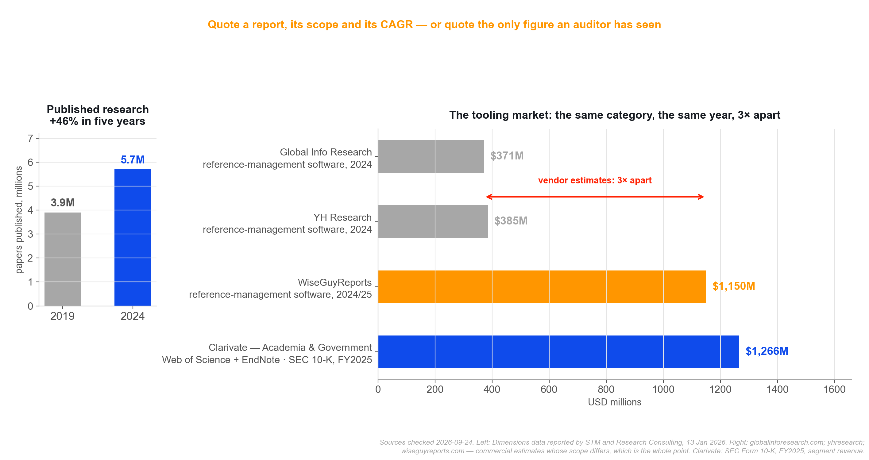
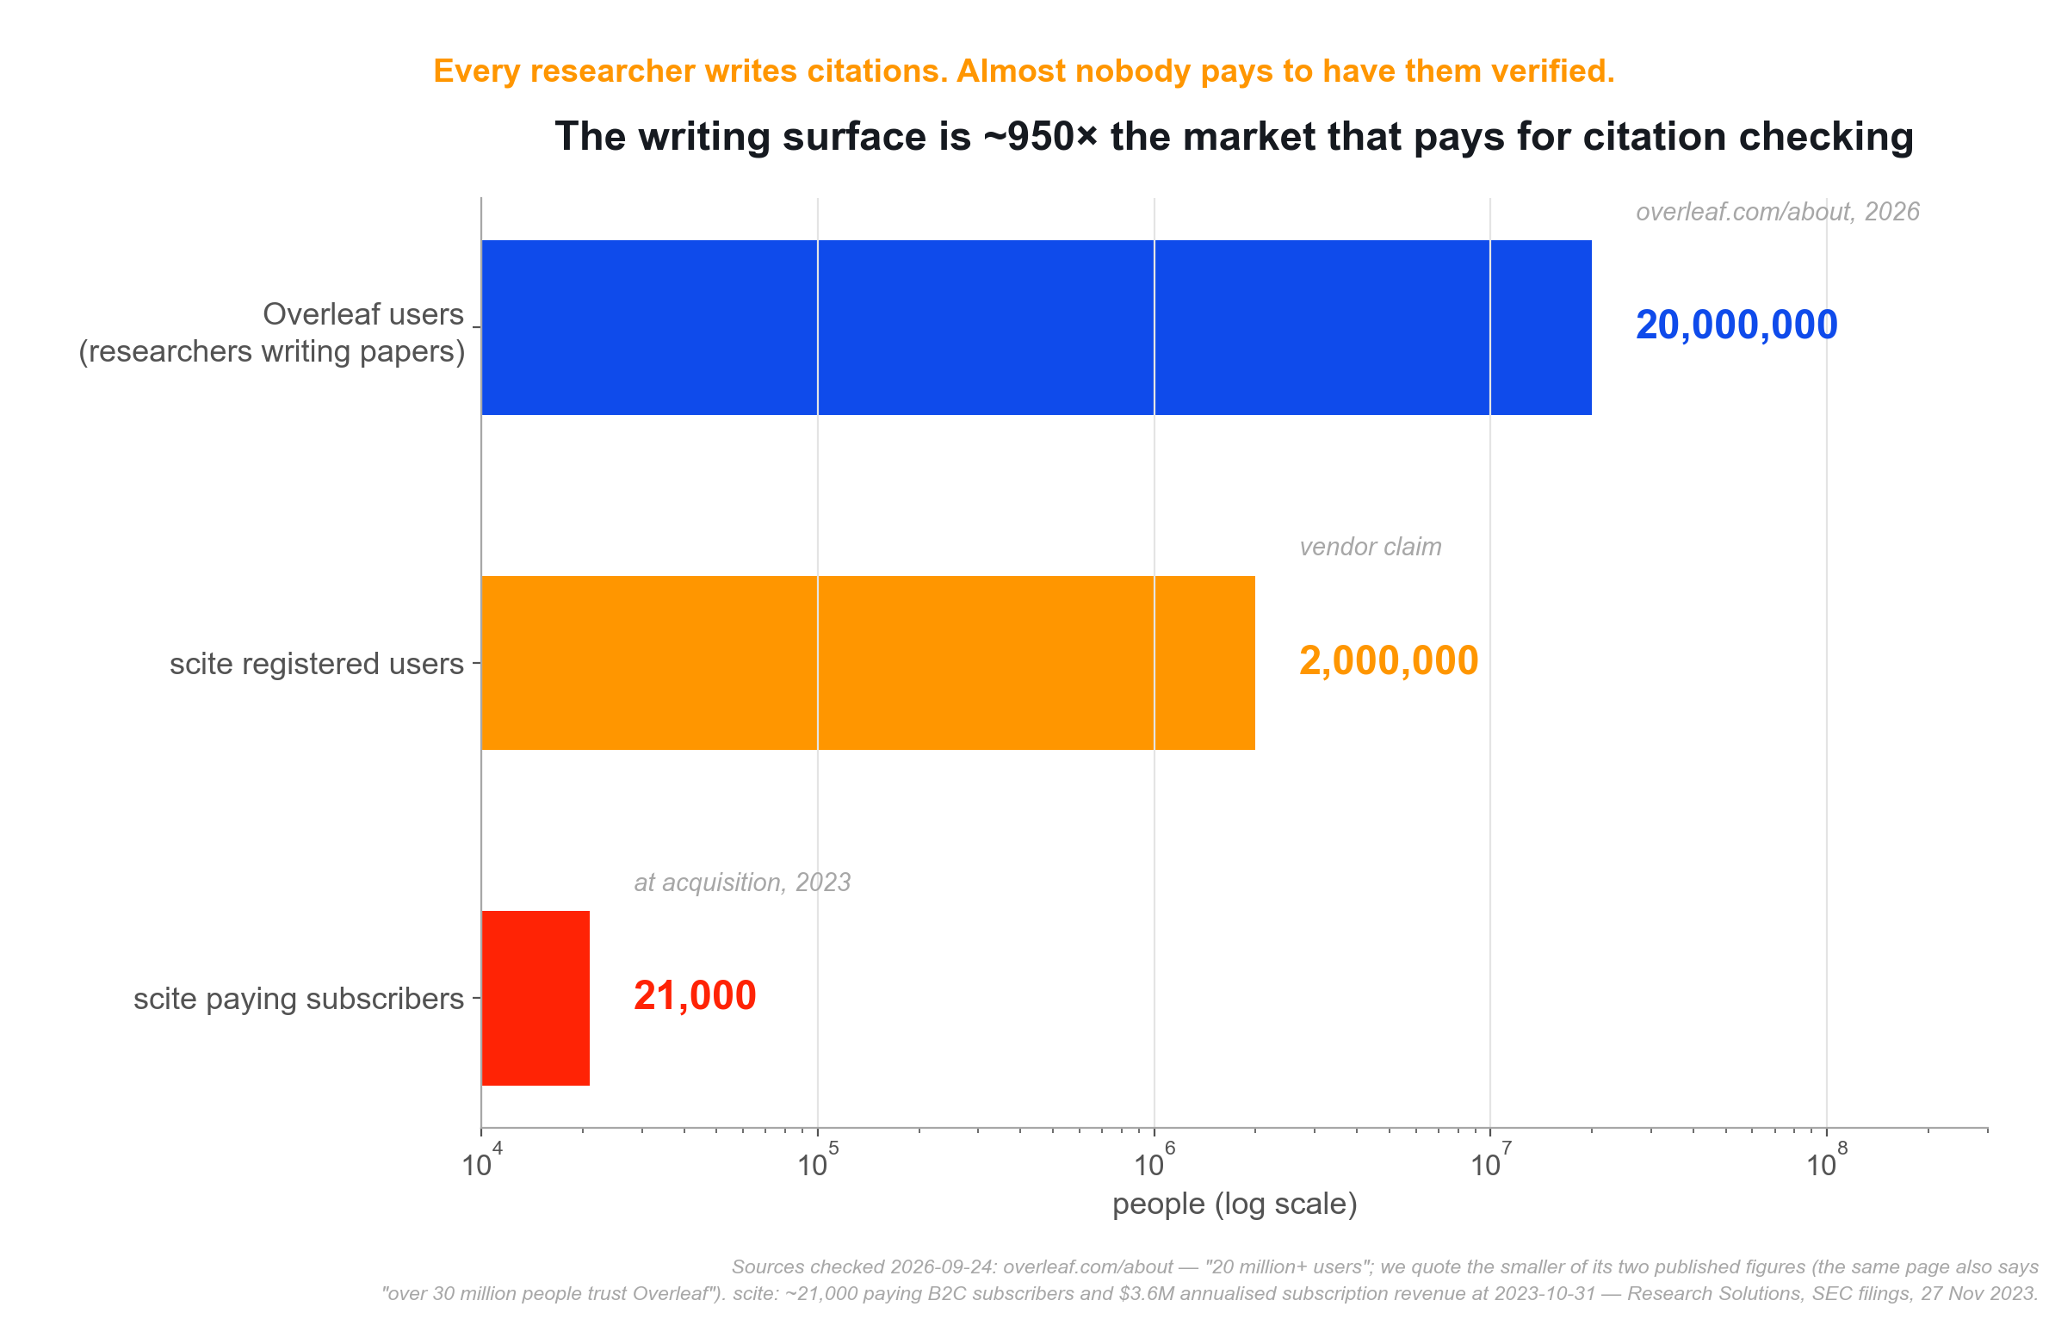
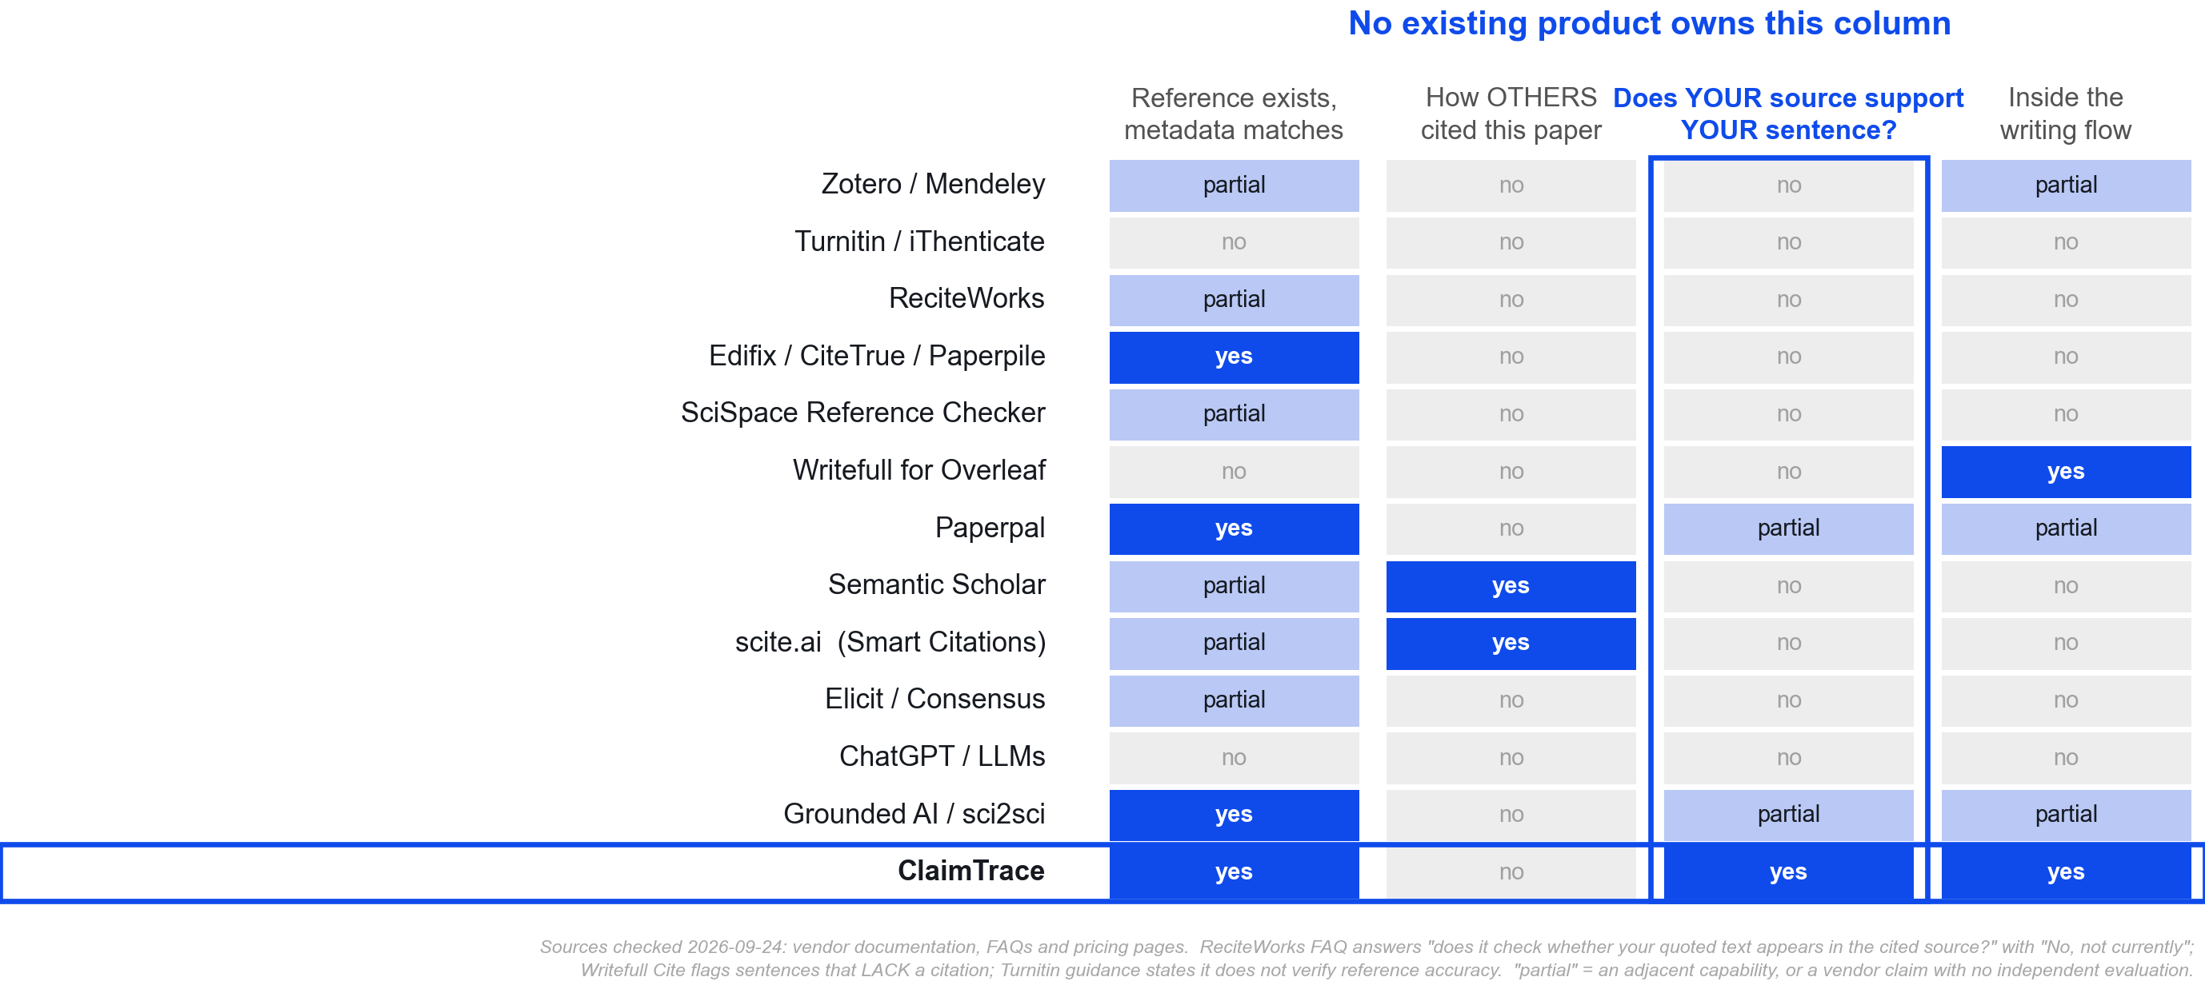
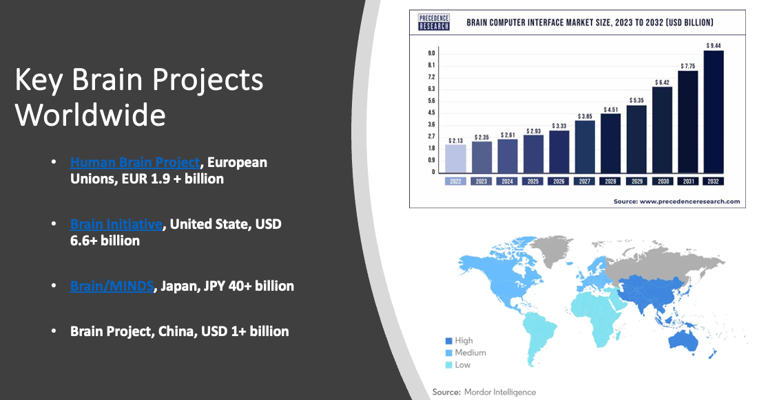
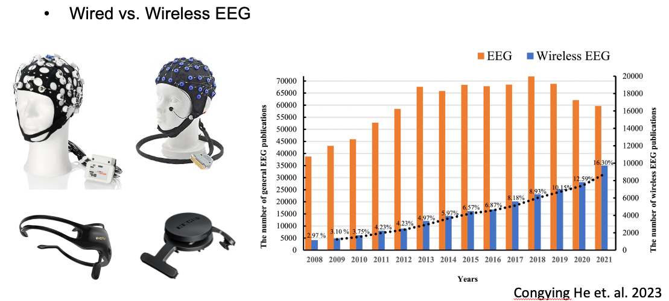
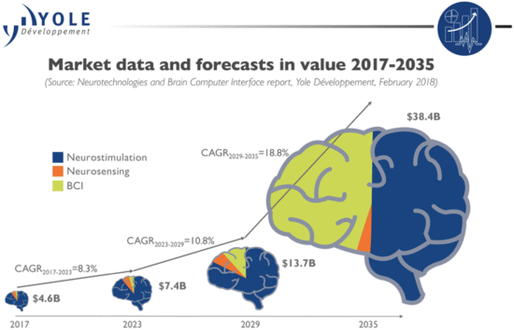
The targeted market
Bottom left: the people who write citations, against the far smaller group that pays to have them checked.
Top right: the volume of research keeps growing, but the tooling market that serves it is sized 3× apart by different vendors for the same year.
Bottom right: what each class of tool actually checks. The outlined column is the gap.
Notes:
Three figures, one argument.
BOTTOM LEFT — the surface. 20M+ people write in Overleaf; scite — the category leader — had about 21,000 paying subscribers at acquisition. Roughly 950:1. Every researcher writes citations; almost none pays to have them verified.
TOP RIGHT — the market. Two panels: the volume of research is growing 46% in five years, but the tooling market that serves it is sized 3× apart by different vendors for the same year, and the only audited number in the picture belongs to a public company's segment report. That is why we name a scope rather than quote a point estimate.
BOTTOM RIGHT — the competitive reality. Every class of tool does one of the first three columns. 'Yes' means the vendor documents the capability; 'partial' means an adjacent capability or a vendor claim with no independent evaluation. The outlined column is the prospective check — does YOUR source support YOUR sentence — and no established product owns it.

Slide 4
Case Study
scite.ai — the biggest competitor, and the one every reviewer names first
What it is
• Founded 2018 in Brooklyn; co-founder & CEO Josh Nicholson.
• Smart Citations label how a paper has been cited — supporting, contrasting or mentioning — one label per citation statement.
• 1.6B+ Smart Citations, 317M+ articles indexed, 44+ publisher partners.
• Acquired by Research Solutions (NASDAQ: RSSS), announced 27 Nov 2023, closed 1 Dec 2023 — about $20.9M net of cash acquired.
• At acquisition: ~21,000 paying subscribers, $3.6M annualised subscription revenue, $1.1M FY2023 revenue.
Why it is the case to study
• It is the only competitor with a comparable data pipeline: full-text ingestion, a trained classifier, published methods.
• It proves the category is paid for. A NASDAQ-listed company bought it.
• Its own peer-reviewed paper publishes its accuracy — including where it is weak.
• It answers a different question from ours, and says so on its own product page.
The category is real and funded. But the market leader answers “how have others cited this paper?” — never “does my sentence match my source?”
Notes:
scite.ai is the biggest competitor and the one a tutor names first — so it is the case worth studying properly.
SOURCES
• Founding, scale, features: scite.ai/features (checked 2026-09-24).
• Acquisition: Research Solutions (Nasdaq: RSSS) press release 27 Nov 2023, closed 1 Dec 2023. Be precise if asked: ~$21.1M initial consideration per the FY2025 10-K, and the earn-out was finalised at $15.4M in July 2025, so all-in is roughly $29M. The A1 pitch said “$20.9M” — that is the initial net-of-cash figure, not the total.
• Subscribers and revenue: ~21,000 paying B2C subscribers, $3.6M annualised subscription revenue, $1.1M FY2023 revenue at 2023-10-31 (SEC filings / press release).
THE POINT TO LAND: the category is real, paid for, and owned by a company that publishes its methods. It still answers a different question. That is the whole case study in one line, and it sets up the next two slides.

Slide 5
Case Study – Function 1
Smart Citations — classify how a paper has been cited, at scale
Empathise
• A researcher holding an unfamiliar paper asks one question: can I trust this?
• Reading every citing paper is impossible; the citation count alone says nothing about whether anyone disagreed.
• They want a signal that survives scrutiny, not a score.
Define
• For each citation statement in each citing paper, decide whether it supports, contrasts with, or merely mentions the cited work.
• Constraint: a label must rest on scientific evidence, not sentiment. scite states it is explicitly not sentiment analysis.
Ideate
• Fine-tuned SciBERT over 38,925 labelled citation statements with a 9,708 holdout; ~2 years of annotation, at least two blind annotators, up to 8 experts.
• Three classes: supporting / mentioning / disputing, surfaced as Smart Citations.
• Production targets >80% precision on every class.
What its own paper measures
• F-score at first publication: 96.3 mentioning · 55.3 supporting · 20.5 disputing
weak where it matters
• Disputing later reached 58.97 F-score at 85.19 precision
improved, still low
• Real-world distribution: ~92.6% mentioning, 6.5% supporting, 0.8% disputing
the classes that matter are the rarest
• Ingestion “fails to identify approximately 30% of citation statements/references in PDF files”
their own stated limit
An independent peer-reviewed audit found worse
• Bakker, Theis-Mahon & Brown (2023), Hypothesis 35(2), doi:10.18060/26528
• 324 citations of retracted works; scite classified only 98 (no full text for 118).
• scite returned 2 supporting / 96 mentioning / 0 contrasting.
• Human assessors found 42 supporting / 39 mentioning / 17 contrasting.
• F-measures ranged 0.0–0.58.
Our comment
• The engineering is serious and openly documented — this is the strongest competitor, not a straw man.
• The failure mode is not a wrong label; it is a label that reads as reassurance. A human saw 17 contrasting citations where the product showed none.
• Aggregate labels about a paper cannot answer a question about your sentence. That is a scope limit, not a bug to be tuned away.
• ClaimTrace's response is the opposite discipline: a verdict is only ever carried by a state that actually judged, and every other state stays visibly unjudged.
Notes:
FUNCTION 1 — Smart Citations.
DEMO: the free scite tier shows Smart Citations on any paper; open one live, or paste a screenshot into the space at the right of this slide. Say plainly that the numbers below come from scite's own published evaluation, not from our testing.
SOURCES
• Method and accuracy: Nicholson et al. (2021), Quantitative Science Studies 2(3):882-898, doi:10.1162/qss_a_00146. F-scores 96.3 mentioning / 55.3 supporting / 20.5 disputing; disputing later 58.97 F at 85.19 precision; real-world distribution ~92.6/6.5/0.8; ingestion “fails to identify approximately 30% of citation statements/references in PDF files”.
• Independent audit: Bakker, Theis-Mahon & Brown (2023), Hypothesis 35(2), doi:10.18060/26528. 324 citations of retracted works, 98 classified, scite 2/96/0 vs human 42/39/17, F 0.0-0.58. scite-affiliated authors replied in 2025; if asked, acknowledge the reply and note the methodological dispute — do not present the critique as settled.
COMMENT: credit the engineering, then make the scope argument — an aggregate label about a paper cannot answer a question about a sentence. The failure that matters is not a wrong label but a reassuring one.

Slide 6
Case Study – Function 2
Reference Check — point the same corpus at your own manuscript
Empathise
• The moment before submission: the bibliography is the part nobody re-reads until a reviewer does.
• Authors inherit references from co-authors, from Google Scholar exports, from AI assistants.
• The fear is specific — that one entry is retracted, or describes a different paper.
Define
• Upload a manuscript PDF and see, for every reference, how it has been cited by others: retractions, editorial notices, contrasting findings.
• The unit of analysis moves from “a paper” to “my reference list”.
Ideate
• Reuse the Smart Citations corpus and the retraction and editorial-notice data.
• Report per reference rather than per paper, so the output is a submission checklist.
• Keep it inside the existing subscription rather than a separate product.
Our comment — where this stops
• It looks like it checks your manuscript. It still reports on third parties.
Reference Check tells you reference #12 has been retracted. It cannot tell you that your sentence about #12 is wrong, and it does not claim to.
• Metadata, not meaning.
Retraction and editorial notices are facts about a record. They are silent on whether the record supports the claim it was attached to.
• No published accuracy figure for Reference Check.
Smart Citations has a peer-reviewed evaluation; this feature does not.
• Pricing is per user and unpublished institutionally.
$20/mo Basic, $50/mo Pro, both billed yearly; no public institutional price.
ClaimTrace covers the two layers Reference Check leaves open
• Audit — the record
Reference exists; title, authors, year, venue agree. OpenAlex first, Crossref as fallback, both keyless.
• Verify — the meaning
The source passage that supports or contradicts your sentence, with the passage shown, not just a label.
• The failure rule
A failed lookup stays LOOKUP_FAILED. NOT_FOUND means the search completed and found nothing — never “looks fabricated”.
Notes:
FUNCTION 2 — Reference Check.
DEMO: scite's Reference Check accepts a manuscript PDF. If you have not run it, do not claim you did — the feature is documented on scite.ai/features and quoted verbatim here.
SOURCE: scite.ai/features — “Upload a manuscript PDF and instantly see how every reference has been cited by others”, including retractions, editorial notices and contrasting findings. Pricing scite.ai/pricing: Basic $20/mo, Pro $50/mo, both billed yearly; no institutional price published.
THE ARGUMENT: this looks like it checks your manuscript, and it is the closest thing in the market to our Audit feature. But the unit of analysis is still the cited paper, and the evidence is still what third parties did with it. It cannot see your sentence.
THEN HAND OVER TO OURS — the two layers: Audit checks the record (existence + metadata agreement, OpenAlex then Crossref, both keyless), Verify checks the meaning (the passage, shown, not just a label). And the failure rule: a failed lookup stays LOOKUP_FAILED; NOT_FOUND means the search completed and found nothing — it is never a claim that a reference was fabricated. See claimtrace/docs/audit-contract.md §2 and §4.

Slide 7
Thank you
Notes:
Close. Offer the two things we can show live: the Overleaf hover flow, and an audit run on a real bibliography. Then invite the question we most expect — “scite already does this” — which slides 5 and 6 answer.

