Slide 1
Seminar „Virtual Acoustic Reality“ (WiSe 25/26)
Acoustic Sandbox
A Virtual Reality Environment for Spatial Sound
Owen Ackerman
Ez Nasser-Eddin, 510441, Faculty I, AKT
Rodrigo Loyola, 501611, Faculty I, AKT
Khalif Shirad, 379390, Faculty I, AKT
Notes:
Good afternoon
Our names are Ez and Isabella
And today we are gonna present the paper titled cultural evolution of emotional expression in 50 years of songs lyrics, which was written by brand, acerbi and mesourdi in 2019

Slide 2
Context and Goal
Existing game-engine audio pipelines are technically demanding for non-programmers
Spatial audio workflows often require expensive hardware or static offline previews
Our goal: make an Unreal Engine 5 App where users can have accessible interactive spatial audio in mixed reality

Slide 3
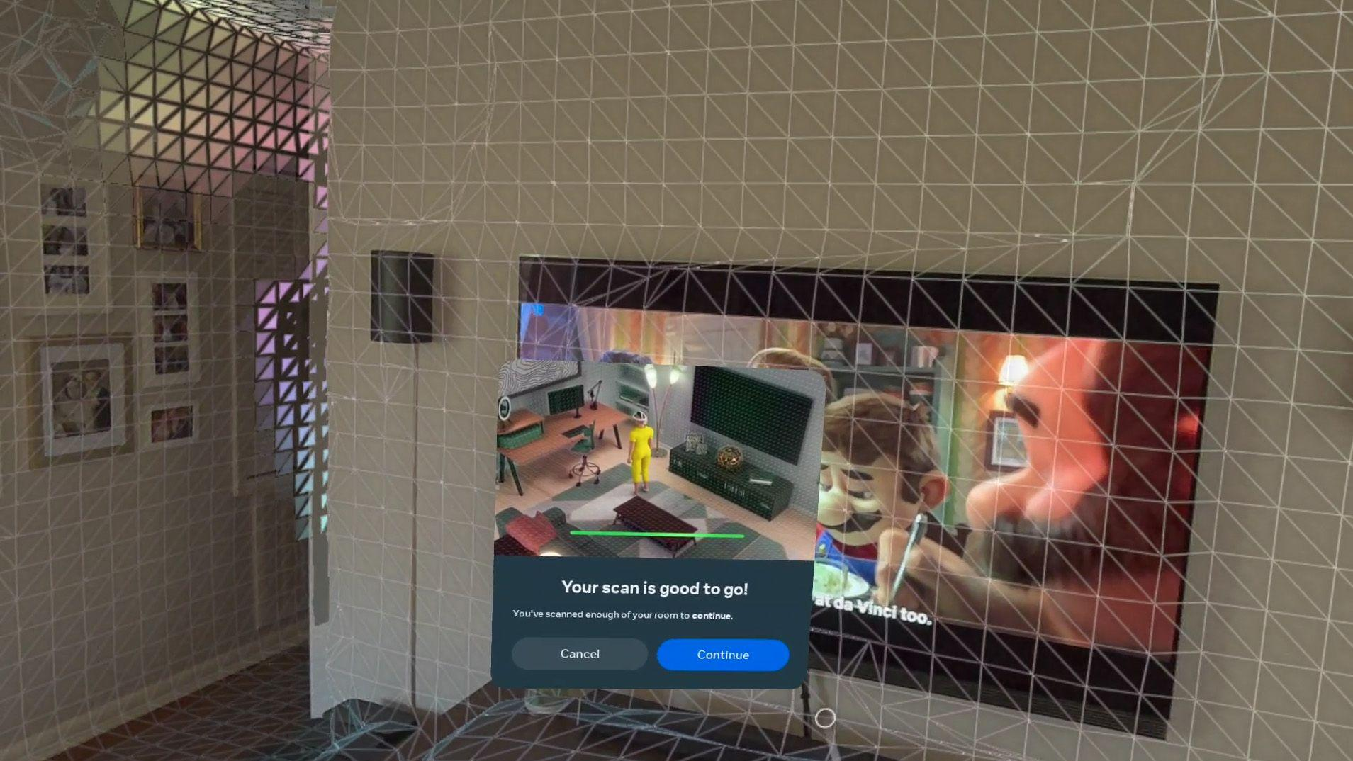
Headset Room Scan
Quest 2:
Create room outline
Highlight objects and label them
Creates room mesh
Quest 3:
Automatic (high resolution) scan

Slide 4
System Architecture
Blueprint or VSCode (C++)
Blueprint: Utilizing Meta Quest's Mixed Reality Utility Kit (MRUK) to fetch scanned anchors
Acoustic Integration C++: Attaching dynamic Audio Geometry Components to spawned meshes on BeginPlay
Acoustic Integration Blueprint: Bake Ray tracing live
Meta Quest Scan
↓
Anchors
↓
Runtime Mesh Generation
↓
Audio Geometry Components
↓
Ray Tracing + HRTF Spatialization
↓
User Binaural Audio Experience

Slide 5
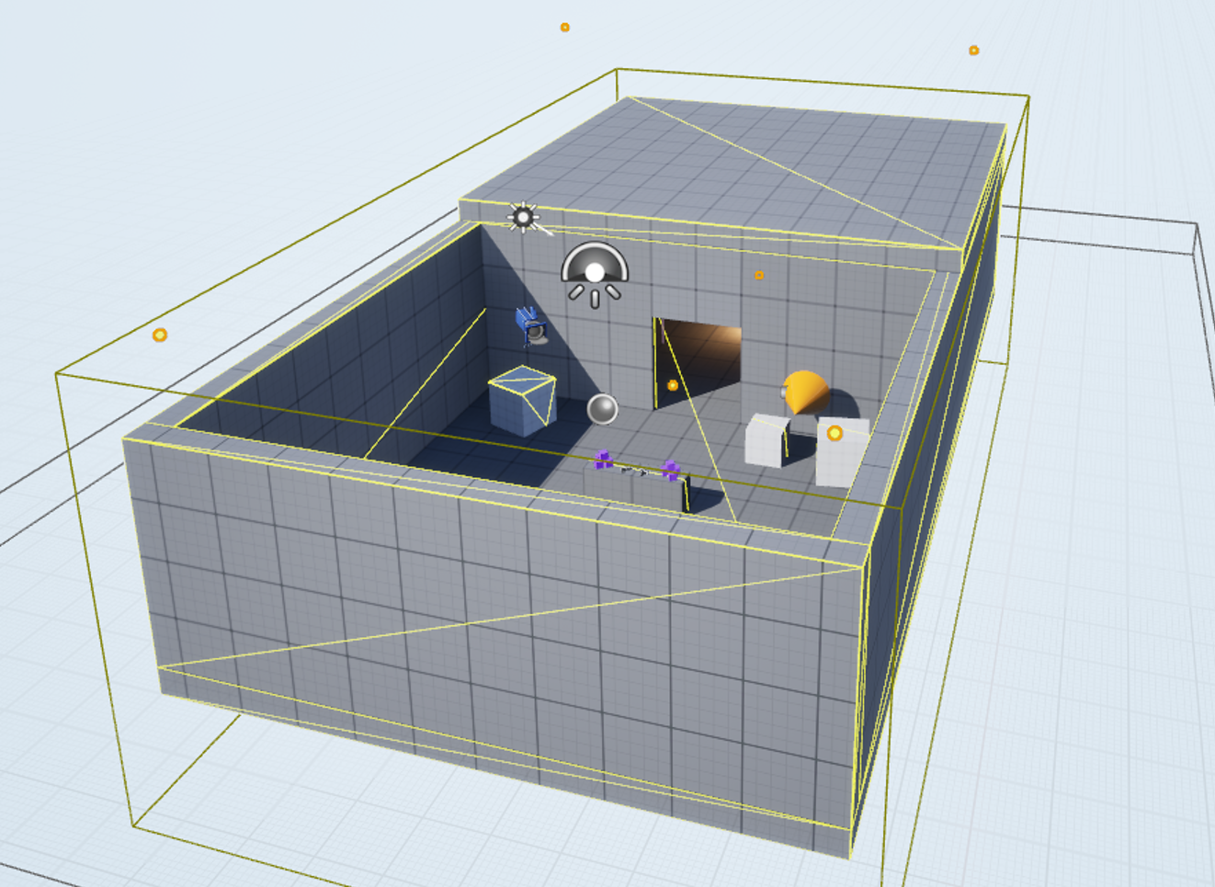
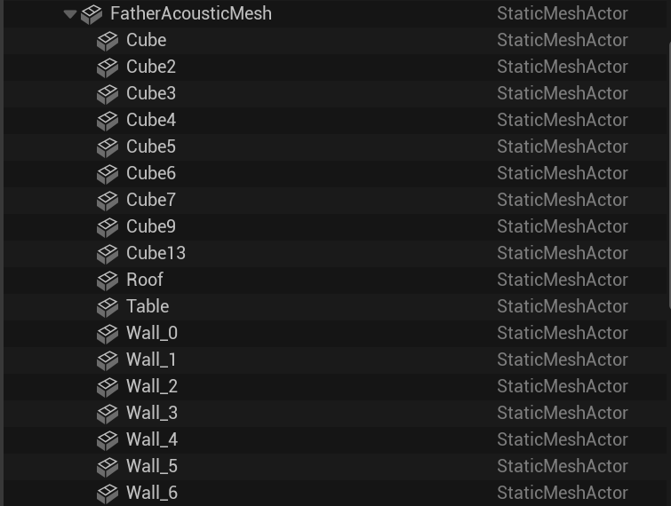
Acoustic Ray Tracing
Add geometry to the scene
Pre bake the geometry for Ray Tracing
Real time RT spatialization for sounds based on the simplified baked acoustics

Slide 6
Complications
High barrier of entry
Lack of information for Unreal
Quest room scans were inaccessible for Unreal (Data Protection)
MetaXR Audio requires stable geometry and meshes before playing for ray tracing and baked acoustics
Crashing when adding MetaXRAcousticGeometry component

Slide 7
Solutions
Solution:
Added a JSON-based fallback room; this makes testing in Unreal possible
Try to package and test in the Quest (can of worms)
Blueprint:
Load JSON room model
Spawn Anchor Actors with MRUKSubsystem
Attach MetaXR Audio Geometry Components
Bake acoustics and Raytrace

Slide 8
Project Evaluation
Project not fully finished.
Got the room meshing and live ray tracing working separately, but still needs more work to connect to Mixed Reality
Should have adapted after noticing the difficulty of working with Unreal Engine

Slide 9
Future Work
Fix the Room Scan → Acoustic Ray Tracing pipeline
work through the software permissions of grabbing the room scan and baking it as the acoustic mesh for ray tracing
Create mixed reality experiences
Mixed Reality music experiences, multiple sources
Mixed Reality studio (place full surround sound spatial audio setup in your room)
Mixed Reality experiences/games: throw a digital ball around the room
Notes:
make it run in real time

Slide 10
THANK YOU FOR YOUR ATTENTION!

Slide 11
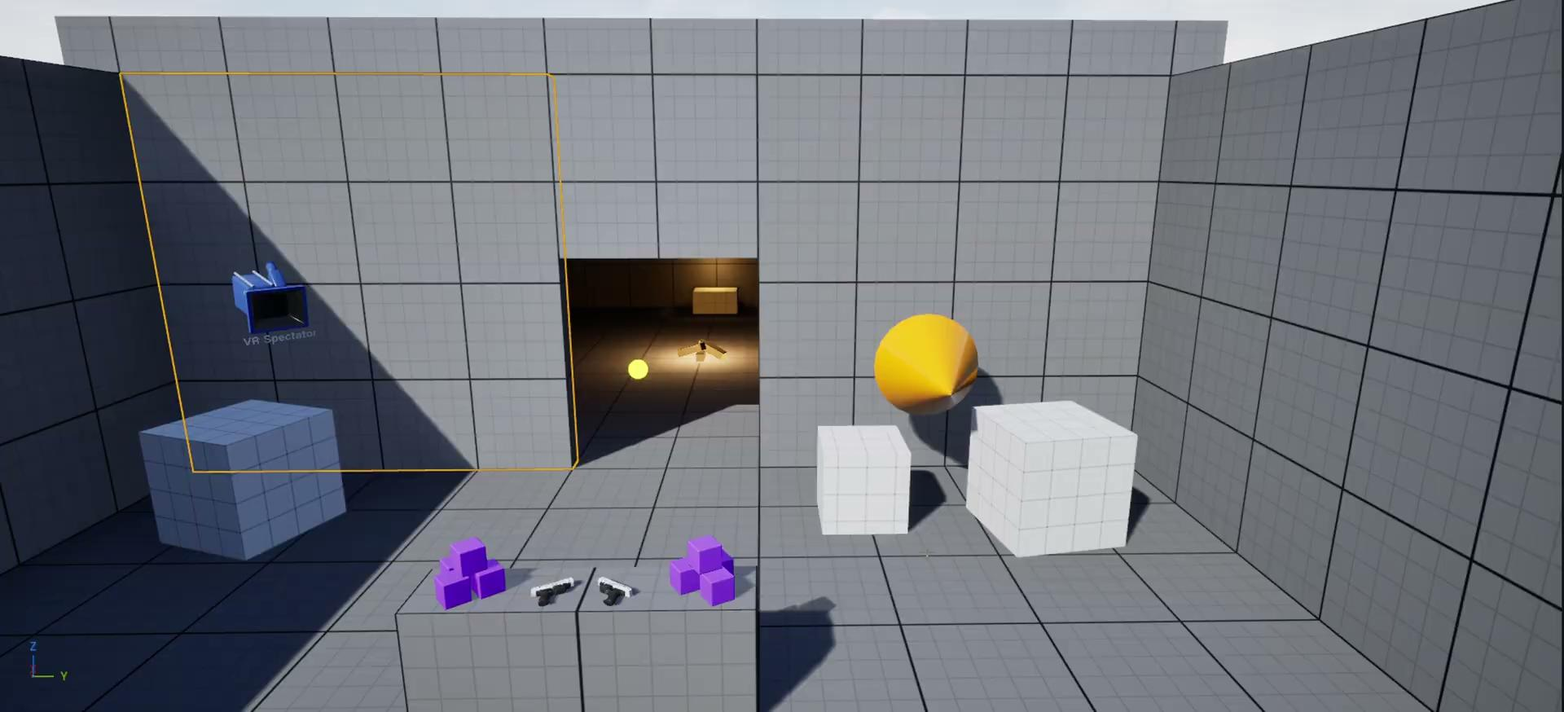
Audio Ray Tracing Demo
Link to the video
https://drive.google.com/file/d/13NglxqI3_13tGp58zvBCQa_5uB4q1yzX/view?usp=sharing
Notes:
Notice the comb filtering when I change my distance to the floor and the walls, as well as the occlusion and wall reflections you can hear in the second room.

