Slide 1
S1000DForge: A Modular Framework for Generating Valid S1000D-Compliant XML Using Large Language Models
User acceptance test (UAT)
BIKE, s1000d-tools-doc
User input
(Markdown to S1000D modules, e.g., descriptive, procedural)
Finetuning
Markdown
Structure Inference Layer
(GPT-2 / GPT-J + LoRA)
S1000D XML
Prompt Engineering
Prompt Engineering
Inner Loop
Error Recovery Loop #1
Major Contributions:
We propose S1000DForge, a novel LLM-guided XML generation framework that integrates probabilistic structure prediction (via Markov modeling) with formal grammar constraints (CFG and CSG), enabling automated generation of S1000D-compliant XML with high structural and semantic accuracy.
We demonstrate an iterative validation-and-repair mechanism that incorporates schema-level validation (using s1kd-tools) and grammar-level repair loops, allowing large language models to self-correct incomplete or ill-formed XML fragments through guided re-generation.
We conduct a user-centered evaluation through interviews and surveys with technical authors and S1000D practitioners, providing empirical evidence on the usability, accuracy, and trustworthiness of the S1000DForge system in real-world documentation workflows.
Local Syntax Check
(XML-aware CSG parser)
Outer Loop
Error Recovery Loop #2
Full Document Validator
(s1kd-validate)
Local accuracy (by modules)
Global accuracy (by document)

Slide 2
S1000DForge: A Modular Framework for Generating Valid S1000D-Compliant XML Using Large Language Models
BIKE, s1000d-tools-doc
User acceptance test (UAT)
User input
(Markdown to S1000D modules, e.g., descriptive, procedural)
Finetuning
Markdown
Structure Inference Layer
(GPT-2 / GPT-J + LoRA)
S1000D XML
Major Contributions:
We propose S1000DForge, a novel LLM-guided XML generation framework that integrates probabilistic structure prediction (via Markov modeling) with formal grammar constraints (CFG and CSG), enabling automated generation of S1000D-compliant XML with high structural and semantic accuracy.
We demonstrate an iterative validation-and-repair mechanism that incorporates schema-level validation (using s1kd-tools) and grammar-level repair loops, allowing large language models to self-correct incomplete or ill-formed XML fragments through guided re-generation.
We conduct a user-centered evaluation through interviews and surveys with technical authors and S1000D practitioners, providing empirical evidence on the usability, accuracy, and trustworthiness of the S1000DForge system in real-world documentation workflows.
Local accuracy (by modules)
Error Recovery Loop #1
Local Syntax Check
(XML-aware CSG parser)
Global accuracy (by document)
Error Recovery Loop #2
Full Document Validator
(s1kd-validate)

Slide 3
S1000DForge-Repair: An LLM-Guided Auto-Repair Framework for Validating and Fixing Structured XML Documentation
Structure Inference Layer
(GPT-2 / GPT-J + LoRA)
User input
(Markdown to S1000D modules, e.g., descriptive, procedural)
Markdown
Generation
User acceptance test (UAT)
Generation
Generation
S1000D XML
Local accuracy (by modules)
Syntax Fix Prompt
Document Fix Prompt
Global accuracy (by document)
Abstract
Structured XML is the cornerstone of technical documentation in aerospace and defense industries, with S1000D being one of the most stringent standards. While large language models (LLMs) demonstrate impressive capabilities in generating human-like text, their ability to produce structurally correct and schema-compliant XML remains limited. This paper presents S1000DForge-Repair, a novel auto-repair framework that enables LLMs to iteratively generate, validate, and self-correct S1000D-compliant XML documents. By integrating a probabilistic tag prediction module, formal grammar constraints (CFG/CSG), and schema-level validators such as s1kd-validate, our system detects structural and semantic errors in LLM-generated XML and applies targeted repair prompts without full regeneration. We further propose a taxonomy of XML error types and design a closed-loop correction mechanism driven by LLM prompt engineering. Empirical evaluations with real-world data and expert users demonstrate that our repair-first strategy significantly improves XML validity, generation efficiency, and user trust, paving the way for reliable AI-assisted technical authoring.
Inner Repair Loop
Full Document Validator
(s1kd-validate)
Major Contributions:
We propose S1000DForge-Repair, the first auto-repair framework that integrates LLM-based XML generation with grammar-aware validation and self-correction loops for complex standards such as S1000D.
We introduce a taxonomy of XML error types (structural, syntactic, and semantic), and map each category to targeted repair strategies using prompt injection, Markov-based structure prediction, and rule-based heuristics.
We conduct a comprehensive evaluation including automated metrics (e.g., validity rate, repair efficiency) and human-centered studies (e.g., expert interviews, perceived trust, usability), demonstrating the effectiveness and practical value of the proposed repair loop.
Outer Repair Loop
Local Syntax Check
(XML-aware CSG parser)

Slide 4
User inputs
LLM Generation
(GPT-OSS, LLaMA, Gemma)
S1000d data module
S1kdGen
(Validation, and repair prompt generation with S1000D Knowledge Graph)

Slide 5
Introduction: Why XML?
Today, many modern data formats like JSON have become popular because they are lightweight and easy to use. However, in industries such as aerospace and defense, XML is still the main standard for technical documentation. This is because XML provides a strict structure, long-term stability, and strong support for industry standards like S1000D. This paper explores how we can apply new technologies, such as generative AI, to help improve XML-based workflows in these traditional industries. Our goal is to bring modern AI tools into legacy systems to make technical content creation more efficient and intelligent.
Although XML is still important, it is also an older markup language. Its heavy use of tags, deep nesting, and context-sensitive structure can be challenging for large language models (LLMs), which are not naturally trained on such formats. To address this, we propose a double-loop mechanism to improve how LLMs generate and repair XML. This approach helps the model better understand XML structure and produce more accurate and usable outputs.

Slide 6
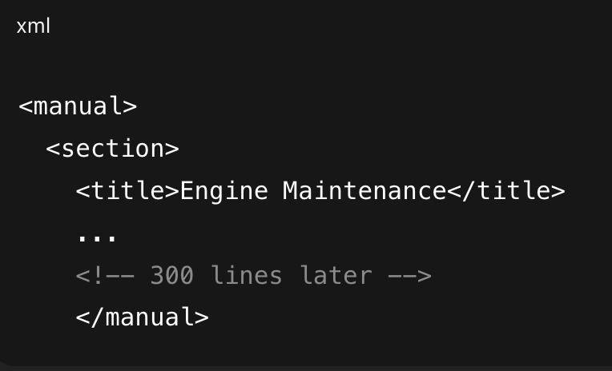
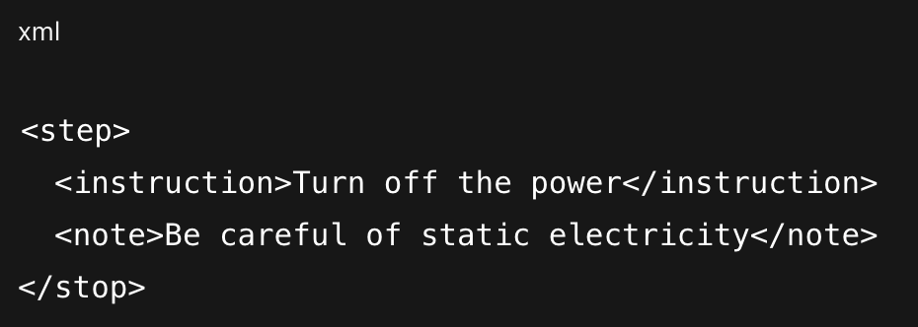
Introduction: Why XML?
Lack of Formal Grammar Constraints: Large language models (LLMs) generate text based on probability, not rules. That means they don't always follow grammar rules exactly, especially for structured formats like XML.
Long-range Dependency (context fragmentation): LLMs have difficulty remembering things that were written many tokens earlier, especially when the document is long or deeply nested.

Slide 7
Dataset
1. Taking the S1000D(bike, s1000d-tools-doc) as an example, how far are its tags? Are these distances difficult for LLM to overcome?

