Slide 1
01 / 11
FEASIBILITY RESEARCH
Return Verification System
One potential build plan — AI camera verification for USEFULL return bins
Owen Barron · March 2026

Slide 2
02 / 11
STARTING POINT
The Problem We Were Asked to Solve
Alison's ask: can we use an AI camera to verify containers are actually returned after a QR scan?
1
Student scans QR code
→
2
System expects a return
→
? Gap
Did a real container actually drop?
Current vulnerability: a student can scan the QR code, walk away without dropping, or drop trash to trigger a simple sensor — and receive credit.

Slide 3
03 / 11
FIELD EVIDENCE
But Is This the Right Problem?
WHAT CAMERA VERIFICATION SOLVES
WHAT IT DOESN'T SOLVE
Scan-and-walk-away (QR scanned, nothing dropped)
Containers never brought back at all (NAU's reported problem)
Fake drops (trash triggered instead of container)
Student-employee collusion to skip checkout entirely
Verifiable return event in the system of record
Student protest and non-participation (UMass Lowell)
Loss at other points in the container lifecycle
A camera system solves a specific failure mode. Before investing, we should confirm this failure mode is actually driving losses.

Slide 4
04 / 11
EXPERT GUIDANCE
What Joshua Told Us
Joshua is CEO of Amherst Intelligence Security, referred by Igor. After advising on the concept, he offered to work with us directly in his personal capacity — he's genuinely excited by the problem.
01
02
Don't point into the bin
More cameras beats better cameras
A messy pile of wet containers is a dead end. Focus on the throat — where the scene can be controlled.
Multiple inexpensive cameras from more angles outperforms a single high-end unit.
03
04
You need a lot of data
Expect a long iteration cycle
This is a scaling problem. The model needs thousands of real return events before it's useful.
Getting something that works even a little in a real food-court environment takes significant time.
Design principle: Watch the passage, not the pile. The throat concept on the next slide was built on this advice.

Slide 5
05 / 11
SENSING ARCHITECTURE — DEVELOPED WITH JOSHUA
The Throat Concept
4 cameras, 2 rails
A, B — Cross-view main cameras
ENTRY → PASSAGE → COMMIT
C, D — Entry / commit watchers
A
B
Cameras sealed behind polycarbonate windows — no electronics in the wet zone
Detection question:
LEFT RAIL 1.75"
CLEAR THROAT 10.5"
RIGHT RAIL 1.75"
Did something substantial pass fully through the throat after a QR scan?
C
D
USB cameras only — no bulky electronics in wet zone
Scan-triggered capture window
Multiple angles reduce false negatives
←————— 14" slot envelope —————→

Slide 6
06 / 11
SYSTEM ARCHITECTURE
What's Inside the System
WET ZONE
DRY BAY (SEALED)
BUILDING INFRASTRUCTURE
Camera A
Powered USB Hub
USEFULL Server
Camera B
→ USB
→ Ethernet
Camera C
Mini PC (edge compute)
Facility power (power in)
Camera D
Power distribution
Wet zone: only optics. Cameras behind polycarbonate windows — no circuitry exposed to moisture.
Field-serviceable: swap compute node or USB hub without touching camera boards. Single Ethernet out, single power in.

Slide 7
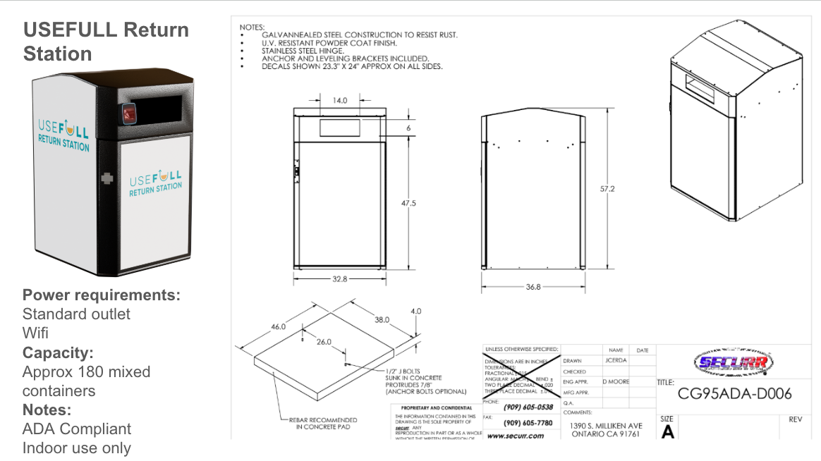
07 / 11
DESIGN CONSTRAINT
The Modularity Challenge
USEFULL RETURN STATION CONCEPT
This concept was designed for USEFULL's own return station — a controlled, known geometry.
NAU may want to use their existing bins. Different geometries, different slot sizes, different internals.
A fully modular "drop-in" system that works in any bin is significantly harder and more expensive.
RECOMMENDATION
Target one known bin design to prove the concept before attempting modularity.
Known geometry
↔
Unknown bins
modularity gap
14" slot, controlled geometry, designed for this system

Slide 8
08 / 11
BUDGET REALITY
What Would This Cost?
Joshua's initial estimate: $10k–$15k all-in for his work (4–5 months, ~60 days on-site). We're planning around ~$8k for his labor. This does NOT include hardware, fabrication, USEFULL software integration, or the dev workstation.
Category | 2-Bin Pilot | 9-Bin Full Rollout
Hardware + installation | $3.5k – $6.1k | $15.7k – $27.4k
Housing / rail design + fabrication | $6k – $15k | $6k – $15k
Dev workstation | $2.5k – $4k | $2.5k – $4k
USEFULL software integration (Nadia + Yulia) | $15k – $27k | $15k – $27k
Consultant labor (Joshua) | ~$8k | ~$8k
All-in with 20% contingency | ~$36k – $65k | ~$50k – $89k
Camera electronics (~$400/bin) are not the expensive part. Software integration, packaging, and iteration are. Recurring cloud/inference: est. $500–$1,200/month if hosted inference is used later.

Slide 9
09 / 11
THE HIDDEN BULK
USEFULL Software Integration — The Largest Cost
Even if the camera system works perfectly, significant dev effort is still required to make it operationally useful.
Work Package (Nadia) | Hours
Integration design + interface definition | 10–18
Event ingestion pipeline | 14–25
DB / schema work | 8–17
Scan ↔ return matching logic (hardest) | 28–49
"Scanned but not dropped" workflows | 18–35
Ops / support tooling | 14–28
Logging / observability | 14–25
QA support + bug fixing + rollout | 21–39
Knowledge transfer / coordination | 10–18
Total Nadia | 137–254
Nadia (Dev)
$12k – $23k
137–254 hrs @ ~$90/hr loaded
Yulia (QA)
$1.9k – $3.8k
42–84 hrs @ ~$45/hr loaded
COMBINED
$15k – $27k
Likely range: $16k–$22k
Yulia (QA): 42–84 hours in parallel

Slide 10
10 / 11
DECISION FRAMEWORK
Three Options
OPTION A
OPTION B
OPTION C
Engage Consultant — Stage-Gated Pilot
Small Internal Pilot — No Consultant
Shelve for Now
2-bin pilot at UMass Lowell · ~$36k–$65k all-in · 4–5 months
Off-the-shelf cameras · basic motion detection · lower upfront cost
Gather loss data first · revisit when loss driver is confirmed
Start with known bin geometry. Decision gate after pilot: does it work well enough? Only expand to 9 bins if pilot succeeds.
Use existing team knowledge to prototype a simpler version. Skip custom throat design to start.
Focus on root causes suggested by NAU and Lowell feedback. Confirm return-station fraud is a significant driver before investing.
+ Most thorough path; real CV expertise; proves concept before scaling
+ Cheaper to start; keeps optionality; builds internal knowledge
+ No investment risk; addresses "are we solving the right problem?" first
– Significant investment before we confirm the problem it solves is driving losses
– No CV expertise; risk of building something that doesn't validate the concept
– If CEO's instinct is right, we lose time; consultant may not be available later

Slide 11
11 / 11
BEFORE WE DECIDE
Key Unknowns & Recommended Next Steps
WHAT WE DON'T KNOW YET
REGARDLESS OF OPTION — IMMEDIATE NEXT STEPS
Whether return-station fraud is actually a significant source of container loss (NAU + Lowell evidence suggests maybe not)
1
Quantify the actual loss rate at return stations specifically, vs. other points in the container lifecycle
Whether the no-illumination approach works in real dining hall lighting on wet, reflective surfaces
2
Clarify whether NAU needs to use existing bins or would adopt USEFULL return stations
Whether NAU's existing bins can accommodate the system — or if they'd adopt USEFULL return stations
3
If proceeding: start with a 2-bin pilot at one site with known geometry — don't try to solve modularity first
Whether Nadia's bandwidth can absorb this without impacting the roadmap
Exact mechanical fit — 1.75" rails are tight once fasteners, brackets, and cable bends are added
A camera-based return verification system is technically plausible. The question is whether it solves the right problem, and whether the investment is justified given what we're learning about where containers are actually being lost.

