Slide 1
EDES 301
Beer Bike Pit Console
Project Proposal
7 October 2026
Owen Button

Slide 2
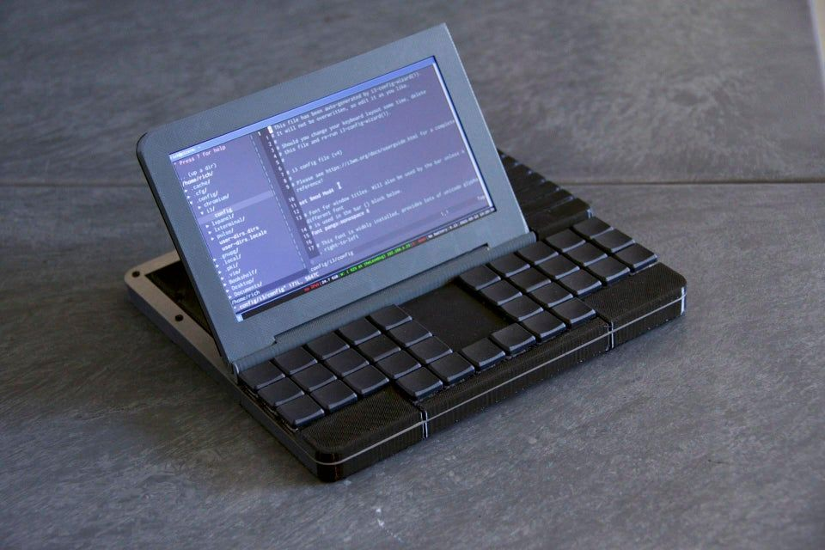
Background Information
  Beer Bike Pit Console
    Brown Bike Team
    Race timing device tailored for Beer Bike at Rice University
    Cyberdeck-style build
    In race, console would record times for pit/chug, and rider segments (including lap splits)
    Console would transition between bikers and pits automatically
    Would include separate modes for Alumni, Womens, and Mens races
  Cyberdeck example
    the Raspberry Pi Recovery Kit
  Stopwatch example
    ULTRAK 495 - 100 Dual Split Memory Stopwatch – SEIKO & Ultrak Timing from CEI
  Adafruit
    Blinka & RGB Display Libraries

Slide 3
System Block Diagram
Physical interfaces and local data storage
LAP / FINISH
RIDER OUT
Start / setup + undo
GPIO
3.3 V logic
PocketBeagle
Python timing program
SPI + GPIO
3.3 V logic
Adafruit 1770
2.8-inch TFT
Onboard file I/O
Existing microSD
Roster + CSV event/results files
Load the roster by USB before racing. The console then runs independently.
Start begins race. Final lap starts pit timing automatically. RIDER OUT starts the next rider.
Notes:
Controls: two 30 mm momentary buttons for LAP/FINISH and RIDER OUT, plus two smaller kit/OEDK momentary buttons for START/SETUP and UNDO. Use four 10 kOhm pull-up resistors to the 3.3 V rail unless a verified class-supported internal pull-up arrangement replaces them. A switch press connects its input to ground. Configure the GPIO pins and debounce each input. Label the timing buttons clearly. The buttons' supplier examples do not include lighting.
Display: approved Adafruit 1770 ILI9341 breakout, SPI data/clock plus chip-select, data/command and reset as required by the chosen driver. Use 3.3 V logic. Leave touch sensing and the display's auxiliary microSD socket unused. Existing PocketBeagle microSD holds Linux, roster and output files. A laptop transfers roster files before racing and retrieves results afterward through the board's existing USB connection; the race program does not require networking.
Timing behavior: START begins the overall clock and opening waiting interval. RIDER OUT saves that interval and starts rider 1, lap 1. LAP/FINISH records each lap. After lap 3 in men's mode or lap 2 in women's mode, the same event closes the leg and opens the next pit interval. RIDER OUT closes that pit and starts the next rider. Rider 8's final lap finishes the race without opening another pit. Store all timestamps so undo can rebuild results without resetting the race clock. A missed crossing cannot be assigned an invented split.
Timing assumption: 'pit' means the entire finish-to-release transition, not isolated chug duration. Confirm the start/finish reference and any departure crossing so a partial lap is not counted as a full lap.
Implementation milestones: week 1, display and button tests; week 2, timing states and file output; week 3, enclosure and integration; week 4, simulated 8-rider races in both modes, correction tests, power-on startup and documentation. Software class diagram is a later assignment deliverable, due October 23.
References: https://docs.beagleboard.org/boards/pocketbeagle/ch05.html ; https://www.adafruit.com/product/1770 ; https://circuitpython.org/blinka/pocketbeagle/ .

Slide 4
Power Block Diagram
Regulated adapter, set to 5 V
2 A source capacity
5 V
5 V
PocketBeagle + microSD
5 V input
0.50 A planning allowance*
TFT display + backlight
5 V input
0.15 A planning allowance*
Board-regulated 3.3 V
4 switches + 10 kOhm pull-ups
3.3 V, up to 1.32 mA
Common ground throughout.
GPIO and SPI signals use 3.3 V logic.
Notes:
The diagram separates 5 V power from 3.3 V logic. The approved adjustable 2 A adapter is listed in EDES301_project_01_parts_list.xlsx, Sheet1 row 44, approximately $15.98: https://www.amazon.com/dp/B01N2K48HR . Set the output to 5 V and verify polarity/connector compatibility before connecting the board. The class prototype can use this adapter. A separately verified commercial 5 V USB battery pack is a possible later replacement for outdoor use and is not included in this baseline budget.
The 0.50 A PocketBeagle and 0.15 A TFT values are conservative proposal planning allowances selected for sizing, not manufacturer maxima or measured results. Validate peak current, startup behavior, backlight draw, supply distribution and board output-current limits during prototyping. The board allowance includes its microSD and the very small button-input load. Main 5 V planning load is approximately 0.65 A, below the proposed 2 A source rating; this arithmetic is not a completed electrical validation.
Four 10 kOhm pull-ups at 3.3 V draw 4 * 3.3/10000 A = 1.32 mA when all four switches are pressed. They are passive switches with no LED load. All grounds are common. The TFT breakout accepts 3-5 V power/logic, but this design uses 3.3 V signals for compatibility with PocketBeagle.
One active power source at a time. PocketBeagle USB and header power paths need review against the manual so a programming computer is not back-fed by the external source. This is a block diagram, not a pin-level wiring schematic.
Sources: https://docs.beagleboard.org/boards/pocketbeagle/ch05.html ; https://docs.beagleboard.org/accessories/power-supplies.html ; https://www.adafruit.com/product/1770 .

Slide 5
Components / Budget
Component | EDES301 to Buy? | Cost
PocketBeagle, microSD and USB cable | No | $0 new
2.8-inch SPI display, Adafruit 1770 | Yes | $29.95
30 mm timing buttons, Adafruit 471 (2) | No | $11.90
2 A adapter | No | $15.98
2 small buttons + 4 10 kOhm resistors | Kit / OEDK* | $0*
Prototype board, wire and headers | Kit / OEDK* | $0*
Cyberdeck case (I still have to figure this one out, potentially a print) | No | TBD
Estimated new electronics: $57.83. Proposed EDES301 purchase: $29.95.
Two off-list timing buttons, and the case will not be on the list either.
Notes:
Budget basis, October 7, 2026. New electronics subtotal is 29.95 + 2*5.95 + 15.98 = $57.83. The proposed class request is the display, $29.95. Other listed new electronics total $27.88; these are proposed student-funded items, not purchases already made or authorized. Tax, shipping and fabrication costs are not included. If the available class contribution is only $25, the display alone leaves $4.95 to fund separately. Reusing a suitable existing supply would reduce new cost.
Approved list: EDES301_project_01_parts_list.xlsx, Sheet1 row 15, SPI screen, Adafruit 1770, $29.95; row 44, adjustable voltage adapter (2 A), $15.98 approximate class price. Display link: https://www.adafruit.com/product/1770 . Adapter link: https://www.amazon.com/dp/B01N2K48HR . The manufacturer lists the screen at $29.95 on the date checked.
Two off-list items: two identical Adafruit 471 30 mm translucent clear arcade buttons, $5.95 each, https://www.adafruit.com/product/471 . They have switches but no built-in lighting. Label one LAP/FINISH and one RIDER OUT. Use stock wire soldered to terminals if appropriate; optional quick-connect harnesses are not included. Instructor should verify the interpretation of the two off-list component allowance and the planned stock items before ordering.
Existing PocketBeagle, microSD and USB cable are based on the user's class setup. Kit/OEDK supply of two small momentary buttons, four 10 kOhm resistors, prototype board, wire, headers, enclosure stock and fasteners has not been inventoried. Zero entries are conditional incremental costs, not assertions that these items are free or currently available. If any require purchase, add exact approved-supplier links and revise the total/off-list count. The enclosure will be fabricated rather than purchased as a finished case.
The template asks for purchase links for components. Exact links are embedded for all proposed new electronics. Kit/OEDK components and fabrication stock require an inventory check; this remains a draft budget until that check is complete. No touchscreen controller, Wi-Fi adapter or separate display microSD is needed for the initial scope.

