Slide 1

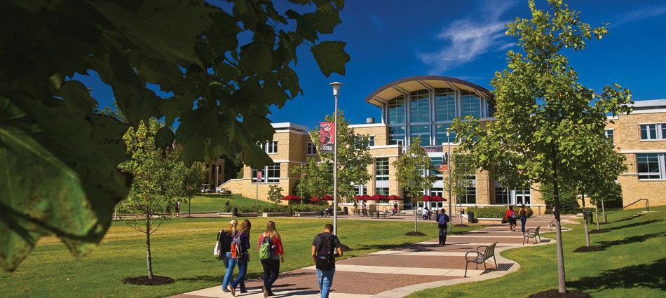

ACM General Meeting
Grab a slice of pizza!
09/01/21
AState.edu
/ArkansasState
@ArkansasState

Slide 2
Meet the Board
Roth In
Owen Habeger
Lakresha Holley
Amine Ghoorchiyani
Kyler Dickey
AState.edu
/ArkansasState
@ArkansasState

Slide 3
What we have planned
Brief background of what we have been discussing.
What is the status on the t-shirts?
When will we hold meetings throughout the semester?
How can you get involved?
AState.edu
/ArkansasState
@ArkansasState

Slide 4



Follow Our Socials
GroupMe: https://groupme.com/join_group/64025441/Kk1bdpbC
Instagram: acm.astate
Website: helper.cs.astate.edu

Slide 5
Resources for CS Students
https://helper.cs.astate.edu
AState.edu
/ArkansasState
@ArkansasState

