Slide 1
C++Programming
Week 2:
Basic Types
Dr. Owen Chen Cary Chinese School
Director of Math and Computer Science
2023 Summer

Slide 2
Week 2: Agenda
Review software installs and resolve any installation issues
Create, Compile and Run first C++ program – Hello World
C++ Variables
C++ Basic Types (integer, char, bool, float)
C++ operators

Slide 3
Review Software Installs
Install WSL on Windows
Install VS Code
Install C++ Compiler
Configure VS Code

Slide 4
Install WSL on Windows
Windows Subsystem for Linux (WSL) is required for this course
Please install it by following this page:
https://learn.microsoft.com/en-us/windows/wsl/install
Follow this page to set up a username and a password for your Linux account:
https://learn.microsoft.com/en-us/windows/wsl/setup/environment#set-up-your-linux-username-and-password
Write down your password – if you will need later when you run “sudo” command

Slide 5
Install VS Code
Download VS Code here: https://code.visualstudio.com/
Follow the setup instruction:
Windows:https://code.visualstudio.com/docs/setup/windows
Mac: https://code.visualstudio.com/docs/setup/mac

Slide 6
Install the Compilers
Install the last gcc/g++ on WSL
$ sudo apt update
$ sudo apt install gcc g++ make gdb
$ gcc --version
$ g++ --version
Install the last clang on Mac
Run the following command from a terminal (iTerm):
The above command will install C++ compiler clang
$ xcode-select --install

Slide 7
How to Compile?
Compile C++ programs in g++ (for WSL):
$ g++ <program.cpp> -o program
Compile C++ programs in clang (for Mac):
$clang <program.cpp> -o program

Slide 8
Hello World

Slide 9
Organize our files in a new folder under your home: ~/cpp
Open your terminal:
Ubuntu App in Windows
iTerm in Mac
Go to home directory (cd)
Create a folder called “cpp” using mkdir:
$ cd
$ mkdir cpp

Slide 10
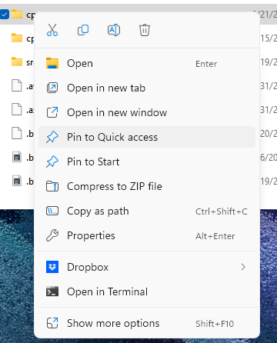
Create a shortcut on your Desktop (for Windows)
Open File Explorer, go to:
Linux -> Unbuntu -> home -> <your username>
Right Click on “cpp” folder,
Select “Pin to Quick access”
Select “Pin to Start”

Slide 11
Start VS Code from your cpp folder for both Windows and Mac
You can always go to cpp folder anywhere with this command:
From your terminal, type the following commands to start
VS Code from your cpp folder:
$ cd ~/cpp
$ cd ~/cpp
$ code .

Slide 12
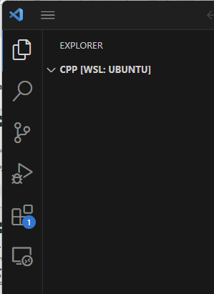
Install C++ extensions in VS Code
It will Extensions
Type “C++” in the search
Install
Click on Extensions Icon on Left Bar
or type Ctrl+Shit+X

Slide 13
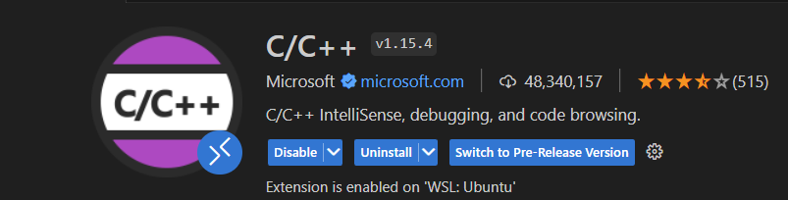
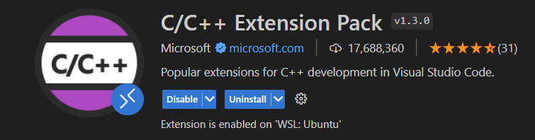
Install C++ extensions in VS Code
Install these two packages:
C/C++ by Microsoft
C/C++ Extension Pack by Microsoft

Slide 14
Hello World
1/2
Open VS Code and create our first C++ program: hello_world.cpp
#include <iostream>
int main() {
std::cout << "Hello World!\n";
}
std::cout
represent the standard output stream

Slide 15
Compile and Execute Programs
Open your VS Code Terminal: Top Menu -> View ->Terminal
$ g++ hello_world.cpp -o hello_world
$ hello_world
Compile C++ programs in clang (for Mac):
$ clang hello_world.cpp -o hello_world
$ hello_world

Slide 16
Hello World
2/2
The previous example can be written with the global namespace:
std
#include <iostream>
using namespace std;
int main() {
cout << "Hello World!\n";
}

Slide 17
Hello World
1/2
Open VS Code and create a C version of hello world program: hello_world.c
#include <stdio.h>
int main() {
printf("Hello World!\n");
}
printf
prints on standard output

Slide 18
I/O Stream (std::cout)
1/3
std::cout
is an example of output stream. Data is redirected to a destination, in
this case the destination is the standard output
C:
#include <stdio.h>
int main() {
int a
= 4;
= 3.0;
double b
char c[] = "hello"; printf("%d %f %s\n", a, b, c);
}
C++:
#include <iostream>
int main() {
int a
double b
= 4;
= 3.0;
char c[] = "hello";
std::cout << a << " " << b << " " << c << "\n";
}

Slide 19
Variables and Basic Types

Slide 20
Integter Data Types

Slide 21
int
int is the most frequently used integer type
int i; //declare a variable
int j = 10; //declare and initialize
int k;
k = 20; //assign a value
Remember to initialize a variable!
Will the compiler give an error?
int i;
cout << i; //what is i's value?

Slide 22
How to initialize a variable
int num;
num = 10;//do not forget this line
int num = 10;
int num (10);
int num {10};

Slide 23
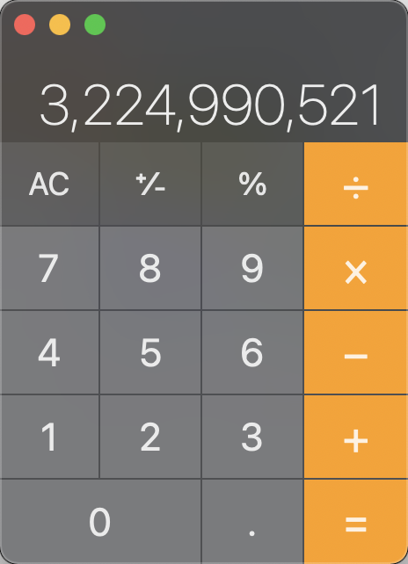

Overflow
Int_overflow.cpp
int main(){
int a = 56789;
int b = a;
int c = a * b;
cout << "int product:" << endl;
cout << a << "*" << b;
cout << "=" << c << endl;

Slide 24
Arithmetic Types
Type Bytes Range Fixed width types
bool 1 true, false
char † 1 -127 to 127
signed char 1 -128 to 127 int8 t
unsigned char 1 0 to 255 uint8 t
short 2 -2¹⁵ to 2¹⁵-1 int16 t
unsigned short 2 0 to 2¹⁶-1 uint16 t
int 4 -2³¹ to 2³¹-1 int32 t
unsigned int 4 0 to 2³²-1 uint32 t
long int 4/8 int32 t/int64 t
∗
long unsigned int 4/8∗ uint32 t/uint64 t
long long int 8 -2⁶³ to 2⁶³-1 int64 t
long long unsigned int 8 0 to 2⁶⁴-1 uint64 t
float (IEEE 754) 4 ±1.18 × 10⁻³⁸ to ±3.4 × 10⁺³⁸
double (IEEE 754) 8 ±2.23 × 10⁻³⁰⁸ to ±1.8 × 10⁺³⁰⁸
∗ 4 bytes on Windows64 systems, † one-complement

Slide 25
Arithmetic Types - Short Name
Signed Type
short name
signed char signed short int signed int signed long int
signed long long int
/ short int long
long long
Unsigned Type
short name
unsigned char unsigned short int unsigned int unsigned long int
unsigned long long int
/
unsigned short unsigned unsigned long
unsigned long long
19/100

Slide 26
Max Integers
#include <climits>
#include <cmath>
#include <iostream>
using namespace std;
int main(){
// Max numbers from <climits>
int n = INT_MAX;
unsigned un = UINT_MAX;
long l = LONG_MAX;
cout << "Max int = " << n << endl;
cout << "Max unsigned int = " << un << endl;
cout << "Max long = " << l << endl;
// Calculated limits;
int n2 = (long)(pow(2, 31) - 1);
unsigned un2 = (long)(pow(2, 32) - 1);
long l2 = (long)(pow(2, 63) - 1);
cout << "Max int = " << n2 << endl;
cout << "Max unsigned int = " << un2 << endl;
cout << "Max long = " << l2 << endl;
}

Slide 27
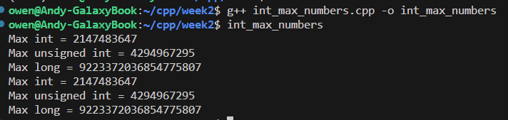
Max Integers

Slide 28
Arithmetic Types - Suffix and Prefix
Type | SUFFIX | example
int | / | 2
unsigned int | u | 3u
long int | l | 8l
long unsigned | ul | 2ul
long long int | ll | 4ll
long long unsigned int | ull | 7ull
float | f | 3.0f
double |  | 3.0
Representation | PREFIX | example
Binary C++14 | 0b | 0b010101
Octal | 0 | 0308
Hexadecimal | 0x or 0X | 0xFFA010
C++14 allows also digit separators for improving the readability
1'000'000
20/100

