Slide 1
C++Programming
Week 4:
Arrays, Strings and Vectors
Dr. Owen Chen Cary Chinese School
Director of Math and Computer Science
2023 Summer

Slide 2
Week 4: Agenda
Review C++ operators
Review Flow Control
Review Homework
Arrays
Strings
Vectors

Slide 3
Operators Precedence
1/3
Precedence | Operator | Description | Associativity
1 | a++ a-- | Suffix/postfix increment and decrement | Left-to-right
2 | ++a --a ! ∼ | Prefix increment/decrement, Logical/Bitwise Not | Right-to-left
3 | a*b a/b a%b | Multiplication, division, and remainder | Left-to-right
4 | a+b a-b | Addition and subtraction | Left-to-right
5 | ≪ ≫ | Bitwise left shift and right shift | Left-to-right
6 | < <= > >= | Relational operators | Left-to-right
7 | == != | Equality operators | Left-to-right
8 | & | Bitwise AND | Left-to-right
9 | ˆ | Bitwise XOR | Left-to-right
10 | | | Bitwise OR | Left-to-right
11 | && | Logical AND | Left-to-right
12 | || | Logical OR | Left-to-right | 31/100

Slide 4
if and if-else
Statements are executed conditionally
int num = 10;
if (num < 5)
cout << "The number is less than 5. " << endl;
else
cout << “else condition”;
if (num == 5 ) {
cout << "The number is 5." << endl;
} else {
cout << "The number is not 5." << endl;
}

Slide 5
if-else if-else
if (num < 5)
cout << "The number is less than 5." << endl;
else if (num > 20)
cout << "The number is greater than 20." << endl;
else if (num > 10)
cout << "The number is in range (10, 20]." << endl;
else
cout << "The number is in range [5, 10]." << endl;

Slide 6
Relational Expressions
The condition can be a relational expression
The 6 relational/comparison operators
Return 1 if the condition (such as a==b) is true,
Return 0 if the condition is false.
Operator name | Example
equal to | a == b
not equal to | a != b
less than | a < b
greater than | a > b
less than or equal to | a <= b
greater than or equal to | a >= b

Slide 7
Logical Expressions
An operand is not bool, it will be converted to bool implicitly.
Precedence: ! > && > ||
What’s the value of the follow expressions?
if(-2 && true)
cout << "The condition is true." << endl;
if(not -2)
cout << " (!-2) is true, really?" << endl;
Operator name | Symbol-like operator | Keyword-like operator | Example
negation | ! | not | !a
AND | && | and | a && b
Inclusive OR | || | or | a || b

Slide 8
for and while Loops
for
for ([init]; [cond]; [increment]) {
...
}
To use when number of iterations is known
while
while (cond) {
...
}
To use when number of iterations is not known
do while
do {
...
} while (cond);
To use when number of iterations is not known, but there is at least one iteration
13/24

Slide 9
while loop
while.cpp
Syntax :
while ( expression ) {
//...
}
If the condition is true, the statement (loop body) will be executed.
int num = 10;
While (num > 0) {
cout << "num = " << num << endl;
num--;
}

Slide 10
do-while loop
while.cpp
The test takes place after each iteration in a do-while loop.
The test takes place before each iteration in a while loop.
int num = 10;
do {
cout << "num = " << num << endl;
num--;
} while (num > 0);

Slide 11
for loop
for.cpp
Syntax:
for (init-clause; cond-expression; iteration-expression)
loop-statement
Example:
int sum = 0;
for(int i = 0; i < 10; i++)
{
sum += i;
cout << "Line " << i << endl;
}
cout << "sum = " << sum << endl;

Slide 12
switch Statement
Execute one of several statements, depending on the value of an expression.
break prevents executing some following statements. Don’t forget break!
More similar to goto, not if-else if-else
switch (input_char)
{
case 'a’:
x = ‘a’;
break;
case 'A':
cout << "Move left." << endl;
break;
case 'd':
case 'D':
cout << "Move right." << endl;
break;
default:
cout << "Undefined key." << endl;
break;
}
switch.cpp

Slide 13
Review Homework for last week
1) Go over Week 3 Class Notes. 2) Is the following program legal? If so, what values are printed? int i = 100, sum = 0; for (int i = 0; i != 10; ++i) sum += i; cout << i << " " << sum << endl;
3) Write a program that uses a while to sum the numbers from 50 to 100.
4) Write a C++ program using a for loop to print out the first 20 Fibonacci numbers like this: First 20 Fibonacci Numbers: 1 1 2 3 5 8 13 21 34 55 89 144 233 377 610 987 1597 2584 4181 6765 5) Write a C++ program to print all printable symbols and their corresponding ASCII codes. The first printable symbol with the smallest ASCII code is ! and its ASCII code is 33 and the last printable symbol with the largest ASCII code of 126 is ~

Slide 14
Review Homework for last week
1) Go over Week 3 Class Notes. 2) Is the following program legal? If so, what values are printed? int i = 100, sum = 0; for (int i = 0; i != 10; ++i) sum += i; cout << i << " " << sum << endl;
3) Write a program that uses a while to sum the numbers from 50 to 100.
4) Write a C++ program using a for loop to print out the first 20 Fibonacci numbers like this: First 20 Fibonacci Numbers: 1 1 2 3 5 8 13 21 34 55 89 144 233 377 610 987 1597 2584 4181 6765 5) Write a C++ program to print all printable symbols and their corresponding ASCII codes. The first printable symbol with the smallest ASCII code is ! and its ASCII code is 33 and the last printable symbol with the largest ASCII code of 126 is ~
Solutions:
homework3_loop.cpp
fibonacci_numbers.cpp
print_ascii_table.cpp

Slide 15
Today’s Topics: Strings, Arrays and Vectors

Slide 16
Strings

Slide 17
What is a String?
Strings are essentially collections of characters.
Examples:
"Hello World",
"My name is Jason"
They're enclosed in a double “quote” or a single ‘quote’.

Slide 18
Two types of strings in C++
In C++, we have two types of strings:
1) std::string
The std::string class that's provided by the C++ Standard Library is the preferred method to use for strings.
2) C-style Strings
These are strings derived from the C programming language and they continue to be supported in C++.
These "collections of characters" are stored in the form of arrays of type char that are null-terminated (the \0 null character).
C-style strings are relatively unsafe and not recommended.

Slide 19
C++ string
A string is a variable-length sequence of characters. To use the string type, we must include the string header. Because it is part of the library, string is defined in the std namespace. Our examples assume the following code:
#include <string> using std::string;
This section describes the most common string operations;

Slide 20
Defining and Initializing strings
Each class defines how objects of its type can be initialized. A class may define many different ways to initialize objects of its type. Each way must be distin- guished from the others either by the number of initializers that we supply, or by the types of those initializers. Table 3.1 lists the most common ways to initialize strings. Some examples:
Table 3.1: Ways to Initialize a string
string s1 string s2(s1) string s2 = s1
Default initialization; s1 is the empty string.
s2 is a copy of s1.
Equivalent to s2(s1), s2 is a copy of s1.
string s3("value") s3 is a copy of the string literal, not including the null. string s3 = "value" Equivalent to s3("value"), s3 is a copy of the string literal. string s4(n, ’c’) Initialize s4 with n copies of the character ’c’.

Slide 21
C-style strings
A C-style string (null-terminated strings/arrays of characters) is a series of characters stored in bytes in memory.
This kind of strings can be declared as follows
char rabbit[16] = {'P', 'e', 't', 'e', 'r'};
char bad_pig[9] = {'P', 'e', 'p', 'p', 'a', ' ', 'P', 'i', 'g’}; //a bad one!
char good_pig[10] = {'P', 'e', 'p', 'p', 'a', ' ', 'P', 'i', 'g', '\0'};
initchar.cpp
size_t strlen( const char *str );
Returns the number of characters, the first NULL will not be included.
char name[10] = {'Y', 'u', '\0', 'S', '.', '0'};
cout << strlen(name) << endl;

Slide 22
C-Style String manipulation and examination
Copy
char* strcpy( char* dest, const char* src );
char *strncpy(char *dest, const char *src, size_t count);
Concatenate: appends a copy of src to dest
char *strcat( char *dest, const char *src );
Compare
int strcmp( const char *lhs, const char *rhs );
stringop.cpp

Slide 23
String literals
It isn’t convenient to initial a string character by character. String literals can help.
char name1[] = “North Carolina";
char name2[] = "North " " Carolina";
char name3[] = "Carolina"; //how many bytes for the array?
const wchar_t[] s5 = L"ABCD";
const char16_t[] s9 = u”ABCD"; //since C++11
const char32_t[] s6 = U”ABCD"; //since C++11
0 | name3+4
'D' | name3+3
'C' | name3+2
'B' | name3+1
'A' | name3+0

Slide 24
C++ string class
C++ string class provides functions to manipulate and examinate strings.
std::string str1 = "Hello";
std::string str2 = "SUSTech";
std::string result = str1 + ", " + str2;
Different types of strings
std::string
std::wstring
std::u8string //(C++20)
std::u16string //(C++11)
std::u32string //(C++11)
stdstring.cpp

Slide 25
Example: read a string from user: hello_name.cpp
#include <iostream>
#include <string>
using namespace std;
int main(){
string name;
cout << "Please enter your name:";
cin >> name;
cout << "Hello, " << name << "!" << endl;
return 0;
}

Slide 26
Operations on strings
Reading and Writing strings
We use the iostream library to read and write values of built-in types such as int, double, and so on.
We use the same IO operators to read and write strings:
string s;
cin >> s;
cout << s << endl;

Slide 27
string Operations
Table 3.2: string Operations
os << s | Writes s onto output stream os. Returns os.
is >> s | Reads whitespace-separated string from is into s. Returns is.
getline(is, s) | Reads a line of input from is into s. Returns is.
s.empty() | Returns true if s is empty; otherwise returns false.
s.size() | Returns the number of characters in s.
s[n] | Returns a reference to the char at position n in s; positions start at 0.
s1 + s2 | Returns a string that is the concatenation of s1 and s2.
s1 = s2 | Replaces characters in s1 with a copy of s2.
s1 == s2 | The strings s1 and s2 are equal if they contain the same characters.
s1 != s2 | Equality is case-sensitive.
<, <=, >, >= | Comparisons are case-sensitive and use dictionary ordering.

Slide 28
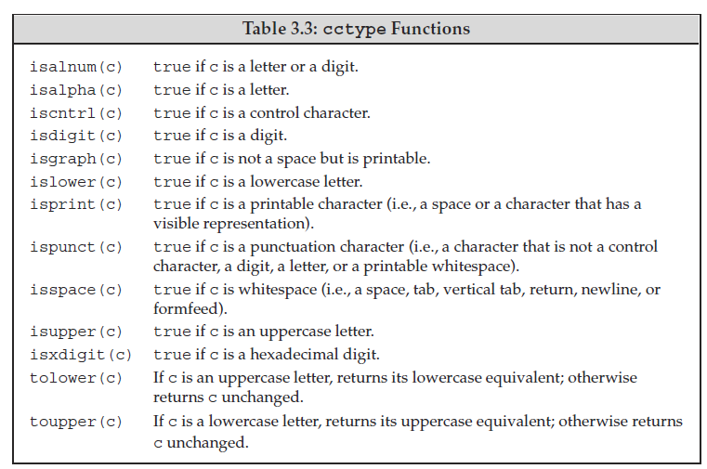
string cctype functions

Slide 29
Example: string + operator: hello_name2.cpp
#include <iostream>
#include <string>
using namespace std;
int main(){
string name;
string greet = "Hello, ";
string greet_end = "!\n";
cout << "Please enter your name:";
cin >> name;
cout << greet + name + greet_end;
return 0;
}

Slide 30
C-Style String
char str[] = "c string";
char str[9] = "c string";
char str[] = {'c', ' ', 's', 't', 'r', 'i', 'n', 'g', '\0’};
char str[9] = {'c', ' ', 's', 't', 'r', 'i', 'n', 'g', '\0'};

Slide 31
Arrays
- An array is a contiguously allocated block of memory
Fixed number of elements
Its element type can be any fundamental type (int, float, bool, etc), structure, class, pointer, enumeration,
#include <iostream>
using namespace std;
int main()
{
int num_array1[5]; //uninitialized array, random values
int num_array2[5] = {0, 1, 2, 3, 4}; //initialization for(int i = 0; i < 5; i++)
cout << num_array1[i] << " ";
cout << endl; for(int i = 0; i < 5; i++)
cout << num_array2[i] << " ";
cout << endl; return 0;
}
array.cpp

Slide 32
Variable-length arrays
If the length is not an integer constant expression, the array will be a variable-length one.
variable-array.cpp
int len = 1;
while ( len < 10 )
{
int num_array2[len]; //variable-length array
cout << "len = " << len;
cout << ", sizeof(num_array2)) = "
<< sizeof(num_array2) << endl;
len ++;
}

Slide 33
Arrays of unknown size
The number is not specified in the declaration.
The arguments of a function
int num_array[ ] = {1, 2, 3, 4}; // the type of num_array is "array of 4 int"
float array_sum(float values[], size_t length);
float array_sum(float *values, size_t length);

Slide 34
Element accessing
Index | Value | Address
 |  | p+19
 |  | p+18
 |  | p+17
 |  | p+16
3 | 6 | p+15
 |  | p+14
 |  | p+13
 |  | p+12
2 | 7 | p+11
 |  | p+10
 |  | p+9
 |  | p+8
1 | 8 | p+7
 |  | p+6
 |  | p+5
 |  | p+4
0 | 9 | p+3
 |  | p+2
 |  | p+1
 |  | p+0
 |  | p-1
 |  | p-2
 |  | p-3
 |  | p-4
index-bound.cpp
Arrays are not objects in C/C++ (different with Java);
Arrays can be regarded as addresses
int array1[4] = {9,8,7,6};
int array2[4];
array2 = array1; //error!
array2[0] = array1[0]; //okay
array2[1] = array1[1]; //okay
array2[2] = array1[2]; //okay
array2[3] = array1[3]; //okay
No bounds-checking in C/C++.
int num_array[5];
for(int idx = -1; idx <= 5; idx++)
num_array[idx] = idx * idx;
for(int idx = -1; idx <= 5; idx++)
cout << num_array[idx] << endl;

Slide 35
Multidimensional arrays
Index | Value | Address
 |  | p+25
 |  | p+24
[1][2] | 16 | p+23
 |  | p+22
 |  | p+21
 |  | p+20
[1][1] | 15 | p+19
 |  | p+18
 |  | p+17
 |  | p+16
[1][0] | 14 | p+15
 |  | p+14
 |  | p+13
 |  | p+12
[0][2] | 13 | p+11
 |  | p+10
 |  | p+9
 |  | p+8
[0][1] | 12 | p+7
 |  | p+6
 |  | p+5
 |  | p+4
[0][0] | 11 | p+3
 |  | p+2
 |  | p+1
 |  | p+0
 |  | p-1
 |  | p-2
int mat[2][3] = {{11,12,13}, {14,15,16}};
for (int r = 0; r < rows; r++)
{
for(int c = 0; c < cols; c++)
cout << mat[r][c] << ",";
cout << endl;
}
md-array.cpp
Arrays of unknown bound
void init_2d_array(float mat[][], //error
size_t rows, size_t cols)
void init_2d_array(float mat[][3],
size_t rows, size_t cols)

Slide 36
const Arrays
const float PI = 3.1415926f;
PI += 1.f; // error
const float values[4] = {1.1f, 2.2f, 3.3f, 4.4f};
values[0] = 1.0f; // error
Used as function arguments
float array_sum(const float values[], size_t length)
{
float sum = 0.0f;
for (int i = 0; i < length; i++)
{
sum += values[i];
//values[i] = 0; //error
}
return sum;
}
int main()
{
float values[4] = {1.1f, 2.2f, 3.3f, 4.4f};
float sum = array_sum(values, 4);
}
const-array.cpp

Slide 37
Vector
A vector is a collection of objects, all of which have the same type. Everyobject in
the collection has an associated index, which gives access to that object. A vector
is often referred to as a container because it “contains” other objects.
To use a vector, we must include the appropriate header. In our examples,
we also assume that an appropriate using declaration is made:
#include <vector>
using std::vector;
A vector is a class template. C++ has both class and function templates.

Slide 38
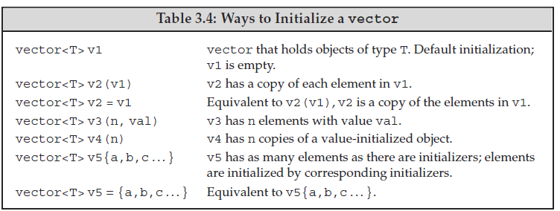
Vector Initialization
Code: vector.cpp

Slide 39
Adding Elements to a vector
Code: vector.cpp
vector<int> v2; // empty vector
for (int i = 0; i < 100; i++) {
v2.push_back(i);
}

Slide 40
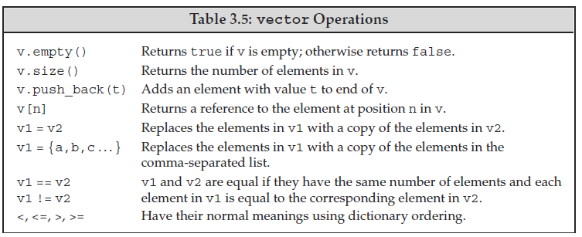
Vector Operations

Slide 41
Range-based for Loop
1/3
C++11 introduces the range-based for loop to simplify the verbosity of traditional for loop constructs. They are equivalent to the for loop operating over a range of values, but safer
The range-based for loop avoids the user to specify start, end, and increment of the loop
for (int v : { 3, 2, 1 }) // INITIALIZER LIST
cout << v << " "; // print: 3 2 1
int values[] = { 3, 2, 1 };
for (int v : values) cout << v << " ";
// ARRAY OF VALUES
// print: 3 2 1
for (auto c : "abcd") cout << c << " ";
// RAW STRING
// print: a b c d

Slide 42
Range-based for Loop ⇝
2/3
Range-based for loop can be applied in three cases:
Fixed-size array int array[3] , "abcd"
Branch Initializer List
{1, 2, 3}
Any object with
begin()
and
end()
methods
std::vector vec{1, 2, 3, 4};
int matrix[2][4];
for (auto& row : matrix) {
for (auto element : row) cout << "@";
cout << "\n";
}
// print: @@@@
// @@@@
for (auto x : vec) { cout << x << ", ";
// print: "1, 2, 3, 4"

