Slide 1
C++Programming
Week 5:
Functions
Dr. Owen Chen Cary Chinese School
Director of Math and Computer Science
2023 Summer

Slide 2
Week 5: Agenda
Review Arrays, Strings, Vectors
Review Homework 4)
New Topic: Functions

Slide 3
Two types of strings in C++
In C++, we have two types of strings:
1) std::string
The std::string class that's provided by the C++ Standard Library is the preferred method to use for strings.
2) C-style Strings
These are strings derived from the C programming language and they continue to be supported in C++.
These "collections of characters" are stored in the form of arrays of type char that are null-terminated (the \0 null character).
C-style strings are relatively unsafe and not recommended.

Slide 4
Defining and Initializing strings
Each class defines how objects of its type can be initialized. A class may define many different ways to initialize objects of its type. Each way must be distin- guished from the others either by the number of initializers that we supply, or by the types of those initializers. Table 3.1 lists the most common ways to initialize strings. Some examples:
Table 3.1: Ways to Initialize a string
string s1 string s2(s1) string s2 = s1
Default initialization; s1 is the empty string.
s2 is a copy of s1.
Equivalent to s2(s1), s2 is a copy of s1.
string s3("value") s3 is a copy of the string literal, not including the null. string s3 = "value" Equivalent to s3("value"), s3 is a copy of the string literal. string s4(n, ’c’) Initialize s4 with n copies of the character ’c’.

Slide 5
string Operations
Table 3.2: string Operations
os << s | Writes s onto output stream os. Returns os.
is >> s | Reads whitespace-separated string from is into s. Returns is.
getline(is, s) | Reads a line of input from is into s. Returns is.
s.empty() | Returns true if s is empty; otherwise returns false.
s.size() | Returns the number of characters in s.
s[n] | Returns a reference to the char at position n in s; positions start at 0.
s1 + s2 | Returns a string that is the concatenation of s1 and s2.
s1 = s2 | Replaces characters in s1 with a copy of s2.
s1 == s2 | The strings s1 and s2 are equal if they contain the same characters.
s1 != s2 | Equality is case-sensitive.
<, <=, >, >= | Comparisons are case-sensitive and use dictionary ordering.

Slide 6
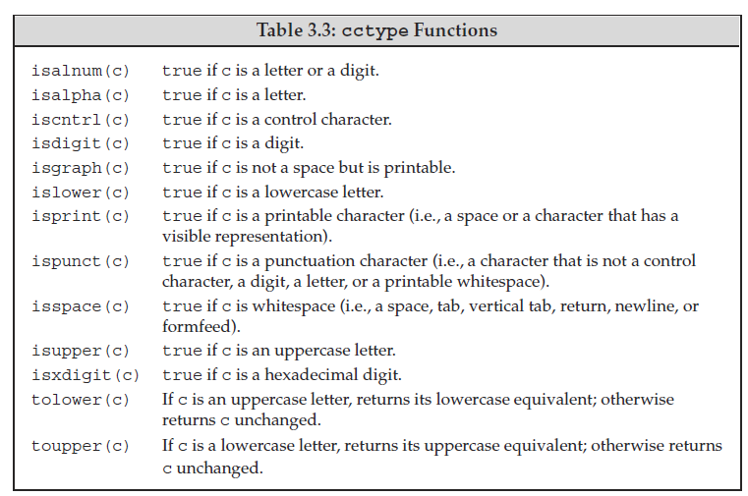
string cctype functions

Slide 7
Arrays - C-style arrays
Syntax:
Type array name[size] {…};
#include <iostream>
using namespace std;
int main()
{
int num_array1[5]; // int array
int num_array2[5] = {0, 1, 2, 3, 4}; // int array
float f_array1[5]{0.0, 1.0, 2.0, 3.0, 4.0}; // float array
string s_array1[5]{“w1”, “w2”, “w3”,”w4”, “w5”}; // string array
}

Slide 8
Arrays - C++ STL arrays since C++11
Syntax:
#include <array>
Array<T, size> array_name {…};
#include <iostream>
#include <array>
#include <string>
using namespace std;
int main()
{
array<int, 5> num_array1{9}; //initialized int array
array<int, 5> num_array2{0, 1, 2, 3, 4}; //initialized int array
array<float, 5> float_array3{0.0, 1.0, 2.0, 3.0, 4.0}; //float array
array<string, 5> s_array5{“”, “”, “”, “”, “”, “”); //string array
}

Slide 9
Vector
A vector is a collection of objects, all of which have the same type. Everyobject in
the collection has an associated index, which gives access to that object. A vector
is often referred to as a container because it “contains” other objects.
To use a vector, we must include the appropriate header. In our examples,
we also assume that an appropriate using declaration is made:
#include <vector>
using std::vector;
A vector is a class template. C++ has both class and function templates.

Slide 10
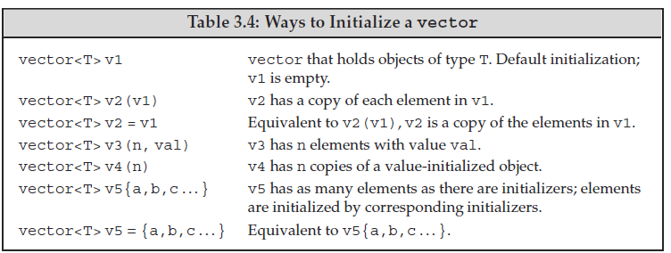
Vector Initialization

Slide 11
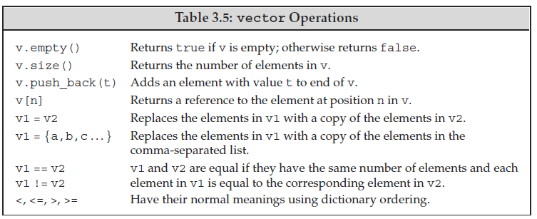
Vector Operations

Slide 12
Range-based for Loop
1/3
C++11 introduces the range-based for loop to simplify the verbosity of traditional for loop constructs. They are equivalent to the for loop operating over a range of values, but safer
The range-based for loop avoids the user to specify start, end, and increment of the loop
for (int v : { 3, 2, 1 }) // INITIALIZER LIST
cout << v << " "; // print: 3 2 1
int values[] = { 3, 2, 1 };
for (int v : values) cout << v << " ";
// ARRAY OF VALUES
// print: 3 2 1
for (auto c : "abcd") cout << c << " ";
// RAW STRING
// print: a b c d

Slide 13
Homework 4
1) What does the following program do? Is it valid? If not, why not? string s; cout << s[0] << endl;

Slide 14
Homework 4
1) What does the following program do? Is it valid? If not, why not? string s; cout << s[0] << endl;
Solution:
The program declares a string variable s and outputs the first character of the string s. It is valid. However, since String s is not initialized, s[0] could be blank or any random value.

Slide 15
Homework 4
2) Which, if any, of the following vector definitions are in error? For those that are legal, explain what the definition does. For those that are not legal, explain why they are illegal. (a) vector<vector<int>> ivec; (b) vector<string> svec = ivec; (c) vector<string> svec(10, "null");

Slide 16
Homework 4
2) Which, if any, of the following vector definitions are in error? For those that are legal, explain what the definition does. For those that are not legal, explain why they are illegal. (a) vector<vector<int>> ivec; (b) vector<string> svec = ivec; (c) vector<string> svec(10, "null");
Solution:
(a) is legal. It declares ivec as a 2-dimension vector of integers (vector of vector of integers).
(b) It is invalid. Can not assign a 2-d vector to a string of vector.
(c) It is valid. svec is a vector of 10 string elements with each element being initialized as "null".

Slide 17
Homework 4
3) How many elements are there in each of the following vectors? What are the values of the elements?
(a) vector<int> v1;
(b) vector<int> v2(10); (c) vector<int> v3(10, 42);
(d) vector<int> v4{10}; (e) vector<int> v5{10, 42};
(f) vector<string> v6{10}; (g) vector<string> v7{10, "hi"};

Slide 18
Homework 4
3) How many elements are there in each of the following vectors? What are the values of the elements?
(a) vector<int> v1;
(b) vector<int> v2(10); (c) vector<int> v3(10, 42);
(d) vector<int> v4{10}; (e) vector<int> v5{10, 42};
(f) vector<string> v6{10}; (g) vector<string> v7{10, "hi"};
Solution:
v1:0 elements v2:10 elements of 0 v3:10 elements of 42 v4:1 element of 10 v5:2 elements of 10 and 42 v6:10 elements of blank strings v7:10 elements of "hi"

Slide 19
Homework 4
4) Is there any error in the following code? int array_size = 10; int ia[array_size]; for (int ix = 1; ix <= array_size; ++ix) ia[ix] = ix;

Slide 20
Homework 4
4) Is there any error in the following code? int array_size = 10; int ia[array_size]; for (int ix = 1; ix <= array_size; ++ix) ia[ix] = ix;
Solution:
The code will compile and run without any error.
However, the last iteration of the for loop, ia[ix] with ix=10 is out of bound.
ia[10] memory is not allocated - its value is unstable.
It could override another variable's value and it could also be overridden by another variable.

Slide 21
Homework 4 - Programming
5) Write a program that reads a string of characters including punctuation and writes what was read but with the punctuation removed. 6) Write a program to read a sequence of ints from cin and store those values in a vector. 7) Modify your program in 6) above to read strings this time. 8) Write a program to copy a vector of ints into an array of ints.
Solutions
homework5_p5.cpp
homework5_p6.cpp
homework5_p7.cpp
homework5_p8.cpp

Slide 22
Functions

Slide 23
Function Overview
A function (procedure or routine) is a piece of code that performs a specific task. Function is a block of code which only runs when it is called.
Purpose:
Avoiding code duplication: less code for the same functionality → less bugs
Readability: better express what the code does
Organization: break the code in separate modules

Slide 24
Function Overview
Function is a block of code with a name.
Declare a function with its name, parameters and return type
Define a function with details
Execute a function by calling the function
A function takes zero or more arguments and usually returns a result.
Functions can be overloaded, meaning that the same name may have different arguments and different return values

Slide 25
Declaration/Definition
Declaration/Prototype
A declaration (or prototype) of an entity is an identifier describing its type
A declaration is what the compiler and the linker needs to accept references (usage) to that identifier
C++ entities (class, functions, etc.) can be declared multiple times (with the same signature)
Definition/Implementation
An entity definition is the implementation of a declaration
For each entity, only a single definition is allowed

Slide 26
Declaration/Definition Function Example
void f(int a, string b); // function declaration -> put a function declaration in a .h file
void f(int a, string) { // function definition -> put a function definition in a .cpp file
... // "b" can be omitted if not used
}
void f(int a, string b); // function declaration
// multiple declarations is valid
f(3, "abc"); // usage
void g(); // function declaration
g(); // linking error "g" is not defined

Slide 27
Examples: Declare a function
#ifndef LOCALMATH_H
#define LOCALMATH_H
//definition in LocalMath.cc
int fact(int); // iterative definition of factorial
#endif

Slide 28
Examples: define a function: LocalMath.cpp
#include "LocalMath.h"
// factorial of val is val*(val-1)*(val-2) . . . * ((val-(val-1)) * 1)
long fact(int val)
{
long ret = 1; // local variable to hold the result as we calculate it
while (val > 1)
ret *= val--; // assign ret * val to ret and decrement val
return ret; // return the result
}

Slide 29
Examples: call a function from main(): fact.cpp
#include <iostream>
using namespace std;
#include "LocalMath.h"
int main()
{
cout << fact(5) << endl;
cout << fact(0) << endl;
return 0;
}

Slide 30
Recursion
A function that calls itself, either directly or indirectly, is a recursive function.

Slide 31
Examples: Recursive Function
#include "LocalMath.h"
// recursive version of factorial:
// calculate val!, which is 1 * 2 * 3 . . . * val
long factorial(int val)
{
if (val > 1)
return factorial(val-1) * val;
return 1;
}

Slide 32
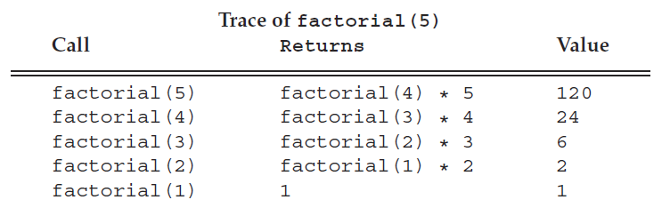
Recursion

Slide 33
Examples: Compare both factorial functions
#include <iostream>
#include <array>
#include <chrono>
using namespace std;
using namespace std::chrono;
#include "LocalMath.h“
int main()
{
array<int, 9> n{0, 5, 6, 7, 8, 9, 10, 20, 40};
//Version 1 - while loop
auto time_start = high_resolution_clock::now();
cout << "Factorial function - Version 1: fact() - while loop" << endl;
for(int i:n) cout << i << "! = " << factorial(i) << endl;
auto run_time = duration_cast<microseconds>(high_resolution_clock::now() - time_start);
cout << "Elapsed Time = " << run_time.count() << " microseconds (1/million seconds)" << endl;
//Version 2 - recursive function
time_start = high_resolution_clock::now();
cout << "Factorial function - Version 2: factorial() - recursive function" << endl;
for(int i:n) cout << i << "! = " << fact(i) << endl;
run_time = duration_cast<microseconds>(high_resolution_clock::now() - time_start);
cout << "Elapsed Time = " << run_time.count() << " microseconds (1/million seconds)" << endl;
return 0;
}

Slide 34
Examples: Compile multiple C++ programs into one executable
# Step 1) Compile multiple C++ programs into objects first
$ g++ -c LocalMath.cpp fact.cpp
# Step 2) Link object files into an executable $ g++ LocalMath.o fact.o -o fact.exe
# Combined one step
$ g++ LocalMath.cpp fact.cpp –o fact.exe

Slide 35
Examples: Compare both factorial functions
~/cpp/week5$ fact.exe
Factorial function - Version 1: fact() - while loop
0! = 1
5! = 120
6! = 720
7! = 5040
8! = 40320
9! = 362880
10! = 3628800
20! = 2432902008176640000
40! = -70609262346240000
Elapsed Time = 71 microseconds (1/million seconds)
Factorial function - Version 2: factorial() - recursive function
0! = 1
5! = 120
6! = 720
7! = 5040
8! = 40320
9! = 362880
10! = 3628800
20! = 2432902008176640000
40! = -70609262346240000
Elapsed Time = 8 microseconds (1/million seconds)

Slide 36
Exercise: Generate Fibonacci numbers using a recursive function
// Week 3
int main()
{
int a = 0, b = 1;
int temp = 0;
cout << "First 20 Fibonacci Numbers:" << endl;
for(int i = 0; i < 20; i++){
temp = b;
b = a + b;
a = temp;
cout << a << " ";
}
cout << endl;
return 0;
}

Slide 37
Exercise: Generate Fibonacci numbers using a recursive function
#include <iostream>
#include <vector>
using namespace std;
int fibonacci(int n)
{
if (n < 3) {
return 1;
} else {
return fibonacci(n-2) + fibonacci(n-1);
}
}
void fibonacci_sequence(int n, vector<int> & fib_sequence)
{
if (n == 1) {
fib_sequence = {1};
} else if (n == 2) {
fib_sequence = {1, 1};
} else {
for(int i = 2; i <= n; i++){
fib_sequence.push_back(fibonacci(i));
}
}
}
int main()
{
vector<int> fib_seq;
cout << "First 20 Fibonacci Numbers:" << endl;
fibonacci_sequence(20, fib_seq);
for (int fib: fib_seq) {
cout << fib << " ";
}
cout << endl;
return 0;
}

Slide 38
Function Parameter and Argument
Function Parameter [formal]
A parameter is the variable which is part of the method signature
Function Argument [actual]
An argument is the actual value (instance) of the variable that gets passed to the
function
void f(int a, string b); // parameters: int a, string b
// return type: void
f(3, "abc"); // arguments: 3, "abc"

Slide 39
Where should a function be? Option 1
// draw.cpp
// The function must be defined before it was called
bool drawLine(int x1, int y1, int x2, int y2)
{
// Source code here
return true;
}
bool drawRectangle(int x1, int y1, int x2, int y2)
{
// some calculation here
drawLine(...);
drawLine(...);
drawLine(...);
drawLine(...);
return true;
}

Slide 40
Where should a function be? Option 2
// draw.cpp
// declared first, parameter names can be omitted
bool drawLine(int x1, int y1, int x2, int y2);
bool drawRectangle(int x1, int y1, int x2, int y2)
{
// some calculation here
drawLine(...);
drawLine(...);
drawLine(...);
drawLine(...);
return true;
}
// define it later
bool drawLine(int x1, int y1, int x2, int y2)
{
// Source code here
return true;
}

Slide 41
Where should a function be? Option 3
// draw.h
#ifndef __DRAW_H__
#define __DRAW_H__
bool drawLine(int x1, int y1, int x2, int y2);
bool drawRectangle(int x1, int y1, int x2, int y2);
#endif
// main.cpp
#include <draw.h>
int main()
{
// ...
drawRectangle(10, 20, 50, 100);
// ...
}
// draw.cpp
#include <draw.h>
bool drawRectangle(int x1, int y1, int x2, int y2)
{
// some calculation here
drawLine(...);
drawLine(...);
drawLine(...);
drawLine(...);
return true;
}
// define it later
bool drawLine(int x1, int y1, int x2, int y2)
{
// Source code here
return true;
}

Slide 42
How are functions called?
A call stack can store information about the active functions of a program
Store the address the program returns after the function call
Store the registers
Store the local variables
//do some work of the called function
Restore the registers
Restore the local variables
Store the function returned result
Jump to the return address
The cost to call a function!

Slide 43
Function Parameters
The symbolic name for "data" that passes into a function.
Three ways to pass into a function:
Pass by value
Pass by pointer
Pass by reference

Slide 44
Pass by-Value
Call-by-value
The object is copied and assigned to input arguments of the method f(T x)
Advantages:
Changes made to the parameter inside the function have no effect on the argument
Disadvantages:
Performance penalty if the copied arguments are large (e.g. a structure with a large array)
When to use:
Built-in data type and small objects (≤ 8 bytes)
When not to use:
Fixed size arrays which decay into pointers
Large objects
9/57

Slide 45
Pass by-Pointer
Call-by-pointer
The address of a variable is copied and assigned to input arguments of the method
f(T* x)
Advantages:
Allows a function to change the value of the argument
Copy of the argument is not made (fast)
Disadvantages:
The argument may be null pointer
Dereferencing a pointer is slower than accessing a value directly
When to use:
Raw arrays (use
When not to use:
All other cases
const T*
if read-only)
10/57

Slide 46
Pass by-Reference
Call-by-reference
The reference of a variable is copied and assigned to input arguments of the method
f(T& x)
Advantages:
Allows a function to change the value of the argument (better readability compared with pointers)
Copy of the argument is not made (fast)
References must be initialized (no null pointer)
Avoid implicit conversion (without const T& )
When to use:
All cases except raw pointers
When not to use:
Pass by-value could give performance advantages and improve the readability with built-in_{11/57} data type and small objects

Slide 47
Examples
struct MyStruct;
void f1(int a);
// pass by-value
void f2(int& a); // pass by-reference
void f3(const int& a); // pass by-const reference
void f4(MyStruct& a); // pass by-reference
void f5(int* a); // pass by-pointer
void f6(const int* a); // pass by-const pointer
void f7(MyStruct* a); // pass by-pointer
void f8(int*& a); // pass a pointer by-reference
//--------------------------------------------------------------
char c = 'a';
f1(c); // ok, pass by-value (implicit conversion)
// f2(c); // compile error different types
f3(c); // ok, pass by-value (implicit conversion)

Slide 48


Pass by value: fundamental type
The parameter is a copy of the original variable
int foo(int x)
{ // x is a copy
x += 10;
return x;
}
int main()
{
int num1 = 20;
int num2 = foo( num1 );
return 0;
}
Will num1 be changed in foo()?

Slide 49
Pass by value: pointer
What’s the difference?
int foo(int * p)
{
(*p) += 10;
return *p;
}
int main()
{
int num1 = 20;
int * p = &num1;
int num2 = foo( p );
return 0;
}
It still is passing by value (the address!)
A copy of the address
param-pointer.cpp

Slide 50
Pass by value: structure
How about structure parameter?
struct Matrix
{
int rows;
int cols;
float * pData;
};
float matrix_max(struct Matrix mat)
{
float max = FLT_MIN;
for(int r = 0; r < mat.rows; r++)
for (int c = 0; c < mat.cols; c++)
{
float val = mat.pData[ r * mat.cols + c];
max = ( max > val ? max : val);
}
return max;
}

Slide 51
Pass by value: structure
. . .
Matrix matA = {3,4};
matrix_max(matA);
matA | pData
 | cols:4
 | rows:3
float matrix_max(struct Matrix mat)
{
float max = FLT_MIN;
for(int r = 0; r < mat.rows; r++)
for (int c = 0; c < mat.cols; c++)
{
float val = mat.pData[ r * mat.cols + c];
max = ( max > val ? max : val);
}
return max;
}
mat | pData
 | cols:4
 | rows:3

Slide 52
Pass by value: structure
If the structure is a huge one, such as 1K bytes.
A copy will cost 1KB memory, and time consuming to copy it.
?

Slide 53
References in C++
References are in C++, not in C.
A reference is an alias to an already-existing variable/object.
int n = 0;
int &r = n; //r is a reference to n
r = 10; // what is the value of n?
int i = 42;
r = i; //What is the value of n?
reference.cpp

Slide 54
References in C++
A reference to an object
struct Matrix
{
int rows;
int cols;
float * pData;
};
Matrix matA = {3,4};
matA.pData = new float[matA.rows * matA.cols]{};
Matrix& matA_ref = matA;
Matrix * pMatA = &matA;

Slide 55
References in C++
A reference must be initialized after its declaration.
Reference VS Pointer: References are much safer
int& num_ref; // error
Matrix& mat_ref; // error

Slide 56
Function parameters with a huge structure
If the huge struct is passed as a function parameter
struct PersonInfo
{
char firstname[256];
char middlename[256];
char lastname[256];
char address[256];
char nationalID[16];
// and more
};
char * fullname(struct PersonInfo pi)
{
// ...
}
The data will be copied. Not a good choice!

Slide 57
The problem
struct PersonInfo
{
char firstname[256];
char middlename[256];
char lastname[256];
char address[256];
char nationalID[16];
// and more
}; char * fullname(struct PersonInfo * ppi)
{
if (ppi == NULL)
{
cerr << "Invalid pointer" << endl;
return NULL;
}
// ...
}
One solution is to use a pointer

Slide 58
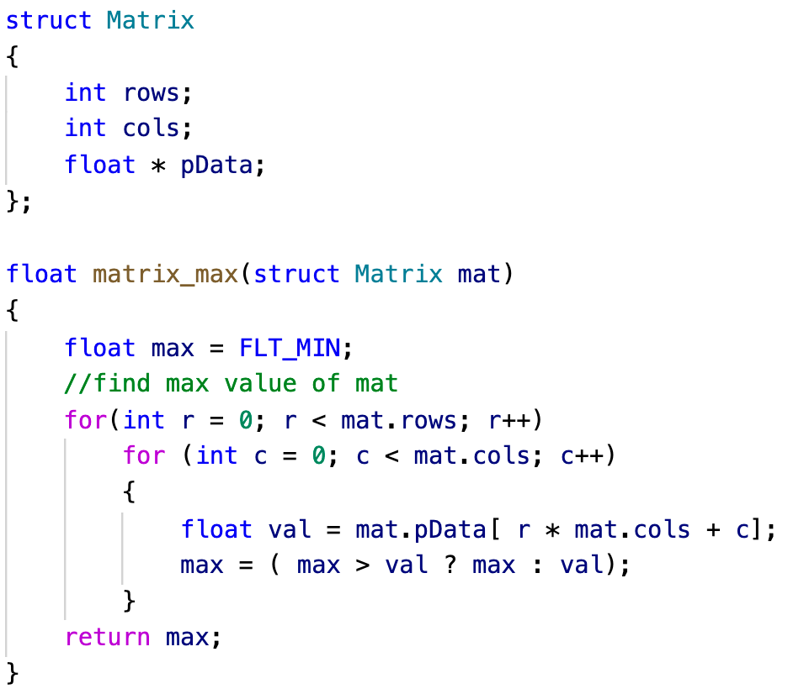
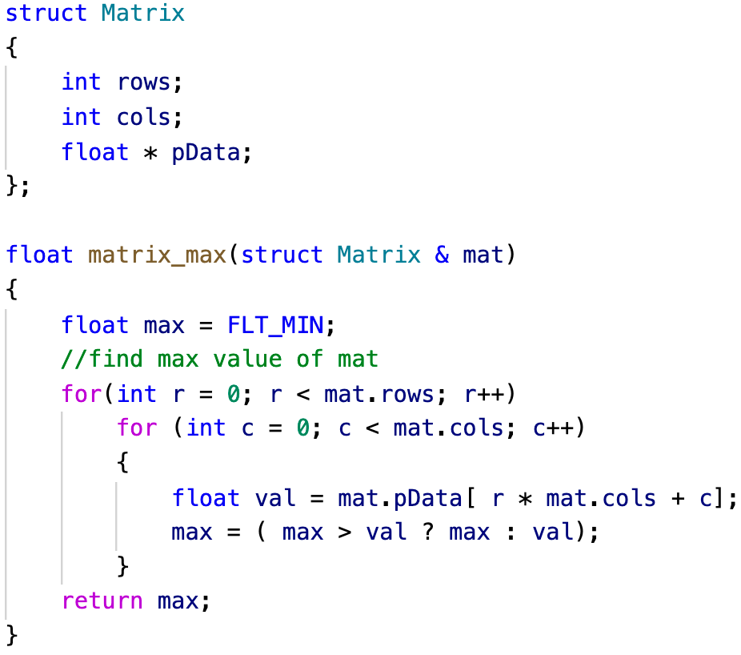

References as function parameters
No data copying in the reference version; Better efficiency
The modification to a reference will affect the original object

Slide 59
References as function parameters
To avoid the data is modified by mistakes,
float matrix_max(const struct Matrix& mat)
{
float max = FLT_MIN;
// ...
return max;
}

Slide 60
Return statement
Statement return; is only valid if the function return type is void.
Just finish the execution of the function, no value returned.
void print_gender(bool isMale)
{
if(isMale)
cout << "Male" << endl;
else
cout << "Female" << endl;
return;
}
void print_gender(bool isMale)
{
if(isMale)
cout << "Male" << endl;
else
cout << "Female" << endl;
}

Slide 61
Return statement
The return type can be a fundamental type or a compound type.
Pass by value:
Fundamental types: the value of a constant/variable is copied
Pointers: the address is copied
Structures: the whole structure is copied
float maxa = matrix_max(matA);
Matrix * pMat = create_matrix(4,5);
Matrix * create_matrix(int rows, int cols)
{
Matrix * p = new Matrix{rows, cols};
p->pData = new float[p->rows * p->cols]{1.f, 2.f, 3.f};
// you should check if the memory is allocated successfully
// and don’t forget to release the memory
return p;
}

Slide 62
If we have a lot to return
Such as a matrix addition function (A+B->C)
A suggested prototype:
To use references to avoid data copying
To use const parameters to avoid the input data is modified
To use non-const reference parameters to receive the output
bool matrix_add(const Matrix &matA, const Matrix &matB, Matrix &matC)
{
// check the dimensions of the three matrices
// re-create matC if needed
// do: matC = matA + matB
// return true if everything is right
}

Slide 63
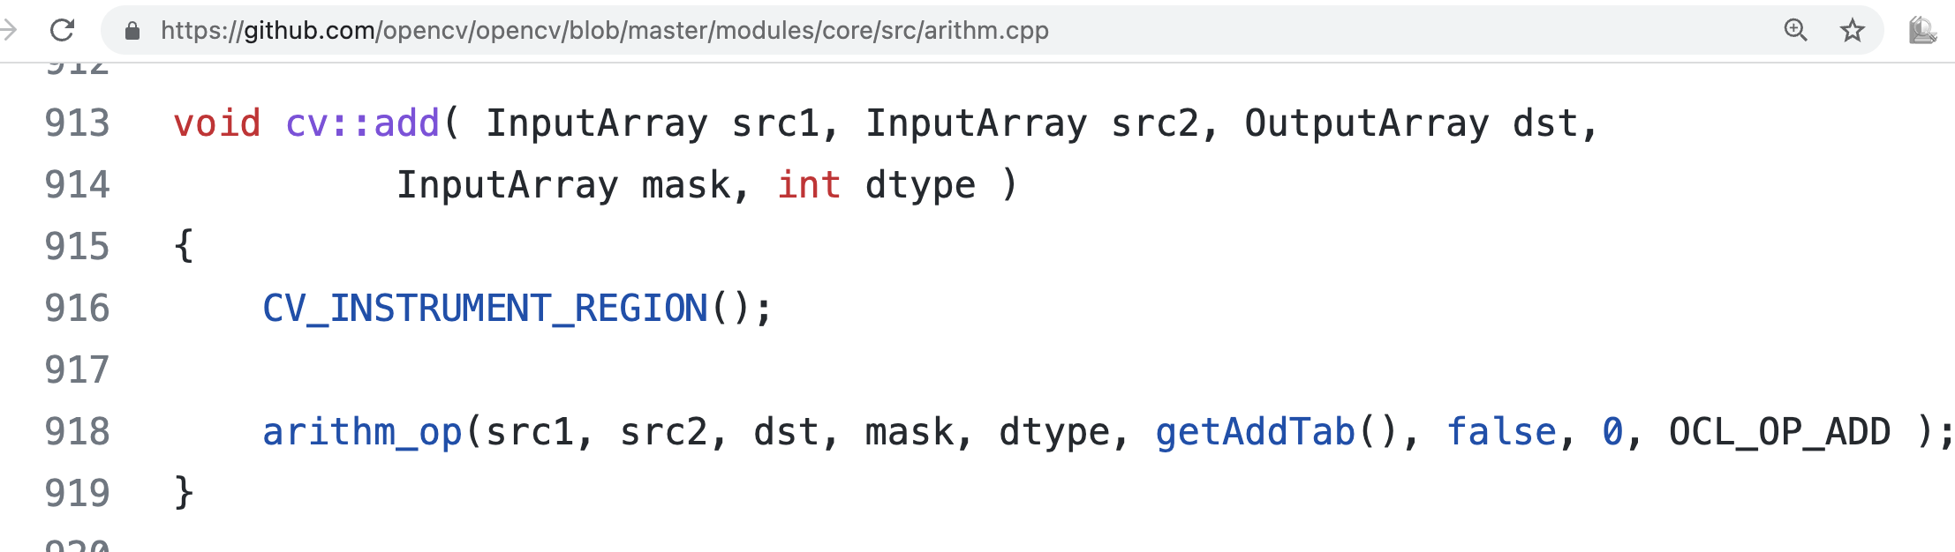
Similar mechanism in OpenCV
Matrix add in OpenCV
https://github.com/opencv/opencv/blob/master/modules/core/src/arithm.cpp

Slide 64
inline functions
inline Functions Avoid Function Call Overhead
A function specified as inline (usually) is expanded “in line” at each call.

Slide 65
inline functions
Stack operations and jumps are needed for a function call.
It is a heavy cost for some frequently called tiny functions.
float max_function(float a, float b)
{
if (a > b)
return a;
else
return b;
}
int main()
{
int num1 = 20;
int num2 = 30;
int maxv = max_function(num1, num2);
maxv = max_function(numn, maxv);
}

Slide 66
Inline functions
The generated instructions by a compiler can be as follows to improve efficiency
int main()
{
int num1 = 20;
int num2 = 30;
int maxv =
maxv =
}
{if (num1 > num2)
return num1;
else
return num2;}
{if (numn > maxv)
return numn;
else
return maxv;}

Slide 67
Inline functions
inline suggests the compiler to perform that kind of optimizations.
The compiler may not follow your suggestion if the function is too complex or contains some constrains.
Some functions without inline may be optimized as an inline one.
inline float max_function(float a, float b)
{
if (a > b)
return a;
else
return b;
}

Slide 68
Preprocessor macro
#define MAX_MACRO(a, b) (a)>(b) ? (a) : (b)
The source code will be replaced by a preprocessor.
Surely no cost of a function call,
And a, b can be any types which can compare.
inline.cpp

Slide 69
Function Signature and Overloading 1/2
Signature
Function signature defines the input types for a (specialized) function and the
inputs + outputs types for a template function
A function signature includes the number of arguments, the types of arguments, and the order of the arguments
The C++ standard prohibits a function declaration that only differs in the return type
Function declarations with different signatures can have distinct return types
Overloading
Function overloading allows to have distinct functions with the same name but with different signatures

Slide 70
Overloaded Functions
Functions that have the same name but different parameter lists and that appear in
the same scope are overloaded. For example, functions named print:
void print(const char *cp);
void print(string s);
void print(const int *beg, const int *end);
void print(const int ia[], size_t size);

Slide 71
Function Signature and Overloading
2/2
void f(int a, char* b); // signature: (int, char*)
// char f(int a, char* b); // compile error same signature
// but different return types
void f(const int a, char* b); // same signature, ok
// const int == int
void f(int a, const char* b); // overloading with signature: (int, const char*)
int f(float);
// overloading with signature: (float)
// the return type is different

Slide 72
Overloading Resolution Rules
An exact match
A promotion (e.g. char to int)
A standard type conversion (e.g. float and int)
A constructor or user-defined type conversion
void f(int a);
void f(float b); // overload
void f(float b, char c); // overload
//--------------------------------------------------------------
f(0);
// f('a');
f(2.3f);
// f(2.3);
// ok
// compile error ambiguous match
// ok
// compile error ambiguous match
f(2.3, 'a'); // ok, standard type conversion

Slide 73
Function Default Parameters
Default/Optional parameter
A default parameter is a function parameter that has a default value
If the user does not supply a value for this parameter, the default value will be used
All default parameters must be the rightmost parameters
Default parameters must be declared only once
Default parameters can improve compile time and avoid redundant code because they avoid defining other overloaded functions
void f(int a, int b = 20); // declaration
//void f(int a, int b = 10) { ... } // compile error, already set in the declaration void f(int a, int b) { ... } // definition, default value of "b" is already set f(5); // b is 20

Slide 74
Function Default Parameters
typedef string::size_type sz; // typedef
string screen(sz ht = 24, sz wid = 80, char backgrnd = ’ ’);
string window;
window = screen(); // equivalent to screen(24,80,’ ’)
window = screen(66);// equivalent to screen(66,80,’ ’)
window = screen(66, 256); // screen(66,256,’ ’)
window = screen(66, 256, ’#’); // screen(66,256,’#’)

