Slide 1
Vector Visualisation

Slide 2
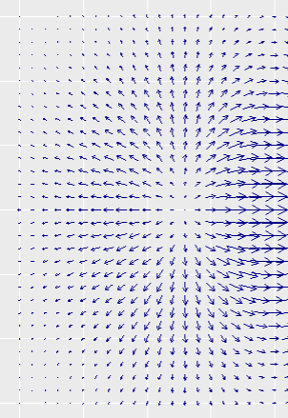
Task 1: Direct vector field visualisation
Direct vector field visualization uses glyphs to indicate the vector direction and magnitude of the field at a subset of the points in space. It is useful for visualizing spatially autocorrelated vector field data (i.e., the lines run into each other), and fields with sparse structure (e.g., fields that have only one or two major features. The following R code snippets require the pracma, tidyverse and ggquiver libraries.
Step 1: Create a grid of values in 2D coordinate space
sp = 0.1 #Grid spacing
x_points = seq(-2, 2, by = sp)
y_points = seq(-1.5, 1.5, by = sp)
X = matrix(x_points, nrow = length(y_points), ncol = length(x_points),byrow=TRUE)
Y = matrix(y_points, nrow = length(y_points), ncol = length(x_points),byrow=FALSE)
xy_pairs = unique(expand.grid(x = as.vector(X), y = as.vector(Y))) #Get unique pairs of gridpoints
Step 2: At each point in (x,y) space, generate a third dimension
z = function(x){ x[1] * exp(-x[1]^2 - x[2]^2) }
Z = matrix(apply(data.frame(xy_pairs),1,FUN=z),nrow = length(y_points), ncol = length(x_points),byrow = TRUE)
Step 3: Create a vector field from the gradients of this landscape in the x and y directions:
Vx = gradient(Z,h1 = sp, h2 = sp)$X
Vy = gradient(Z,h1 = sp, h2 = sp)$Y
Step 4: Visualise the vector field using ggplot, and geom_quiver() from the ggquiver library (hint: you will need to think about how to reshape the data into an appropriate form for ggplot).
Note: this is not the complete vector field

Slide 3
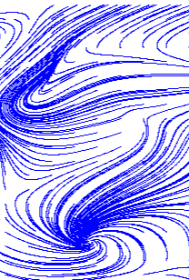
Task 2: Streamline visualisation
Integral vector field visualisation may also use glyphs, but they convey the integral (i.e., longer-term) behaviour of the field.
Step 1: Load the .RDS files Vx.RDS and Vy.RDS (from Canvas). These contain (respectively) the x and y velocities for a 2D vector field of size 400x400.
Step 2: Visualise the field using streamlines with regularly spaced start positions.
Define a suitable grid
Choose a set of regularly spaced seed points for streamlines (points in the grid to initialise streamlines)
Create streamlines starting from these positions, by following the vector field, i.e.
  Starting from a seed point, corresponding to an initial (x,y) pair, get the corresponding velocity (from Vx and Vy).
  Use this velocity to compute steps dx and dy, and follow the vector field (e.g. update x and y locations after taking a step (dx,dy): x <- x + dx, y <- y + dy)
    You can use Vx and Vy directly as steps (e.g. dx = Vx[x location, y location], however for smooth streamlines, you may wish to scale the velocity when computing steps; dx = h*Vx[x location, y location], 0<h<1)
  Take some appropriately chosen number of steps along the streamline/following the vector field (repeating the above process)
  Record which have been ‘visited’ by a streamline to build the image
  Repeat for all seed points
Note: You will need to work out how to handle the boundaries of your grid (when/how to stop computing streamlines so you do not leave the grid)
Step 3: Choose different numbers of streamlines, different placements, and different number of steps per streamline, to improve the visual appeal and clarity of the streamlines.
Not: Similar results can be achieved in MATLAB using the stream2() and/or streamline() functions. This task must be completed in R.
Hint: better results are obtained if streamlines are drawn in both directions, i.e., following the velocity field both forwards and backwards from the seed point.
Note: this is not the complete vector field

Slide 4
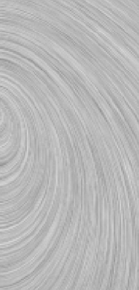
Task 3: Line Integral Convolution
Line integral convolution (LIC) is another integral-based method of visualizing vector fields, by convoluting random data fields. It can produce clear visualisations of complex vector fields without visual clutter.
We can think of the streamlines we constructed in the previous task as representing line integrals over a vector field. To perform LIC, we start with a random data field (white noise, e.g. a grid with elements generated by runif()). We then move along each streamline, accumulating these random data values.
Step 1: Create a grid (e.g.):
x_points = seq(1,400, by = 1)
y_points = seq(1,400, by = 1)
X = matrix(x_points, ncol = length(y_points), nrow = length(x_points),byrow=FALSE)
Y = matrix(y_points, ncol = length(y_points), nrow = length(x_points),byrow=TRUE)
Step 2: Construct the following velocity field:
Vx = X*(-Y + 200 - X)
Vy = Y*(X + 200 - Y)
Step 3: Compute streamlines (Choose the length of the integration, and the stepsize, carefully)
For LIC all points in the grid should be seed points for streamlines – this can be computationally expensive; however, each individual streamline does not need to be as long as the streamlines in Task 2 to get a reasonable quality LIC image.
You are encouraged to reuse your code from Task 2 to compute the streamlines. If you were not able to compute streamlines in Task 2, you may wish to use stream2() in MATLAB (and then save the results in a format that you can work with in R).
Note: this is not the complete vector field

Slide 5
Task 3: Line Integral Convolution
Step 4: For each grid point, travel along the streamline, accumulating all the values of the random data as you go. The following is pseudocode only, and will not run:
LIC <- matrix(0, nrow = nrow(X), ncol = ncol(X))
for (<each Steamline>) {
xi,yi: <(x,y) pair of streamline seedpoints>
for (<each point along streamline>) {
#over each point in the streamline, accumulate the random value
LIC[xi,yi] <- LIC [xi,yi] + RandomTexture[<closest x to current point along streamline>,<closest y to current point along streamline>]
}
}
Step 5: Visualise the LIC using a function such as heatmap or image in R, e.g.:
heatmap(as.matrix(LIC),Rowv=NA, Colv=NA,col=gray.colors(256))
image(x_points, y_points,t(LIC), col = gray.colors(256))
Notes:
For heatmap, the Rowv=NA and Colv=NA arguments prevent R from re-ordering the elements of LIC and adding a dendrogram
For image, we input the transpose of LIC: t(LIC) (from ?image: “…image interprets the z matrix as a table of f(x[i], y[j]) values, so that the x axis corresponds to row number and the y axis to column number, with column 1 at the bottom, i.e. a 90 degree counter-clockwise rotation of the conventional printed layout of a matrix”. Look into Normalized Device Coordinates for further information.
Note: this is not the complete vector field

Slide 6
Task 3: Line Integral Convolution
(Optional extensions)
Some hints for the best LIC result:
Some streamlines might be shorter than others due to leaving the domain before the maximum number of steps is reached. This means some seed points will be darker. Can you correct for this?
Streamlines can “slow down” in regions where the vector field has a small magnitude (the vectors magnitude can be computed as sqrt(vx^2 + vy^2)). Consider normalising the velocity before taking a step in the streamline.
(To normalise a vector is to divide it by its magnitude so the new vector’s magnitude is 1)
Note: this is not the complete vector field

Slide 7
Tasks for Computer lab portfolio
The following tasks are to be completed using R (include code and the specified visualisations in any standard format):
Direct vector field visualisation using a quiver plot (as described in Task 1).
Integral vector field visualisation using streamlines (one good visualisation and one poor visualisation, as described in Task 2).
Line integral convolution for vector field visualisation (as described in Task 3).

