Slide 1
Visualising High Dimensional Data

Slide 2
PCA vs LDA
Principal component analysis (PCA) is an unsupervised dimensional reduction method. It produces a set of orthonormal basis vectors, which can be used to reduce the dimensionality of a dataset while retaining a large proportion of the variance in the dataset. It is based on an eigenvalue/vector decomposition of the data’s correlation matrix.
Linear discriminant analysis (LDA) is a supervised dimensional reduction technique. It works by projecting a higher dimensional dataset down onto a lower dimensional space, generally a single line. The best projection is the one that maximises Fisher’s linear discriminant – a metric that compares the variation between different groups, with the variation among the groups.
This week, we look at a first principles application of these techniques in R.

Slide 3
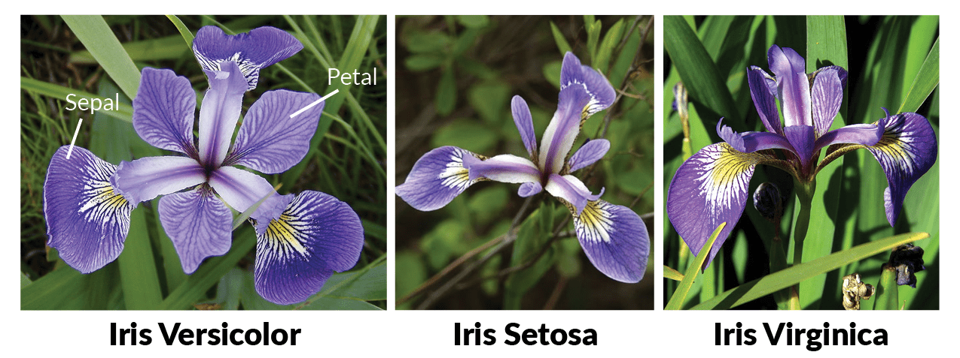
Principal component analysis
Step 1: Load the iris flower dataset constructed by Ronald Fisher
data(iris)

Slide 4
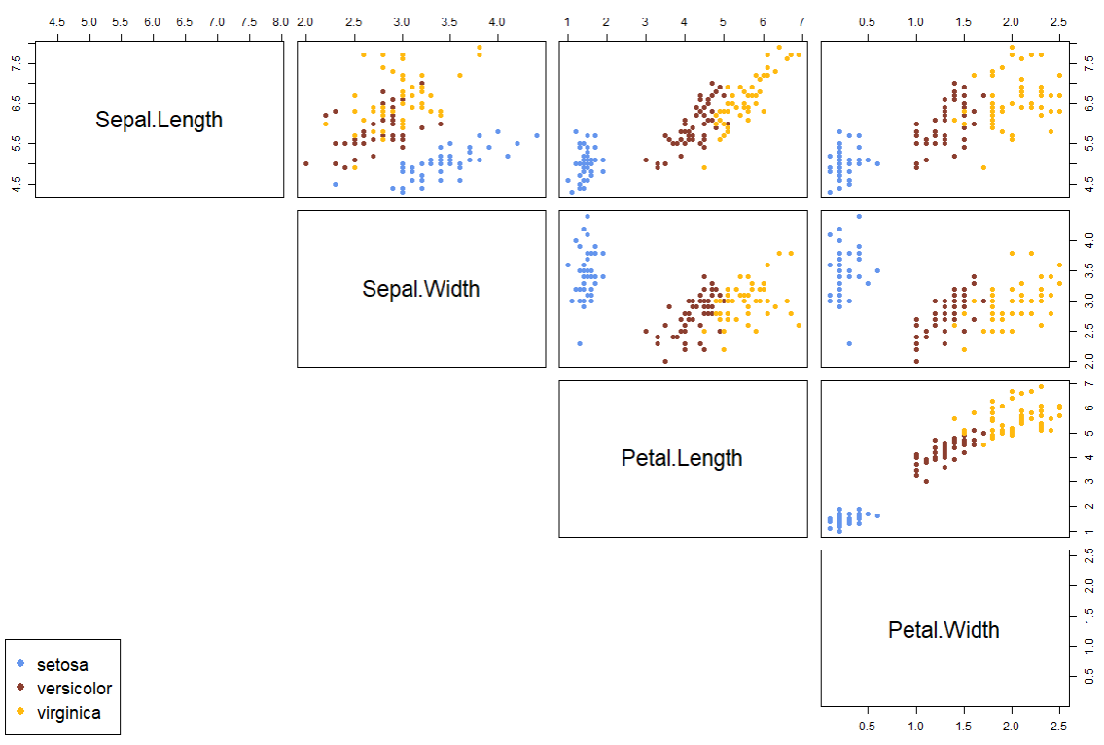
Principal component analysis
Step 2: Produce a scatter plot of each dimension of the dataset against each other dimension (i.e., a 𝑝-by-𝑝 grid). Colour code the different species.
In base R, you can achieve this using the pairs() function.

Slide 5
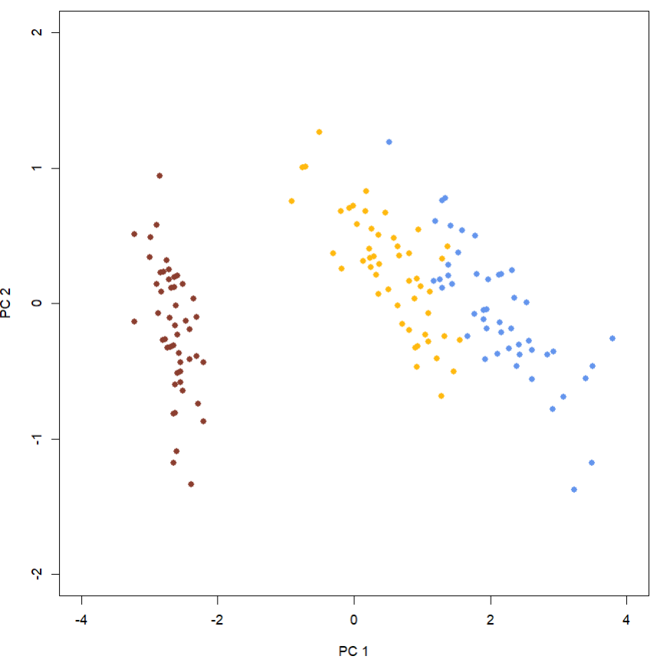
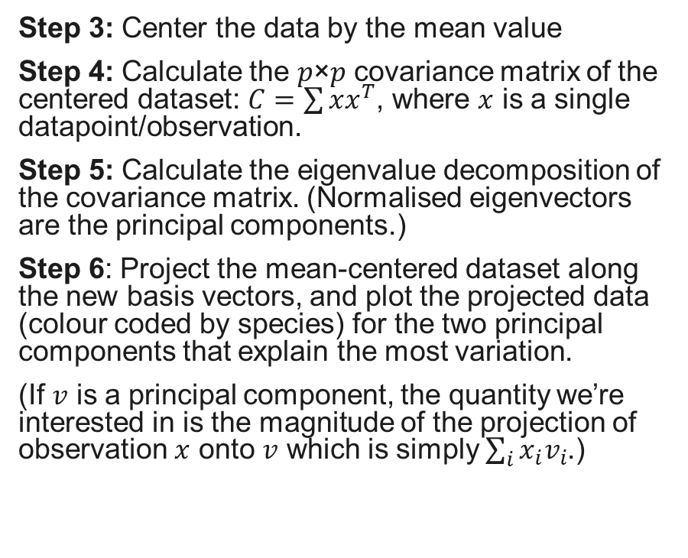
Principal component analysis
Step 3: Center the data by the mean value
Step 4: Calculate the 𝑝×𝑝 covariance matrix of the centered dataset: $C=\sum{xx^{T}}$, where $x$ is a single datapoint/observation.
Step 5: Calculate the eigenvalue decomposition of the covariance matrix. (Normalised eigenvectors are the principal components.)
Step 6: Project the mean-centered dataset along the new basis vectors, and plot the projected data (colour coded by species) for the two principal components that explain the most variation.
(If $v$ is a principal component, the quantity we’re interested in is the magnitude of the projection of observation $x$ onto $v$ which is simply $\sum_{i}{x_{i}v_{i}}$.)

Slide 6
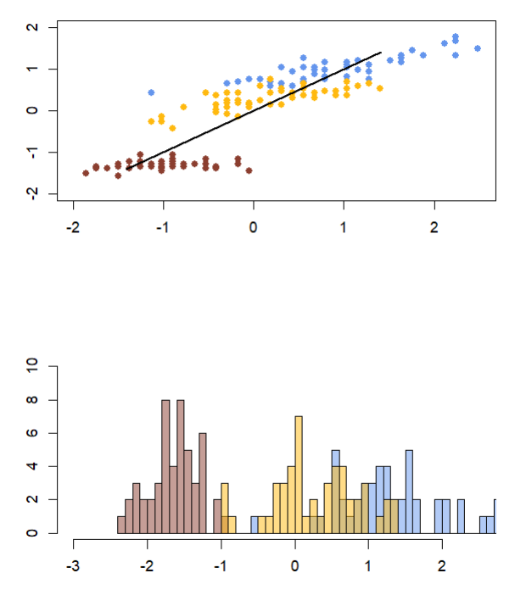
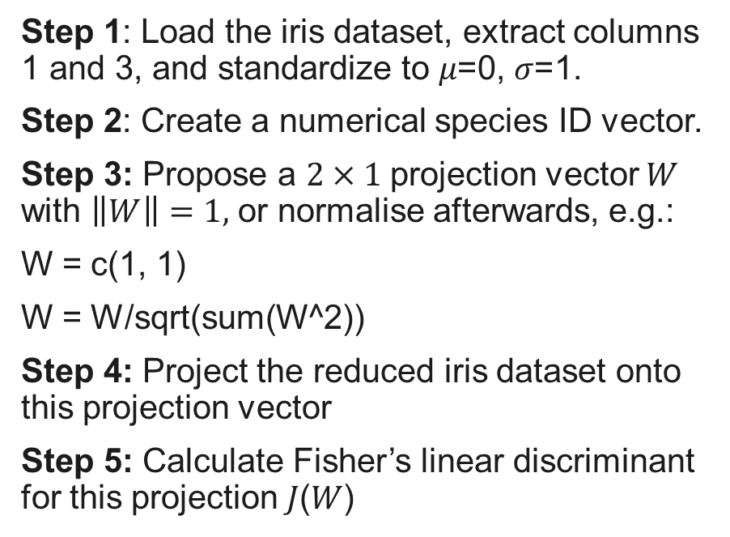
Linear Discriminant Analysis
Step 1: Load the iris dataset, extract columns 1 and 3, and standardize to 𝜇=0, 𝜎=1.
Step 2: Create a numerical species ID vector.
Step 3: Propose a $2×1$projection vector $W$ with $\left\|W\right\|=1,$ or normalise afterwards, e.g.:
W = c(1, 1)
W = W/sqrt(sum(W^2))
Step 4: Project the reduced iris dataset onto this projection vector
Step 5: Calculate Fisher’s linear discriminant for this projection 𝐽(𝑊)
Note: W=(1,1), shown here, does a poor job of separating the different species

Slide 7
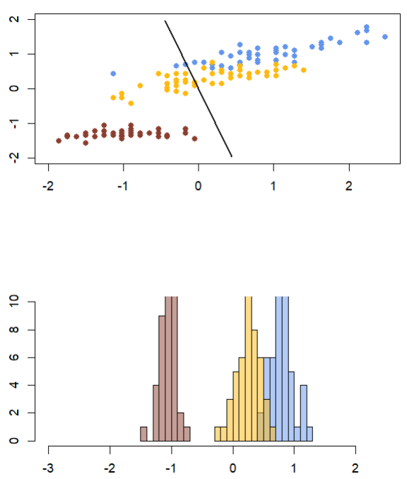
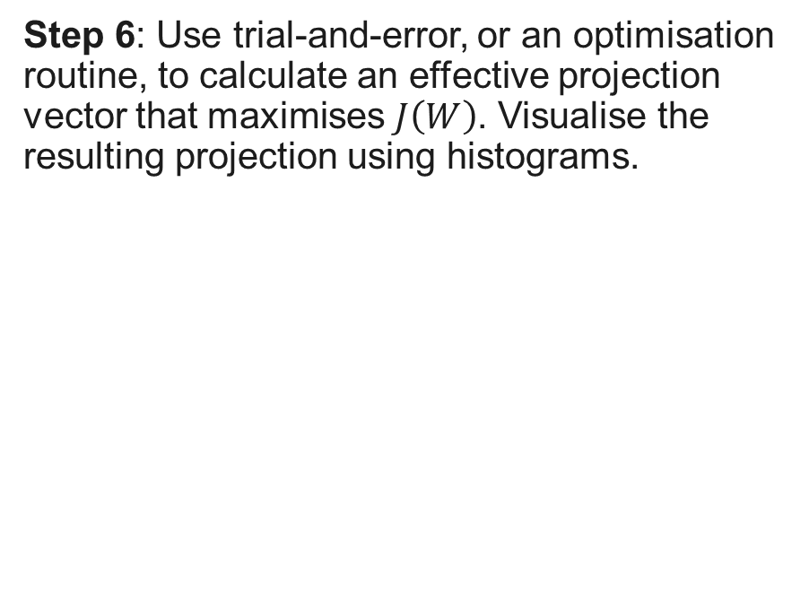
Linear Discriminant Analysis
Step 6: Use trial-and-error, or an optimisation routine, to calculate an effective projection vector that maximises $J\left(W\right)$. Visualise the resulting projection using histograms.
Note: This projection vector does a much better job

Slide 8
Tasks for Computer lab portfolio
The following tasks are to be completed using R:
A scatter plot of each dimension of the dataset against each other dimension. Colour code the different species.
A scatter plot of the data projected onto the two principal components that explain the most variation.
Calculate a good projection vector for applying LDA to the first two dimensions of the iris dataset. Report both the 2x1 vector W and the value of J(W).
A visualisation of the iris data along this projection vector, showing how it separates the different species of flower.

