Slide 1
Volume Visualisation 2

Slide 2
A simple volume renderer
You have been supplied with a data volume, DiCubic.mat, a 256 x 256 x 54 MRI scan of a portion of a human head. Write an R script that loads and then analyses the Di array as follows (recall that the readMat from the R.matlab library can be used to load .mat files in R):
Denote the elements of Di as (x,y,z),
where x = 1:256, y = 1:256 and z = 1:54.
At each point (x,y) of Di, sum the values over all z and put them in an array called I. That is, I(x1,y1) = Di(x1,y1,1) + Di(x1,y1,2) + …+ Di(x1,y1, 54).
hint - use the sum command or a for loop.
Display the matrix I using image command and a gray scale colourmap.
The small script you have just written is in fact a very simple volume renderer. Describe the simple volume renderer you have just written.
What blending mode does it implement?
Modify your volume renderer to use Maximum Intensity Projection (MIP).

Slide 3
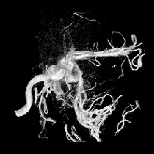
A simple volume renderer (continued)
The file aneurism.mat contains an MRI scan of an aneurism located in the brain.
Using your simple volume renderer, create average
value (X-Ray) and MIP volume renderings of this data set.
Try various colourmaps on the aneurism renderings, and compare the results you get from using each blending technique from the previous slide.

Slide 4
Common Ray Traversal Blending Modes
Max
Intensity
Average
Accumulate or Composite
Depth along ray

Slide 5
A compositing, ray casting volume render
We will now develop another volume rendering of the MRI data. This time, we will composite the final rendered image.
In order to composite an image, we need to “light” the volume. That is, we need to associate a colour (grey scale in this case) and opacity value at each point in the volume.
Two simple transfer functions will do this:
alpha(x,y,z) = Di(x,y,z)/maxDi, where, maxDi is the maximum value in the volume.
C(x,y,z) = Di(x,y,z), that is, grey colour intensity equals the volume data.
Using the transfer functions defined above for the volume Di, write a compositing version of your volume renderer using front-to-back compositing (see next slide).
Generate a composited volume rendering of the aneurism scan.

Slide 6
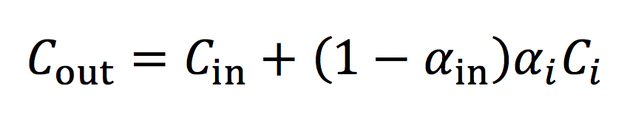
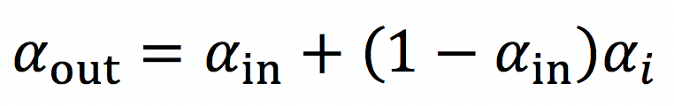
A compositing, ray casting volume render (continued)
Classical Approach – Front-to-back Compositing
Approximation of volume rendering integral
is usually calculated using the recursive formulas:
C_{in}
α_{in}
Given: C_{i}
α_{i}
Calculate:
C_{out}
α_{out}
Attenuation is:
  Conserved
  Compounded by local density
  (a photon survived, and then was absorbed)
C_{in}
α_{in}

Slide 7
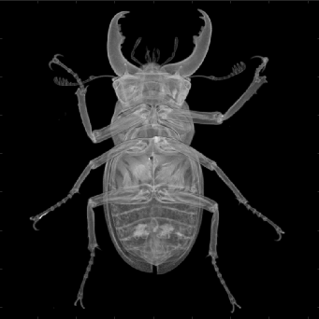
Task 1: Volume rendering (R)
Download the micro-CT scan of a staghorn beetle in .raw format:
stag_beetle_832x832x494_uint16.raw
Use the following R commands to load and reshape the data:
fid <- file('stag_beetle_832x832x494_uint16.raw', 'rb')
beetle_data <- readBin(fid, 'integer', n = 832*832*494, size = 2,
signed = FALSE)
close(fid)
beetle_data <- array(beetle_data, dim = c(832, 832, 494))
Use the simple volume renderer you created previously to produce a greyscale visualisation of the structure of the animal, with a perspective from below.
The example image here uses a compositing, ray casting approach to produce an even higher quality render. Feel free to experiment!

Slide 8
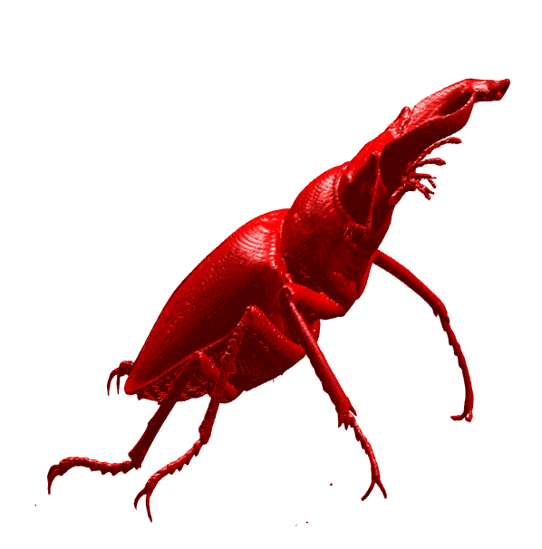
Task 2: More volume rendering (MATLAB)
One technical aspect of volume visualisation that MATLAB excels at is dynamic lighting. Load the stag beetle data into MATLAB:
fid = fopen('stag_beetle_832x832x494_uint16.raw','r');
data = fread(fid, 832*832*494, 'uint16');
fclose(fid);
Use the isosurface command to create a surface at the density value of outer chitin:
D = D(1:3:end,1:3:end,end:-3:1);
x = 1:size(D,1);
y = 1:size(D,2);
z = 1:size(D,3);
Choose an ISOVALUE that produces a clear visualisation:
surface = isosurface(x,y,z,D,ISOVALUE);
p = patch(surface, 'FaceColor', 'red', 'EdgeColor', 'none');
lighting gouraud
axis vis3d off
set(gcf,'color','w')
Rotate the visualisation & alter lighting:
for t = 1:720
view([-75+t,19])
pause(0.025)
if t == 1 | t == 181
camlight
end
end
Find a good ISOVALUE and viewing angle and include this visualisation in your computer lab portfolio.

Slide 9
Tasks for Computer lab portfolio
The following tasks are to be completed using R (include code and the specified visualisations in any standard format):
A greyscale visualisation of the internal and external structure of the stag beetle, with a perspective from below.
The following tasks are to be completed using MATLAB (include code and the specified visualisation in any standard format):
A coloured isosurface of the stag beetle with an appropriately chosen ISOVALUE and viewing angle that produce a clear volume visualisation.

