Slide 1
Visualising Uncertainty

Slide 2
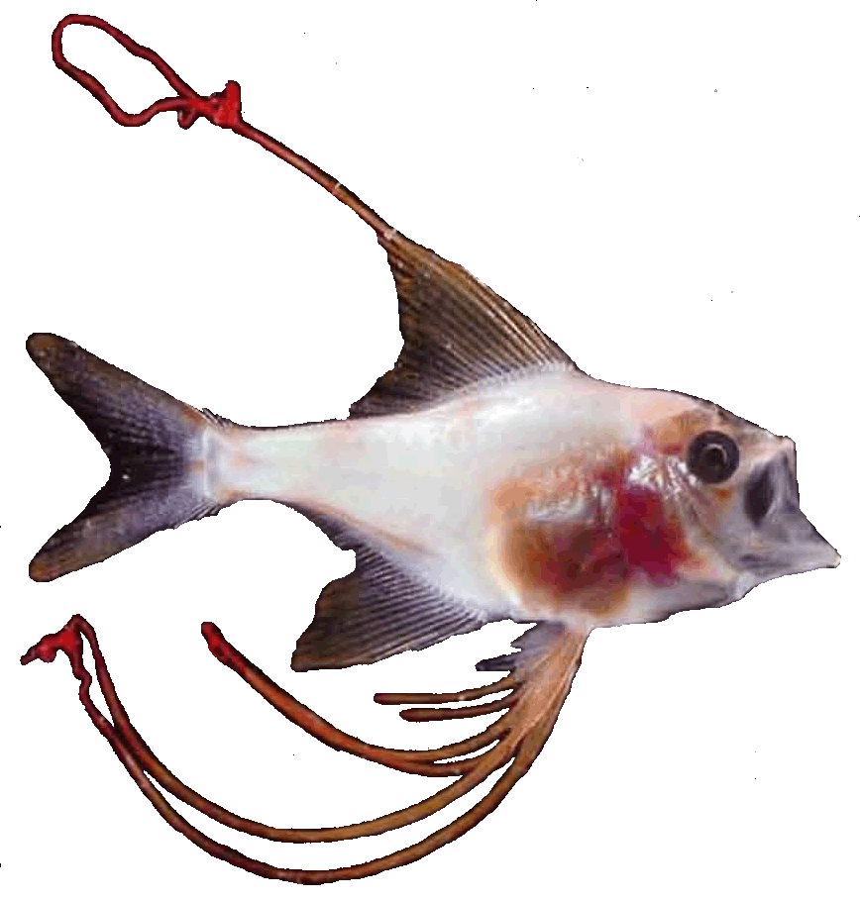
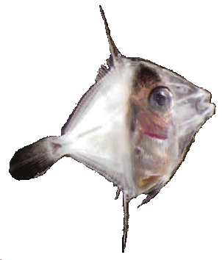
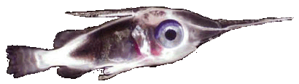
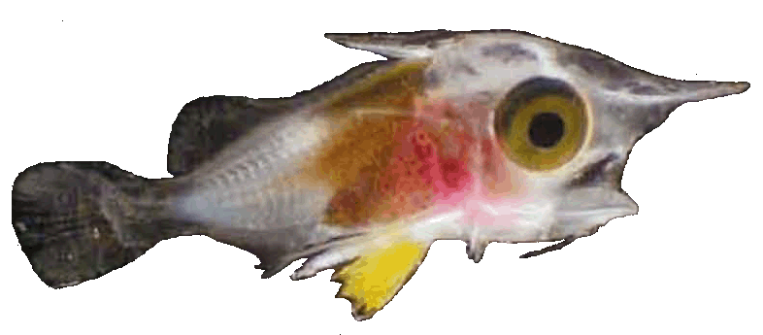
Task 1: Visualising spatial uncertainty (MATLAB)
Coral reef fish larvae spend a long time in the open ocean (pelagic) environment before they choose a location to spend their adult life.
The hydrodynamic flow structure of the ocean environment is highly sensitive to initial conditions. Two larvae who leave the same reef at the same time can end up in very different destinations.
Visualising this uncertainty is important for communicating how hard fisheries management is. If we can’t predict where baby larvae come from and travel to, we can’t plan our fishing quotas for next year.

Slide 3
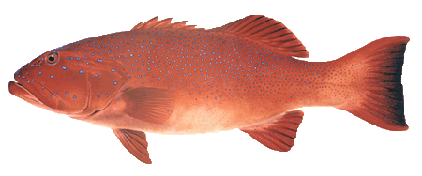
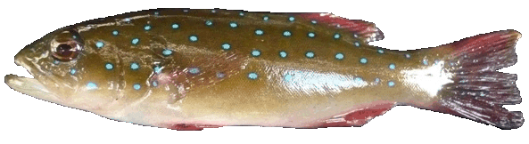
Task 1: Visualising spatial uncertainty (MATLAB)
We will model the possible destinations of coral reef fish larvae that were spawned on Egg Rock in the Keppel Islands group, on July 26, 2011.
Plectropomus maculatus
Egg Rock, Keppel Islands

Slide 4
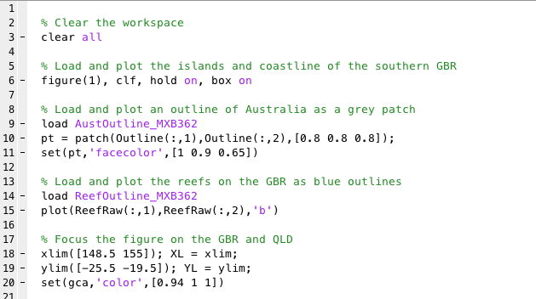
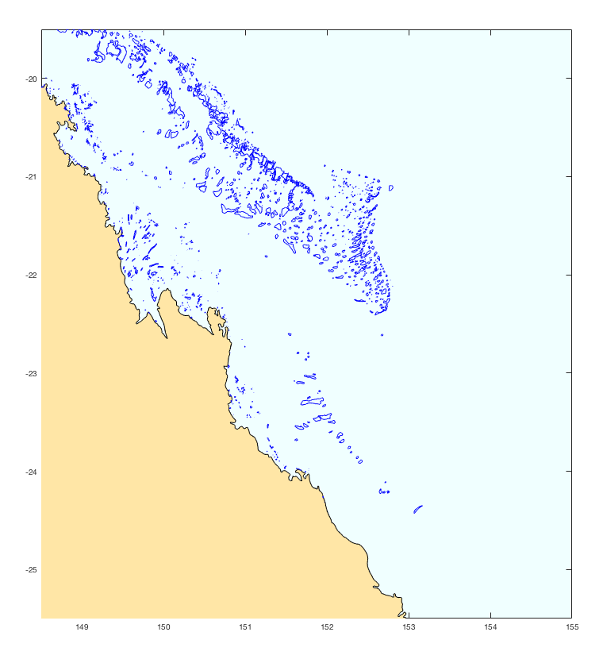
Task 1: Visualising spatial uncertainty (MATLAB)
For this task, we will use MATLAB to produce an animation of spatial data over time to communicate uncertainty. Begin by re-creating a simple map of the Great Barrier Reef (from the first practical).

Slide 5
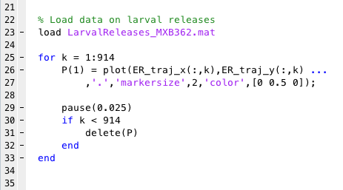
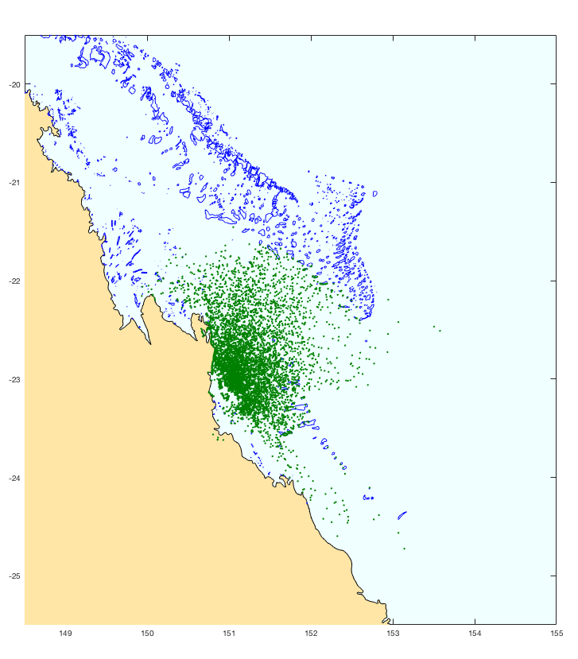
Task 1: Visualising spatial uncertainty (MATLAB)
Now create an animated cloud of releases using the data in LarvalReleases_MXB362.mat

Slide 6
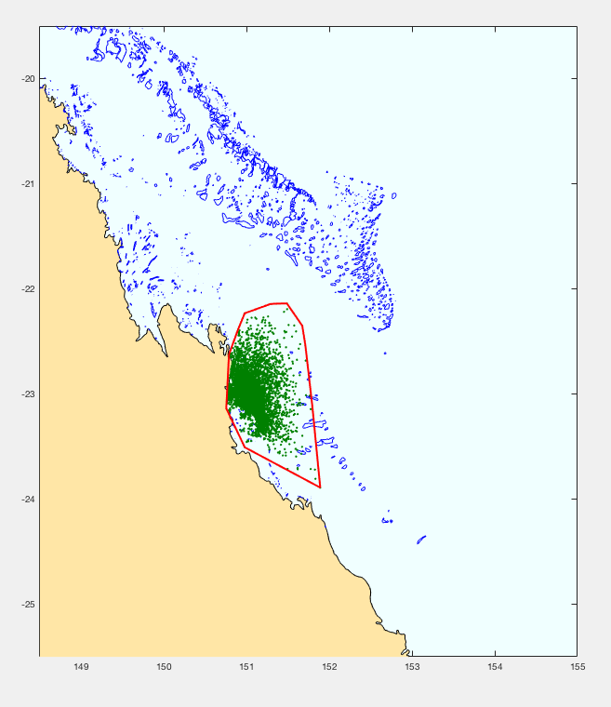
Task 1: Visualising spatial uncertainty (MATLAB)
Now create an animated cloud of releases using the data in LarvalReleases_MXB362.mat
At each timestep, create a method for describing the overall distribution of the larvae (and thus the spatial uncertainty) in some way.
Options include convex hulls (see figure to right), contour maps, density kernels, 2D histograms, etc.
Produce a .gif file animation of the dispersal uncertainty

Slide 7
Task 2: Visualising multiple types of uncertainty (R)
Forecasts of ecological systems contain three forms of uncertainty:
Stochastic variation
  Species’ dynamics often vary through time as a result of environmental stochasticity (e.g., climatic variation), and demographic stochasticity (e.g., the chance variation in population rates that result from a finite population).
Structural uncertainty
  We don’t always know which animals interact with each other, or the spatial distributions of their populations, or the functional forms of their relationships (among many other factors).
Scenario uncertainty
  We don’t know how human interactions with ecosystems will change in the future, and these depend on currently unknowable choices. For example, will people stop wanting to purchase rhino horns, or travel to South Africa for trophy hunting.
The different consequences of different types of uncertainty should often be clearly distinguishable.

Slide 8



Task 2: Visualising multiple types of uncertainty (R)
Consider a model for the dynamics of a simple fishery population, N, incorporating multiplicative normal variation about the intrinsic growth rate, r, and per-capita harvest rate, h:
Where and . The parameter K represents some carrying capacity and the exponent z is a constant governing the growth dynamics.

Slide 9
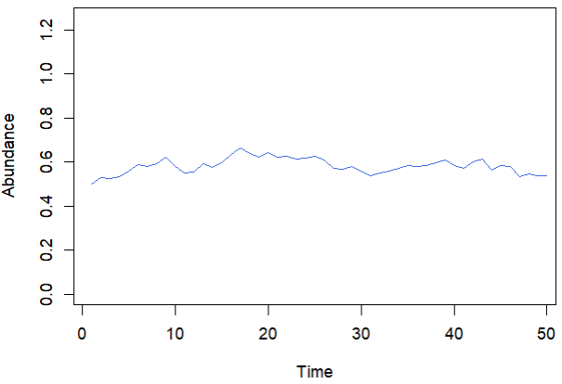
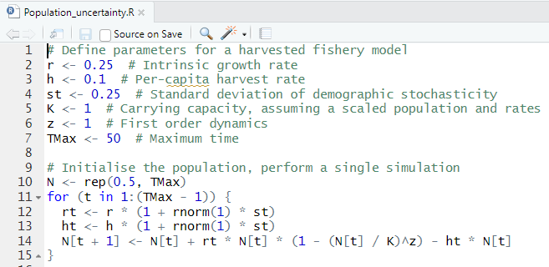
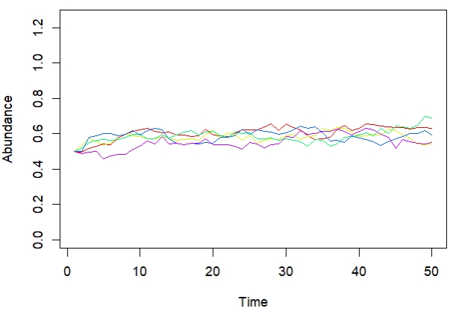
Task 2: Visualising multiple types of uncertainty (R)
(a)
The result of one simulation is presented in Figure (a). The results of five simulations are presented in Figure (b). Why do the results differ? What type of uncertainty is this?
(b)

Slide 10
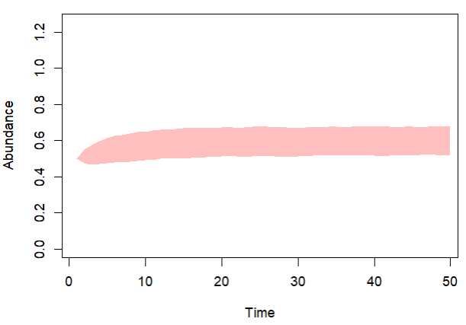
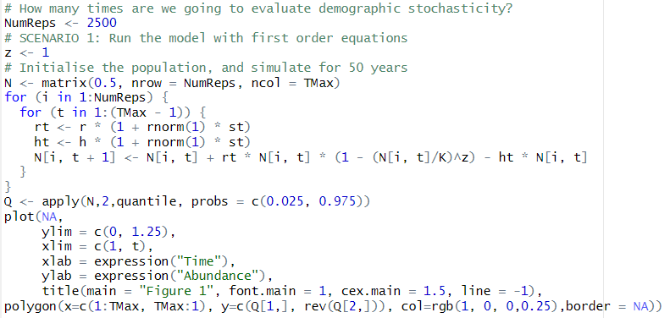
Task 2: Visualising multiple types of uncertainty (R)
We can explore the uncertainty associated with stochastic variation by repeating the simulation many times:

Slide 11
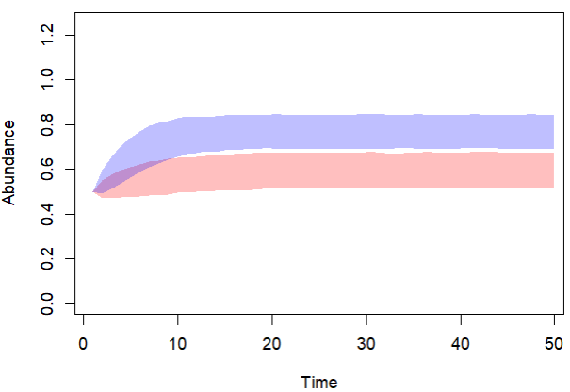
Task 2: Visualising multiple types of uncertainty (R)
Forecast the abundance of the population under different forms of uncertainty:
Demographic uncertainty – allow the harvest rates and population growth rates to vary with multiplicative noise, centred on one, with standard deviations of 0.25;
Structural / Parametric uncertainty – consider the possibility that the exponent z is either 1 or 2.
Scenario uncertainty – assuming the exponent z is 1, consider the possibility that the harvest rates double from current rates (i.e., change from h = 0.1 to h = 0.2);
For each form of uncertainty, choose a way to visualize the timeseries uncertainty (e.g., the figure on the right uses quantile shading).
Label the figure appropriately and add a legend.

Slide 12
Tasks for Computer lab portfolio
The following tasks are to be completed using MATLAB (include code and the specified animation in any standard format):
Animation of uncertainty surrounding larval cloud through time. Does not need to be a convex hull.
The following tasks are to be completed using R (include code and the specified visualisation in the specified format):
TIFF file showing the effects of different forms of uncertainty. Show three forms, with appropriate labels and legend.

