Slide 1

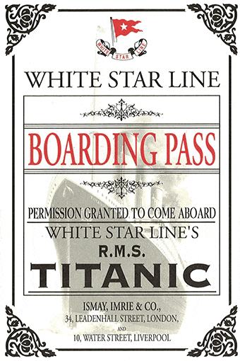
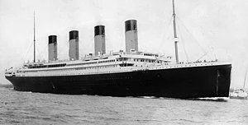
Final Project
RMS Titanic Survival

Slide 2
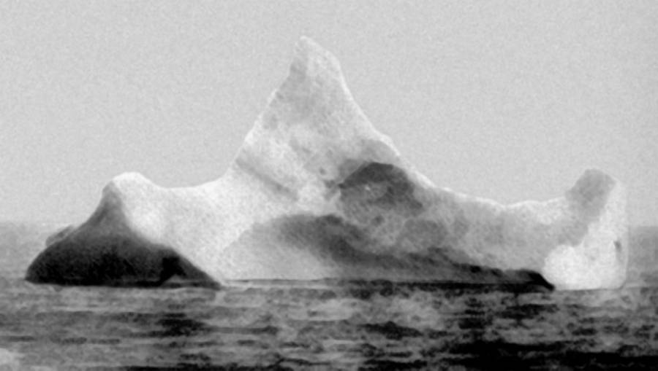
The Team!
Owen “Iceman” Meyer
“The Unsinkable” Michelle Bannon
Rob “White Star” Bowen
Colin “The Lifeboat” Daniels

Slide 3
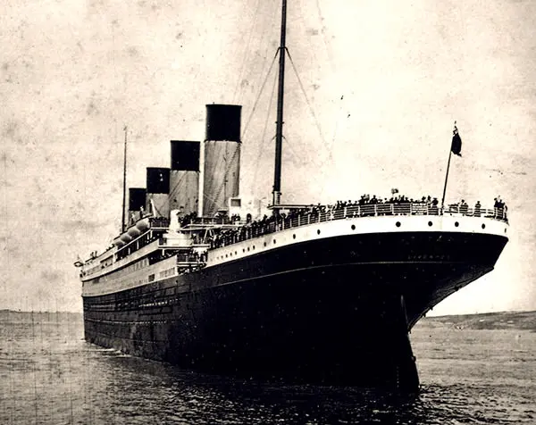
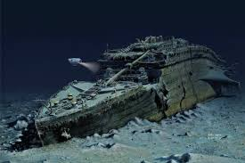
Background
Shortly before midnight on April 14, 1912, on her first Trans-Atlantic Voyage from Southampton, UK to New York, NY, the Royal Mail Ship (RMS) Titanic struck an iceberg setting in motion one of the greatest tragedies in history.
Shortly after 2 A.M (less than 3 hours later) on the morning of 15 April 1912, the Titanic sank beneath the waves taking with it almost two-thirds of the passengers and crew (more than 1500 lives lost).
Analysis of this tragic accident has generated many theories and hoaxes but has led to an amazing collection of information and imagery of the famous ship and its passengers.
This analysis seeks to explore the idea that passenger survival of this tragedy can be predicted based on demographic (age, gender, ticket (social) class) data.

Slide 4
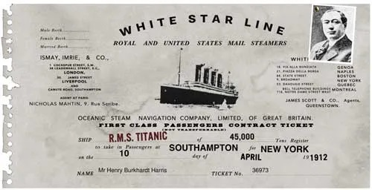
Predicting Survival
Can Machine Learning be used to predict the likelihood of survival of a passenger on the RMS Titanic based on:
Age
Gender
Ticket Class (1st, 2nd, 3rd)
# of Spouses or Siblings Onboard
Parent or Child
Fare Paid

Slide 5
Predicting Survival
Model Types
Support Vector Machine
Logistic Regression
Neural Network
Split Data
Feature Importance
Hypertuning
Evaluate

Slide 6
Project Design
Lat/ Long Data
Data Cleaning
titanicDataSet_LatLong.csv
Data Visualization
titanicDataSet.csv
Webpage
Webpage
Machine Learning

Slide 7
Project Challenges
Data Cleaning
Spelling: Names and Ages inconsistently recorded between different data sets – Manual Scrub
Missing Data - Cross referenced multiple datasets to fill in gaps
Hometowns not on the map - Used Google Places API to pull Lat/Long

Slide 8
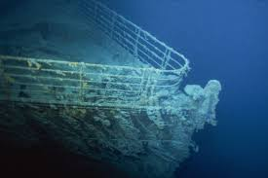
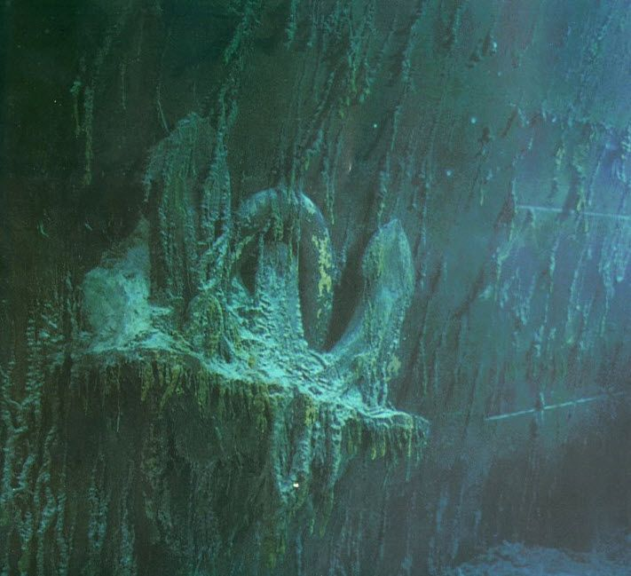

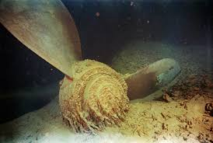
Demonstration

Slide 9
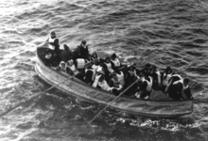
Wish List
Find salary data:
Filter by Salary
Average salary on map
Compare salary by job type/title
Wrapping large histogram labels
Precise location by address
Export utility on search (csv, json)
Set page length with scrollable list

