Slide 1
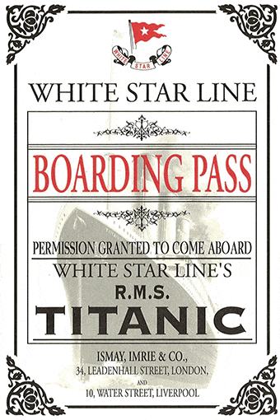
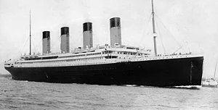
Titanic Data Webpage
RMS Titanic Survival

Slide 2
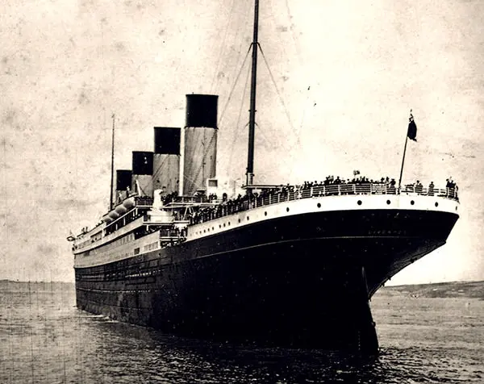
Background
Analysis of this tragic accident has generated many theories and hoaxes but has led to an amazing collection of information and imagery of the famous ship and its passengers.
This analysis seeks to explore the idea that passenger survival of this tragedy can be predicted based on demographic (age, gender, ticket (social) class) data.
Shortly before midnight on April 14, 1912, on her first Trans-Atlantic Voyage from Southampton, UK to New York, NY, the Royal Mail Ship (RMS) Titanic struck an iceberg setting in motion one of the greatest tragedies in history.
Shortly after 2 A.M (less than 3 hours later) on the morning of 15 April 1912, the Titanic sank beneath the waves taking with it almost two-thirds of the passengers and crew (more than 1500 lives lost).

Slide 3
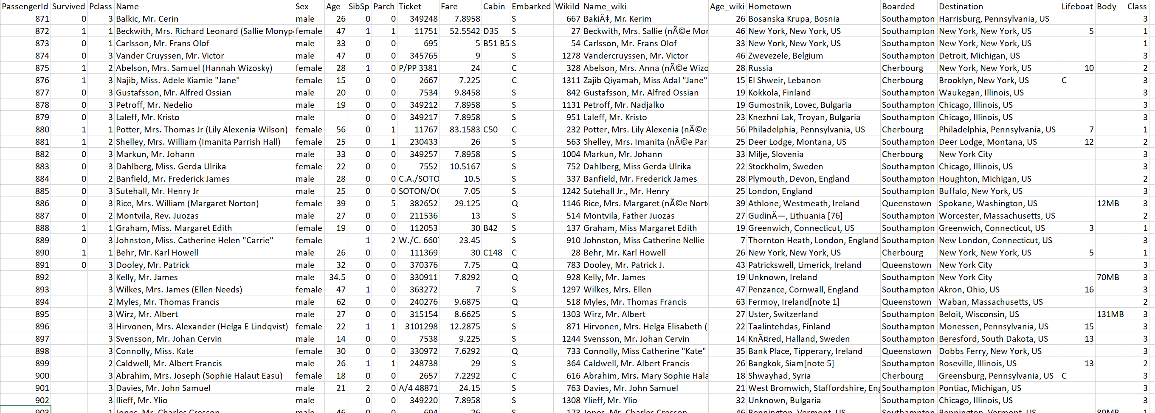
Raw Data
Cleaning
Spelling (Cities, Names)
Missing Values (Survival)
Number Format (Fare)

Slide 4
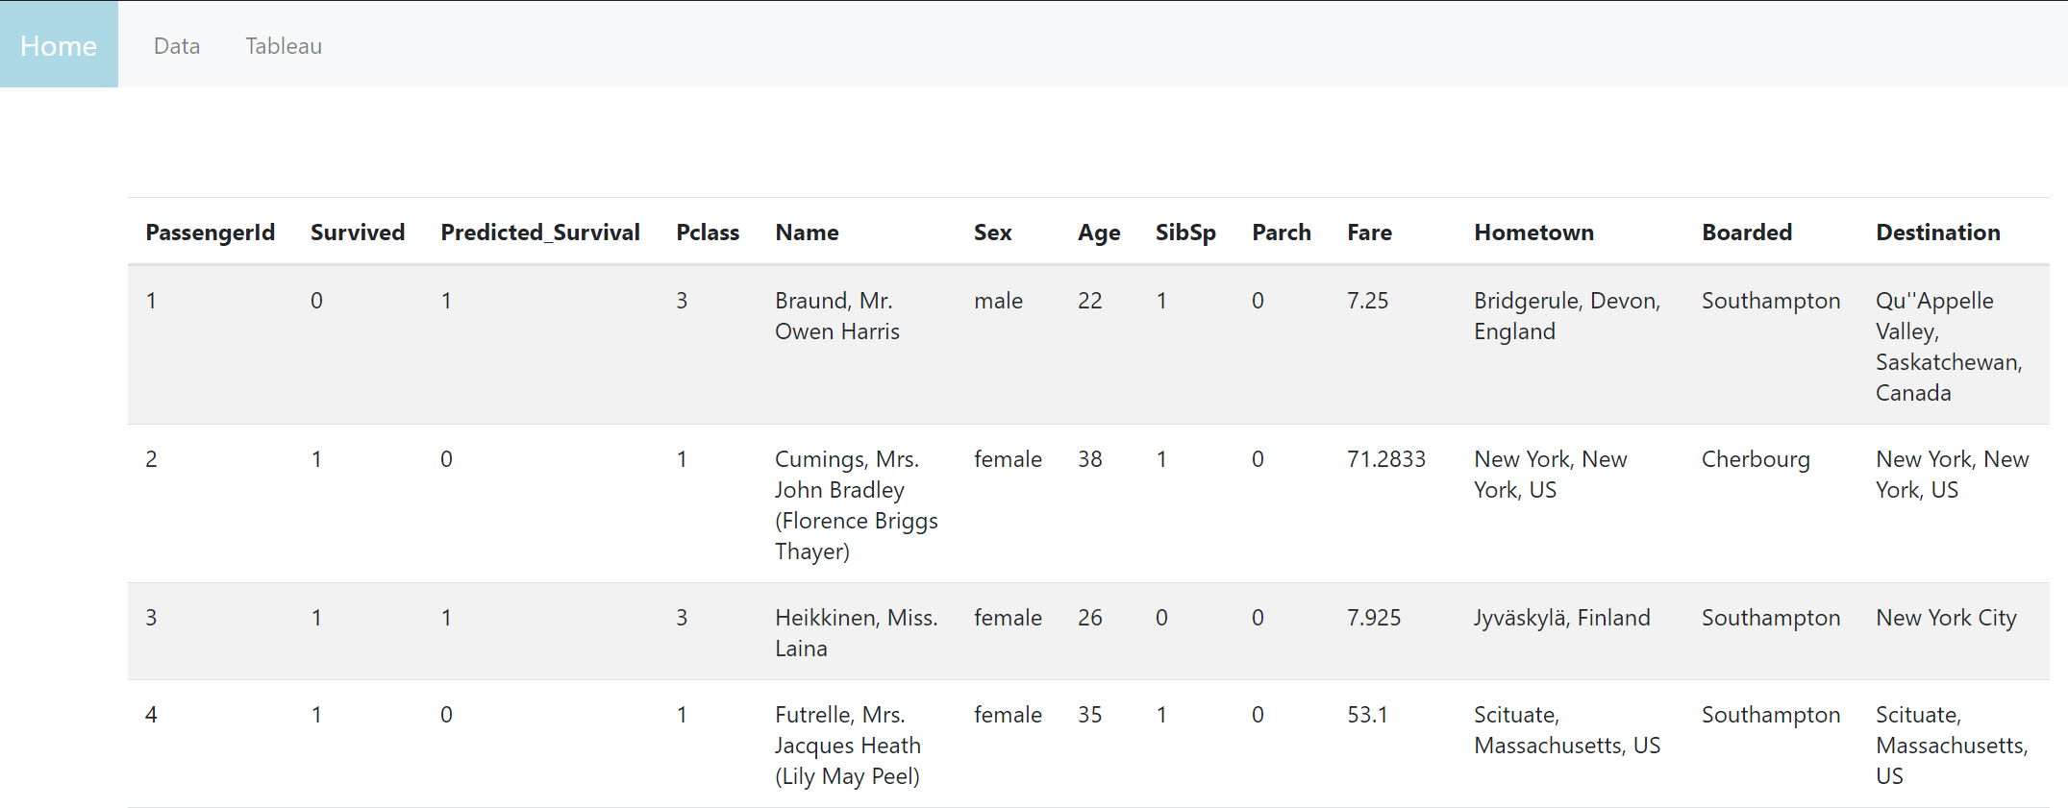
Data Display
Python Flask Backend
Load CSV data
Pass data to/from noSQL database (mongo)
Pass data to JS via render_template
From Machine Learning Results

Slide 5
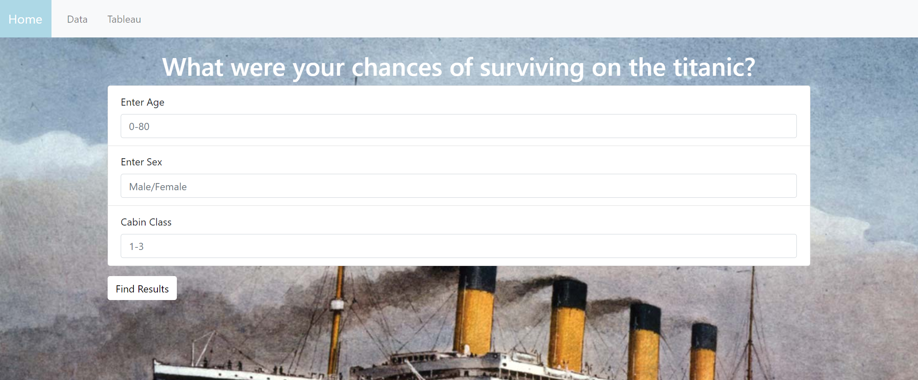
Data Filter
Form submission
Get query string from URL on form submission
Filter data in python
Pass data to JS via render_template / redirect to data page

Slide 6
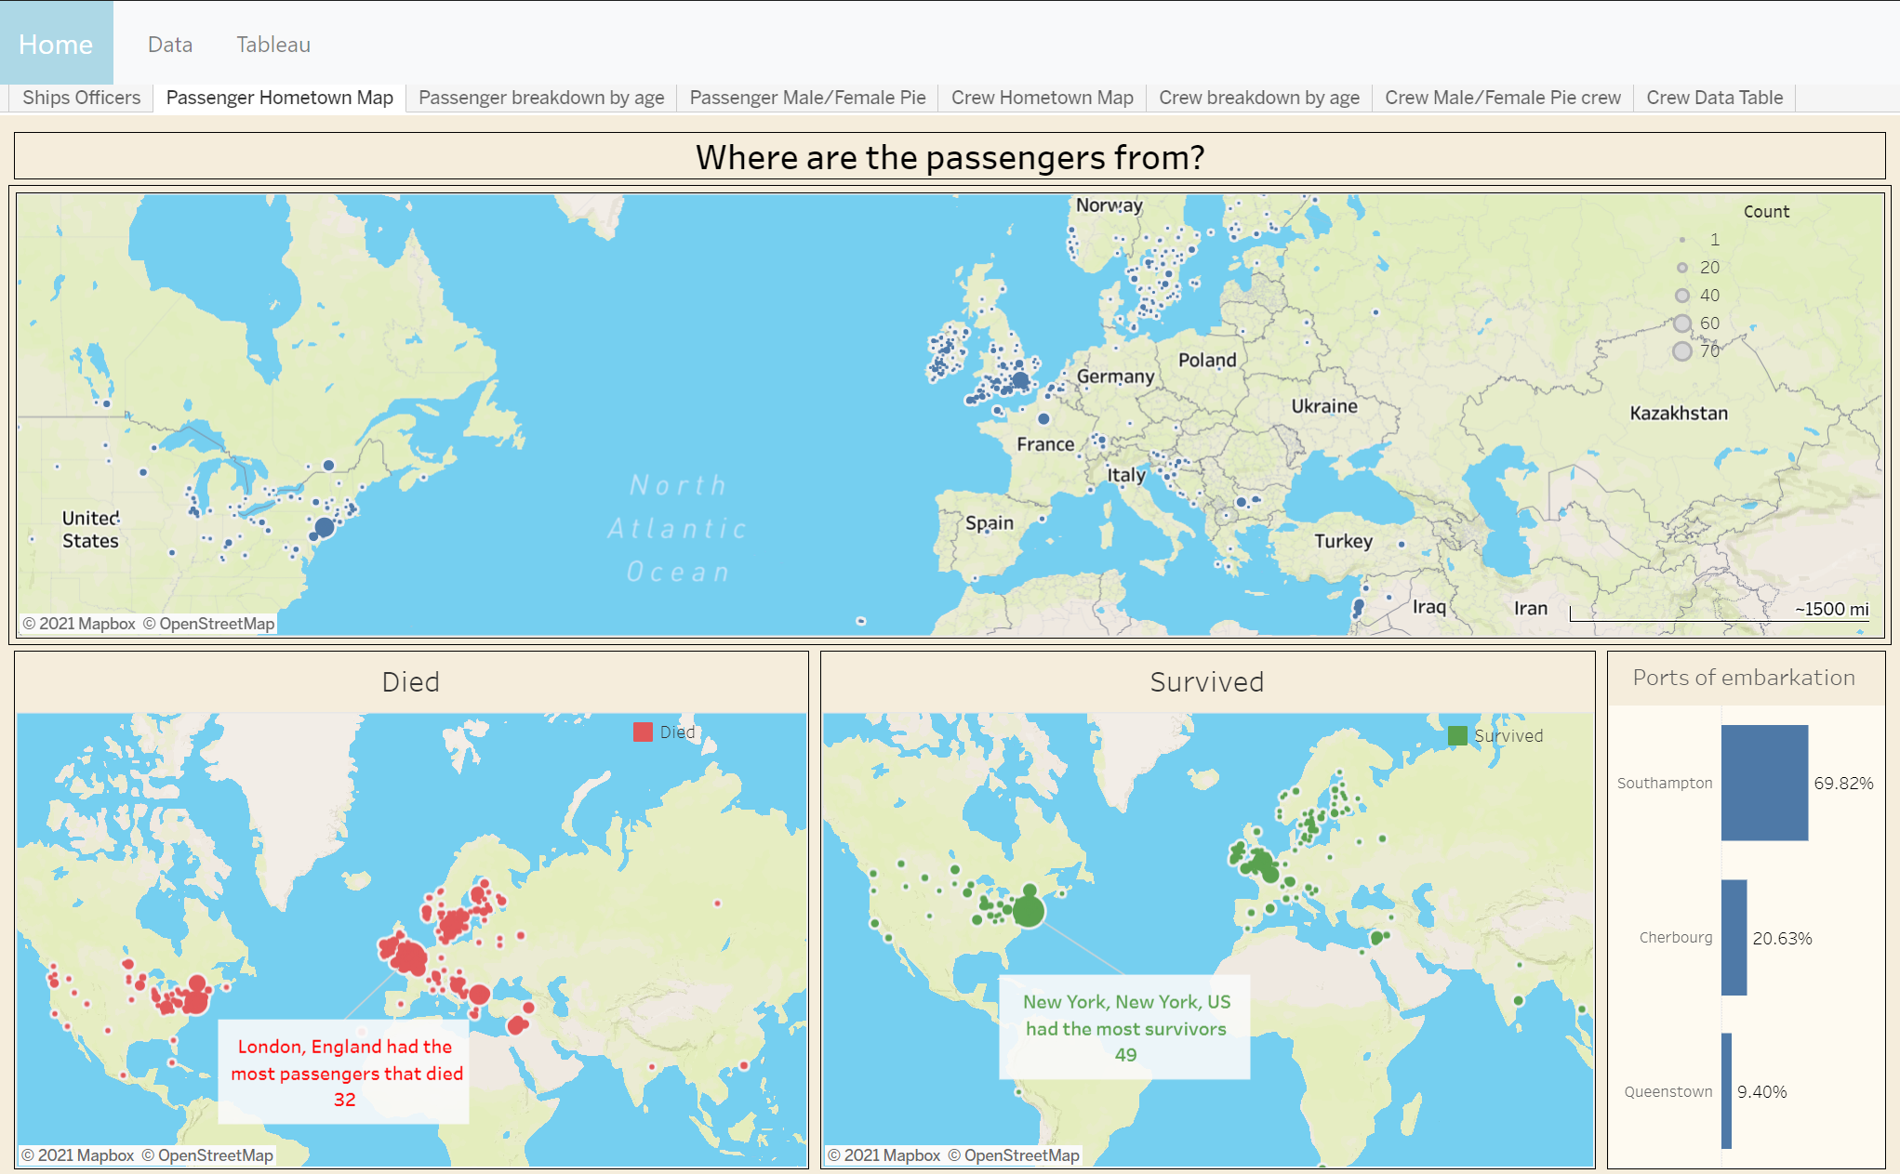
Visualization
Tableau Public
Web embedded
Latitude / Longitude from Google Places API

Slide 7
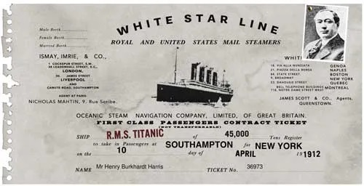
Predicting Survival
Can Machine Learning be used to predict the likelihood of survival of a passenger on the RMS Titanic based on:
Age
Gender
Ticket Class (1st, 2nd, 3rd)
# of Spouses or Siblings Onboard
Parent or Child
Fare Paid

Slide 8
Predicting Survival
Model Types
Support Vector Machine
Logistic Regression
Neural Network
Data Manipulation
Split Data
Feature Importance
Hypertuning
Evaluate

