Slide 1

Hermite, Laguerre, Jacobi Listen to Random Matrix Theory It’s trying to tell us something
Alan Edelman
Mathematics
Presented originally 2014
Nice overview for 18.338 Lecture 1

Slide 2
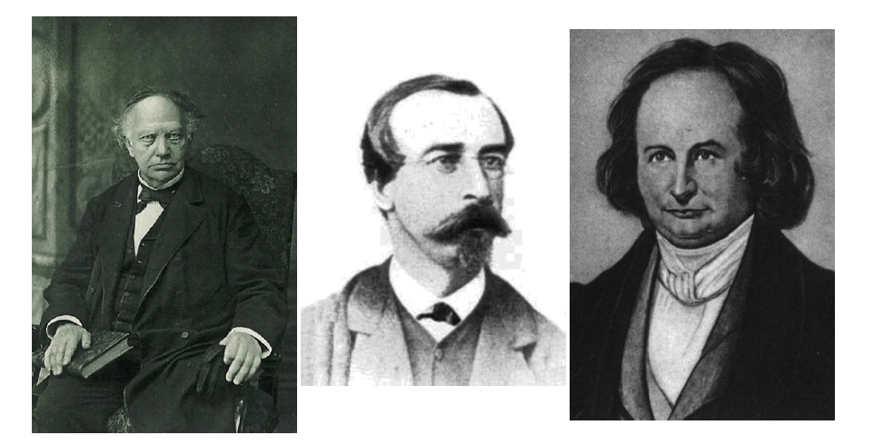
Hermite, Laguerre, and Jacobi
Hermite
1822-1901
Laguerre
1834-1886
Jacobi
1804-1851

Slide 3
An Intriguing Mathematical Tour Sometimes out of my comfort zone Opportunities Abound

Slide 4

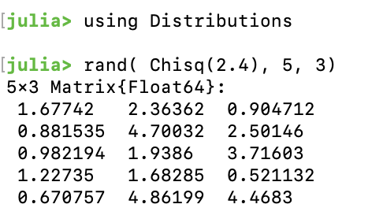
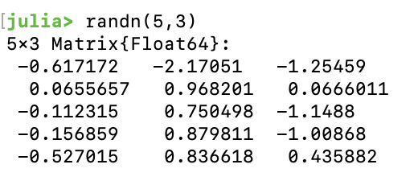
Scalar Random Variables (n=1)
MATH | Julia | Probability Density | Remark
Standard Normal | Normal()
Chi-Squared | Chisq(v) |  | Using LinearAlgebra norm(randn(v))^2
Beta Distribution | Beta(a,b) |  | x=rand(Chisq(2a)) y= rand(Chisq(2b)) x/(x+y)
If v = pos int
Julia Note: randn() in Base gives standard normal

Slide 5
Scalar Random Variables (n=1)
MATH | Julia | Probability Density | Remark
Standard Normal | Normal()
Chi-Squared | Chisq(v) |  | Using LinearAlgebra norm(randn(v))^2
Beta Distribution | Beta(a,b) |  | x=rand(Chisq(2a)) y= rand(Chisq(2b)) x/(x+y)
Hermite
Laguerre
Jacobi

Slide 6
Random Matrices
Ensembles | RMs | Julia |  | Joint Eigenvalue Density
Hermite | Gaussian Ensembles Wigner (1955) | G=randn(n,n) S=(G+G’)/2 | Symmetric
Laguerre | Wishart Matrices (1928) | G=randn(m,n) W=(G’G)/n | Positive Definite
Jacobi | MANOVA Matrices (1939) | W1=Wishart(m1,n) W2=Wishart(m2,n) J=W1/(W1+W2) | (Morally) Symmetric 0 < J < I

Slide 7
Three biggies in numerical linear algebra: eig, svd, gsvd
 | Random Matrix | Algorithm | JULIA
Hermite | Gaussian Ensembles | eig | G=randn(n,n) S=(G+G’)/2 eig(S)
Laguerre | Wishart | svd | svd(randn(m,n))
Jacobi | MANOVA | gsvd | svd(randn(m1,n),randn(m2,n))

Slide 8

The Jacobi Ensemble: Geometric Interpretation
Take reference n≤m dimensional subspace of R^{m}
Take RANDOM n≤m dimensional subspace of R^{m}
The shadow of the unit ball in the random subspace when projected onto the reference subspace is an ellipsoid
The semi-axes lengths are the Jacobi ensemble cosines. (MANOVA Convention=Squared cosines)

Slide 9
GSVD(A,B)
m=m₁+m₂ dimensions
n ≤ m
A,B have n columns
Flattened View Expanded View
subspaces represented by
lines planes
(m₂ dim)
c₁u₁
Y
( )
s₁v₁
n-dim subspace =span( )
s₁v₁
A
B
c₁u₁
( )
s₁v₁
π
Y
π
s₁v₁
c₁u₁
X
(m₁ dim)
c₁u₁
X
Ex 1: Random line in R² through 0:
On the x axis: c
On the z axis: s
Ex 2: Random plane in R4 through 0:
On xy plane: c1,c2
On zw plane: s1,s2

Slide 10
GSVD(A,B)
m=m₁+m₂ dimensions
n ≤ m
A,B have n columns
Flattened View Expanded View
subspaces represented by
lines planes
(m₂ dim)
c₁u₁
Y
( )
s₁v₁
n-dim subspace =span( )
s₁v₁
A
B
c₁u₁
( )
s₁v₁
π
Y
π
s₁v₁
c₁u₁
X
(m₁ dim)
c₁u₁
X
Ex 3: Random line in R3 through 0:
On the xy plane: c and 0
On the z axis: s
Ex 4:
Random plane in R3 through 0:
On the xy plane: c and 1 (one axis in the xy plane)
On the z axis: s

Slide 11
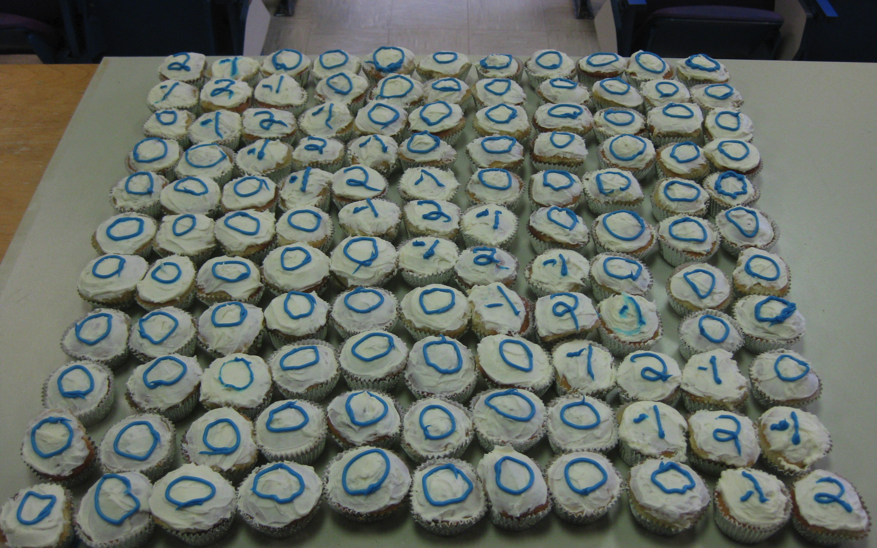
Infinite Random Matrix Theory & Gil Strang’s favorite matrix

Slide 12
Limit Laws for Eigenvalue Histograms
 | Law | Formula
Hermite | Semicircle Law Wigner 1955 Free CLT
Laguerre | Marcenko-Pastur Law 1967
Jacobi | Wachter Law 1980
Too Small

Slide 13
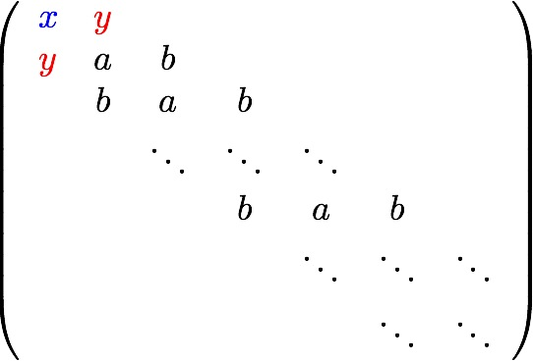
Three big laws: Toeplitz+boundary
 | Law | Equilibrium Measure
Hermite | Semicircle Law 1955 Free CLT | x=a y=b
Laguerre | Marcenko-Pastur Law 1967 | x=parameter y=b
Jacobi | Wachter Law 1980 | x=parameter y=parameter
Free Poisson
Anshelevich, Młotkowski
(2010) (Free Meixner)
E, Dubbs (2014)
Free Binomial
That’s pretty special!
Corresponds to 2nd order differences with boundary

Slide 14
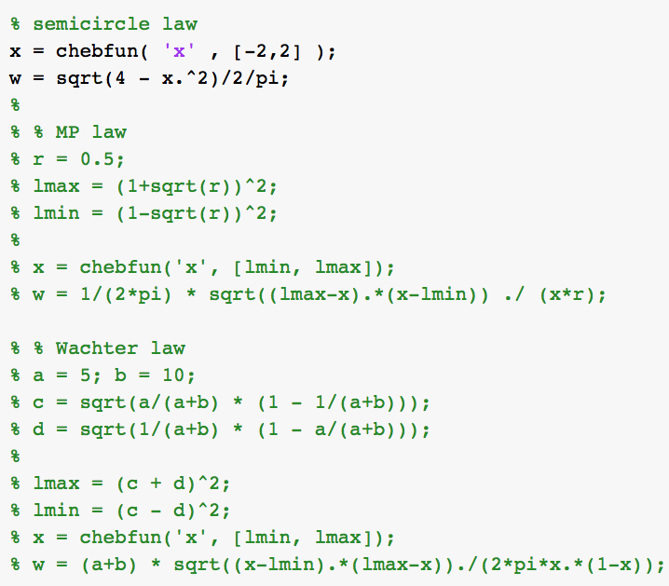
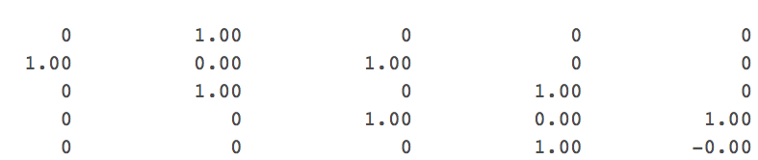
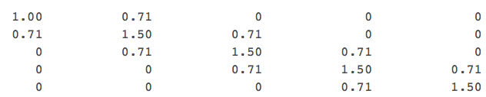

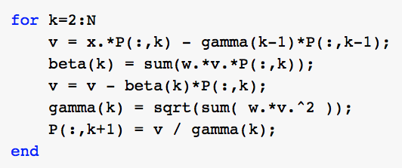
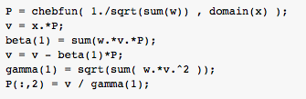
Example Chebfun Lanczos Run
Verbatim from Pedro Gonnet’s November 2011 Run
Thanks to
Bernie Wang
Lanczos

Slide 15
Why are Hermite, Laguerre, Jacobi all over mathematics? I’m still wondering.

Slide 16
Varying Inconsistent Definitions of Classical Orthogonal Polynomials
Hermite, Laguerre, and Jacobi Polynomials
“There is no generally accepted definition of classical orthogonal polynomials, but …” (Walter Gautschi)
Orthogonal polynomials whose derivatives are also orthogonal polynomials (Wikipedia: Honine, Hahn)
Hermite, Laguerre, Bessel, and Jacobi … are called collectively the “classical orthogonal polynomials (L. Miranian)
Orthogonal Polynomials that are eigenfunctions of a fixed 2nd-order linear differential operator (Bochner, Grünbaum,Haine)
All polynomials in the Askey scheme

Slide 17
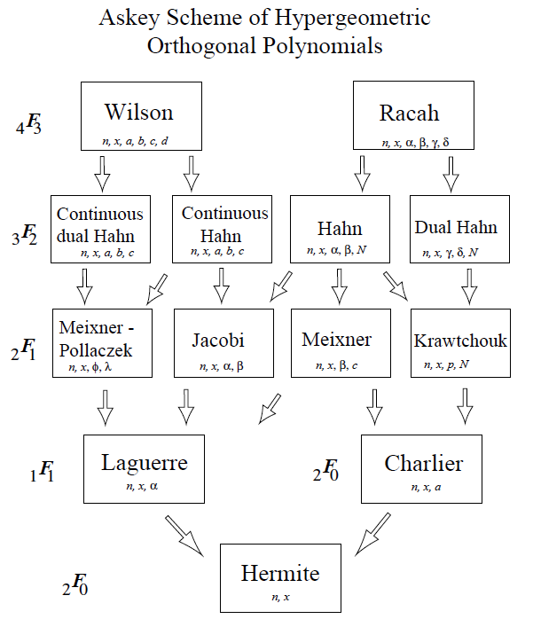
Askey Scheme
chart from Temme, et. al

Slide 18
Varying Inconsistent Definitions of Classical Orthogonal Polynomials
The differential operator has the form
where Q(x) is (at most) quadratic and L(x) is linear
Possess a Rodrigues formula (W(x)=weight)
Pearson equation for the weight function itself:

Slide 19
Yet more properties
Sheffer sequence ( for linear operator Q)
Hermite, Laguerre, and Jacobi are Sheffer
not sure what other orthogonal polynomials are Sheffer
Appell Sequence must be Sheffer
Hermite (not any other orthogonal polynomial)

Slide 20
All the definitions are formulaic
Formulas are concrete, useful, and departure points for many properties, but they don’t feel like they explain a mathematical core
Where else might we look?
Anything more structural?

Slide 21
A View towards Structure
Hermite: Symmetric Eigenproblem:
(Sym Matrices)/(Orthogonal matrices)
(Eigenvalues )
Laguerre: SVD
(Orthogonals) \ (m x n matrices) / (Orthogonals)
(Singular Values )
Jacobi: GSVD
(Grassmann Manifold)/(Stiefel m1 x Stiefel m2)
(Cosine/Sine pairs )
KAK Decompositions?

Slide 22
Homogeneous Spaces
Take a Lie Group and quotient out a subgroup
The subgroup is itself an open subgroup of the fixed points of an involution
Symmetric Space

Slide 23
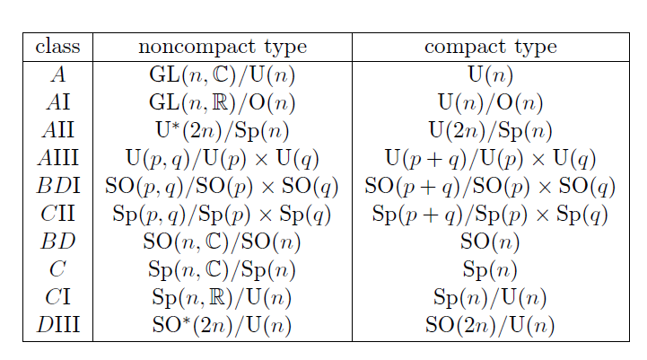
Symmetric Space Charts

Slide 24
Hermite
Circular Ensembles
Jacobi: m₁=n
What are these?
Laguerre I’m told?
Haar
also
Jacobi
Jacobi: β=1,m₁=n+1,m₂=n+1
Jacobi: β=4, m₁=½,1½, m₂= ½

Slide 25
Random Matrix Story Clearly Lined up with Symmetric Spaces (Hermite, Circular)
also a Jacobi
What are these?
Some must be Laguerre
Symmetric Spaces fall a little short (where are the rest of the Jacobi’s???)
(Zirnbauer, Dueñez)

Slide 26
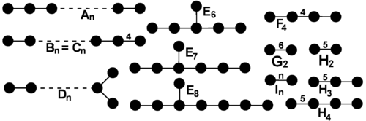
Coxeter Groups?
Symmetry group of regular polyhedra
Weyl groups of simple Lie Algebras
Foundation for structure

Slide 27
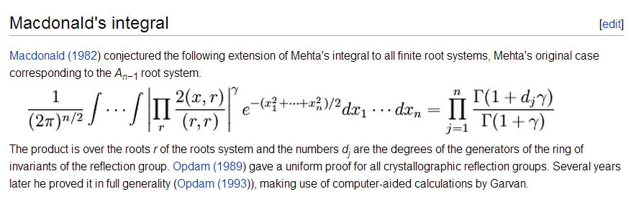
Macdonald’s Integral form of Selberg’s Integral
Integrals can arise in random matrix theory
A_{n}→Hermite B_{n} &D_{n}→Two special cases of Laguerre
Connection to RMT, Very Structural, but ☹ does not line up

Slide 28
Graph Theory
Hermite:
Random Complete Graph
Incidence Matrix is the semicircle law
Laguerre:
Random Bipartite Graph
Incidence Matrix is Marcenko-Pastur law
Jacobi:
Random d-regular graph (McKay)
Incidence Matrix is a special case of a Wachter law

Slide 29
Quantum Mechanics Analytically Solvable?
Hermite: Harmonic Oscillator
Laguerre: Radial Part of Hydrogen
Morse Oscillator
Jacobi: Angular part of Hydrogen is Legendre
Hyperbolic Rosen-Morse Potential
Thanks to Jiahao Chen regarding Derizinsky,Wrochna

Slide 30
Representations of Lie Algebras
Hermite Heisenberg group H_3
Laguerre Third Order Triangular Matrices
Jacobi Unimodular quasi-unitary group
In the orthogonal polynomial basis, the tridiagonal matrix and its pieces can be represented as simple differential operators

Slide 31
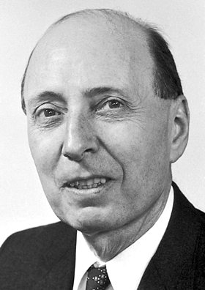
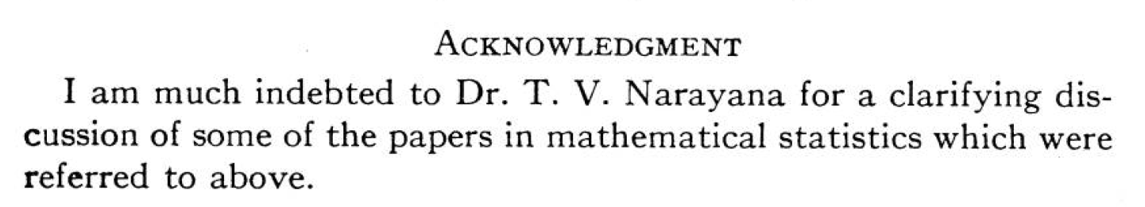
Wigner and Narayana
Narayana
Photo
Unavailable
[Wigner, 1957]
(Narayana was 27)
Marcenko-Pastur = Limiting Density for Laguerre
Moments are Narayana Polynomials!
Narayana probably would not have known

Slide 32
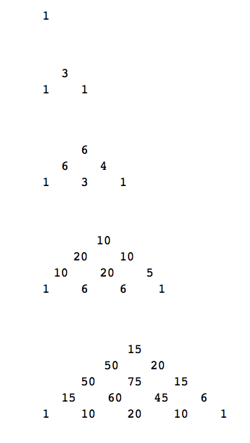
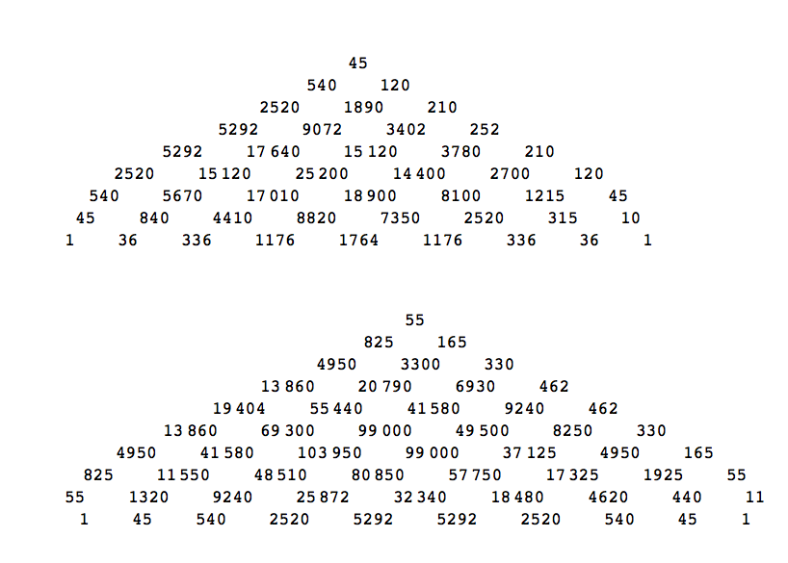
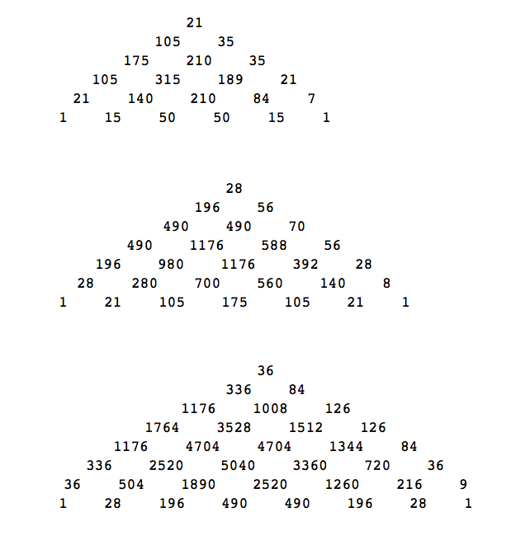
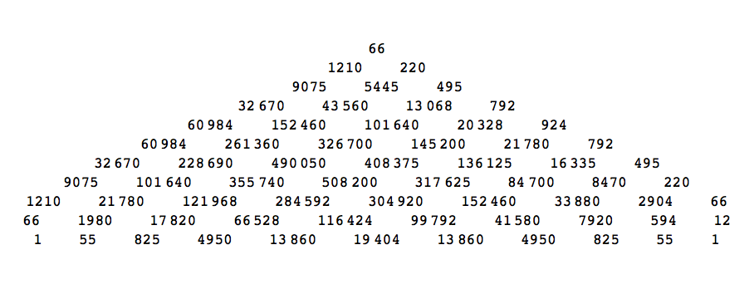
Cool Pyramid
Narayana everywhere!

Slide 33
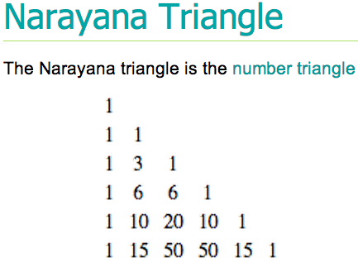
Cool Pyramid

Slide 34
Cool Pyramid

Slide 35
Cool Pyramid

Slide 36
Cool Pyramid

Slide 37
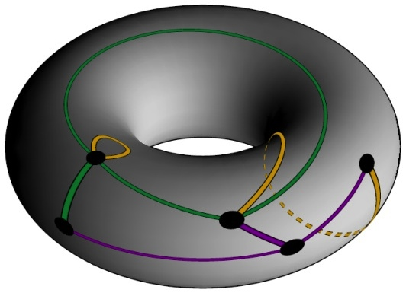
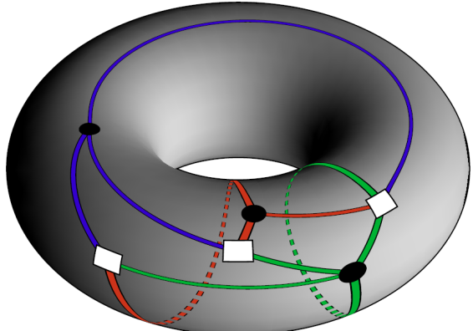
Graphs on Surfaces??? Thanks to Mike LaCroix
Hermite: Maps with one Vertex Coloring
Laguerre: Bipartite Maps with multiple Vertex Colorings
Jacobi: We know it’s there, but don’t have it quite yet.

Slide 38
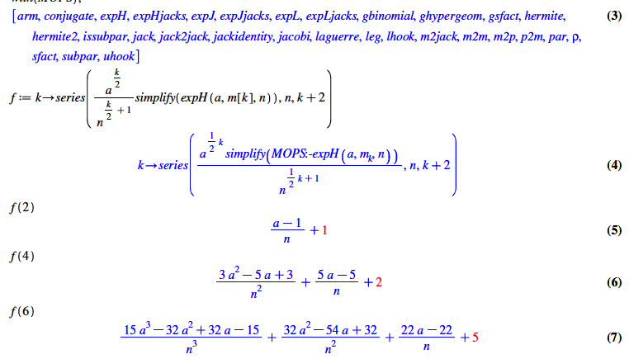
The “How I met Mike” Slide
Mops
Dumitriu, E, Shuman 2007
a=2/β

Slide 39
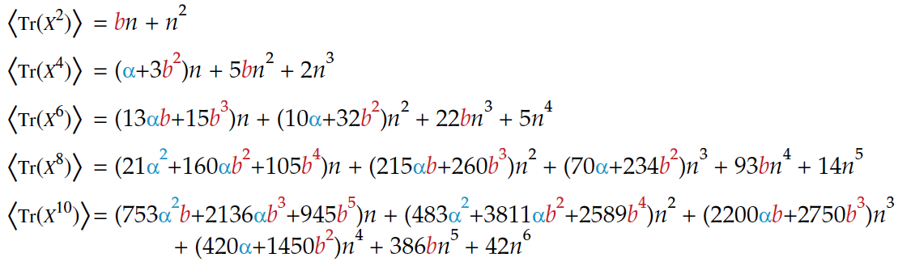
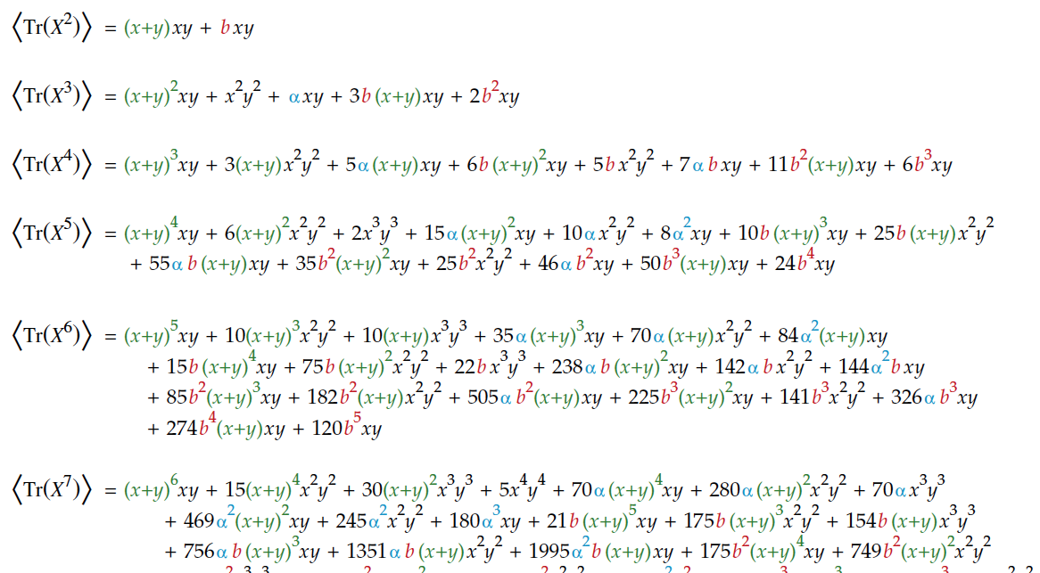
Multivariate Hermite and Laguerre Moments α=2/β=1+b

Slide 40
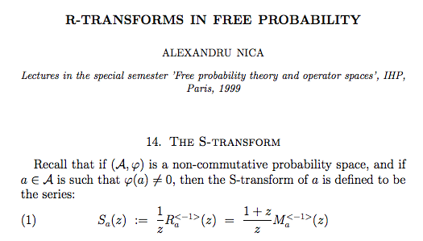
 | Law | S-transform
Hermite | Semicircle Law
Laguerre | Marcenko-Pastur Law
Jacobi | Wachter Law

Slide 41
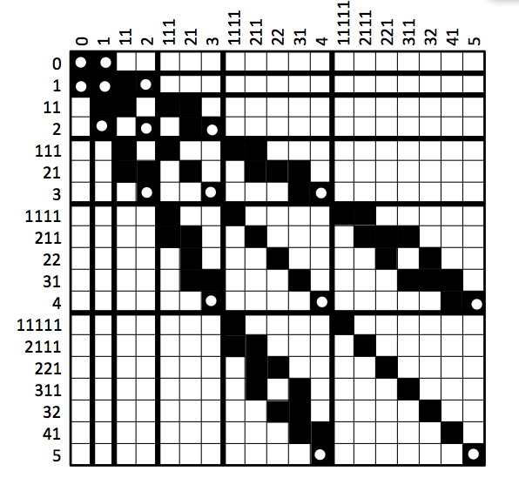
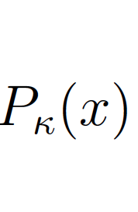
Polynomials of matrix argument
β=2
Praveen and E (2014)
Young Lattice Generalizes
Sym tridiagonal
Always for β=2
Only HLJ for other β?
Schur :: Jack as
:: General β

Slide 42
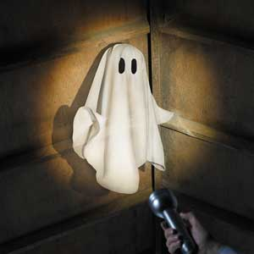
Real, Complex, Quaternion is NOT Hermite, Laguerre,Jacobi
We now understand that Dyson’s fascination with the three division rings lead us astray
There is a continuum that includes β=1,2,4
Informal method, called ghosts and shadows for β- ensembles
E. (2010)

Slide 43
Finite Random Matrix Models
Hermite
Laguerre
Jacobi

Slide 44
But ghosts lead to corner’s process algorithms for H,L,J! (see Borodin, Gorin 2013)
Hermite: Symmetric Arrow Matrix Algorithm
Laguerre: Broken Arrow Matrix Algorithm
Jacobi: Two Broken Arrow Matrices Algorithm
Dubbs, E. (2013) and
Dubbs, E., Praveen (2013)
Also Forrester, etc.

Slide 45
Sine Kernel, Airy Kernel, Bessel Kernel NOT Hermite, Laguerre, Jacobi
Bulk
Hard Edge (fixed)
Bulk
Soft Edge (free)

Slide 46
Conclusion
?
Is there a theory???
Whose answer is
1) exactly Hermite, Laguerre, Jacobi
2) or includes HLJ
For Laguerre and Jacobi
includes all parameters
Connects to a Matrix Framework?
Can be connected to Random Matrix Theory
Can Circle back to various differential,difference,hypergeometric,umbral definitions?
Makes me happy!

Slide 47
Challenges for you
In your own research: Find the hidden triad!!

